Slide 1
CARDIOMYOPATHY AND PERICARDITIS
Dr.V.Shanthi
Associate Professor, Pathology
Sri Venkateswara Institute of Medical Sciences

Slide 2
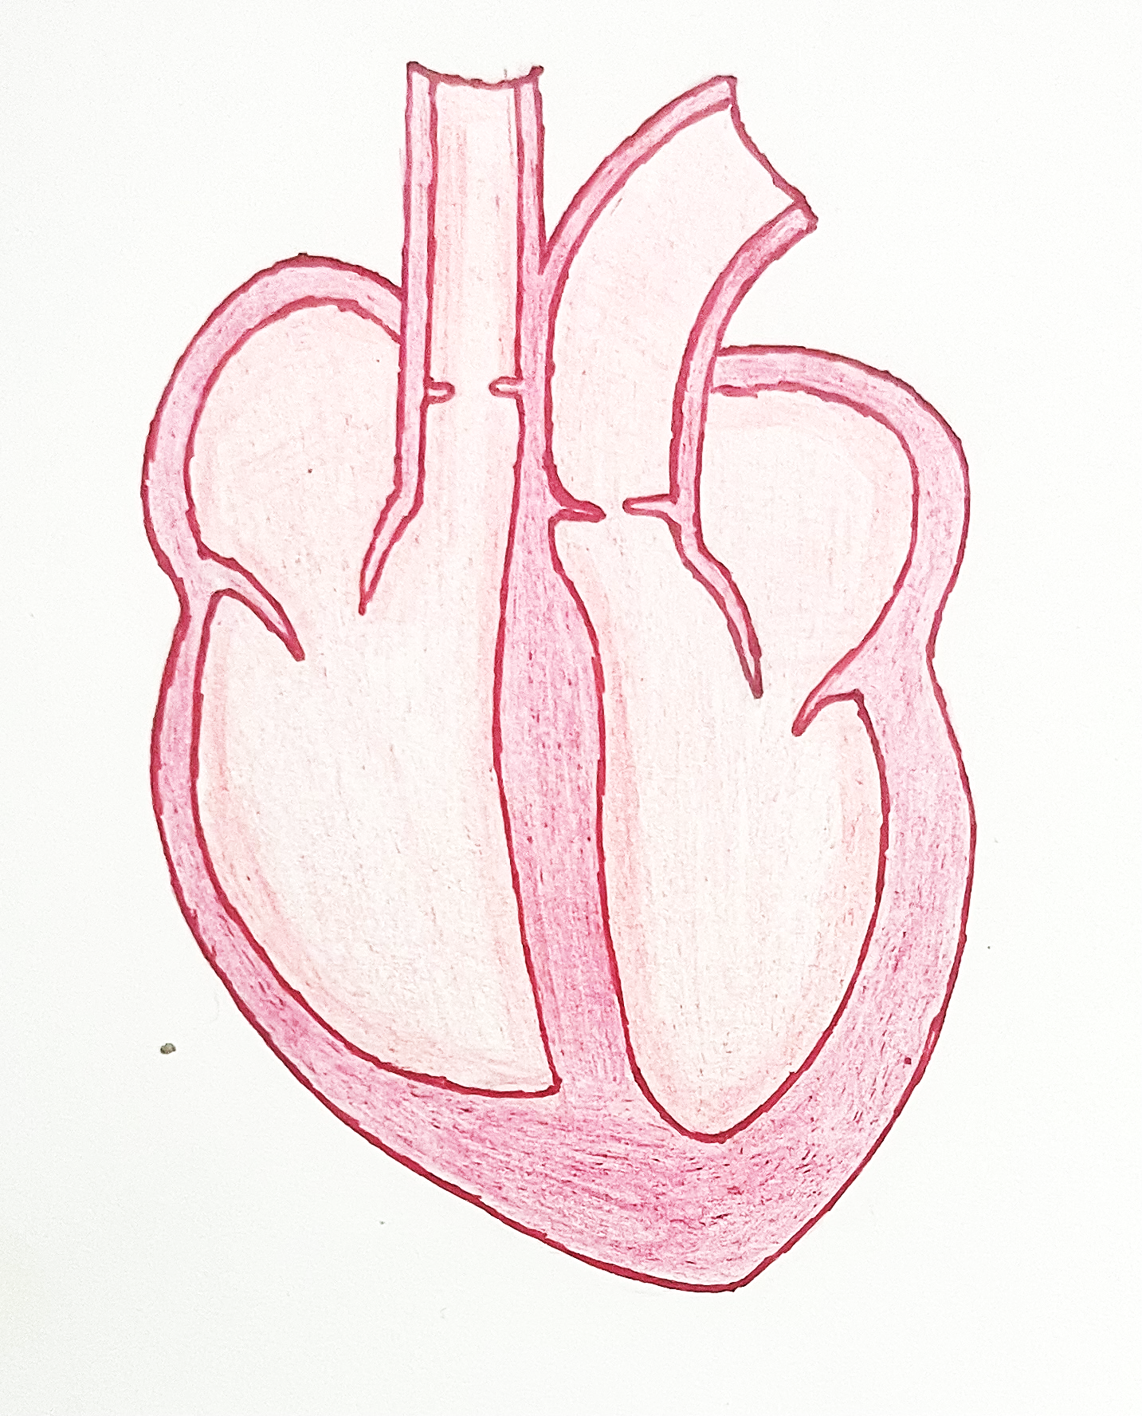
CARDIOMYOPATHY
Cardiomyopathies are a heterogeneous group of diseases of the myocardium associated with mechanical and/or electrical dysfunction that usually (but not invariably) exhibit inappropriate ventricular hypertrophy or dilatation and are due to a variety of causes that frequently are genetic

Slide 3
CARDIOMYOPATHY
Two major groups of cardiomyopathies are –
Primary cardiomyopathies involve predominantly the heart
They may be genetic or acquired (e.g., viral myocarditis, anthracycline cardiotoxic)
Secondary cardiomyopathies
have myocardial involvement as a component of a systemic or multiorgan disorder (e.g. hemochromatosis, amyloidosis)

Slide 4
CARDIOMYOPATHY
Cardiomyopathies can be classified according to a variety of criteria, including the underlying genetic basis of dysfunction
Disorders that produce anatomic abnormalities are of three distinct pathologic patterns
Dilated cardiomyopathy (DCM) (including arrhythmogenic cardiomyopathy)
Hypertrophic cardiomyopathy
Restrictive cardiomyopathy
Among the three major patterns, DCM is most common (90% of cases), and restrictive cardiomyopathy is the least frequent.

Slide 5
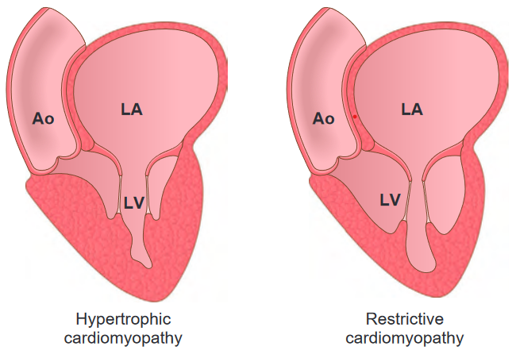
CARDIOMYOPATHY

Slide 6
DILATED CARDIOMYOPATHY (DCM)
DCM is characterized by cardiac dysfunction due to progressive cardiac dilation, usually with concomitant hypertrophy
Pathogenesis
Several different pathways can lead to DCM
Diagnosis is only made after the patient has developed end-stage heart failure
Clinical evaluation at that point is done to exclude ischemic, valvular, hypertensive, or congenital causes
Once they have been ruled out, a diagnosis of primary dilated cardiomyopathy can be suggested

Slide 7
ABC⁵ D GST IP
Idiopathic – most common
Alcohol abuse
Causes of dilated cardiomyopathy
Takotsubo cardiomyopathy
Ethanol toxicity or a secondary nutritional disturbance
Increased psycological stress “Heart break syndrome”
Beriberi heart disease
Thiamine deficiency
Cobalt poisoning
Supraphysiologic stress
Genetic causes
Tachycardia,hyperthyroidism, tumors that elaborate epinephrine (pheochromocytoma)
In tainting in beer production
Viral myocarditidis
Doxorubicin toxicity
Coxsackie B virus
Iron overload
Pregnancy
Chronic coaciane use
Chemotherapy drugs
Chagas disease
Hemochromatosis
Excessive blood transfusion
pregnancy-associated hypertension, volume overload, nutritional deficiency, and/or other subtle metabolic derangements
Notes:
Takotsubo cardiomyopathy - left ventricular contractile dysfunction after extreme psychological stress (thus also called broken heart syndrome). the left ventricular apex is most often affected, leading to “apical ballooning” that resembles a takotsubo, Japanese for “fishing pot for trapping octopus”
Iron overload –
Either hereditary hemochromatosis or from multiple transfusions
may be caused by interference with metal-dependent enzyme systems or by injury from iron-mediated production of reactive oxygen species

Slide 8
DILATED CARDIOMYOPATHY (DCM)
Pathogenesis
Genetic Influences-
Up to 50% of cases, caused by mutations in a diverse group of more than 20 genes encoding proteins involved in the cytoskeleton, sarcolemma, and nuclear envelope (e.g., lamin A/C)
Truncation mutations in TTN, a gene that encodes titin (so-called because it is the largest protein expressed in humans), may account for approximately 10% to 20% of all cases of DCM
Autosomal dominant inheritance is the predominant pattern
X-linked, autosomal recessive, and mitochondrial inheritance of DCM are less common

Slide 9
DILATED CARDIOMYOPATHY (DCM)
X-linked cardiomyopathy
- Duchenne and Beckers muscular dystrophy
Mitochondrial gene deletion – effects oxidative phosphorylation

Slide 10
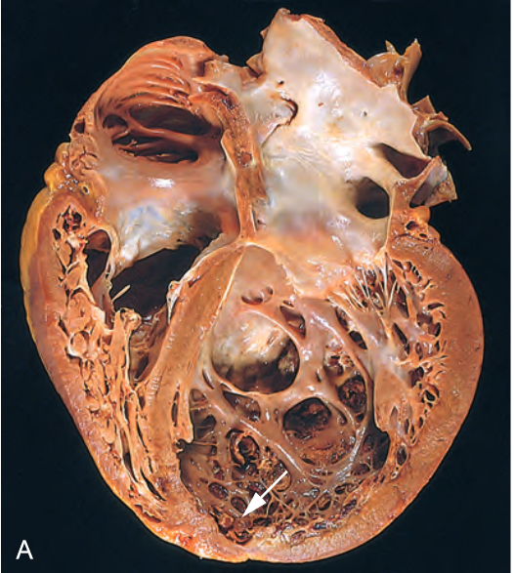
DILATED CARDIOMYOPATHY (DCM)
Morphology
Heart is typically enlarged, heavy (often weighing two to three times normal), and flabby, due to dilation of all chambers
Mural thrombi can result from relative stasis of the blood
To be considered DCM, the heart should have no primary valvular alterations
if mitral (or tricuspid) regurgitation is present, it results from left (or right) ventricular chamber dilation (functional regurgitation)

Slide 11
DILATED CARDIOMYOPATHY (DCM)

Slide 12
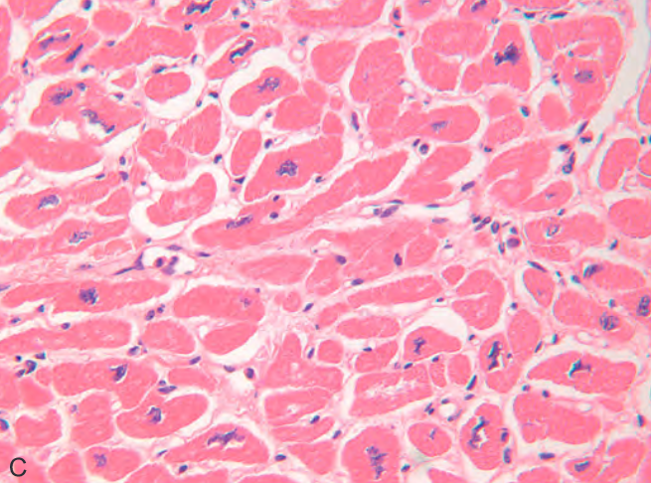
DILATED CARDIOMYOPATHY (DCM)
Morphology
Histologic abnormalities in DCM are nonspecific
Muscle cells are hypertrophied with enlarged nuclei, but some are attenuated, stretched, and irregular
DCM caused by truncating mutations in the titin gene, myocytes may exhibit hyperchromatic, highly distorted “Ninja star”-like nuclei

Slide 13
DILATED CARDIOMYOPATHY (DCM)
Clinical features
Fundamental defect in DCM is ineffective contraction
In end-stage DCM, the cardiac ejection fraction typically is less than 25% (normal is 50% to 65%)
progressive signs and symptoms of CHF including dyspnea, easy fatigability, and poor exertional capacity
Secondary mitral regurgitation and abnormal cardiac rhythms are common, and embolism from intracardiac thrombi can occur
Death usually results from progressive cardiac failure or arrhythmia

Slide 14
HYPERTROPHIC CARDIOMYOPATHY (DCM)
Myocardial dysfunction due to asymmetric hypertrophy of interventricular septum
Heterogeneous, genetic disorder characterized by myocardial hypertrophy, poorly compliant left ventricular myocardium leading to abnormal diastolic filling, and intermittent ventricular outflow obstruction
HCM causes primarily diastolic dysfunction, systolic function is usually preserved

Slide 15
HYPERTROPHIC CARDIOMYOPATHY (DCM)
Pathogenesis
Genetic causes
Autosomal dominant pattern of inheritance
HCM is most commonly caused by mutations in any one of several genes that encode sarcomeric proteins
Mutations causing HCM are found most commonly in the genes encoding
β- heavy chain myosin
Myosin-binding protein C
Cardiac TnI, TnT
α-tropomyosin

Slide 16
HYPERTROPHIC CARDIOMYOPATHY (DCM)
Pathogenesis
Precise mechanism by which these mutations cause HCM is unclear
Evidence suggests that it arises from defective energy transfer from its source of generation (mitochondria) to its site of use (sarcomeres)
In contrast, DCM is mostly associated with abnormalities of cytoskeletal proteins
Mutations in certain genes can give rise to either HCM or DCM, depending on the site and nature of the mutation

Slide 17
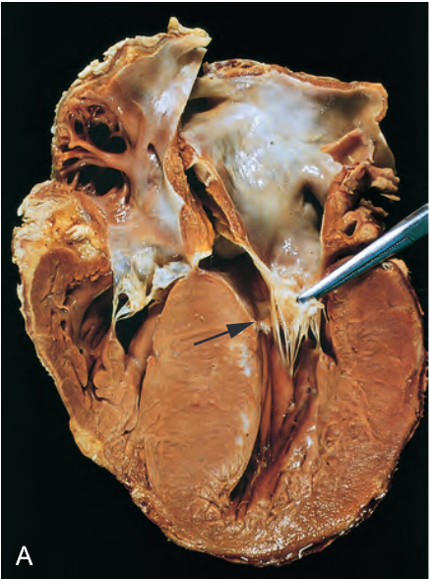
HYPERTROPHIC CARDIOMYOPATHY (DCM)
Morphology
Massive myocardial hypertrophy, usually without ventricular dilation
Classic pattern involves disproportionate thickening of the ventricular septum relative to the left ventricle free wall, termed asymmetric septal hypertrophy
On longitudinal sectioning, the normally round-to-ovoid left ventricular cavity may be compressed into a “banana-like” configuration by bulging of the ventricular septum into the lumen

Slide 18
HYPERTROPHIC CARDIOMYOPATHY (DCM)
Morphology
Although marked hypertrophy can involve the entire septum, it is usually most prominent in the subaortic region
Left ventricular outflow tract often exhibits a fibrous endocardial plaque and thickening of the anterior mitral leaflet
Both findings result from contact of the anterior mitral leaflet with the septum during ventricular systole

Slide 19
HYPERTROHIC CARDIOMYOPATHY (DCM)

Slide 20
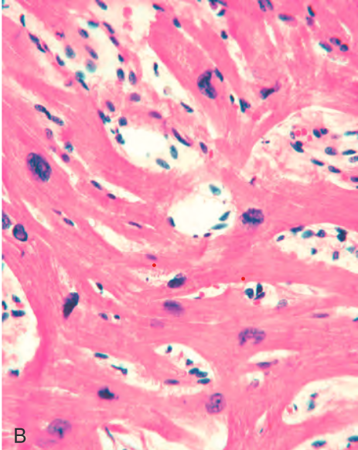
HYPERTROPHIC CARDIOMYOPATHY (DCM)
Microscopy
The most important histologic features of HCM myocardium are
Massive myocyte hypertrophy, with transverse myocyte diameters frequently greater than 40 μm (normal is approximately 15 μm)
Haphazard disarray of bundles of myocytes, individual myocytes, and contractile elements in sarcomeres within cells (termed myofiber disarray)
Fibrotic narrowing of small intramural arteries
Interstitial and replacement fibrosis
Notes:
Histologic appearance demonstrating myocyte disarray, extreme hypertrophy, and exaggerated myocyte branching, as well as the characteristic
interstitial fibrosis

Slide 21
HYPERTROPHIC CARDIOMYOPATHY (DCM)
Clinical Features
Characterized by reduced stroke volume due to impaired diastolic filling
25% of patients with HCM have dynamic obstruction to the left ventricular outflow as the anterior mitral leaflet moves toward the ventricular septum during systole
Compromised cardiac output in conjunction with a secondary increase in pulmonary venous pressure explains the exertional dyspnea
Because of the massive hypertrophy, high left ventricular chamber pressure, and frequently thick-walled intramural arteries, focal myocardial ischemia commonly results

Slide 22
HYPERTROPHIC CARDIOMYOPATHY (DCM)
Clinical Features
Major clinical problems in HCM are
Atrial fibrillation
Mural thrombus formation leading to embolization and possible stroke
Intractable cardiac failure
Ventricular arrhythmias
Sudden death (common cause of sudden, otherwise unexplained death in young athletes)
Treatment – either by Implantable cardioverter defibrillators or by surgical reduction of mass

Slide 23
RESTRICTIVE CARDIOMYOPATHY
Myocardial dysfunction due to fibrosis or infiltration of cardiac tissue
Restrictive cardiomyopathy is characterized by a primary decrease in ventricular compliance, resulting in impaired ventricular diastolic filling
Contractile (systolic) function of the left ventricle is usually unaffected

Slide 24
RESTRICTIVE CARDIOMYOPATHY
Restrictive cardiomyopathy can be idiopathic (most common) or associated with distinct disorders that affect the myocardium
Causes are
Metastatic tumors
Radiation-induced fibrosis
Amyloidosis
Sarcoidosis
Hemochromatosis - the accumulation of metabolites from inborn errors of metabolism
TRASH

Slide 25
RESTRICTIVE CARDIOMYOPATHY
Morphology
Non-specific, although bi-atrial dilation is commonly observed due to restricted ventricular filling and pressure overloads
ventricles are of approximately normal size (or slightly enlarged), the cavities are not dilated, and the myocardium is largely unremarkable
Microscopically, there can be patchy or diffuse interstitial fibrosis, varying from minimal to extensive

Slide 26
RESTRICTIVE CARDIOMYOPATHY
Three other specific restrictive conditions are
Endomyocardial fibrosis
Loeffler endomyocarditis
Endocardial fibroelastosis

Slide 27
RESTRICTIVE CARDIOMYOPATHY
Endomyocardial fibrosis
Most common form of restrictive cardiomyopathy
Principally a disease of children and young adults in Africa and other tropical areas
Characterized by fibrosis of the ventricular endocardium and subendocardium that extends from the apex upward, often eventually involving the tricuspid and mitral valves
The fibrous tissue markedly diminishes the volume and compliance of affected chambers and so causes a restrictive functional defect
Ventricular mural thrombi may develop
Endomyocardial fibrosis is linked to nutritional deficiencies and/or inflammation related to parasitic infections (e.g., hypereosinophilia)

Slide 28
RESTRICTIVE CARDIOMYOPATHY
Loeffler endomyocarditis
Results in endomyocardial fibrosis, typically with large mural thrombi
In addition to the cardiac changes, there is often a peripheral eosinophilia and eosinophilic infiltrates in multiple organs, including the heart
Release of toxic products of eosinophils, especially major basic protein, probably causes endomyocardial necrosis
Followed by scarring of the necrotic area, layering of the endocardium by thrombus, and finally organization of the thrombus
Many patients with Loeffler endomyocarditis have a myeloproliferative disorder

Slide 29
RESTRICTIVE CARDIOMYOPATHY
Endocardial fibroelastosis
Uncommon heart disease characterized by fibroelastic thickening that typically involves the left ventricular endocardium
Most common in the first 2 years of life
Accompanied by aortic valve obstruction or other congenital cardiac anomalies
Represent a common morphologic end-point of several different insults including viral infections (e.g., intrauterine exposure to mumps) or mutations in the gene for tafazzin, which affects mitochondrial inner membrane integrity
Diffuse involvement may be responsible for rapid and progressive cardiac decompensation and death

Slide 30
RESTRICTIVE CARDIOMYOPATHY
Amyloidosis
Amyloidosis is an important form of restrictive cardiomyopathy resulting from the extracellular accumulation of protein fibrils that form insoluble β-pleated sheets
Cardiac amyloidosis can appear as a consequence of systemic amyloidosis (e.g., due to myeloma or inflammation associated amyloid) or can be restricted to the heart, particularly in the aged (senile cardiac amyloidosis)
Cardiac amyloidosis is mostly because of deposition of transthyretin

Slide 31
RESTRICTIVE CARDIOMYOPATHY
Amyloidosis
Morphology
Heart varies in consistency from normal to firm and rubbery
Chambers are usually of normal size but can be dilated and have thickened walls
Small, semitranslucent nodules resembling drips of wax may be seen on the atrial endocardial surface, particularly on the left
Histologically, hyaline eosinophilic deposits of amyloid may be found in the interstitium, conduction tissue, valves, endocardium, pericardium, and small intramural coronary arteries
Intramural arteries and arterioles may have sufficient amyloid in their walls to compress and occlude their lumens, inducing myocardial ischemia (“small-vessel disease”)

Slide 32
RESTRICTIVE CARDIOMYOPATHY
Hematoxylin and eosin stain, showing amyloid appearing as amorphous pink material around myocytes
Congo red stain viewed under polarized light, in which amyloid shows characteristic apple-green birefringence

Slide 33
PERICARDITIS
Pericardial inflammation can occur secondary to a variety of cardiac, thoracic, or systemic disorders, metastases from remote neoplasms, or cardiac surgical procedures
Major causes of pericarditis are –

Slide 34
ACUTE PERICARDITIS
Types of acute pericarditis are
Serous pericarditis
Fibrinous pericarditis or Serofibrinous pericarditis
Purulent and suppurative pericarditis
Hemorrhagic pericarditis

Slide 35
ACUTE PERICARDITIS
Serous pericarditis
Serous pericarditis is characteristically produced by noninfectious inflammatory diseases including
Rheumatic fever
SLE
Scleroderma
Tumors - cause lymphatic obstruction
Uremia
Histologically, serous pericarditis elicits a mild inflammatory infiltrate in the epipericardial fat consisting predominantly of lymphocytes

Slide 36
ACUTE PERICARDITIS
Fibrinous and serofibrinous pericarditis
Most frequent types of pericarditis
Composed of serous fluid variably admixed with a fibrinous exudate
Common causes include
Acute MI
Postinfarction (Dressler) syndrome (an autoimmune response appearing weeks after an MI),
Uremia
Rheumatic fever
SLE
Trauma
Radiation used to treat breast, lung, or mediastinal neoplasms

Slide 37
ACUTE PERICARDITIS
Fibrinous and serofibrinous pericarditis
Symptoms of fibrinous pericarditis characteristically include
Pain (sharp, pleuritic, and position dependent)
Fever
Congestive failure
Loud pericardial friction rub is the most striking
Collection of serous fluid can actually prevent rubbing by separating the two layers of the pericardium

Slide 38
ACUTE PERICARDITIS
Purulent or suppurative pericarditis
Reflects an active infection caused by microbial invasion of the pericardial space
This can be caused by –
Direct extension from neighboring infections, such as an empyema of the pleural cavity, lobar pneumonia, mediastinal infections, or extension of a ring abscess through the myocardium or aortic root
Seeding from the blood
Lymphatic extension
Direct introduction during cardiotomy

Slide 39
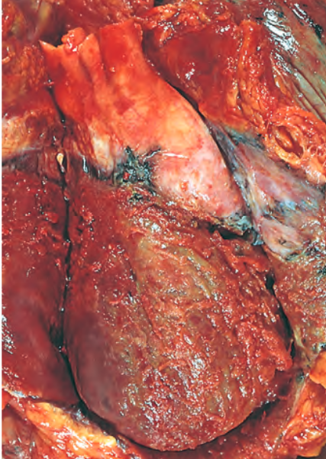
ACUTE PERICARDITIS
Purulent or suppurative pericarditis
The exudate ranges from a thin cloudy fluid to frank pus up to 500 mL in volume
The serosal surfaces are reddened, granular, and coated with the exudate
Microscopically there is an acute inflammatory reaction, which sometimes extends into surrounding structures (mediastinopericarditis)
Complete resolution is infrequent, and organization by scarring is the usual outcome

Slide 40
ACUTE PERICARDITIS
Hemorrhagic pericarditis
Exudate composed of blood mixed with a fibrinous or suppurative effusion
Causes are
spread of a malignant neoplasm to the pericardial space (most common)
Bacterial infections
persons with an underlying bleeding diathesis
Tuberculosis
Following cardiac surgery
Clinical significance is similar to that of fibrinous or suppurative pericarditis

Slide 41
CHRONIC OR HEALED PERICARDITIS
Organization of pericardial inflammation may produce plaque like fibrous thickenings of the serosal membranes (“soldiers’ plaque”) or thin, delicate adhesions that rarely cause impairment of cardiac function
Two forms of chronic pericarditis are
Adhesive mediastino-pericarditis
May follow infectious pericarditis, previous cardiac surgery, or mediastinal irradiation
Pericardial sac is obliterated, and adherence of the external aspect of the parietal layer to surrounding structures strains cardiac function
With each systolic contraction, the heart pulls not only against the parietal pericardium but also against the attached surrounding structures
Increased workload occasionally causes significant cardiac hypertrophy and dilation

Slide 42
CHRONIC OR HEALED PERICARDITIS
Constrictive pericarditis
Heart is encased in a dense, fibrous, or fibrocalcific scar that limits diastolic expansion and cardiac output, features that mimic a restrictive cardiomyopathy
Fibrous scar can be up to 1 centimeter in thickness, obliterating the pericardial space and sometimes calcifying
In extreme cases, it can resemble a plaster mold (concretio cordis)
Cardiac output may be reduced at rest
Treatment consists of surgical resection of the shell of constricting fibrous tissue (pericardiectomy)

Slide 43
TUMORS OF THE HEART
Primary Cardiac Tumors
Are uncommon and most are benign. They are
Myxomas
Fibromas
Lipomas
Papillary fibroelastomas
Rhabdomyomas
Primary malignant tumors of heart are angiosarcoma and sarcoma

Slide 44
TUMORS OF THE HEART
Metastatic tumors
More common metastatic tumors of heart are
Lung
Breast carcinomas
Melanomas
Leukemias
Lymphoma

Slide 45
THANK YOU

