Slide 1
HEART FAILURE

Slide 2
NORMAL HEART
Heart pumps more than 7500 L of blood through the body each day, and beating more than 40 million times a year
Weight of the heart – 0.4% - 0.5% of body weight (250-320g in females and 300 – 360g in males)

Slide 3
HEART FAILURE
Heart failure, often called congestive heart failure (CHF)
Heart failure is defined as the condition in which a heart cannot pump blood to adequately meet the metabolic demands of peripheral tissues
Heart failure occurs insidiously from the cumulative effects of
Chronic work overload (e.g., in valve disease or hypertension)
IHD (e.g., after myocardial infarction [MI] with heart damage)

Slide 4
HEART FAILURE
Physiologic mechanisms that maintain arterial pressure and organ perfusion when cardiac workload increases or cardiac function is compromised
Physiologic mechanisms that maintain arterial pressure and organ perfusion when cardiac workload increases or cardiac function is compromised
Myocardial adaptation
Myocardial hypertrophy
Frank-Starling mechanism
Activation of neurohumoral systems
Increased filling volumes
Activation of adrenergic nerves of the autonomic nervous system
Activation of the renin-angiotensin-aldosterone system
Release of atrial natriuretic peptide
Stretches heart muscle
water and salt retention
Increases vascular tone
Diuresis
Vascular smooth muscle relaxation
Release of norepinephrine
Increased Actin-myosin cross bridging
Increases circulatory volume
Elevating heart rate
Augmenting myocardial contractility
Increasing vascular resistance
Counter balances Renin-Angiotensin mechanism
Enhanced contractility
Increased stroke volume

Slide 5
HEART FAILURE
Systolic dysfunction
Diastolic dysfunction
Decreased myocardial contractility
Inability of the heart chambers to sufficiently expand during diastole
Ischemic injury
Inadequate adaptation to pressure or volume overload due to hypertension
Valvular disease
Ventricular dilation
Left ventricular hypertrophy
Myocardial fibrosis
Constrictive pericarditis
Amyloid deposition

Slide 6
HEART FAILURE
Cardiac Hypertrophy
Pathophysiology and Progression to Heart Failure
Myocytes increase in size (cellular hypertrophy) due to
Sustained increase in mechanical work of either ventricle due to
Pressure overload
Volume overload
Trophic signals (e.g., those mediated through the activation of β-adrenergic receptors)
Hypertrophy requires increased protein synthesis to form additional sarcomeres, as well as increasing the numbers of mitochondria
Hypertrophic myocytes - have multiple or enlarged nuclei, attributable to increased DNA ploidy resulting from DNA replication in the absence of cell division

Slide 7
HEART FAILURE
Cardiac Hypertrophy
new sarcomeres are assembled parallel to the long axes of cells, expanding the cross-sectional area of myocytes in ventricles
Pressure-overload hypertrophy
Due to hypertension or aortic stenosis
Concentric increase in wall thickness
Pattern of hypertrophy
Reflects the nature of the stimulus
Volume-overload hypertrophy
Characterized by new sarcomeres being assembled in series within existing sarcomeres, leading primarily to ventricular dilation
Due to valvular regurgitation
Heart thickness may increase or normal but weight of the heart increases

Slide 8
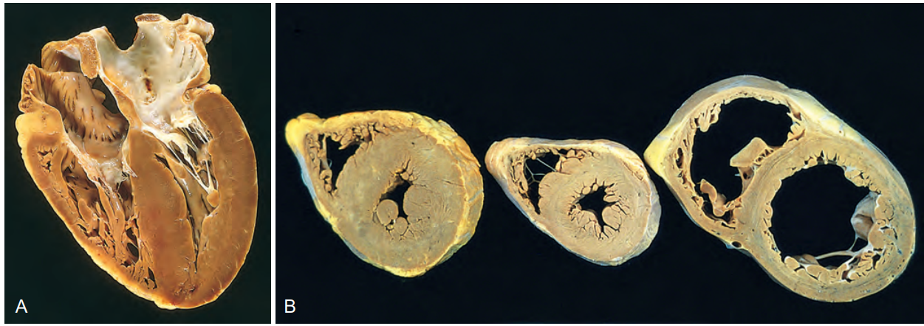
HEART FAILURE
Notes:
Left ventricular hypertrophy. (A) Pressure hypertrophy due to left ventricular outflow obstruction. The left ventricle is on the lower right in this apical four-chamber view of the heart. (B) Left ventricular hypertrophy with and without dilation, viewed in transverse heart sections. Compared with a normal heart (center), the pressure-hypertrophied hearts (left and in A) have increased mass and a thick left ventricular wall, and the hypertrophied, dilated heart (right) has increased mass and an apparently normal wall thickness

Slide 9
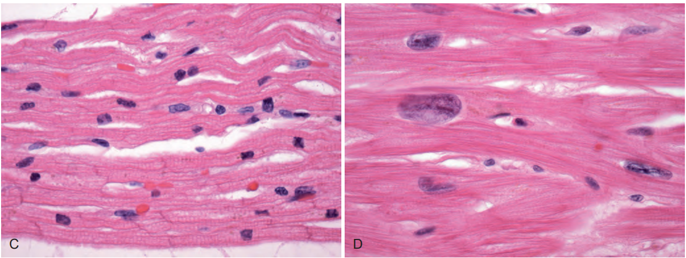
HEART FAILURE
Notes:
Normal myocardium. (D) Hypertrophied myocardium (C and D are photomicrographs at the same magnification)

Slide 10
HEART FAILURE
Myocardial ischemia
Ischemia-related decompensation
Consequences of cardiac hypertrophy
Cardiac failure
Insufficient supply of oxygen and nutrients to hypertrophied muscle
Deposition of fibrous tissue (interstitial fibrosis)
Increased resistance to diastolic filling
Molecular changes in hypertrophied cardiomyocytes include the expression of immediate-early genes (e.g., FOS, JUN, MYC, and EGR1) putatively driving cellular growth and altered protein expression

Slide 11
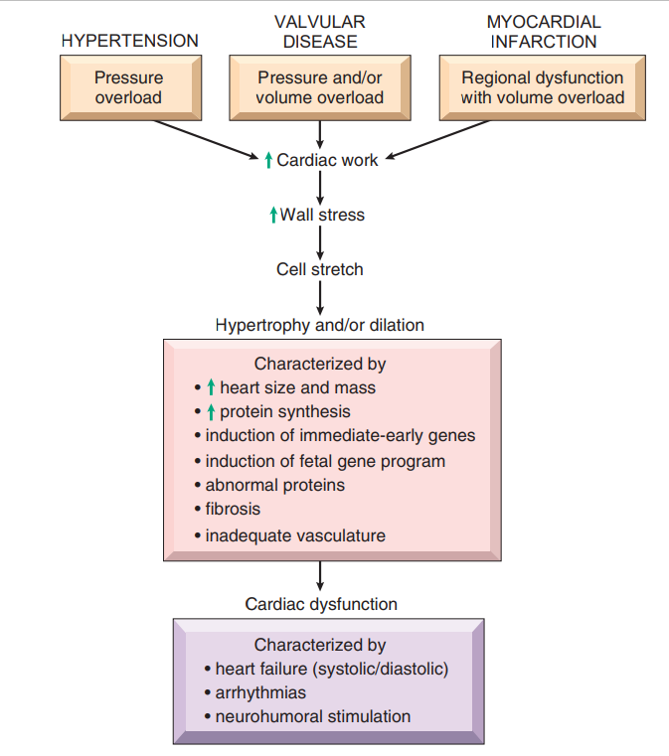

Slide 12
HEART FAILURE
CHF is characterized by variable degrees of decreased cardiac output and tissue perfusion (forward failure), as well as pooling of blood in the venous capacitance system (backward failure) which may cause pulmonary edema, peripheral edema, or both
Significant clinical features and morphologic changes noted in CHF are actually secondary to disorders induced by hypoxia and congestion in noncardiac peripheral tissues
Although left-sided and right-sided failure can occur independently, failure of one side (particularly the left) often produces excessive strain on the other, terminating in global heart failure

Slide 13
HEART FAILURE
Decreased cardiac output
Decreased tissue perfusion (forward failure)
Consequence of Heart failure
Pooling of blood in the venous system (backward failure)
Pulmonary edema, peripheral edema, or both
Types of heart failure –
Left sided heart failure
Right sided heart failure
Both can occur independently or one type can lead to the other type

Slide 14
LEFT-SIDED HEART FAILURE
Left-sided heart failure is most often caused by the following:
IHD
Hypertension
Aortic and mitral valvular diseases
Primary myocardial diseases

Slide 15
LEFT-SIDED HEART FAILURE
The clinical and morphologic effects of left-sided CHF are a consequence of
passive congestion (blood backing up in the pulmonary circulation)
Stasis of blood in the left-sided chambers
Inadequate perfusion of downstream tissues leading to organ dysfunction

Slide 16
LEFT-SIDED HEART FAILURE
Morphology
Heart
Left ventricle is usually hypertrophied and often dilated, sometimes massively
Left ventricular diastolic dysfunction or dilation with mitral valve incompetence causes secondary dilation of the left atrium, increasing the risk of atrial fibrillation
Results in stasis of blood, particularly in the atrial appendage, which is a common site of thrombus formation
Microscopic changes are nonspecific: variable degrees of myocyte hypertrophy and interstitial fibrosis

Slide 17
LEFT-SIDED HEART FAILURE
Morphology
Lungs
Pulmonary changes—from mildest to most severe—include
Perivascular and interstitial edema, particularly in the interlobular septa
Progressive edematous widening of alveolar septa
Accumulation of edema fluid in the alveolar spaces
Extravasated red cells and plasma proteins in the alveoli are phagocytosed and digested by macrophages – heart failure cells
Pleural effusions (typically serous) arise from elevated pleural capillary and lymphatic pressure and the resultant transudation of fluid into the pleural cavities

Slide 18
LEFT-SIDED HEART FAILURE
Clinical manifestation include
Dyspnea – orthopnea, paroxysmal nocturnal dyspnea, dyspnea at rest
Left ventricular enlargement
Tachycardia
With progressive ventricular dilation, the papillary muscles are displaced outward, causing mitral regurgitation and Sub-sequent chronic dilation of the left atrium can cause atrial fibrillation

Slide 19
LEFT-SIDED HEART FAILURE
Clinical manifestation include
Moderate CHF, a reduced ejection fraction leads to diminished renal perfusion, causing activation of the renin-angiotensin-aldosterone system - leads to salt and water retention, with expansion of the interstitial and intravascular fluid volumes
Hypoperfusion of kidney leads to azotemia
Cerebral hypoperfusion can give rise to hypoxic encephalopathy and can progress to stupor and coma with ischemic cerebral injury

Slide 20
LEFT-SIDED HEART FAILURE
Left-sided heart failure can be divided into systolic and diastolic failure
Systolic failure - is insufficient ejection fraction (pump failure) and can be caused by any of the many disorders that damage or derange the contractile function of the left ventricle
Diastolic failure- the left ventricle is abnormally stiff and cannot relax during diastole and causes back pressure to pulmonary circulation causing pulmonary edema
Seen in Diabetes mellitus, hypertension, bilateral renal stenosis, constrictive pericarditis, and in aging due to stiffening of muscle

Slide 21
RIGHT-SIDED HEART FAILURE
Right-sided heart failure is most commonly caused by left-sided heart failure
Consequently, the causes of right-sided heart failure include all the etiologies for left- sided heart failure
Isolated right-sided heart failure is infrequent and typically occurs in patients with one of a variety of disorders affecting the lungs; hence it is often referred to as cor- pulmonale eg – parenchymal lung disease, primary pulmonary hypertension, recurrent pulmonary thromboembolism, pulmonary vasoconstriction (obstructive sleep apnea, altitude sickness)

Slide 22
RIGHT-SIDED HEART FAILURE
Major morphologic and clinical effects of primary right-sided heart failure differ from those of left-sided heart failure in that pulmonary congestion is minimal while engorgement of the systemic and portal venous systems is pronounced
Morphology
Heart - hypertrophy and dilation of the right atrium and ventricle
Liver and Portal System- Congestion of the hepatic and portal vessels may produce pathologic changes in the liver, the spleen, and the gastrointestinal tract
Liver – increased in size and weight (congestive hepatomegaly) caused by passive congestion, greatest around the central veins
Grossly, this is reflected as congested red-brown pericentral zones, with relatively normal-colored tan periportal regions, producing the characteristic “nutmeg liver” appearance

Slide 23
RIGHT-SIDED HEART FAILURE
Morphology
Liver -
With longstanding severe right-sided heart failure, the central areas can become fibrotic, eventually culminating in cardiac cirrhosis
Portal hypertension can also contribute to chronic congestion and edema of the bowel wall which may interfere with nutrient (and/or drug) absorption
Pleural, Pericardial, and Peritoneal Spaces
Systemic venous congestion can lead to fluid accumulation (effusions) in the pleural, pericardial, or peritoneal spaces (a peritoneal effusion is also called ascites)

Slide 24
RIGHT-SIDED HEART FAILURE
Morphology
Subcutaneous Tissues –
Edema of the peripheral and dependent portions of the body, especially foot/ankle (pedal) and pretibial edema, is a hallmark of right-sided heart failure
In chronically bedridden patients, presacral edema may predominate. Generalized massive edema (anasarca) can also occur
kidney and the brain are also prominently affected in right-sided heart failure
Kidney – renal congestion - fluid retention, peripheral edema, and more pronounced azotemia.
Venous congestion and hypoxia of the central nervous system can also produce deficits of mental function

Slide 25
RIGHT-SIDED HEART FAILURE
Treatment
Correcting any underlying cause
Clinical approach includes salt restriction or pharmacologic agents that variously
reduce volume overload (e.g., diuretics),
Increase myocardial contractility (so-called positive inotropes)
reduce afterload (via adrenergic blockade or inhibitors of angiotensin-converting enzymes [ACE]

Slide 26
CONGENITAL HEART DISEASE
CHD refers to abnormalities of the heart or great vessels that are present at birth
CHD arises from faulty embryogenesis during gestational weeks 3 to 8, when major cardiovascular structures form and begin to function
CHD include
Septal defects, or “holes in the heart,” including atrial septal defects (ASDs) or ventricular septal defects (VSDs)
Stenotic lesions, either at the level of valves, or the entire cardiac chamber as in hypoplastic left heart syndrome
Outflow tract anomalies including inappropriate routing of the great vessels from the ventricles, or anomalous coronary arteries

Slide 27
CONGENITAL HEART DISEASE
Etiology and Pathogenesis
Environmental exposures (e.g., congenital rubella infection, teratogens—including some therapeutic drugs, and gestational diabetes)
Nutritional factors - folate supplementation during early pregnancy reduces CHD incidence
Genetic factors
specific loci implicated in familial forms of CHD and certain chromosomal abnormalities (e.g., trisomies 13, 15, 18, and 21, and monosomy X/Turner syndrome)
single-gene mutations, the affected genes encode proteins belonging to several different functional classes

Slide 28
CONGENITAL HEART DISEASE
Most of the various structural anomalies in CHD can be organized into three major categories according to the major functional abnormalities they cause:
Left-to-right shunt
Right-to-left shunt
Obstruction

Slide 29
CONGENITAL HEART DISEASE
Left-to-right shunts are
ASD
VSD
Patent ductus arteriosus [PDA]
Left-to-right shunts chronically elevate both volume and pressure in the normally low-pressure, low-resistance pulmonary circulation

Slide 30
CONGENITAL HEART DISEASE
Most important causes of right-to-left shunts are
Tetralogy of Fallot (TOF)
Transposition of the great arteries (TGA)
Persistent truncus arteriosus
Tricuspid atresia
Total anomalous pulmonary venous connection
When blood from the right side of the circulation flows directly into the left side (right-to-left shunt), hypoxemia and cyanosis result because the pulmonary circulation is bypassed and poorly oxygenated venous blood shunts directly into the systemic arterial supply

Slide 31
CONGENITAL HEART DISEASE
Obstructive lesions include
Valve stenoses
Aortic coarctation
Clinical severity of the lesion depends on the degree of stenosis and the patency of the ductus arteriosus

