Slide 1
INFECTIVE ENDOCARDITIS
Dr.V.Shanthi,
Associate Professor, Pathology
Sri Venkateswara Institute of Medical Sciences
Trupathi

Slide 2
INFECTIVE ENDOCARDITIS
Definition
Infective endocarditis is a microbial infection of the heart valves or mural endocardium that leads to the formation of vegetations composed of thrombotic debris and organisms, often associated with destruction of the underlying cardiac tissue

Slide 3
INFECTIVE ENDOCARDITIS
Etiology
Bacteria, fungi and other microorganisms
Infective endocarditis is classified on clinical grounds into acute and subacute forms indicating the severity of disease which depends upon the virulence of infecting organism

Slide 4
INFECTIVE ENDOCARDITIS
Acute infective endocarditis-
Infection of previously normal heart valve by highly virulent organism (staphylococcus aureus) that rapidly produces necrotizing and destructive lesions
Death ensue with in days to weeks despite appropriate treatment with antibiotics and surgery

Slide 5
INFECTIVE ENDOCARDITIS
Sub acute infective endocarditis
Infection by organisms of lower virulence (Streptococci viridans) that causes insidious infections of deformed valves with over all less destruction
Disease has course of weeks to months and cure can be achieved with antibiotics

Slide 6
INFECTIVE ENDOCARDITIS
Feature | Acute IE | Sub acute IE
Duration | < 6 weeks | >6 weeks
Most common organism | Staph. aureus | Staph. viridans
Virulence of organism | Highly virulent | Less virulent
Previous condition of valves | Usually previously normal | Usually previously damaged
Lesion on valves | Invasive, destructive and suppurative | Usually not invasive or suppurative
Clinical features | Features of acute systemic infection | Splenomegaly, clubbing of fingers and petchiae

Slide 7
INFECTIVE ENDOCARDITIS
Pathogenesis
Virulent organisms can infect even the normal valves, but Rheumatic heart disease with valvular scarring is major antecedent disorder
Other disorders which can predispose are
Mitral valve prolapse
Degenerative calcific valvular stenosis
Bicuspid aortic valve
Prosthetic or artificial valves
Unrepaired and repaired congenital defects

Slide 8
INFECTIVE ENDOCARDITIS
Pathogenesis
Organisms causing are
50% to 60% of cases affecting previously damaged or otherwise abnormal valves – Streptococcus viridans (normal component of oral cavity flora)
20% to 30% of cases affecting healthy or deformed valves – Staphylococus aureus
IE in IV drug abusers – Staphylococcus aureus
Prosthetic valve endocarditis is caused most commonly by – Coagulase negative staphylococci (Staphylococcus epidermidis)

Slide 9
INFECTIVE ENDOCARDITIS
Pathogenesis
Other bacterial causes include Enterococci and HACEK group
H – Haemophilus
A- Actinobacillus
C – Cardiobacterium
E – Eikenella
K - Kingella

Slide 10
INFECTIVE ENDOCARDITIS
Pathogenesis
Other agents causing endocarditis include – Gram negative bacilli and fungi
In 10% of cases – no organism is identified (“Culture negative” endocarditis)
Causes for the culture negative endocarditis are
Prior antibiotic therapy
Difficulty in isolating the offending agent
Organism is deeply embedded in enlarged vegetation that it cannot be released into blood

Slide 11
INFECTIVE ENDOCARDITIS
Pathogenesis
Predisposing causes
3 main types of predisposing factors leading to bacterial endocarditis are
Conditions that causes seeding of microorganisms into the blood (Bacteremia or Fungemia)
Underlying heart disease
Impaired host defenses

Slide 12
INFECTIVE ENDOCARDITIS
Predisposing causes
Source of infection may be
Periodontal infections and dental procedures
Contaminated needle shared by IV drug abusers
Infections of genitourinary tract during procedures like catheterization, cystoscopy, and obstetrical procedures during normal delivery or abortions
Infections and surgeries of bowel and biliary tract
Skin infections like boils, carbuncles and abscesses
Respiratory tract infections
Cardiac catheterization and surgery for valve replacement

Slide 13
INFECTIVE ENDOCARDITIS
Predisposing causes
Commonly associated underlying heart diseases are
Chronic rheumatic valvular disease (50% of cases)
Congenital heart diseases (20% of cases) like
VSD, PDA, Sub aortic stenosis, pulmonary stenosis, bicuspid aortic valve and coarctation of aorta
Other causes are
Syphilitic valvular disease, atherosclerotic valvular disease, floppy mitral valve, prosthetic heart valves

Slide 14
INFECTIVE ENDOCARDITIS
Predisposing causes
Impaired host defenses
Impaired specific immunity in lymphomas
Leukemias
Cytotoxic therapy for cancer patients and transplant patients
Deficient functions of neutrophils and macrophages

Slide 15
INFECTIVE ENDOCARDITIS
Pathogenesis
Bacteria from blood stream in any of the above mentioned routes are implanted on the cardiac valves or mural endocardium as they have surface adhesion molecules which mediate their adherence to endocardium
Conditions predispose to implantation are –
Previously damaged valves from diseases like RHD, congenital heart disease and prosthetic valves
Hemodynamic stress
causes damage to endothelium on valves, favoring the formation of platelet-fibrin thrombi which get infected from circulating bacteria where they proliferate

Slide 16
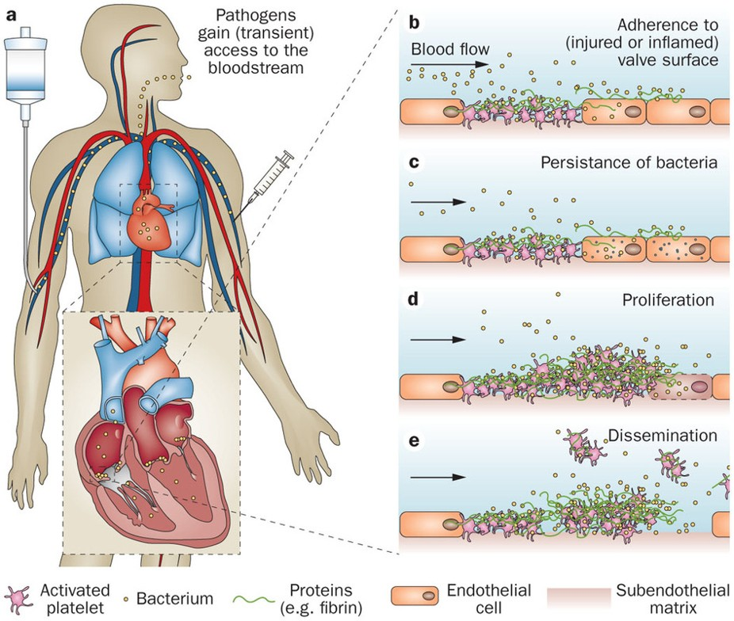
PATHOGENESIS OF INFECTIVE ENDOCARDITIS

Slide 17
PATHOGENESIS OF INFECTIVE ENDOCARDITIS

Slide 18
PATHOGENESIS OF
INFECTIVE ENDOCARDITIS
Source of bacteria
IV drug abusers
Dental procedures
Skin infections
Open wounds
Surgical procedures
Valve abnormality
Prosthetic valves
Native valve damage
Thrombi with fibrin and platelets
Bacteria in blood stream
Bacteria adhere to thrombi and proliferate
Endocarditis (usually on valves)
Vegetations

Slide 19
INFECTIVE ENDOCARDITIS
Morphology
Classic hall mark of Infective endocarditis is vegetations on heart valves
Common sites of vegetations are
Aortic and mitral valves
Valves of right heart are involved in intravenous drug abusers
They can be single or multiple and may involve more than one valve
Occasionally they can erode into underlying myocardium and produce an abscess (ring abscess)

Slide 20
INFECTIVE ENDOCARDITIS
Consequences of vegetations
Vegetations can embolize and as their embolic fragments contain virulent organisms, abscesses develop where they lodge, leading to sequelae such as septic infarcts or mycotic aneurysms
Vegetations of subacute endocarditis are associated with less valvular destruction than acute endocarditis

Slide 21
INFECTIVE ENDOCARDITIS
Vegetations
Gross
Common sites – valves of left heart
Most frequently on the mitral followed by aortic, simultaneous involvement of both mitral and aortic and rarely on the valves of right heart
In SABE, vegetations are found on diseased valves and in ABE, vegetations are found on previously normal valves
Location – on the atrial surface of atrioventricular valve and ventricular surface of semilunar valves

Slide 22
INFECTIVE ENDOCARDITIS
Vegetations
Gross
Size – from few mm to several centimetres
Appearance – Flat, filiform, fungating or polypoidal
Grey-tawny to greenish, irregular, single or multiple and typically friable present along the closure of cusps
Vegetations in ABE are bulkier and globular than those of SABE.
Vegetations in ABE may cause ulceration or perforation of the underlying valve leaflet or may produce myocardial abscess

Slide 23
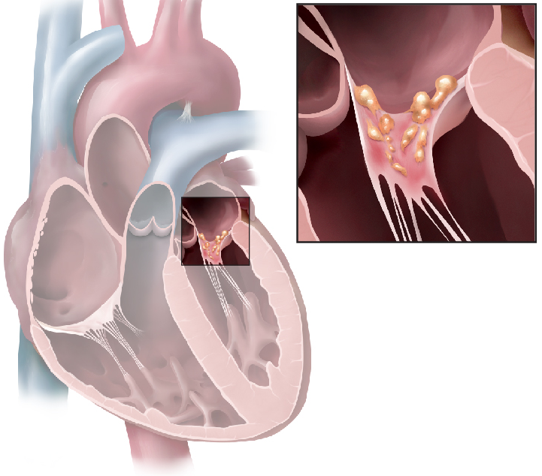
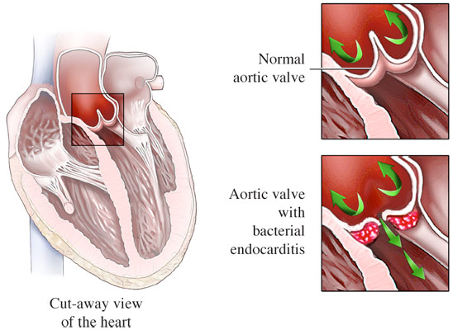
VEGETATIONS IN INFECTIVE ENDOCARDITIS

Slide 24
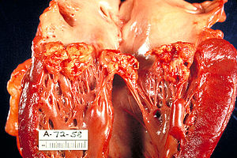
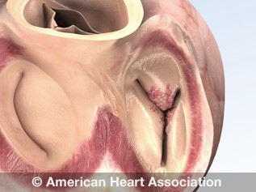
VEGETATIONS IN INFECTIVE ENDOCARDITIS

Slide 25
INFECTIVE ENDOCARDITIS
Vegetations
Microscopy
Vegetations consists of 3 zones
Outer layer or cap – consists of eosinophilic material composed of fibrin and platelets
Underneath this layer is basophilic zone containing colonies of bacteria
Deeper zone – consists of non-specific inflammatory reaction. In SABE there may be granulation tissue (evidence of repair)

Slide 26
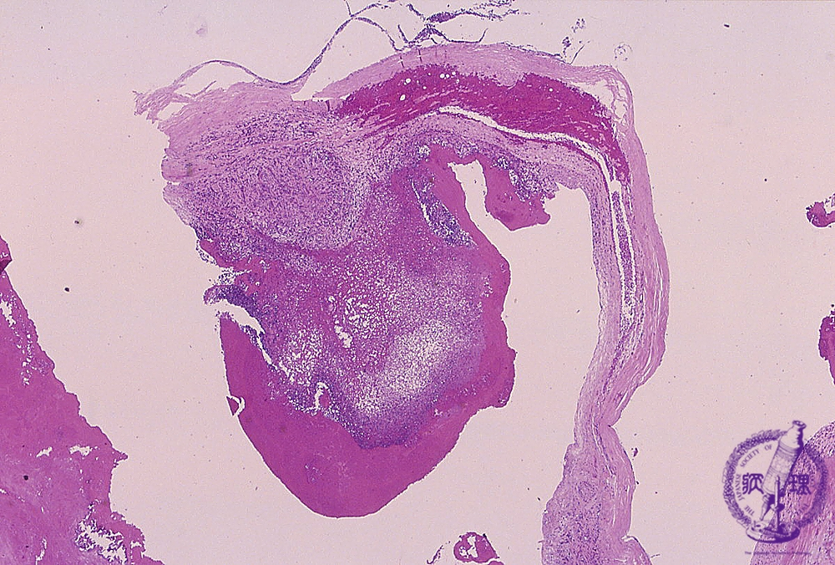
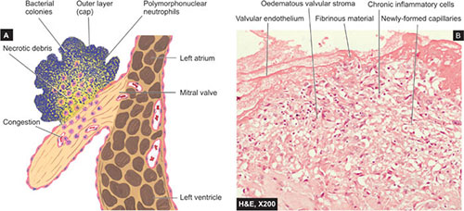
VEGETATIONS IN INFECTIVE ENDOCARDITIS

Slide 27
INFECTIVE ENDOCARDITIS
Vegetations
Microscopy
In Acute BE – inflammatory infiltrate consists mainly of neutrophils and is accompanied by tissue necrosis and abscess in the valve ring
In Subacute BE – healing by granulation tissue with mononuclear infiltrate and proliferating fibroblast are present

Slide 28
INFECTIVE ENDOCARDITIS
Clinical features
Acute Infective endocarditis
Rapidly developing fever, chills, weakness and lassitude
In older patients fever may be slight or absent and have non-specific symptoms like fatigue, loss of weight and flu-like syndrome
Murmurs may be present in 90% of patients with left-sided IE due to valvular defect

Slide 29
INFECTIVE ENDOCARDITIS
Diagnostic criteria of infective endocarditis (Modified Dukes – criteria)
Pathologic criteria
Clinical criteria
Major criteria
Minor criteria

Slide 30
INFECTIVE ENDOCARDITIS
Diagnostic criteria of infective endocarditis (Modified Dukes – criteria)
Pathologic criteria
Microorganisms demonstrated by culture, in a vegetation, embolism from vegetation or intracardiac abscess
Histologic confirmation of active endocarditis in vegetation or intracardiac abscess

Slide 31
INFECTIVE ENDOCARDITIS
Diagnostic criteria of infective endocarditis (Modified Dukes – criteria)
Clinical criteria
Major
Blood culture positive for a characteristic organism or persistently positive for an unusual organism in culture taken 12 hours apart
ECG identification of valve related or implant – related mass or abscess, or partial separation of artificial valve
New valvular regurgitation

Slide 32
INFECTIVE ENDOCARDITIS
Diagnostic criteria of infective endocarditis (Modified Dukes – criteria)
Clinical criteria
Minor
Predisposing heart lesions or intravenous drug use
Fever
Vascular lesions, including arterial petechiae, subungal/splinter hemorrhages, emboli, septic infarcts, mycotic aneurysm, intracranial hemorrhages, Janeway lesions
Immunological phenomenon, including glomerulonephritis, Osler nodes, Roths spots, rheumatoid factor
Microbiologic evidence, including a single culture positive for an unusual organism
ECG findings consistent with but not diagnostic of endocarditis, including worsening or changing of pre-existent murmur

Slide 33
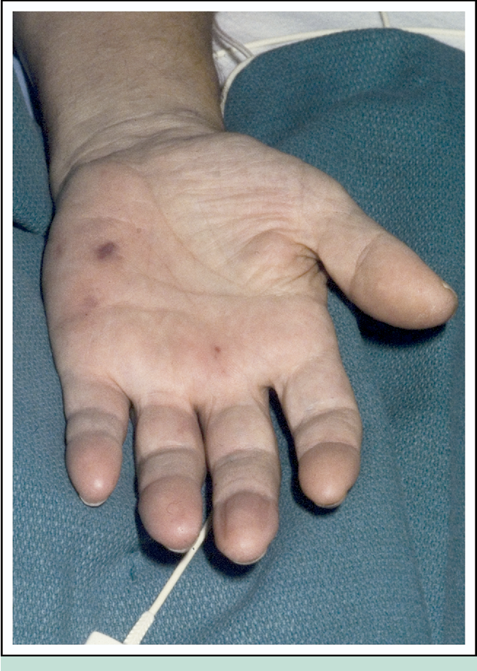
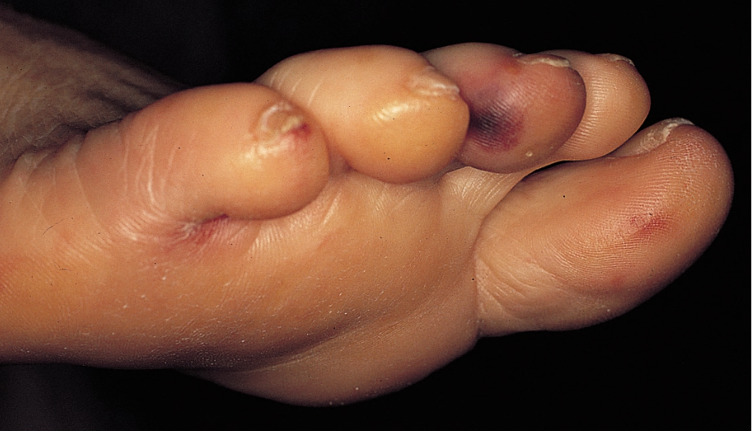
OSLER NODES Painful small swelling (1cm) appearing at the tip of fingers or toes caused by deposition of immune complex and hypersensitivity vasculitis

Slide 34
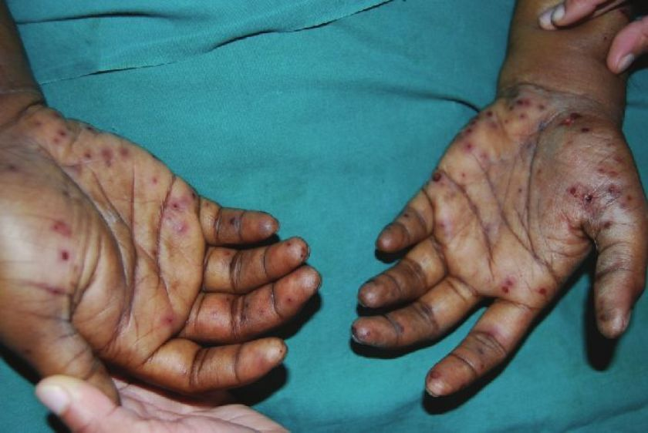
JANEWAY LESIONS
Small erythematous or hemorrhagic, macular non-tender lesions on palms and soles
These are microabscess of the dermis with marked necrosis and inflammatory infiltrate not involving the epidermis
They are caused by septic emboli which deposit bacteria, forming microabscesses

Slide 35
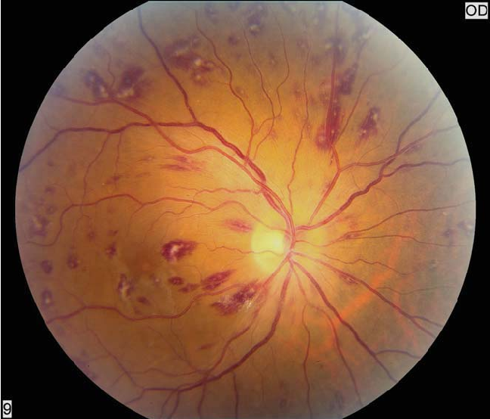
ROTH SPOTS
Caused by immune complex mediated vasculitis
Retinal hemorrhages with pale center composed of coagulated fibrin
Flame shaped hemorrhages

Slide 36
Diagnostic criteria (Modified Dukes criteria)
Pathologic criteria
Clinical criteria
Microbiologic evidence / histopathologic evidence
Histologic confirmation of active endocarditis
Major criteria
Minor criteria
Blood culture positive
ECG findings
New Valvular regurgitation
Predisposing conditions
Fever
Vascular lesions
Immunological lesions
Microbiologic evidence
ECG findings

Slide 37
INFECTIVE ENDOCARDITIS
Diagnostic criteria of infective endocarditis (Modified Dukes – criteria)
Definite infective endocarditis
Pathologic criteria
Clinical criteria
2 major criteria (or)
1 major criteria and 3 minor criteria
5 minor criteria
Possible infective endocarditis
1 major criteria and 1 minor criteria
3 minor criteria

Slide 38
INFECTIVE ENDOCARDITIS
Complications of Infective endocarditis
Complications begin in first few weeks of onset and are divided into cardiac and extra cardiac
Cardiac complications
Valvular stenosis or insufficiency
Perforation, rupture and aneurysm of valve leaflets
Abscess in the valve ring
Myocardial abscesses
Suppurative pericarditis
Cardiac failure from one or more of the foregoing complications

Slide 39
INFECTIVE ENDOCARDITIS
Complications of Infective endocarditis
Extra cardiac complications
Extra cardiac manifestations are due to friable vagetations which get dislodged into the blood stream forming emboli
Emboli from left side of the heart – Enters the systemic circulation and affect organs like spleen, brain, kidneys producing infarcts, abscesses and mycotic aneurysms
Kidneys – petechial hemorrhages (Flea bitten). Focal glomerulonephritis and infarction may develop
Spleen – infarction with pain
Brain – infarction with neurological dysfunction

Slide 40
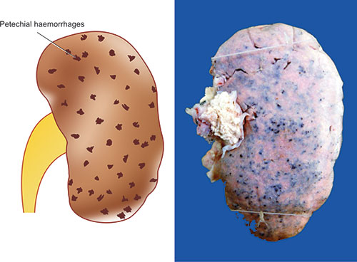
FLEA BITTEN KIDNEY

Slide 41
INFECTIVE ENDOCARDITIS
Complications of Infective endocarditis
Extra cardiac complications
Emboli from right side of the heart – enters the pulmonary circulation and produces pulmonary abscesses
Petechiae may be seen in skin and conjunctiva due to emboli or toxic damage to capillaries
In SABE, Oslers nodes and in ABE , Janeway lesions may appear due to toxic or allergic inflammation of the vessel wall
Focal necrotizing glomerulonephritis due to circulating immune complexes

Slide 42
INFECTIVE ENDOCARDITIS
Other types of endocarditis are
Tuberculous endocarditis
Syphilitic endocarditis
Fungal endocarditis – caused by Candida albicans, Histoplasma capsulatum, Aspergillus, Mucor, Blastomycosis, Cryptococcosis
Rickettsial endocarditis

Slide 43
NON BACTERIAL ENDOCARDITIS
NBTE is characterized by deposition of small sterile thrombi on the leaflets of cardiac valves
Also called Marantic endocarditis as it was usually encountered in debilitated patients (marasmus- malnutrition)
Morphology of vegetations
Size – 1 to 5 mm
Occur as single or multiple vegetations along the line of closure of the leaflets or cusps

Slide 44
NON BACTERIAL ENDOCARDITIS
Microscopy
Comprises bland thrombi that are loosely attached to the underlying valve
Vegetations are not invasive and do not elicit any inflammatory reaction
Local affect of these vegetations is trivial but can produce systemic emboli leading to infarcts in brain, heart and other organs

Slide 45
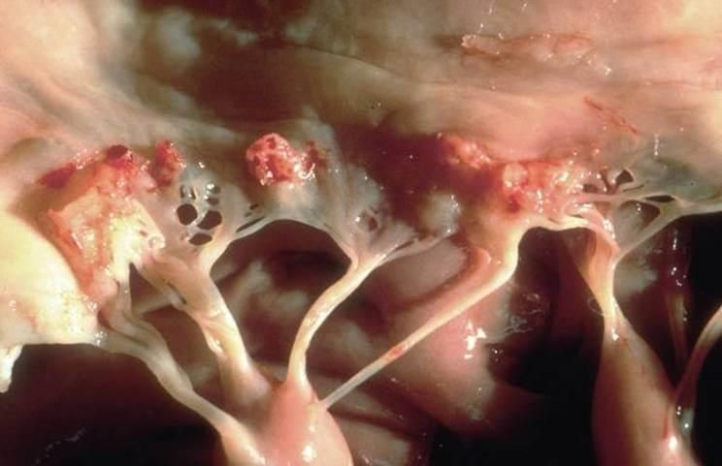
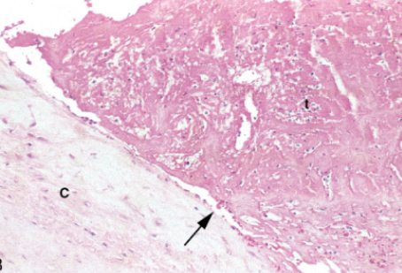
VEGETATIONS IN NON BACTERIAL ENDOCARDITIS

Slide 46
NON BACTERIAL ENDOCARDITIS
NBTE frequently occurs concomitantly with
Deep vein thrombosis
Pulmonary emboli
Other underlying systemic hypercoagulable state like mucinous adenocarcinoma which produces mucin which has procoagulant affect causing migratory thrombophlebitis (Trousseau syndrome)
Endocardial trauma from an indwelling catheter

Slide 47
LIBMAN-SACKS ENDOCARDITIS
Endocarditis of Systemic Lupus Erythematosus
Mitral and tricuspid valvulitis with small, sterile vegetations
Morphology
Gross
Lesions are small m/s 1 to 4mm in diameter
Occuring as single or multiple, sterile, pink vegetations with a warty appearance
Location – undersurface of atrioventricular valves, Valvular endocardium, chords and mural endocardium of atria or ventricles

Slide 48
LIBMAN-SACKS ENDOCARDITIS
Morphology
Microscopy
Vegetations consists of finely granular fibrinous eosinophilic material containing cellular debris including nuclear remnants
Vegetations are associated with an intense valvulitis, characterized by fibrinoid necrosis of valve substance and reflecting the activation of complement and recruitment of Fc receptor bearing cells

Slide 49
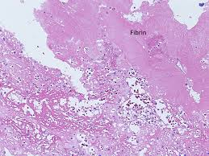
LIBMANSACKS ENDOCARDITIS FLAT, REDDISH-TAN VEGETATIONS

Slide 50
VEGETATIONS IN DIFFERENT FORMS OF ENDOCARDITIS
FEATURE | BACTERIAL (INFECTIVE) | NON-BACTERIAL THROMBOTIC | LIBMAN-SACKS | RHEUMATIC
Valves commonly affected | - Mitral - Aortic - Combined mitral and aortic | - Mainly mitral - Less often aortic and tricuspid | Mitral, tricuspid | - Mitral alone - Mitral aortic combined
Location on valve cusps | Along the line of closure, atrial surface of atrioventricular valves and ventricular surface of semilunar valves | Occurs along the line of closure | Occurs on both surfaces of valve leaflets or cusps, in the valve pockets | Similar to infective endocarditis

Slide 51
VEGETATIONS IN DIFFERENT FORMS OF ENDOCARDITIS
FEATURE | BACTERIAL (INFECTIVE) | NON-BACTERIAL THROMBOTIC | LIBMAN-SACKS | RHEUMATIC
Gross appearance
Size | Often large and irregular | Small but larger than those of rheumatic | Medium sized | Small and warty
Number | Single or multiple | Single or multiple | multiple | Multiple
Appearance | Gray-tawny to greenish typically friable | Brownish firm but more friable than those of rheumatic | Pink warty vegetations and they do not produce Valvular deformity | Grey brown translucent firmly attached and produce Valvular deformity

Slide 52
VEGETATIONS IN DIFFERENT FORMS OF ENDOCARDITIS
FEATURE |  | BACTERIAL (INFECTIVE) |  | NON-BACTERIAL THROMBOTIC |  | LIBMAN-SACKS | RHEUMATIC
Microscopy
Composition of vegetation | Composed of outer eosinophilic zone of fibrin and platelets, covering colonies of bacteria and deeper zone of non-specific acute and chronic inflammatory cells |  | Composed of degenerated Valvular tissue, fibrin platelets thrombi and no bacteria |  | Composed of fibrinoid material with superimposed fibrin and platelet thrombi and no bacteria |  | Composed of fibrin with superimposed platelet thrombi and no bacteria
Changes in underlying endocardium | Underlying endocardium may show abscesses in ABE and granulation tissue in SABE |  | Underlying valve shows swelling of collagen, fibrinoid change, proliferation of capillaries but no significant inflammatory infiltrate |  | Underlying endocardium shows fibrinoid necrosis, proliferation of capillaries and acute and chronic inflammatory infiltrate and haematoxylin bodies |  | Adjacent and underlying endocardium shows edema, proliferation of capillaries, mononuclear inflammatory cells and occasional Aschoff bodies

Slide 54
VEGETATIONS IN DIFFERENT ENDOCARDITIS

Slide 55
THANK YOU

