Slide 1
ANEURYSM
Dr.V.Shanthi
Associate professor, Department of pathology
Sri Venkateswara Institute of medical sciences
Tirupathi

Slide 2
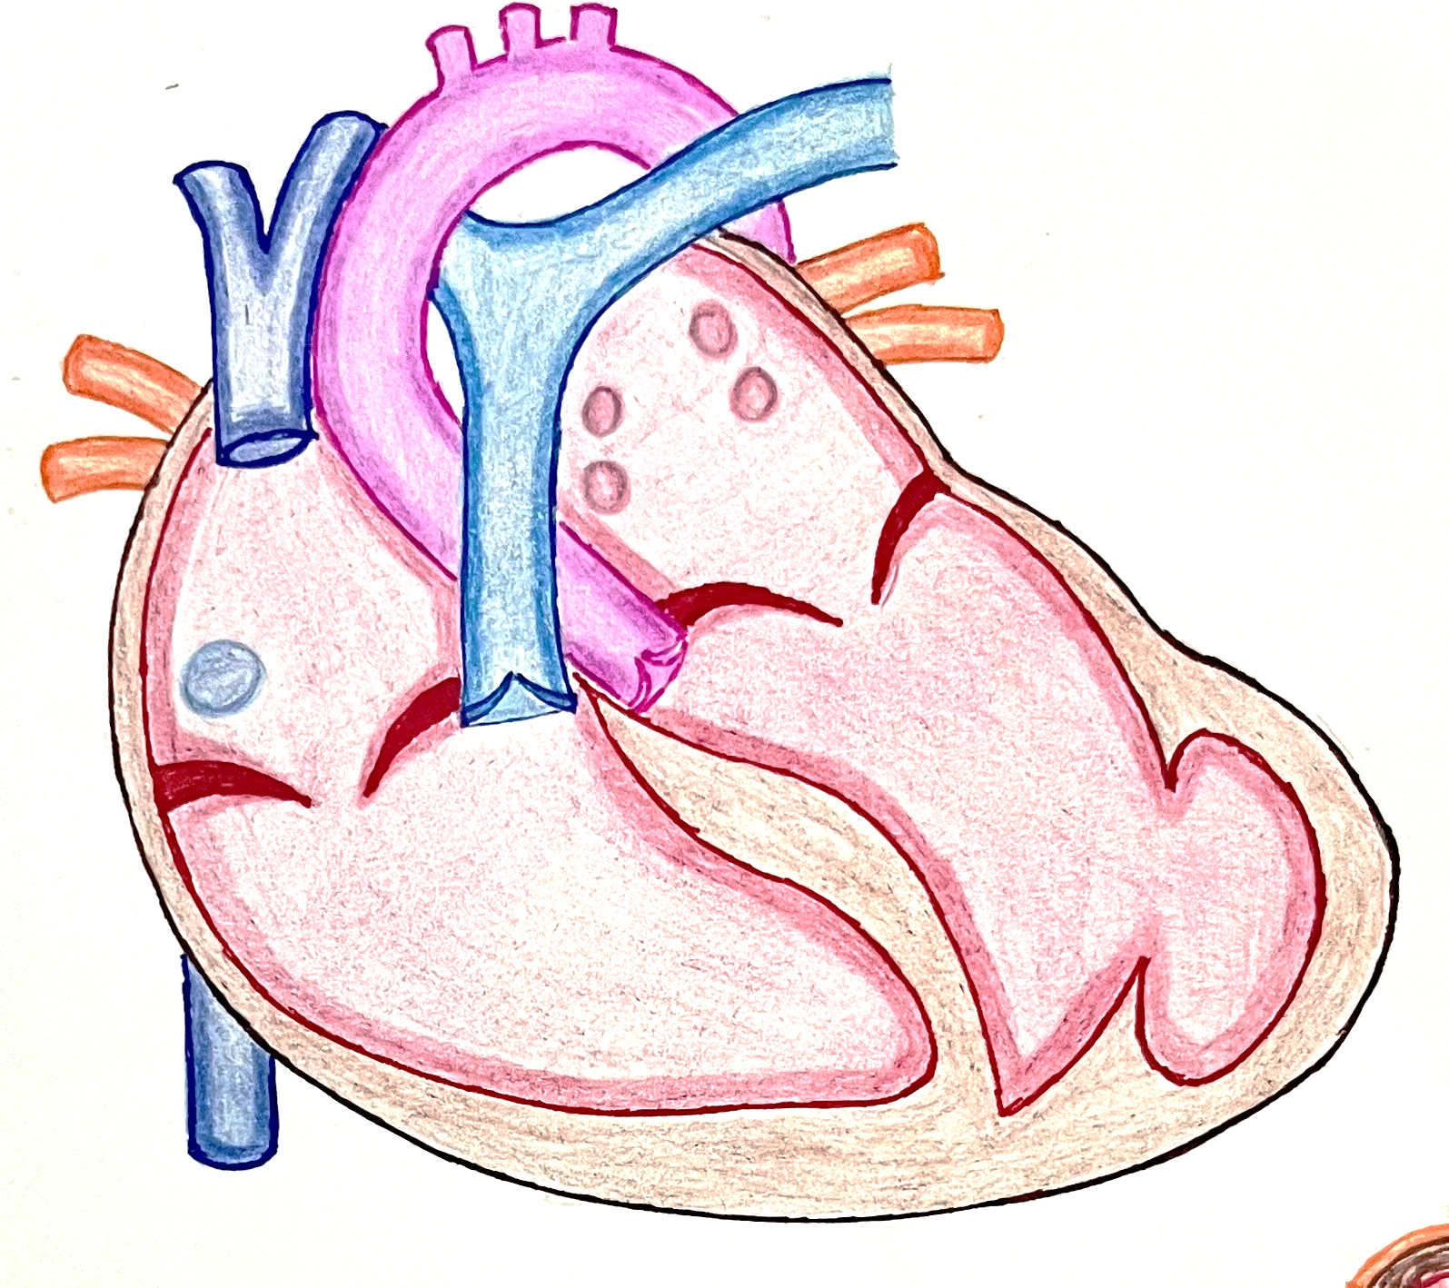
ANEURYSM
An aneurysm is a localized abnormal dilation of a blood vessel or the heart that may be congenital or acquired
Types of Aneurysm
True aneurysm
False aneurysm
Involves all the layers of an intact (but attenuated) arterial wall or the thinned ventricular wall of the heart, it is called a true aneurysm
Defect in the vascular wall leading to an extravascular hematoma that freely communicates with the intravascular space (“pulsating hematoma”)
Atherosclerotic and congenital vascular aneurysms
ventricular aneurysms that follow transmural myocardial infarctions
Ventricular rupture after myocardial infarction, arterial dissection
Arterial dissection arises when blood enters a defect in the arterial wall and tunnels through medial or medial-adventitial planes

Slide 3
ANEURYSM
Aneurysms are classified by macroscopic shape and size into
Saccular aneurysms
Fusiform aneurysm
Spherical outpouchings (involving only a portion of the vessel wall)
In intracranial vessels they generally measure 2 to 20 mm, however, in the aorta they range from 5 to 10 cm in diameter and often contain thrombus
Diffuse, circumferential dilation of a long vascular segment
They vary in diameter (in the aorta generally from 5 to 10 cm) and can involve extensive portions of the aortic arch, abdominal aorta, or even the iliacs

Slide 4
ANEURYSM Pathogenesis
To maintain their structural and functional integrity, arterial walls constantly remodel by synthesizing, degrading, and repairing damage to their ECM constituents
Aneurysms can occur when the structure or function of the connective tissue within the vascular wall is compromised
Defects in synthesis or breakdown of connective tissue contribute to the pathobiology of both heritable aneurysmal diseases, as well as the common, sporadic forms of aneurysms

Slide 5
ANEURYSM Pathogenesis
Causes of aneurysms
Weakening of vessel wall
Poor intrinsic quality of the vascular wall connective tissue
loss of SMCs or the inappropriate synthesis of non-collagenous or nonelastic ECM
Defective type III collagen synthesis
Abnormal transforming growth factor-β (TGF-β) signaling
Balance of collagen degradation and synthesis
Marfan syndrome
Defective synthesis of the scaffolding protein fibrillin leads to the inability to appropriately sequester endogenously produced TGF-β
Ehlers Danlos syndrome
Excessive TGF-β activity causes diminished ECM content and integrity of vessel wall
Loeys-Dietz syndrome
mutations in TGF-β receptors, an intracellular downstream signaling molecule in the TGF-β pathway (SMAD3), and even TGF-β3
Affects primarily ascending aorta

Slide 6
ANEURYSM Pathogenesis
Causes of aneurysms
Weakening of vessel wall
Poor intrinsic quality of the vascular wall connective tissue
loss of SMCs or the inappropriate synthesis of non-collagenous or nonelastic ECM
Abnormal transforming growth factor-β (TGF-β) signaling
Balance of collagen degradation and synthesis
Inflammatory cells like macrophages – in aortitis or atherosclerosis
Decreased expression of TIMPs
Degradation of extracellular matrix (elastin, collagens, proteoglycans, laminin, fibronectin )
Increased production of MMPs
Weakening of vessel wall and aneurysm

Slide 7
ANEURYSM Pathogenesis
Causes of aneurysms
Poor intrinsic quality of the vascular wall connective tissue
Weakening of vessel wall
Abnormal transforming growth factor-β (TGF-β) signaling
Loss of SMCs or the inappropriate synthesis of non-collagenous or nonelastic ECM
Balance of collagen degradation and synthesis
Atherosclerotic thickening of the intima
Systemic hypertension
Tertiary syphilis
significant narrowing of arterioles of the vasa vasorum (e.g., in the aorta)
Obliterative endarteritis occurs in the vasa vasorum
Ischemia of the inner media
Outer medial ischemia
Aneurysm
SMC loss, elastic fiber loss, and inadequate or inappropriate ECM synthesis

Slide 8
Normal media
Cystic medial degeneration
Cross-section of aortic media from a patient with Marfan syndrome showing marked elastin fragmentation and formation of areas devoid of elastin that resemble cystic spaces but are actually filled with increased amounts of proteoglycans
Normal media for comparison showing the regular layered pattern of elastic tissue

Slide 9
AORTIC ANEURYSMS
The two most important causes of aortic aneurysms are
Atherosclerosis
Hypertension
Atherosclerosis is a greater factor in abdominal aortic aneurysms, while hypertension is the most common etiology associated with ascending aortic aneurysms

Slide 10
AORTIC ANEURYSMS
Other risk factors that weaken vessel walls and lead to aneurysms include
Advanced age
Smoking
Trauma
vasculitis
Congenital defects (e.g., fibromuscular dysplasia and berry aneurysms typically in the circle of Willis)
Infections (mycotic aneurysms). Mycotic aneurysms can originate from
Embolization of a septic embolus, usually as a complication of infective endocarditis
Extension of an adjacent suppurative process
Circulating organisms directly infecting the arterial wall

Slide 11
ABDOMINAL AORTIC ANEURYSM
AAAs occur more frequently in men and in smokers
Age - rarely developing before age 50
Atherosclerosis is a major cause of AAA
Atherosclerotic plaque
Increased thickness of the vessel wall
Inflammation – macrophages
Direct compression of wall
Impaired diffusion of oxygen to media
Proteolytic enzymes and MMP’s
Medial ischemia and necrosis
Destruction of ECM
Weakening of the wall
ANEURYSM

Slide 12
ABDOMINAL AORTIC ANEURYSM
Site –
Usually located between the renal arteries and the bifurcation of the aorta
Can occasionally affect the renal and superior or inferior mesenteric arteries, either by direct extension or by occluding vessel ostia with mural thrombi
Shape - AAAs can be saccular or fusiform
Size - greater than 3 cm, but often >5.5 cm in diameter, and up to 25 cm in length

Slide 13
ABDOMINAL AORTIC ANEURYSM VARIANTS
Inflammatory AAA
Immunoglobulin G4–related disease (IgG4-RD)
Mycotic AAAs
5% to 10% of all AAAs
Age – younger age
Clinical presentation - back pain and elevated inflammatory markers
Microscopic - abundant lymphoplasmacytic inflammation with many macrophages (and even giant cells)
Cause - localized immune response to the abdominal aortic wall
Characterized by
High circulating levels of IgG4
Storiform fibrosis
IgG4-positive infiltrating plasma cells in affected tissues
Organs affected
Pancreas
Thyroid
Ascending aorta
Heart vessels
Responds well to steroid and anti–B-cell therapies
Lesions that have become infected by the lodging of circulating microorganisms in the wall
Suppuration further destroys the media, potentiating rapid dilation and rupture

Slide 14
ABDOMINAL AORTIC ANEURYSM CLINICAL FEATURES OF AAA
Often asymptomatic
Palpably pulsating abdominal mass
Rupture into the peritoneal cavity or retroperitoneal tissues with massive, potentially fatal hemorrhage
Risk of rupture is directly related to the size of the aneurysm
SIZE OF ANEURYSM | RISK OF RUPTURE
< 4cms | Nil
4 – 5cm | 1% per year
5 – 6 cm | 11% per year
>6cm | 25% per year
Most aneurysms expand at a rate of 0.2 to 0.3 cm/year, but 20% expand more rapidly

Slide 15
ABDOMINAL AORTIC ANEURYSM CLINICAL FEATURES OF AAA
Compression of the adjacent structures
Obstruction of a branch vessel
Atheroma and mural thrombus
Iliac, renal, mesenteric and vertebral vessels
compression of a ureter or erosion of vertebrae
Embolism
Tissue infarction distal to these arteries

Slide 16
ABDOMINAL AORTIC ANEURYSM TREATMENT OF AAA
Treatment of aneurysm
Operative mortality for unruptured aneurysms is approximately 5%
Aneurysms more than 5cms should be managed aggressively
Open surgery with prosthetic grafts
Surgery
Stent graft via endoscopic approach

Slide 17
THORACIC AORTIC ANEURYSM
Hypertension
Most common
Causes
Marfan syndrome
Loeys-Dietz syndrome
Inflammatory conditions (aortitis)
Other rare causes

Slide 18
THORACIC AORTIC ANEURYSM
Most of the cases are asymptomatic
If there is compression on the adjacent organs, patient may present with symptoms
Compression site | Clinical presentation
Bone erosion or encroachment | Chest pain
Coronary artery | Myocardial ischemia
Oesophagus | Difficulty in swallowing
Pressure on the recurrent laryngeal nerves or irritation of nerve | Hoarseness of voice
Bronchial compression | Respiratory complications

Slide 19
SYPHILITIC ANEURYSM
Seen in tertiary stage of syphilis
More common in men
More common in proximal aorta affecting ascending aorta and common cause of aortic arch aneurysm

Slide 20
SYPHILITIC ANEURYSM Pathogenesis
Inflammation around vasa vasorum of adventitia
Endarteritis obliterans
Ischemic injury to media
Weakening of wall
Aneurysm

Slide 21
SYPHILITIC ANEURYSM Morphology
Ascending aorta –
Intimal surface is wrinkled producing “tree-bark” appearance
Aortic arch aneurysm
Often saccular type m/s 3-5cms
If aortic valve is involved, it leads to incompetence of the valve producing volume overload of enlarged heart leading to Cor – Bovinum (massive left ventricular hypertrophy)
Saccular aneurysm
Tree bark appearance

Slide 22
SYPHILITIC ANEURYSM Microscopy
Inflammatory infiltrate is rich in plasma cells, lymphocytes and macrophages
Adventitia shows fibrous thickening and endarteritis of vasa vasorum
Clinical manifestations can be due to –
Rupture
Compression of adjacent structures
Cardiac manifestions

Slide 23
AORTIC DISSECTION
Aortic dissection occurs when blood separates the laminar planes of the media to form a blood-filled channel within the aortic wall
Men aged 40 to 60 years
Antecedent hypertension
Occurs in two age groups
In syndromic diseases – Marfan’s syndrome
Younger patients

Slide 24
AORTIC DISSECTION
PATHOGENESIS
ETIOLOGY
Hypertension
Connective tissue disorders – eg Marfan’s syndrome
Pregnancy
Iatrogenic
Leads to
medial degenerative changes with SMC loss
Altered ECM content
It may be due to
Hormonally induced vascular remodeling
Hemodynamic stress in perinatal period
Following arterial cannulations
Due to
Defective TGF-β signaling
Defective ECM synthesis
Degradation of ECM
During diagnostic catheterization or cardiopulmonary bypass
Traumatic chest injury (e.g., motor vehicle accident, or even extremely vigorous cardiopulmonary resuscitation)
Intimal tear
Disruption of penetrating vessels of the vasa vasorum without an intimal tear
Blood dissects media under pressure
Hematoma
Notes:
Traumatic chest injury (e.g., motor vehicle accident, or even extremely vigorous cardiopulmonary resuscitation) can cause intimal tears that originate after the origin of arch vessels at the ligamentum arteriosum
In such cases the connective tissue that tethers the aorta and pulmonary vessels in that location can lead to aortic tearing when there is sudden extreme movement of the heart toward the anterior chest wall

Slide 25
AORTIC DISSECTION MORPHOLOGY
In most cases of dissection, medial degeneration is present at the site of tear but may not be seen in the area of propagation
These typically feature elastic fiber fragmentation and loss, mucoid ECM accumulation, and SMC attrition
Inflammation is characteristically absent

Slide 26
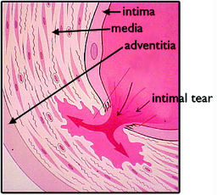
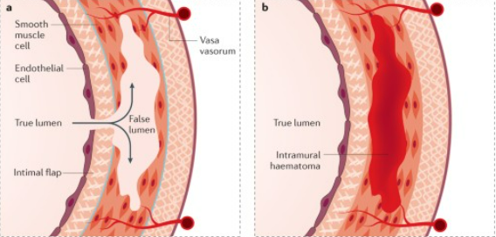
AORTIC DISSECTION MORPHOLOGY
An aortic dissection usually initiates with an intimal tear
Dissecting hematoma spreads characteristically between lamellar units of the outer third of the media or between media and adventitial layers

Slide 27
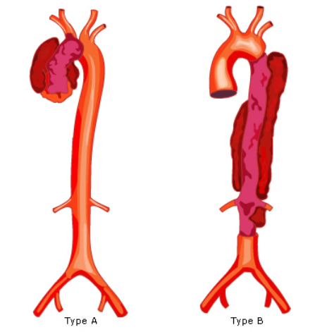
AORTIC DISSECTION MORPHOLOGY
Tear occurs in the ascending aorta, usually within 10 cm of the aortic valve
Such tears are typically transverse with sharp, jagged edges up to 1 to 5 cm in length
Dissection can extend retrograde toward the heart as well as distally, sometimes as far as the iliac and femoral arteries

Slide 28
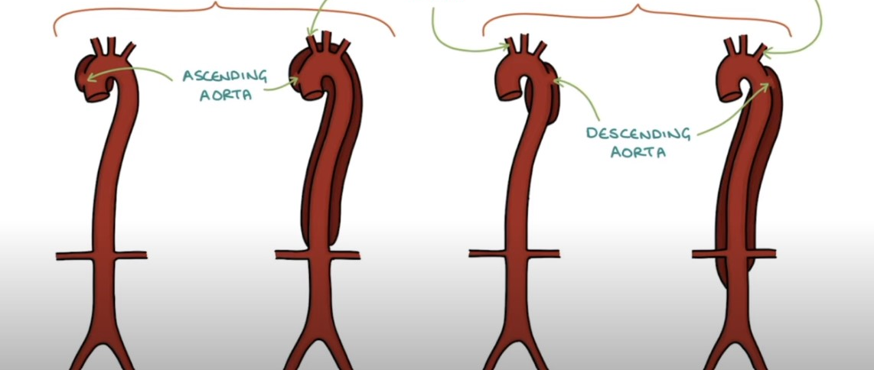
CLASSIFICATION - STANFORD
TYPE A
Brachiocephalic artery
TYPE B
Left subclavian artery
Ascending aorta
Descending aorta

Slide 29
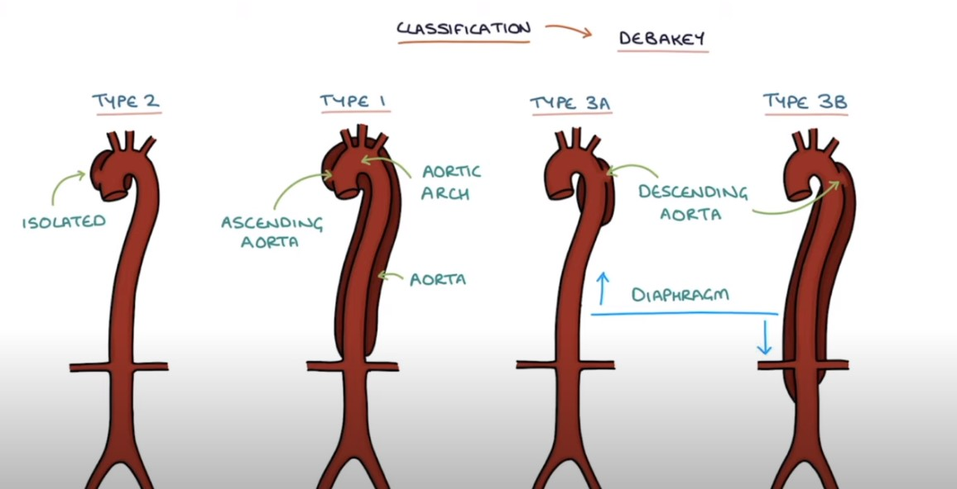
CLASSIFICATION - DEBAKEY
TYPE 2
TYPE 1
TYPE 3A
TYPE 3B
Aortic arch
Descending aorta
Isolated
Ascending aorta
Aorta
Diaphragm

Slide 30
AORTIC DISSECTION
Consequences of aortic dissection
Rupture through the adventitia causing massive hemorrhage (e.g., into the thoracic or abdominal cavities) or cardiac tamponade (hemorrhage into the pericardial sac).
Dissecting hematoma reenters the lumen of the aorta through a second distal intimal tear, creating a new false vascular channel - “double-barreled aorta”
This averts a fatal extraaortic hemorrhage, and over time, such false channels can be endothelialized to become recognizable chronic dissections

Slide 31
AORTIC DISSECTION Clinical Features
Clinical symptoms of aortic dissection are
Sudden onset of excruciating pain, usually beginning in the anterior chest, radiating to the back between the scapulae, and moving downward as the dissection progresses
Pain can be confused with that of myocardial infarction
Ascending aorta
Descending aorta
Sudden-onset of severe “ripping” “tearing” pain in back
Sudden-onset of severe “ripping” “tearing” chest pain
BACK

Slide 32
AORTIC DISSECTION Clinical Features
The morbidity and mortality associated with dissections depends on which part of the aorta is involved
Most serious complications occur with dissections between the aortic valve and the distal arch
Common cause of death is rupture of the dissection and bleeding into the pericardial, pleural, or peritoneal cavities

Slide 33
AORTIC DISSECTION Clinical Features
Retrograde dissection into the aortic root can also disrupt the aortic valve annulus
Common clinical manifestations include cardiac tamponade and aortic insufficiency
Dissections can also extend into the great arteries of the neck or into the coronary, renal, mesenteric, or iliac arteries, causing vascular obstruction and ischemic consequences such as myocardial infarction
Involvement of spinal arteries can cause transverse myelitis

Slide 34
AORTIC DISSECTION Treatment
Type A
Intensive hypertensive and surgical intervention
Midline sternotomy
Remove the dissected area
Replace with a synthetic graft along with aortic valve
Type B
Thoracic endovascular aortic repair
Stent graft
Antihypertensives
10-year survival is 40% to 88%
Over all survival rate is 75%

Slide 35
THANK YOU

