Slide 1
CHRONIC MYELOPROLIFERATIVE DISORDER- POLYCYTHEMIA VERA, ESSENTIAL THROMBOCYTOSIS, PRIMARY MYELOFIBROSIS, LANGERHANS CELL HISTIOCYTOSIS
Dr.v.shanthi
Associate professor, pathology
Sri Venkateswara institute of medical sciences
tirupathi

Slide 2
POLYCYTHEMIA VERA
Neoplasm of multipotent myeloid stem cell, characterized by :
activating point mutations in Tyrosine kinase JAK 2
Increased marrow production of erythroid, granulocytic and megakaryocytic elements
But the symptoms are mainly due to increased red cells

Slide 3
POLYCYTHEMIA VERA
CLASSIFICATION OF POLYCYTHEMIA
I. Polycythemia rubra vera (primary)
II. Secondary polycythemia
a. Appropriate erythropoietin production (tissue hypoxia)
eg: high attitude, obesity, (pickwickian syndrome), COPD, cyanotic heart disease
b. Inappropriate erythropoietin production
eg: erythropoietin producing tumors (RCC, HCC, cerebellar hemangioblastomas)
c. familial erythrocytosis
eg: hemoglobins with high oxygen affinity

Slide 4
POLYCYTHEMIA VERA
CLASSIFICATION OF POLYCYTHEMIA
iii. Relative polycythemia
(rcm & hematocrit remain normal)
eg: - Dehydration, burns, shock
- Gaisbock’s syndrome
(stress polycythemia): hypertensive, obese, nervous males of > 40 yrs with h/o smoking & alcoholism

Slide 5
POLYCYTHEMIA VERA
Pathogenesis
In PCV, transformed progenitor cells have markedly decreased requirements for erythropoietin and other hematopoietic growth factors due to constitutive JAK2 signaling
97% of patients have JAK2 mutations that result in valine – to – phenyl alaline substitution at residue 617
In remaining cases mutations are different
Serum erythropoietin levels are low (high erythropoietin levels in secondary forms)

Slide 6
POLYCYTHEMIA VERA
morphology
BLOOD :
Hemoglobin concentration :18 to 24 g/dl
Hematocrit – 60% or more
Red cell counts of 7 to 10 million/cumm
Moderate to marked leucocytosis with “shift to left” in myeloid series
Increased number of basophils and abnormally large platelets
Platelets : 5 to 10 lakhs/ cumm

Slide 7
POLYCYTHEMIA VERA
morphology
Bone marrow
Hypercellular bone marrow
Increased number of erythroid, myeloid precursors & megakaryocytes
Moderate increase in Reticulin fibres – 10% of marrow
Late in course – PCV progresses to spent phase characterized by extensive fibrosis that displaces hematopoietic cells

Slide 8
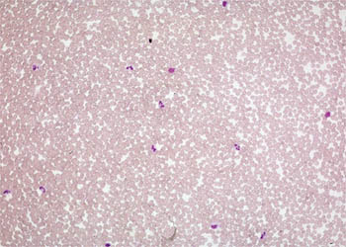
Blood smear, polycythemia vera (P. vera)

Slide 9
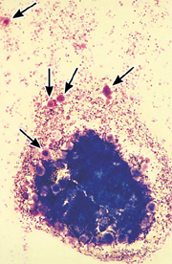
Bone marrow aspirate in polycythaemia rubra vera showing marked hypercellularity and increased megakaryocytes

Slide 10
POLYCYTHEMIA VERA
morphology
Extensive marrow fibrosis is accompanied by extramedullary hematopoiesis in the spleen and liver often leading to prominent organomegaly
Transformation to AML with its typical features occurs in about 1% of patients

Slide 11
POLYCYTHEMIA VERA
Clinical features
Incidence is 1 to 3 / 100,000 per year
Appears insidiously, usually in adults of late middle age
Skin & mucus membranes
Plethora : color of face is ruddy, esp. lips, cheeks, tip of nose, ears & neck
Aquagenic pruritis : intense itching after exposure to water, which may be initial presentation of PV. It is seen in 60% of pts. under age 40
Erythromelalgia: reddening, swelling & pain in digits associated with extreme platelet elevations

Slide 12
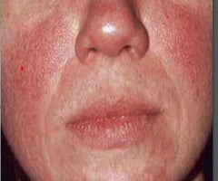
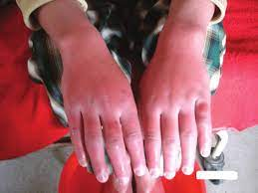
PLETHORA
ERYTHROMELALGIA

Slide 13
POLYCYTHEMIA VERA
Increased red cell mass + hematocrit and increased total blood volume
Abnormal blood flow, particularly on the low pressure venous side of circulation, which becomes greatly distended
Cyanosis due to stagnation and deoxygenation in peripheral vessels

Slide 14
POLYCYTHEMIA VERA
Clinical features
Other symptoms due to release of histamine from basophils are
Headache
Dizziness
Hypertension
GI symptoms
Intense pruritus
Peptic ulceration

Slide 15
POLYCYTHEMIA VERA
Clinical features
High cell turn over – leads to hyperuricemia (symptomatic gout in 5% to 10% of cases)
Abnormality in blood flow and platelet function leads to increased risk of both major bleeding and thrombotic episodes
25% of patients present with deep vein thrombosis, MI and stroke
Thormbotic complications preceed hemorrhagic manifestations like epistaxis and bleeding gums
Life threatening complications occur in 5% to 10% of cases

Slide 16
POLYCYTHEMIA VERA
TREATMENT AND PROGNOSIS
Without treatment death occurs with in few months of diagnosis due to bleeding or thrombosis
Phlebotomy can extend the life span maintaining the red cell mass
If the patient survives for longer time, then the spent phase occurs with the development of myelofibrosis
This transition starts after average period of 10 years
During this phase splenomegaly occurs due to extramedullary hematopoiesis
In 2% of cases PCV transforms into AML

Slide 17
ESSENTIAL THROMBOCYTOSIS
Increased proliferation & production of megakaryocytic elements
Since all CMPDs are associated with thrombocytosis, essential thrombocytosis is a diagnosis of exclusion
ET is often associated with activating point mutations in
JAK 2 (50% of cases)
MPL (5% to 10% of cases)
Few cases show mutations in Calreticulin

Slide 18
ESSENTIAL THROMBOCYTOSIS
Constitutive JAK2 or MPL signaling renders the progenitors thrombopoietin – independent and leads to hyperproliferation
ET manifested by increased platelet count
Polycythemia and marrow fibrosis will be absent which distinguishes it from PCV

Slide 19
ESSENTIAL THROMBOCYTOSIS
MORPHOLOGY
Peripheral smear
Platelet count is increased with abnormally large platelets
Leukocytosis is present
Bone marrow
Cellularity – mildly increased
Megakaryocytes – often markedly increased in number and include abnormally large forms
Uncommonly marrow fibrosis or transformation to AML supervenes
50% of patients present with organomegaly

Slide 20
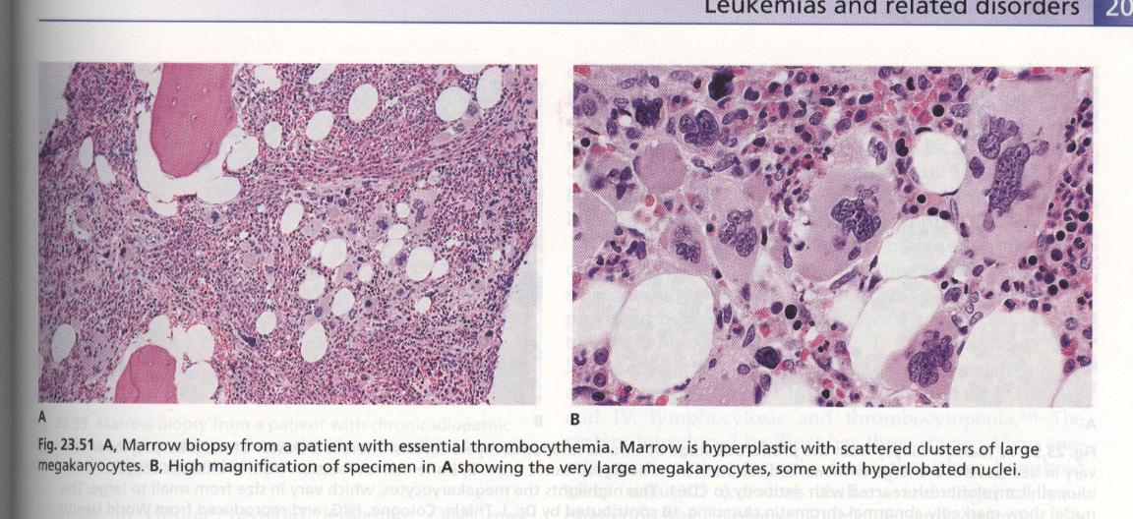

Slide 21
ESSENTIAL THROMBOCYTOSIS
Clinical features
Incidence – 1 to 3/ 100,000 per year
Age group – usually at the age of 60 years but may be seen at any age
Indolent disorder with long asymptomatic periods
Thrombotic complications include –
Deep vein thrombosis
Portal and hepatic vein thrombosis
Myocardial infarction

Slide 22
ESSENTIAL THROMBOCYTOSIS
Clinical features
Other characteristic symptom is erythromelalgia – throbbing and burning of hands and feet caused by occlusion of small arterioles by platelet aggregates, which may also be seen in PCV
Median survival time – 12 to 15 years
Treatment – gentle chemotherapeutic agents to suppress thrombopoiesis

Slide 23
CAUSES OF REACTIVE THROMBOCYTOSIS
Acute blood loss
Iron deficiency
Post splenectomy (up to 2 months)
Recovery from thrombocytopenia(“rebound”)
Malignancies
Chronic inflammatory and infectious diseases (inflammatory bowel disease, connective tissue disorders, temporal arteritis, tuberculosis, chronic pneumonitis)
Acute inflammatory and infectious diseases
Response to exercise
Response to drugs
Hemolytic anemia

Slide 24
PRIMARY MYELOFIBROSIS
Synonyms of primary myelofibrosis
Idiopathic myelofibrosis
Osteomyelo fibrosis
Angiogenic myeloid metaplasia
Myelofibrosis with myeloid metaplasia (MMM)

Slide 25
PRIMARY MYELOFIBROSIS
Pathogenesis
Activating JAK2 mutations are present in 50% to 60% of cases
Activating MPL mutations in an additional 1% to 5% of cases of primary myelofibrosis
Remaining cases have mutations in calreticulin that are hypothesized to give rise to increased JAK-STAT signaling

Slide 26
PRIMARY MYELOFIBROSIS
Characterized by rapid development of obliterative marrow fibrosis
Replacement of marrow by fibrous tissue reduces marrow hematopoiesis, leading to cytopenias and extensive extramedullary hematopoiesis
Marrow fibrosis is due to inappropriate release of fibrogenic factors (PDGF & TGF-β) from neoplastic megakaryocytes

Slide 27
PRIMARY MYELOFIBROSIS
Pathogenesis
As the marrow fibrosis progresses, circulating hematopoietic stem cells resides in niches in secondary hematopoietic organs, such as spleen, liver and lymphnodes leading to the extramedullary hematopoiesis

Slide 28
PRIMARY MYELOFIBROSIS
Morphology
Early in course
Hypercellular marrow due to increase in maturing cells of all lineages
Morphologically –
Megakaryocytes are large, dysplastic and abnormally clustered
Granulocytic and erythroid precursors appear normal
At this stage – fibrosis is minimal
Smear – leukocytosis and thrombocytosis

Slide 29
PRIMARY MYELOFIBROSIS
Morphology
With progression
Marrow becomes hypo cellular and diffusely fibrotic
Clusters of atypical megakaryocytes with unusual nuclear shapes (Cloud-like) are present
Hematopoietic elements are found in dilated sinusoids
Very late course
Fibrotic marrow space may be converted into bone, a change called - Osteosclerosis

Slide 30
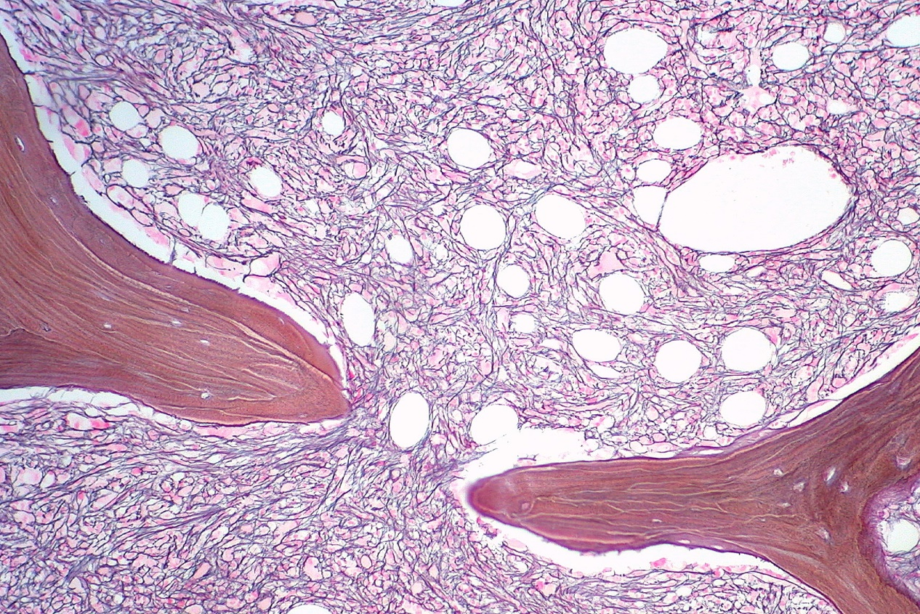
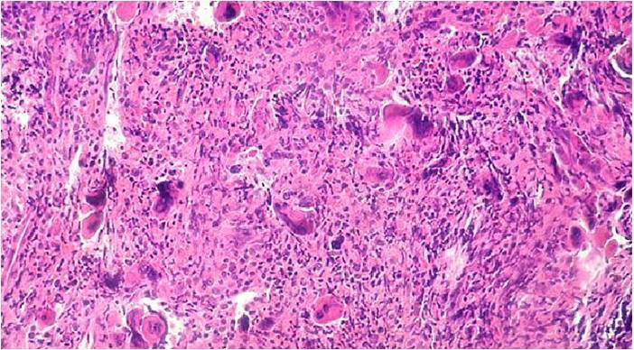
PRIMARY MYELOFIBROSIS

Slide 31
PRIMARY MYELOFIBROSIS
Morphology
Fibrotic obliteration of marrow space leads to extensive extramedullary hematopoiesis producing
Splenomgaly
Hepatomegaly
Lymphadenopathy (rarely hematopoiesis occurs in lymphnodes)

Slide 32
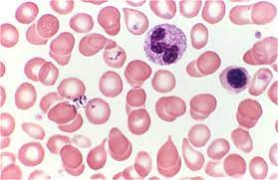
PRIMARY MYELOFIBROSIS
Peripheral blood picture
Normocytic normochromic anemia
Leukoerythroblastosis – due to premature release of nucleated erythroid and early granulocytic progenitors and immature cells from the sites of extramedullary hematopoiesis
Tear drop cells (Dacrocytes) – Cells which are probably damaged during the birthing process in the fibrotic stroma
Other findings
Giant platelets
Basophils

Slide 33
PRIMARY MYELOFIBROSIS
Clinical features
Median age at diagnosis : 60 yrs
Familial form has been reported
Weight loss, bleeding, splenic pain, jaundice etc.,
Hepatosplenomegaly (> 50% of cases)

Slide 34
PRIMARY MYELOFIBROSIS
Diagnostic criteria
Major criteria :
Diffuse bone marrow fibrosis
Absence of Philadelphia chromosome or bcr/abl rearrangement in peripheral blood cells
Splenomegaly

Slide 35
PRIMARY MYELOFIBROSIS
Diagnostic criteria
Minor criteria :
Anisopoikilocytosis with teardrop red cells
Circulating immature myeloid cells
Circulating nucleated red cells
Clustered marrow megakaryoblasts & anomalous megakaryocytes
Myeloid metaplasia
Criteria essential for diagnosis :
All 3 major criteria + any two minor criteria
First 2 major criteria or any 4 minor criteria

Slide 36
LANGERHAN CELL HISTIOCYTOSIS
Histiocytosis – variety of proliferative disorders of dendritic cells or macrophages
Langerhan cell histiocytosis – spectrum of clonal proliferation of immature dendritic cells
considered as unusual myeloid neoplasm

Slide 37
LANGERHAN CELL HISTIOCYTOSIS
Pathogenesis –
Most common mutation – activating valine – to – glutamate substitution at residue 600 in BRAF
Less common mutations detected are – tp53, ras and the receptor tyrosine kinase met
Factor that contributes to homing of neoplastic Langerhan cells is the aberrant expression of chemokine receptors
Epidermal Langerhan cells express ccr6, their neoplastic counterparts express both ccr6 and ccr7
This allows the neoplastic cells to migrate into tissues that express relevant chemokines CCL-20 ( a ligand for ccr6) in skin and bone and ccl19 and ccl21 (ligand for ccr7) in lymphoid organs

Slide 38
LANGERHAN CELL HISTIOCYTOSIS
MORPHOLOGY
Proliferating langerhans cells have abundant, often vacuolated cytoplasm and vesicular nuclei containing nuclear grooves or folds
Presence of Birbeck granules in the cytoplasm is characteristic
Birbeck granules are pentalaminar tubules often with a dilated terminal end producing tennis-racket like appearance which contains the protein Langerin
In addition tumor cells express hla-dr, s-100, and cd 1a

Slide 39
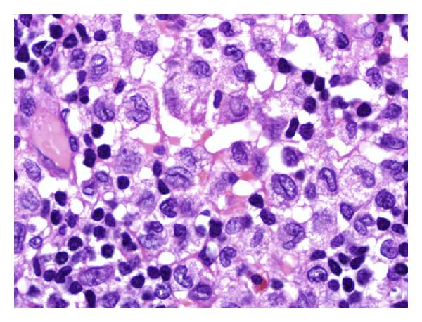
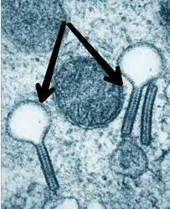
LANGERHAN CELL HISTIOCYTOSIS

Slide 40
LANGERHAN CELL HISTIOCYTOSIS
Clinical features
Presents as
Multifocal multisystem Langerhan cell histiocytosis (Letterer-Siwe disease)
Unifocal and multifocal unisystem Langerhan cell histiocytosis (Eosinophilic granuloma)
Pulmonary Langerhans cell histiocytosis
They may heal spontaneously or may be cured by local excision or irradiation

Slide 41
THANK you

