Slide 1
ALL AND CLL/SLL
Dr.V.Shanthi
Associate Professor , Pathology
Sri Venkateswara Institute of Medical Sciences
Tirupathi

Slide 2
ACUTE LYMPHOBLASTIC LEUKEMIA
Primarily a disease of children
Age - Majority occur between 1-5 yrs ( second peak in adults between 30-40 yrs)
B cell ALL – age of 3
T cell ALL - adolescence
Sex - Slight male preponderance
75-80% are B-lineage; 20-25% T-lineage
MC extra medullary sites of involvement in B-ALL - skin, soft tissue, lymph nodes & bone
Mediastinal involvement is common in T-ALL

Slide 3
ACUTE LYMPHOBLASTIC LEUKEMIA
Pathogenesis
B –CELL ALL | T- CELL ALL
Arise from bone marrow precursor B cell | Precursor T cell (often thymic origin)
Most common in children | Most common in adolescent males
Diverse chromosomal translocations Mutations affecting genes like PAX5, TCF3, ETV6 and RUNX1 (all of which are required for early hematopoietic precursor) | Diverse chromosomal translocations NOTCH 1 mutations (50 to 70 %)
Hyperploidy (>50 chromosomes) | Different translocations

Slide 4
ACUTE LYMPHOBLASTIC LEUKEMIA
Predisposing factors for ALL

Slide 5
ACUTE LYMPHOBLASTIC LEUKEMIA
MORPHOLOGY
Bone marrow - hypercellular and packed with lymphoblasts which replace normal marrow elements
T cell ALL – present with mediastinal masses in 50 to 70% of cells and also associated with lymphadenopathy and splenomegaly
Tumor cells – scant basophilic cytoplasm and nuclei is somewhat larger than those of small lymphocytes
Nuclear chromatin – delicate, finely stippled and nucleoli are often small and demarcated by rim of condensed chromatin
Nuclear membrane is deeply subdivided imparting it convoluted appearance
Interspersed macrophages ingesting apoptotic tumor cells gives it “starry sky appearance”

Slide 6
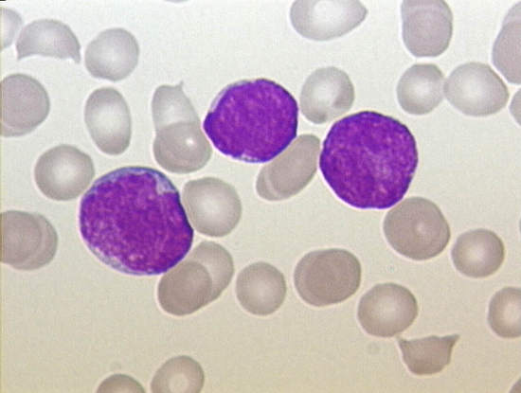
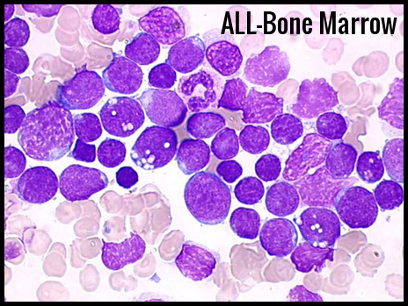
Lymphoblasts in PB Lymphoblasts in BM

Slide 7
ACUTE LYMPHOBLASTIC LEUKEMIA – FAB CLASSIFICATION

Slide 8
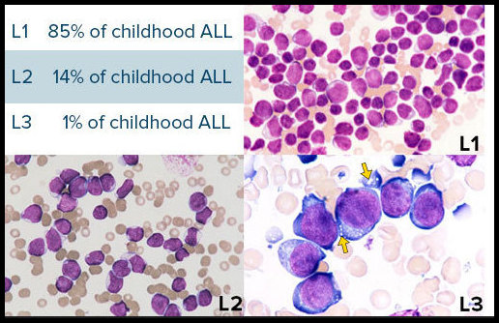

Slide 10
WHO Classification of ALL(2016) (Precursor Lymphoid neoplasms)
-B lymphoblastic leukaemia/lymphoma, NOS
-B lymphoblastic leukaemia/lymphoma with recurrent genetic abnormalities
-T Lymphoblastic leukemia/lymphoma, NOS
Early T cell precursor lymphoblastic leukaemia
• Natural killer cell lymphoblastic leukemia / lymphoma

Slide 11
Immunologic Classification of ALL
1. B cell -ALL
- Pro B cell ALL
- Early Pre B cell ALL
- Pre B cell ALL
- Mature B cell ALL
2. T cell -ALL
3. Mixed Lineage Acute Leukemia

Slide 12
ACUTE LYMPHOBLASTIC LEUKEMIA PERIPHERAL SMEAR
Accumulation of neoplastic blasts in marrow suppresses normal hematopoiesis
RBC: Moderate to severe anemia
WBC: Markedly increased , >20% lymphoblasts
Subleukemic/Aleukemic ALL - Some Patients present with pancytopenia with few/no blasts in peripheral blood
Lymphoblast morphology :
Large Nucleus with condensed chromatin
Inconspicuous nucleoli
Scant cytoplasm without granules
Platelets: Moderate to severe thrombocytopenia

Slide 13
ACUTE LYMPHOBLASTIC LEUKEMIA
Cytochemical stains :
Myeloperoxidase & Sudan Black : Negative
Periodic acid schiff (PAS) :Block Positivity
Acid phosphatase: Positive in T-ALL

Slide 15
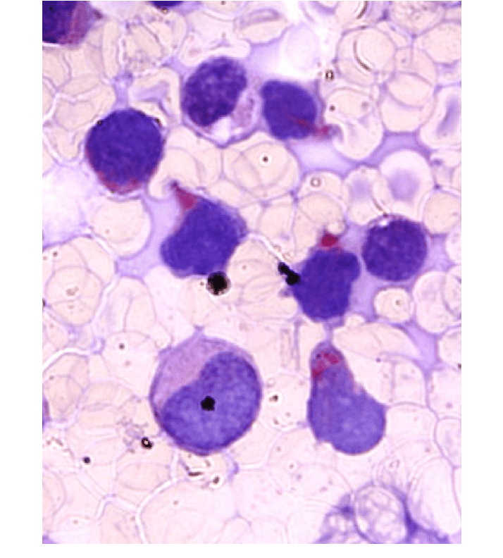
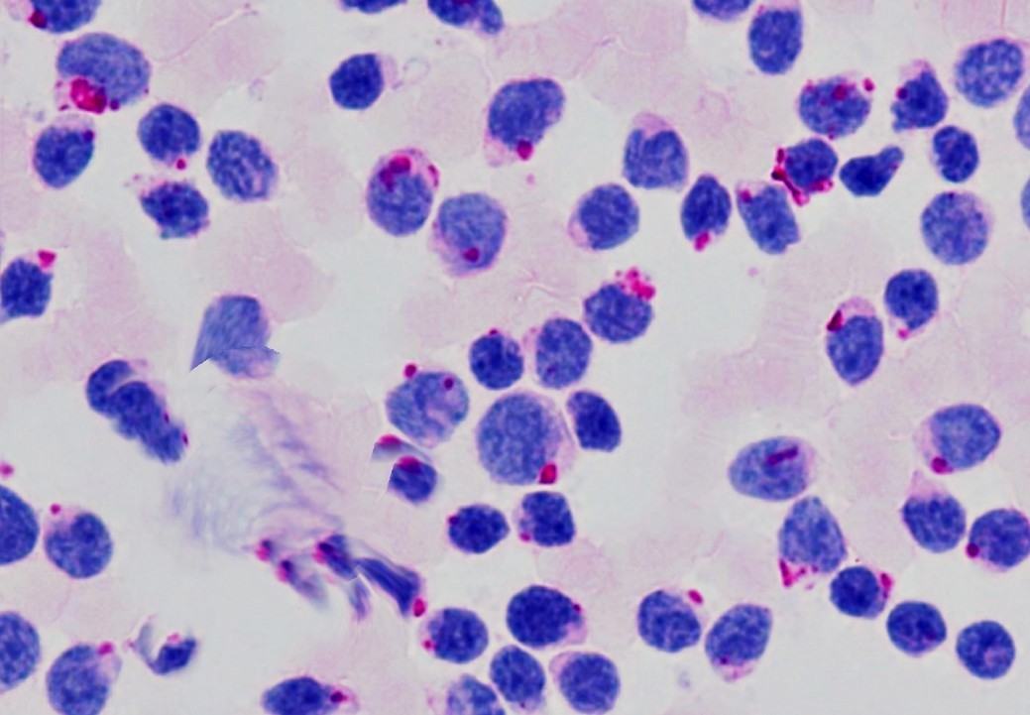
ALL CYTOCHEMISTRY
Acid phosphatase
T lymphocytes have a high levels of acid phosphatase & can be used to help make a diagnosis of acute T-lymphocytic leukemia

Slide 16
ALL- Immunophenotyping
Tdt, a specialized DNA polymerase is positive in > 95 % cases of pre-B & pre-T lymphoblasts
Primary B-cell ALL : CD10 (CALLA), CD19, CD20, CD79a, HLA-DR, PAX5
Primary T-cell ALL : CD1,CD2, CD5, CD7 & CD99

Slide 17
ACUTE LYMPHOBLASTIC LEUKEMIA
CLINICAL FEATURES
Symptoms related to depression of marrow function including
Fatigue – due to anemia
Fever, reflecting infections – due to neutropenia
Bleeding – due to thrombocytopenia
Mass affects caused by neoplastic infiltration
Bone pain – marrow expansion and infiltration of subperiosteum
Generalized lymphadenopathy
Splenomegaly
Hepatomegaly
Testicular enlargement
Compression of large vessels and airways in mediastinum

Slide 18
ACUTE LYMPHOBLASTIC LEUKEMIA
CLINICAL FEATURES
CNS manifestations
Such as headache, vomiting and nerve palsies – resulting from meningeal spread
Treatment
Aggressive chemotherapy cures 95% of children form cancer deaths
Factors associated with worse prognosis are
Age younger than 2 years
Presentation in adolescence or adulthood
Peripheral blood blasts > 1,00,000 /cumm

Slide 19
ACUTE LYMPHOBLASTIC LEUKEMIA
Factors associated with favorable prognosis
Age between 2 -10yrs
Low white cell count
hyperdiploidy
Trisomy of chromsomes 4,7, and 10
Presence of translocation t(12:21)
Molecular detection of residual disease

Slide 20
AML VS ALL
Features | Myeloblasts | Lymphoblast
Size | Large | Small
Cytoplasm | Moderate | Scanty
Nucleoli | Prominent | Inconspicuous
Chromatin | Fine | Coarse/ Clumped
Auer rods | Present | Absent
Myeloperoxidase | Positive | Negative
Sudan black D PAS | Positive Negative | Negative Positive

Slide 21
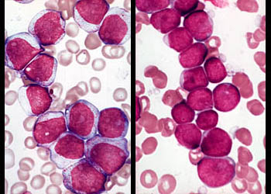
Blood smears, cytology of acute leukemia, AML vs. ALL

Slide 22
CHRONIC LYMPHOCYTIC LEUKEMIA/SMALL LYMPHOCYTIC LYMPHOMA
Neoplasms composed of small round to slightly irregular B- lymphocytes in peripheral blood, bone marrow, spleen & lymph nodes
Two disorders are morphologically, phenotypically & genotypically indistinguishable, differ only in degree of peripheral blood lymphocytosis
Lymphocytosis sufficient to fulfill the diagnostic requirement of CLL – absolute lymphocyte count > 5000/mm³ (normal range – 800 to 5000/mm³ )

Slide 23
CHRONIC LYMPHOCYTIC LEUKEMIA
Median age 60
Male predominance (M:F 2:1)
Generalized lymphadenopathy
Hepatosplenomegaly
Associated with Autoimmune disorders

Slide 24
CHRONIC LYMPHOCYTIC LEUKEMIA
Cell of origin – either post germinal center memory B cell or naïve B cell which is somatically hypermutated
Pathogenesis
Most common genetic anomalies are – deletions of 13q14.3, 11q, and 17p and trisomy 12q
Chromosomal deletions on 13 has implicated 2 microRNAs, miR15a, miR16-1, tumor suppressor gene
Loss of these microRNAs is believed to result in overexpression of the anti apoptotic protein BCL2 which is uniformly observed in CLL/SLL

Slide 25
CHRONIC LYMPHOCYTIC LEUKEMIA
Pathogenesis
Other mutations in CLL genomes are
Gain of function mutations involving the NOTCH1 receptor
Mutations in genes that regulate RNA splicing
Loss of function mutations in BTK gene
Growth of CLL/SLL cells is largely confined to proliferation centres, where tumor cells receive cues from microenvironment

Slide 26
CHRONIC LYMPHOCYTIC LEUKEMIA
Morphology
Lymph node
Architecture is effaced diffusely by predominantly small lymphocytes having round to slightly irregular nuclei, condensed chromatin and scant cytoplasm
Admixed are variable number of larger activated lymphocytes that often gather in loose aggregates referred to as proliferation centre containing mitotically active cells

Slide 27
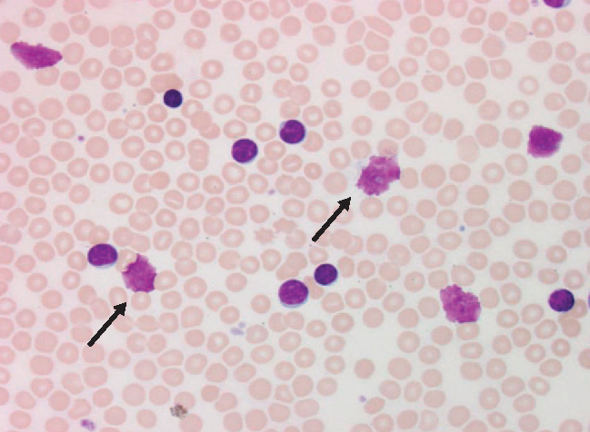
Hematologic parameters in CLL
Hb: Usually <13g/dl ; in late stages <10g/dl
TLC: Range of 20,000 to 50,000/cumm
Absolute lymphocyte count > 5000/ cumm for more 3 months is diagnostic
Smudge cells/Basket cells/Fragile cells/Shadow cells of Gumprecht are prominent – disrupted cells in the process of making smears
Platelet count: Initially normal, later stages decreases
Coombs test: Positive in 10-20% (AIHA)

Slide 28
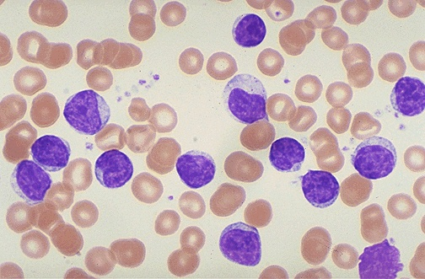
CLL-Convent girl appearance ( as all the tumor cells are uniform looking like convent girls having uniform)

Slide 29
CHRONIC LYMPHOCYTIC LEUKEMIA
International workshop CLL guidelines for diagnosis of CLL
Clonal expansion of abnormal B lymphocytes > 5000/cumm in PB (for 3 months)
Atypical /Immature cells/Prolymphocytes < 55%
> 30% lymphoid cells in bone marrow
Co expression of CD5 & CD23
Lack of pan T-cell markers other than CD5

Slide 30
CLL - Immunophenotype
Immunophenotyping of CLL Neoplastic mature lymphocytes arise by the clonal expansion of B-lymphocytes (95% of cases)
Cells are positive for Pan B-cell markers : CD19, CD20, CD21
CD5 and CD23 positivity are distinctive for CLL
CLL which do not express CD5 but CD19+CD23 expression is present are grouped under atypical CLL
Overexpression of BCL2 is observed in 70% of cases and low level of expression of surface Ig
Chromosomal abnormalities : Trisomy 12 & deletions of 11 q & 13q

Slide 31
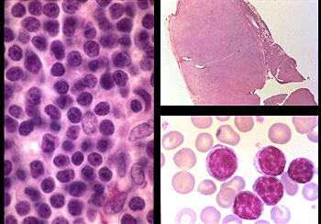
Chronic lymphocytic leukemia/small lymphocytic lymphoma (CLL/SLL)

Slide 32
CHRONIC LYMPHOCYTIC LEUKEMIA
Clinical features
Often asymptomatic
Symptoms are non-specific – easy fatigability, weight loss, and anorexia
Generalized lymphadenopathy and hepatosplenomegaly
Leukocyte count is variable –
SLL – leukopenia
CLL – 200000/mm³

Slide 33
CHRONIC LYMPHOCYTIC LEUKEMIA
Clinical features
CLL/ SLL disrupts the normal immune mechanism through uncertain mechanism
Hypogammaglobulinemia – increased susceptibility to infections
10 to 15% of patients present with hemolytic anemia, or thrombocytopenia due to auto antibodies made by non specific B cells

Slide 34
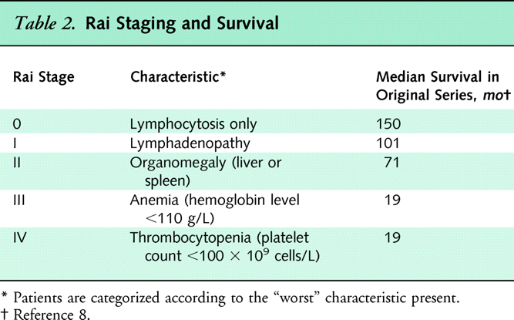

Slide 35
CLL/SLL

Slide 36
CLL/SLL
Prognosis
Course and prognosis are extremely variable depending upon the clinical stage
Overall survival is 4 to 6 years but if tumor burden is less than it can be more than 10 years
Variables with worse outcome are
Presence of deletions of 11q and 17p (latter involvingTp53)
Lack of somatic hypermutations
Expression of ZAP-70 proteins that augments signals produced by the Ig receptor
Presence of NOTCH1 mutations

Slide 37
Transformation in CLL
Ritcher’s syndrome- Most common to Diffuse Large B cell lymphoma
Prolymphocytic leukemia
Multiple Myeloma
ALL

Slide 38
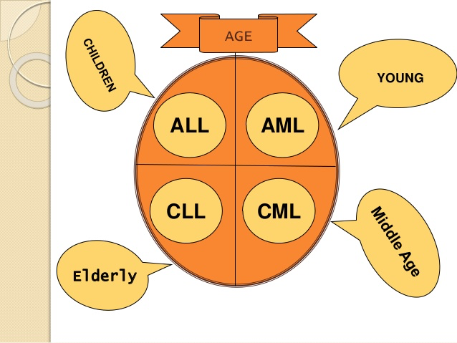

Slide 39
THANK YOU

