Slide 1
TISSUE REPAIR
Dr.V.Shanthi
Associate professor, Pathology
Sri Venkateswara Institute of Medical Sciences, Tirupathi

Slide 2
TISSUE REPAIR
Repair or healing – refers to the restoration of tissue architecture and function after an injury
Repair – term used for parenchymal and connective tissues
Healing – term is for surface epithelia

Slide 3
TISSUE REPAIR
The repair of damaged tissue is caused by two separate process-
Regeneration – growth of cells & tissues to replace lost structure e.g. regeneration after hepatectomy
Connective tissue deposition or scar formation – may restore original structure but involves collagen deposition & scar formation
Healing consists of regeneration or scar formation

Slide 4
TISSUE REPAIR
In parenchymal organs, the replacement of inflammatory infiltrates by granulation & ultimately fibrosis is called Organization
Regeneration requires an intact connective tissue scaffold
Healing with scar formation occurs if extracellular matrix framework is damaged, causing alterations of tissue architecture

Slide 5
Normal homeostasis
Regeneration
Healing
Renewing tissues
Stable cells
Wound
Chronic inflammation
Epidermis, GI tract epithelium, hematopoietic cells
Compensatry growth of liver and kidney
Wound healing and scar formation
Fibrosis

Slide 6
STEM CELLS
Stem cells are characterized by their prolonged self renewal capacity & by their asymmetric replication
There are two types of stem cells –
Embryonic stem cells
Adult stem cells

Slide 7
EMBRYONIC STEM CELLS
Embryonic stem cells can give rise to all the tissues of human body & are present in embryos
The pluripotency of Embryonic cells may be related to unique transcription factors such as Homeobox protein called Nanog & Wnt-B Catenin signaling
Embryonic stem cells may be used to repopulate damaged organs such as liver after hepatocyte necrosis & myocardium after infarction

Slide 8
ADULT STEM CELLS
ASC are reservoirs of stem cells in many tissues
ASC have a more restricted differentiation capacity & are usually lineage specific but stem cells with broad differentiation potential appear to exist in adult BM
Stem cells located outside the BM are referred as “Tissue stem cells”
Stem cells are located in sites called ‘niches’ which differ among various tissue

Slide 9
ADULT STEM CELLS
Hair follicle
Intestine
cornea
liver

Slide 10
GROWTH FACTORS
Growth factors are polypeptides
Growth factors stimulate –
Cell proliferation
Cell locomotion
Contractility
Differentiation
angiogenesis

Slide 11
GROWTH FACTORS
Growth factors involved in tissue regeneration & repair are –
Epidermal growth factors (EGF) & transforming growth factor alpha-
Hepatocyte growth factor
Vascular endothelial growth factor (VEGF )
Platelet derived growth factors (PDGF )
Fibroblast Growth factor
Transforming growth factor Beta & related growth factors

Slide 12
SIGNALLING MECHANISM IN CELL GROWTH

Slide 13
RECEPTORS & SIGNAL TRANSDUCTION PATHWAY
Types of receptors are –
Receptors with intrinsic tyrosine kinase activity
Receptors lacking intrinsic tyrosine kinase activity
Seven Transmembrane G protein coupled receptors
Steroid hormone receptors

Slide 14
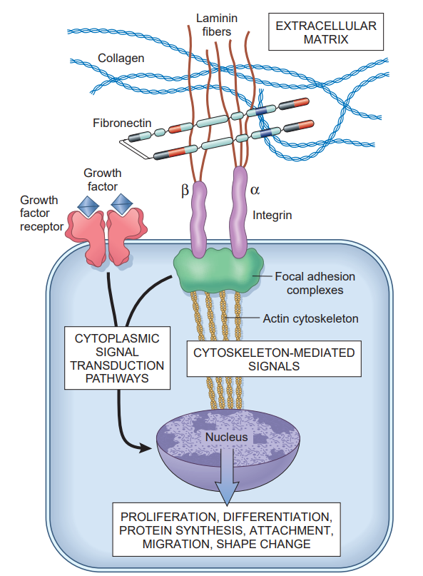
RECEPTORS & SIGNAL TRANSDUCTION PATHWAY
Ligand + receptor
Dimerisation or trimerisation of receptor molecules
Extracellular signals are transduced into the cells
Modulate changes in gene expression

Slide 15
EXTRACELLULAR MATRIX & CELL MATRIX INTERACTION
ECM is secreted locally & assembles into a network in the space surrounding cells
Functions of ECM are
Matrix protein sequester water that provides turgor to soft tissues & minerals that give rigidity to skeletal tissues
Reservoir for growth factors controlling cell proliferation
Important in cell to cell interactions & provides substratum for the cells to adhere , migrate, & proliferate, directly modulating cell form & function

Slide 16
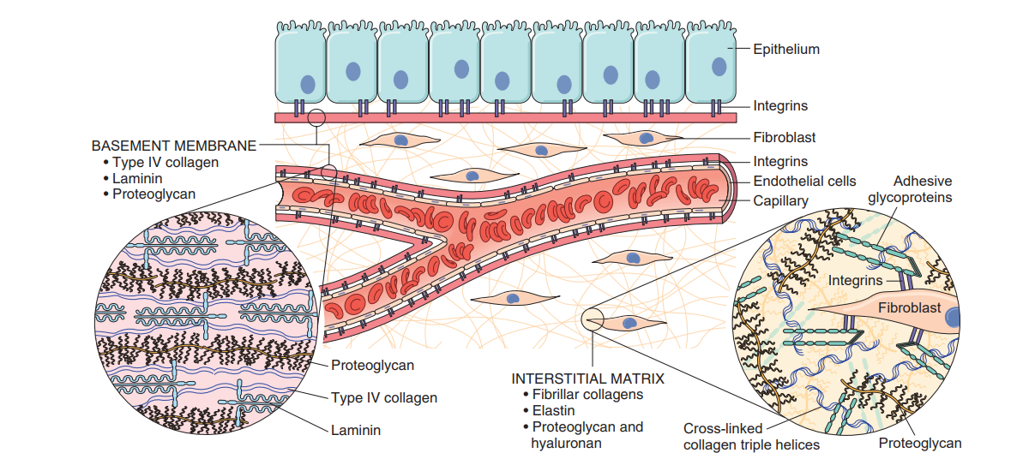
EXTRACELLULAR MATRIX

Slide 17
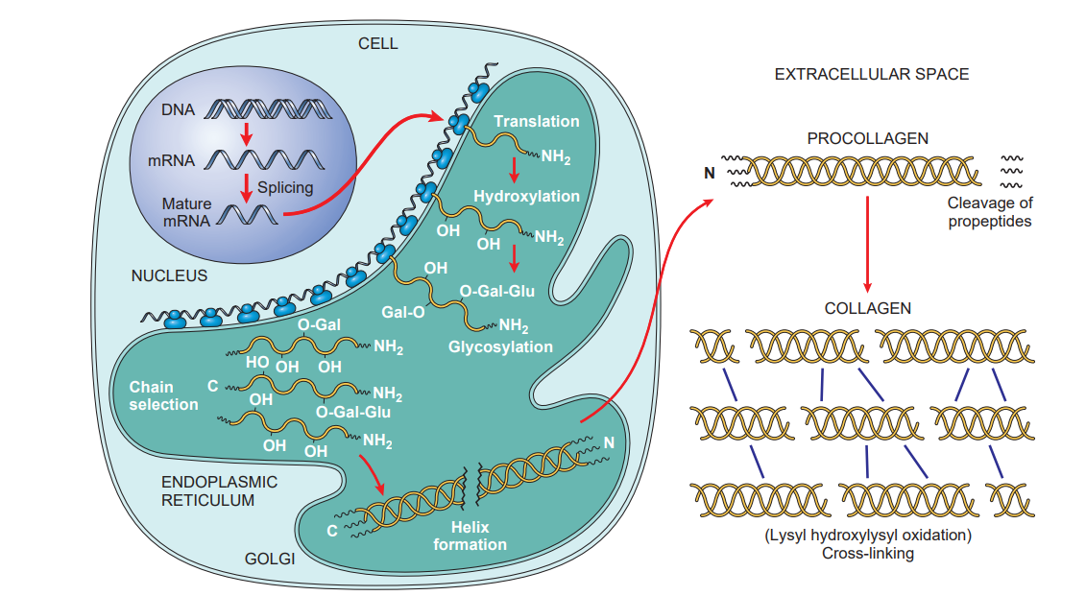
EXTRACELLULAR MATRIX

Slide 18
ELASTIN, FIBRILLIN & ELASTIC FIBRES
Elastic fibers provide the ability to the tissues to recoil
Elastic fibers consists of a central core made of elastin surrounded by a peripheral network of microfibrils containing fibrillin
Large amount of elastin is found in walls of large blood vessels, in uterus, skin, & ligaments
Inherited defects in fibrillin – Marfan syndrome

Slide 19
ANGIOGENESIS
Vasodilation in response to nitric oxide and increased permeability induced by vascular endothelial growth factor (VEGF)
Separation of pericytes from the abluminal surface and breakdown of the basement membrane to allow formation of a vessel sprout.
Migration of endothelial cells toward the area of tissue injury
Proliferation of endothelial cells just behind the leading front (“tip”) of migrating cells – Fibroblast growth factors (FGFs), mainly FGF-2
Remodeling into capillary tubes
Recruitment of periendothelial cells (pericytes for small capillaries and smooth muscle cells for larger vessels) to form the mature vessel
Suppression of endothelial proliferation and migration and deposition of the basement membrane

Slide 20
ANGIOGENESIS

Slide 21
ANGIOGENESIS
PDGF recruits smooth muscle cells

Slide 22
ANGIOGENESIS
TGF-β stabilizes the process, suppresses endothelial proliferation and migration and enhances the production of ECM proteins

Slide 23
HEALING OF SKIN WOUNDS
Based on the nature and size of the wound, the healing of skin wounds is said to occur by first or second intention
Healing by First Intention- when injury involves only the epithelial layer
Healing by second Intention - wounds causing large tissue deficits

Slide 24
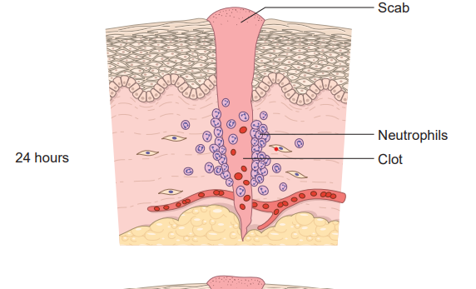
Healing by First Intention

Slide 25
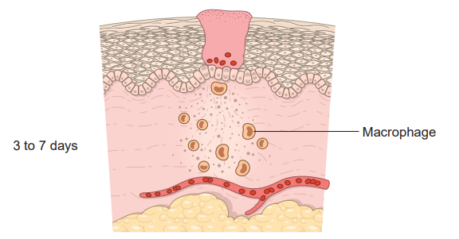
Healing by First Intention

Slide 26
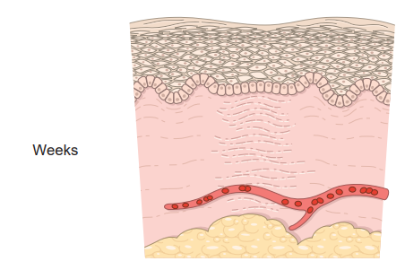
Healing by First Intention

Slide 27
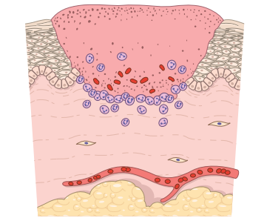
Healing by second Intention

Slide 28
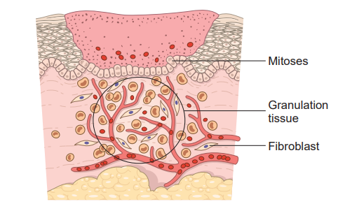
Healing by second Intention

Slide 29
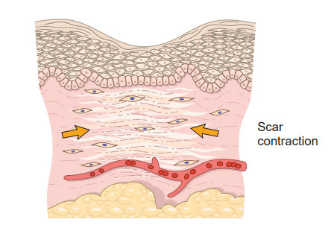
Healing by second Intention

Slide 30
EPIDERMAL REEPITHELIALISATION & EXTENSIVE GRANULATION TISSUE

Slide 31
WOUND CONTRACTION

Slide 32
Factors that influence the wound healing
Systemic factors
Nutrition –
Vitamin C deficiency inhibit collagen synthesis
Protein deficiency
Deficiency of trace elements like Copper and Zinc
Circulatory status – inadequate blood supply usually impairs wound healing
Metabolic status – Diabetes mellitus is associated with delayed wound healing because of microangiopathy
Hormones – such as Glucocorticoids inhibit collagen synthesis. Their administration may result in weakness of the scar due to inhibition of TGF-β production and diminishes fibrosis
Age – wound healing is delayed in old age when compared to young individuals

Slide 33
Factors that influence the wound healing
Local factors –
Infection – It prolongs inflammation and potentially increases the local tissue injury
Mechanical factors – early movements or increased local pressure or torsion may pull apart the wound
Foreign bodies – such as sutures or fragments of steel, glass or even bone can delay healing
Size & type of wound influence the healing - smaller wounds or surgical incisions may heal quickly than larger excisional wounds

Slide 34
Factors that influence the wound healing
Local factors –
Location of the injury and character of tissue is important
Wound on the skin covering the bone may heal slowly as little intervening tissue prevents wound contraction
In tissues like pleural or peritoneal or synovial cavities, inflammation develops extensive exudates which is later resorbed and fibrosis occurs
In absence of necrosis normal tissue architecture is restored

Slide 35
COMPLICATONS OF WOUND HEALING
Complications of wound healing are –
Deficient scar formation
Excessive formation of the repair components
Formation of contracture

Slide 36
KELOID

Slide 37
KELOID

Slide 38
Persistent stimulus (chronic inflammation)
Activation of macrophages and lymphocytes
Growth factors
PDGF, FGF, TGF-β
Cytokines
TNF, IL-1, IL-4, IL-13
Decreased metalloproteinase activity
Proliferation of fibroblasts and endothelial cells
Increased collagen synthesis
Decreased collagen synthesis
FIBROSIS

