Slide 1
CHRONIC INFLAMMATION
Dr.V.Shanthi
Associate professor, Pathology
Sri Venkateswara Institute of Medical Sciences, Tirupathi

Slide 2
CHRONIC INFLAMMATION
Characterized by inflammation of prolonged duration in which active inflammation, tissue destruction & attempts at repair are proceeding simultaneously
e.g. Rheumatoid arthritis, Atherosclerosis, Tuberculosis, Chronic lung disease
Occurs after acute inflammation or begins insidiously as smoldering response with out prior acute inflammation

Slide 3
CHRONIC INFLAMMATION
Causes of chronic inflammation
Persistent infections – e.g. Tubercle bacilli, viral inf. , fungi & parasitic inf. etc.
Prolonged exposure to potentially toxic agents either exogenous or endogenous
E.g. Exogenous agent – silica
Endogenous agent – toxic lipid content chronic inflammatory process Atherosclerosis
Autoimmunity – Rheumatoid arthritis, Lupus erythematosis
Autoantigens immune reactions tissue damage & inflammation

Slide 4
CHRONIC INFLAMMATION
Morphological features
Infiltration of mononuclear cells like macrophages, plasma cells & lymphocytes
Tissue destruction induced by persistent offending agent or by the inflammatory cells
Healing by connective tissue replacement of damaged tissue accomplished by angiogenesis & fibrosis

Slide 5
Chronic inflammation
Acute inflammation

Slide 6
CHRONIC INFLAMMATION Role of macrophages

Slide 7
CHRONIC INFLAMMATION Role of macrophages
In specific organ they are named specifically –
Liver – Kupffer cells
Spleen and lymphnodes – sinus histiocytes
CNS - microglial cells
Lungs – alveolar macrophages
These cells comprise mononuclear phagocyte system called reticuloendothelial system
Half life of blood monocyte is – 1 day
Life span of tissue macrophages – several months or years

Slide 8
CHRONIC INFLAMMATION Role of macrophages
Functions of macrophages
Macrophages are activated by two pathways
Classical pathway for macrophage activation
Alternative pathway for macrophage activation
Response to injurious stimuli is first activation of classical pathway and then alternative macrophage activation

Slide 9
CHRONIC INFLAMMATION Classical macrophage activation
Induced by microbial products like endotoxin
TLRs on T cells
IFN - γ
Activates macrophages
Produce NO, ROS, and lysosomal enzymes
Cytokines IL-1, IL-12, IL-23, chemokines
Destroys the microbes and phagocytosis
inflammation

Slide 10
CHRONIC INFLAMMATION Alternative macrophage activation
Induced by IL-4 and IL-13 produced by T cells
Activates macrophages
Growth factors TGF-β
IL-10, TGF-β
Tissue repair, fibrosis
Anti-inflammatory effect
Once the microbe is removed macrophages disappear either by undergoing apoptosis or making their way into lymphatics

Slide 11
CHRONIC INFLAMMATION Role of lymphatics
Role of Lymphocytes
Microbes and other environmental antigens activate T and B lymphocytes, which amplify and propagate chronic inflammation
Activation of these cells leads to the generation of long-lived memory cells which leads to persistent infection and also granulomatous inflammation

Slide 12
CHRONIC INFLAMMATION
3 subsets of CD4+ T cells that secrete different types of cytokines and elicit different types of inflammation are
CD4+ T cells
Th1 cells
Th2 cells
Th17 cells
IL-17 and other cytokines
IFN-γ
IL-4, IL-5, IL-13
Activates macrophages by classical pathway
Activates macrophages by alternate pathway and recruit eosinophils
Induce the secretion of chemokines responsible for recruiting neutrophils
Defense against bacteria and viruses
Defense against helminthic parasites
Defense against bacteria and viruses

Slide 13
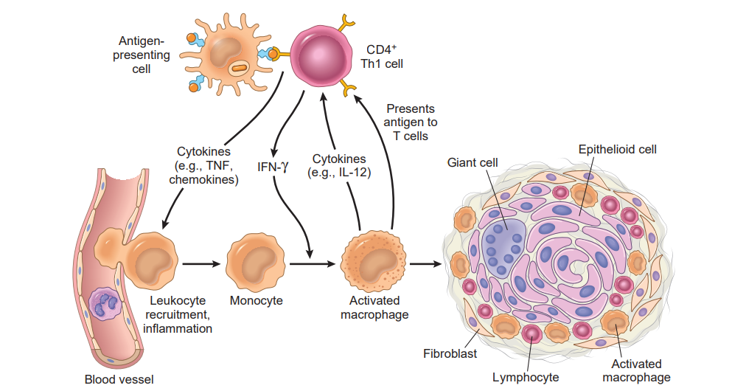
CHRONIC INFLAMMATION Macrophage–lymphocyte interactions in chronic inflammation
Prolonged reactions involving T cells and macrophages may result in granuloma formation

Slide 14
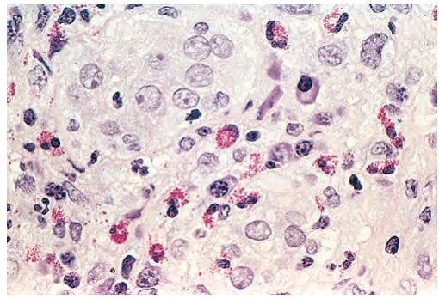
CHRONIC INFLAMMATION
Other inflammatory cells are –
Eosinophils –
abundant in immune reactions mediated by IgE and in parasitic infections
Their recruitment is driven by adhesion molecules called Eotaxin
have granules that contain major basic protein, a highly cationic protein that is toxic to helminths

Slide 15
CHRONIC INFLAMMATION
Mast cells
Participate in both acute and chronic inflammatory reactions
Express on their surface the receptor (FcεRI) that binds the Fc portion of IgE antibody
Degranulation occurs during allergic reactions to foods, insect venom, or drugs, sometimes with catastrophic results (e.g., anaphylactic shock)
Neutrophils –
Induced either by persistent microbes or by mediators produced by activated macrophages and T lymphocytes

Slide 16
GRANULOMATOUS INFLAMMATION
Definition – Distinctive pattern of chronic inflammatory reactions characterized by focal accumulation of macrophages that often develop an epithelial like appearance (epithelioid cells) surrounded by a collar of mononuclear leukocytes mainly lymphocytes & plasma cells
Disease | Types of granuloma
Tuberculosis | Caseating granuloma
Leprosy | Non-caseating granuloma
Syphilis | Necrotizing granuloma
Sarcoidosis | Non caseating granuloma
Crohns disease | Non-caseating granulomas

Slide 17
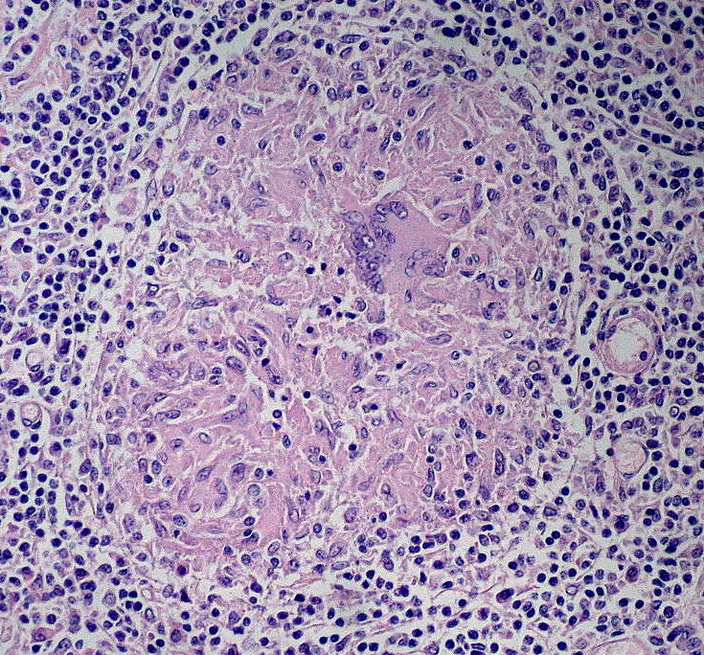
GRANULOMATOUS INFLAMMATION
Histologically
Epithelioid cells having pale pink granular cytoplasm with indistinct cell boundaries often appearing to merge into another. Nucleus – oval or elongated & may show folding of nuclear membrane
Epithelioid cells fuse to form giant cells
Older granulomas – rim of fibroblasts of connective tissue

Slide 18
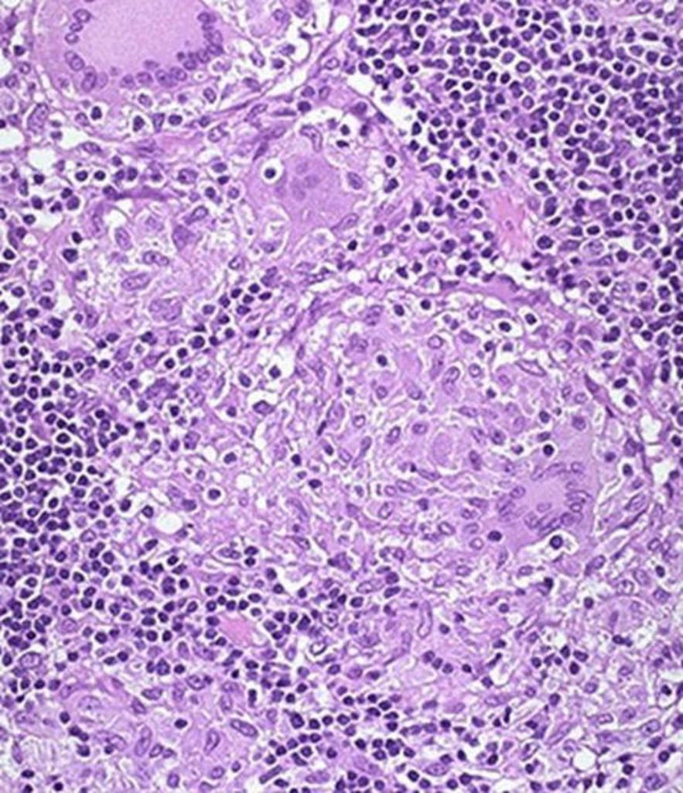
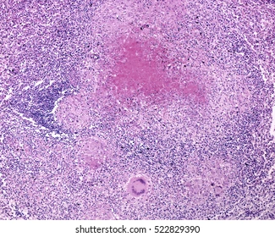
Non-caseating granuloma Caseating granuloma

Slide 19
CHRONIC INFLAMMATION
Foreign body granulomas are incited by inert foreign bodies, which induce inflammation in the absence of T cell– mediated immune responses
Occurs due to Talc suture or other fibers which are large enough to preclude phagocytosis by a single macrophage
Immune granulomas are caused by a variety of agents that are capable of inducing a persistent T cell–mediated immune response
Inciting agent is difficult to eradicate, such as a persistent microbe
In such responses, activated Th1 cells produce cytokines such as IFN-γ, which activates macrophages

Slide 20
SYSTEMIC EFFECTS OF INFLAMMATION
Acute phase response
Systemic changes associated with inflammation especially in patients who have infections
This is because of reactions to cytokines , whose production is stimulated by bacterial products such as Lipopolysaccharides & other inflammatory stimuli

Slide 21
SYSTEMIC EFFECTS OF INFLAMMATION Acute phase response
FEVER
Bacterial products like LPS
(exogenous pyrogens)
Leucocytes release cytokine IL-1 & TNF
(endogenous pyrogens)
Increase in enzyme Cyclooxygenase

Slide 22
SYSTEMIC EFFECTS OF INFLAMMATION Acute phase response
FEVER
Cyclooxygenase
Arachidonic acid Prostaglandin(PGE2)
in Hypothalamus
Production of neurotransmitters like cyclic AMP
Reset the temperature set point at higher level

Slide 23
SYSTEMIC EFFECTS OF INFLAMMATION
ACUTE PHASE PROTEINS
These are plasma proteins produced by liver
Increased in inflammation – 100 folds
The best known examples are-
C-Reactive protein
Fibrinogen
Serum Amyloid A Protein
Cytokines Hepatocyte
CRP & Fibrinogen
IL-6
IL-1,TNF
SAA

Slide 24
SYSTEMIC EFFECTS OF INFLAMMATION ACUTE PHASE PROTEINS
CRP & SAA bind to microbial cell wall & acts as Opsonins. They bind chromatin & helps in clearing of necrotic cell nuclei
SAA replaces Apolipoprotein A, a component of HDL & may alter the targeting of HDL from liver cells to macrophages, which can utilize these particles as a source of energy producing lipids
Fibrinogen causes RBC to form rouleaux that increase ESR

Slide 25
SYSTEMIC EFFECTS OF INFLAMMATION Acute phase response
LEUKOCYTOSIS
Cytokines like IL-1 & TNF
accelerate the release of cells from bone marrow at post mitotic level
Leukocytosis

Slide 26
SYSTEMIC EFFECTS OF INFLAMMATION
Severe bacterial infection ( sepsis )
Increased amounts of organisms & LPS in blood
Increased production of cytokines like TNF & IL-1
Induces tissue factor inhibits TFPI &
Expression on EC EC thrombomodulation
DIC

Slide 27
SYSTEMIC EFFECTS OF INFLAMMATION
Cytokine Liver injury failure to maintain normal blood glucose due to lack of gluconeogenesis
Cytokine activated cardiac myocyte & vascular smooth muscle cells produce NO loss of perfusion pressure & heart failure
Hemodynamic shock
DIC + Hypoglycemia + cardiovascular failure
septic shock

Slide 28
THANK YOU

