Slide 1
CHEMICAL MEDIATORS OF INFLAMMATION - 2
Dr.V.Shanthi
Associate professor, Pathology
Sri Venkateswara Institute of Medical Sciences, Tirupathi

Slide 2
CHEMICAL MEDIATORS
Cell membrane phospholipids
Phospholipases
Dietary sources
Arachidonic acid
(20-carbon polyunsaturated fatty acid)
Precursor molecule- Linoleic acid
Cyclooxygenase
Lipooxygenase
Eicosanoids
Eicosanoids + G-protein coupled receptors on various cell types – mediate steps of inflammation

Slide 3
CHEMICAL MEDIATORS

Slide 4
Arachidonic acid
Cyclooxygenase
Prostaglandins G2 (PGG2)
Prostaglandins H2 (PGH2)
Prostacyclin PGI2
Thrombaxane TXA2
PGD2 and PGE2
Source – vascular endothelium
Source – platelets as they contain Thrombaxane synthetase

Slide 5
Arachidonic acid
5-Lipooxygenase
12- LIPOXYGENASE
5-HPETE
5-HETE
5-Hydroperoxyeicosatetraenoic acid
5-Hydroxyeicosatetraenoic acid
CHEMOTAXIS
Lipoxin A4 (LXA4)
Lipoxin B4 (LXB4)
Leukotriene A4
Leukotriene B4
SUPPRESS INFLAMMATION
Leukotriene C4
Inhibit neutrophil adhesion and chemotaxis
Inhibit the action of leukotrienes
Leukotriene D4
Leukotriene E4
Require two cell types for transcellular biosynthesis
Leukotriene – source – mast cells and leukocytes

Slide 6
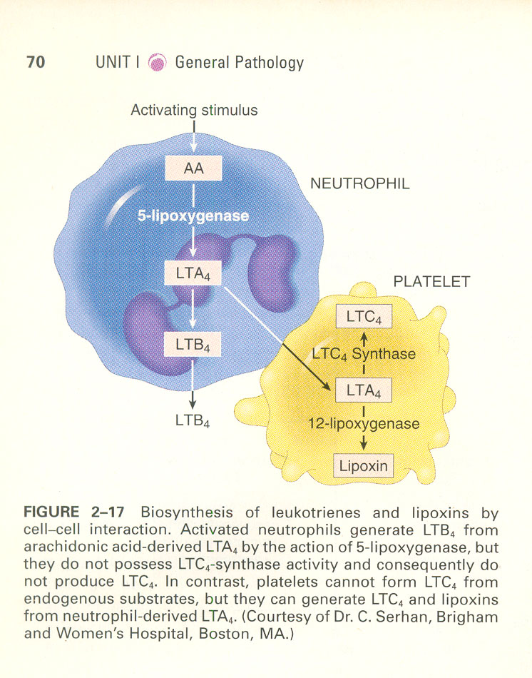
CHEMICAL MEDIATORS Biosynthesis of Leukotrienes & Lipoxins

Slide 7
CHEMICAL MEDIATORS
Anti inflammatory therapy can be directed at many targets along the Eicosanoids biosynthetic pathway
Cyclooxygenase inhibitors – (COX 1, COX 2) e.g. NSAIDS like Indomethacin inhibit Prostaglandin synthesis by irreversibly acetylating & inhibiting Cyclooxygenase
Lipoxygenase pathway inhibitors – used in treatment of Asthma
Broad spectrum inhibitors – e.g. Glucocorticoids. They act by down regulating the expression of genes like genes encoding for COX2, Phospholipase A2, NO synthetase e.t.c. They also up regulate the genes encoding for anti-inflammatory proteins like Lipocortin-1

Slide 8
CHEMICAL MEDIATORS PLATELET ACTIVATING FACTORS
PAF is bioactive phospholipid derived mediators
Sources – Neutrophils, Platelets, Basophils, Mast cells, Endothelial cells
Functions –
Platelet stimulation
Vasoconstriction ( in low conc. It induces vasodilatation & increased venular permeability)
Increased leukocyte adhesion to endothelium
Chemotaxis
Degranulation
Increased synthesis of other mediators by leukocytes & other cells

Slide 9
CHEMICAL MEDIATORS CYTOKINES & CHEMOKINES
Cytokines are proteins produced by many cell types principally
Activated Lymphocytes
Macrophages
Endothelium
Epithelial cells
Dendritic cells
Connective tissue cells

Slide 10
CHEMICAL MEDIATORS CYTOKINES & CHEMOKINES
Cytokines involved in acute inflammation are TNF, IL-1, IL-6, chemokines, IL-17
TUMOR NECROSIS FACTOR & INTERLEUKIN-1
Source - produced mainly by activated macrophages
Secretion of TNF & IL-1 is stimulated by – endotoxins, microbial products, immune complexes, physical injury, foreign bodies
Functions –
Effects on Endothelium, leucocytes, & fibroblast
Induction of systemic & acute phase reactants

Slide 11
CHEMICAL MEDIATORS TUMOR NECROSIS FACTOR & IL-1
ENDOTHELIAL EFFECTS
Increased synthesis of endothelial adhesion molecules & chemical mediators like cytokines, chemokines, growth factors, eicosanoids & NO
Production of enzymes associated with matrix remodeling
Increase in the surface thrombogenecity of the endothelium
Increased procoagulant activity
Decrease in anticoagulant activity

Slide 12
CHEMICAL MEDIATORS TUMOR NECROSIS FACTOR & IL-1
EFFECTS ON FIBROBLAST
Increased proliferation
Increased collagen synthesis
Increased collagenase
Increased protease
Increased PGE synthesis

Slide 13
CHEMICAL MEDIATORS TUMOR NECROSIS FACTOR & IL-1
LEUKOCYTE EFFECT
Increased response of neutrophils to stimuli like – bacteria and toxins
Stimulates microbicidal effect of macrophages by inducing increased production of NO
Increased cytokine secretion ( IL-1, IL-6 )

Slide 14
CHEMICAL MEDIATORS TUMOR NECROSIS FACTOR & IL-1
IL-1 & TNF induces systemic acute phase response which include-
Fever
Loss of appetite
Release of Neutrophils into circulation
Hemodynamic effects like hypotension, decreased vascular resistance, increased heart rate
Regulates body mass by regulating lipid & protein mobilization & by suppressing appetite

Slide 15
CHEMICAL MEDIATORS CHEMOKINES
Chemokines are a family of small proteins that act primarily as chemoattractant for specific type of leukocytes
They are classified into 4 major groups based on the arrangement of conserved cysteine residues in the mature proteins
C-X-C chemokines (Alpha chemokine)
C-C chemokines ( Beta chemokines)
C chemokines ( Gamma chemokines)
CX₃C chemokines

Slide 16
CHEMICAL MEDIATORS CHEMOKINES
C-X-C chemokines (Alpha chemokine)
Have one amino acid separating first two of the four conserved cysteine residues
Eg – IL-8
Source – activated macrophages, endothelial cells and also other cells
Action – activation and chemotaxis of neutrophils

Slide 17
CHEMICAL MEDIATORS CHEMOKINES
C-C chemokines (Beta chemokine)
Has first two conserved cysteine residues
Eg – Monocyte chemoattractant protein (MCP-1), Eotaxin (CCL11), Macrophage inflammatory protein 1α (MIP-1α, CCL -3)
Action – attractants monocytes, eosinophils, basophils and lymphocytes (less potent neutrophils)

Slide 18
CHEMICAL MEDIATORS CHEMOKINES
C chemokines
Lack first and third of four conserved cysteine residues
Eg – Lymphotactin, XCL1
Action – chemo attractants of lymphocytes

Slide 19
CHEMICAL MEDIATORS CHEMOKINES
CX₃C chemokines (Beta chemokine)
Contain 3 amino acids in between two cysteine residues
Eg – Fractalkine (CX₃CL1)
Action – attractants for monocytes, T lymphocytes and promotes strong adhesion of monocytes and T lymphocytes to endothelial cells.

Slide 20
CHEMICAL MEDIATORS CHEMOKINES
Chemokines are displayed attached to proteoglycans on the surface endothelial cells
Two main functions are
Stimulates leukocyte attachment to the endothelium by increasing affinity of integrins
Maintenance of tissue architecture by organizing various cell types in different anatomic regions of the tissues, such as T and B cells in discrete areas in spleen and lymphnodes

Slide 21
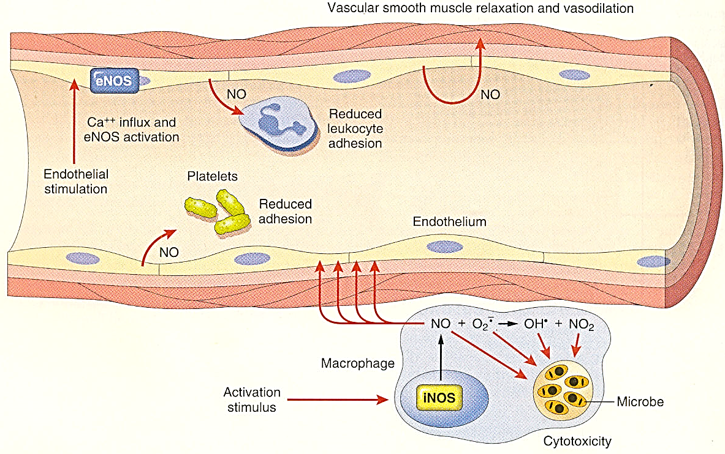
CHEMICAL MEDIATORS NITRIC OXIDE

Slide 22
CHEMICAL MEDIATOR LYSOSOMAL CONSTITUENTS OF LEUKOCYTES
Neutrophils & monocytes contain granules that produce inflammatory response
Neutrophils contain 2 main types of granules-
Small specific granules
Large Azurophilic granules

Slide 23
CHEMICAL MEDIATOR LYSOSOMAL CONSTITUENTS OF LEUKOCYTES
Smaller specific granules contain
Collagenase
Gelatinase
Lactoferrin
Plasminogen activator
Histaminase
Alkaline phosphatase
Phospholipase A2

Slide 24
CHEMICAL MEDIATOR LYSOSOMAL CONSTITUENTS OF LEUKOCYTES
Large Azurophilic granules contain
Myeloperoxidase
Bactericidal factors (lysozyme, defensins)
Acid hydrolases
Variety of neutral proteases (Elastases, Cathepsin G, Non- specific collagenase, proteinase – 3 )
Phospholipase A2
Bacterial permeability increasing protein(BPI)

Slide 25
CHEMICAL MEDIATOR OTHER MEDIATORS
Hypoxia induced factor 1 alpha
Uric acid which is break down product of DNA in necrotic cells

Slide 26
CHEMICAL MEDIATOR OF INFLAMMATION
SUMMARY
CELL DERIVED
PLASMA DERIVED
Secreted newly
Preformed granules
Complement system
Arachidonic acid metabolites
Prostaglandins
Leukotrienes
Lipoxins
Histamine
Serotonin
Lysosomal enzymes
C3a, C3b, C5a, C5b
Kinin system
Bradykinin
Plasmin
Clotting cascade
Thrombin

Slide 27
THANK YOU

