Slide 1
AMYLOIDOSIS

Slide 2
AMYLOIDOSIS
Amyloidosis is a heterogeneous acquired or hereditary disease that results from the predominantly extracellular deposition of abnormal fibrillar protein in various tissues causing damage and functional compromise
Amyloid is deposited predominantly in the extracellular space in various tissue and organs
With progressive accumulation, it encroaches on and produces pressure atrophy of adjacent cells

Slide 3
AMYLOIDOSIS
Fibrillar protein binds to a variety of proteoglycans and glycosaminoglycans including heparan sulfate and dermatan sulfate and plasma proteins notably serum amyloid P
Presence of abundant charged sugar groups in these adsorbed proteins give the deposits staining characteristics that were thought to resemble starch
Hence named as amyloid. Derived from Greek word “Amylon” and “Amylum” in latin – which means cellulose or starch like

Slide 4
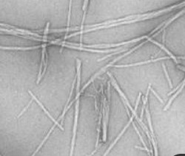
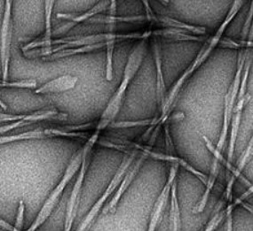
AMYLOIDOSIS PHYSICAL NATURE OF AMYLOID
Electron microscopy - irrespective of type of amyloid, fibrils consist of continuous, non-branching fibrils with a diameter of approximately 7.5 to 10nm

Slide 5
AMYLOIDOSIS PHYSICAL NATURE OF AMYLOID
X-ray crystallography and infrared spectroscopy demonstrates a characteristic cross-β pleated sheet conformation

Slide 6
AMYLOIDOSIS PHYSICAL NATURE OF AMYLOID
cross-β pleated sheet conformation is responsible for this distinctive congo red staining and birefringence of amyloid

Slide 7
AMYLOIDOSIS
Properties of amyloid
Amyloid is not a single chemical entity but contains 20 different proteins which aggregate to form amyloid
There are 3 major and several minor biochemical forms
3 Major proteins are
Amyloid light chain (AL)
Amyloid associated (AA) protein
Β-amyloid (Aβ) protein
Minor subtypes are
Transthyretin (TTR)
β 2 macroglobulin
Calcitonin
Islet amyloid peptide
Atrial natriuretic factor

Slide 8
AMYLOIDOSIS BIOCHEMICAL NATURE OF AMYLOID
Amyloid light chain
made up of complete immunoglobulin light chain, amino terminal fragment of light chain or both
Most of the AL protein analyzed are composed of λ light chains or their fragments
AL protein deposition is seen mostly in plasma cells tumors

Slide 9
AMYLOIDOSIS BIOCHEMICAL NATURE OF AMYLOID
Amyloid associated (AA) protein
Derived from unique non-Ig protein made by liver
It is produced by proteolysis of a larger precursor protein called SAA (Serum Amyloid Associated) protein, synthesized in liver and circulates in the blood bound to high density lipoproteins
Produced as acute phase protein in chronic inflammation

Slide 10
AMYLOIDOSIS BIOCHEMICAL NATURE OF AMYLOID
β - Amyloid (A β) protein
it s derived by proteolysis of much larger transmembrane glycoprotein called amyloid precursor protein
It constitutes the core of cerebral plaques found in Alzheimers disease as well as amyloid is deposited in walls of cerebral blood vessels

Slide 11
AMYLOIDOSIS BIOCHEMICAL NATURE OF AMYLOID
Other minor forms
Transthyretin (TTR)
It is normal protein that binds and transports thyroxine and retinol
Two forms are deposited
Unmutated TTR is deposited as amyloid in heart of aged individuals – senile systemic amyloidosis
Mutant forms of TTR and its fragments form amyloid and are deposited in genetically determined disorder referred to as “amyloid polyneuropathies”

Slide 12
AMYLOIDOSIS BIOCHEMICAL NATURE OF AMYLOID
β 2 macroglobulin
It is a component of MHC class I molecule
This form of Amyloid β₂ macroglobulin is deposited in and around the joints or soft tissues of patients on long term dialysis

Slide 13
AMYLOIDOSIS BIOCHEMICAL NATURE OF AMYLOID
Other rare forms include
Serum Amyloid P component
Apo-lipoprotein – E
Sulfated glycosaminoglycans
Calcitonin
Islet amyloid peptide
Atrial natriuretic factor

Slide 14
Plasma cell tumors
AL amyloid
Abnormal and excess production of normal proteins which aggregate leading to amyloidosis
Chronic inflammation
AA amyloid
MHC class I
Amyloid β₂ microglobulin
PATHOGENESIS
Normal TTR
Amyloid transthyretin
Normal protein which is abnormally metabolized
Transmembrane glycoprotein in neurons and astrocytes
β - Amyloid (A β) protein
Production of mutant proteins in normal amounts which cannot be degraded and aggregate
Amyloid transthyretin
Mutated TTR

Slide 15
CLASSIFICATION OF AMYLOIDOSIS
Clinicopathologic category | Associated diseases | Precursor protein | Major fibril protein
SYSTEMIC (GENERALIZED) AMYLOIDOSIS
Primary amyloidosis (Ig light chain amyloidosis) | Plasma cell tumors | Ig light chains, chiefly λ type | AL
Secondary amyloidosis (Reactive systemic amyloidosis) | Chronic inflammatory conditions | Serum Amyloid Associated protein (SAA) | AA
Hemodialysis – associated amyloidosis | Chronic renal failure | β ₂ microglobulin | Aβ ₂ M
HEREDITARY AMYLOIDOSIS
Familial Mediterranean fever |  | SAA | AA
Familial amyloidotic neuropathies |  | Transthyretin | ATTR
Systemic senile amyloidosis |  | Transthyretin | ATTR
LOCALIZED AMYLOIDOSIS
Senile cerebral | Alzheimer disease | Amyloid Precursor protein (APP) | Aβ
Endocrine Medullary carcinoma thyroid Islets of Langerhans | Type 2 diabetes | Calcitonin Islet amyloid peptide | A Cal AIAPP
Isolated atrial amyloidosis |  | Atrial natriuretic factor | AANF

Slide 16
AMYLOIDOSIS MORPHOLOGY
ORGANS INVOLBED IN DIFFERENT TYPES OF AMYLOIDOSIS
Hereditary amyloidosis
Primary amyloidosis
In Plasma cell proliferations
Commonly involved organs (can involve any organ like in secondary amyloidosis)
Heart
Gastrointestinal tract
Respiratory tract
Peripheral nerves
Skin
Tongue
Familial Mediterranean fever
Systemic senile amyloidosis
Secondary amyloidosis
Kidneys
Blood vessels
Spleen
Respiratory tract
Liver (rarely)
Heart most common but all the organs can be involved
Secondary to chronic inflammatory disorders
Kidneys
Liver
Spleen
lymph nodes
Adrenals
Thyroid
Many other tissues are also involved
Familial amyloidotic neuropathies
Peripheral nerves
Autonomic nerves system

Slide 17
AMYLOIDOSIS MORPHOLOGY
Gross
Macroscopically amyloid may or may not be seen
When it accumulates in larger amounts organ is enlarged and the tissue appears gray with a waxy, firm consistency
Histologically
Amyloid deposition is extracellular and begins between cells, often closely adjacent to basement membranes
As the amyloid accumulates, it encroaches on the cells, in time surrounding and destroying them
In the form associated with plasma cell proliferation, perivascular and vascular deposits are common

Slide 18
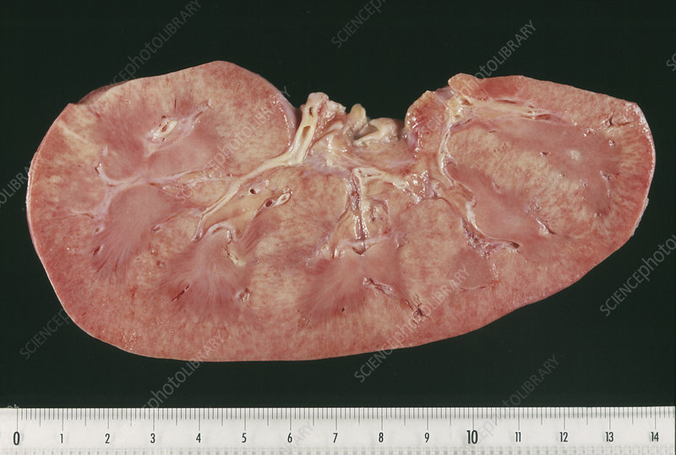
AMYLOIDOSIS KIDNEY
Most common involved in amyloidosis
Gross-
Kidneys may be of normal size and color
In advanced cases, they may be shrunken due to ischemia caused by vascular narrowing induced by the deposition of amyloid within arterial and arteriolar walls

Slide 19
AMYLOIDOSIS KIDNEY
Histologically
Amyloid is deposited primarily in the glomeruli
Glomerular deposits first appear as subtle thickenings of the mesangial matrix, accompanied usually by uneven widening of the basement membranes of the glomerular capillaries.
mesangial depositions and the deposits along the basement membranes cause capillary narrowing and distortion of the glomerular vascular tuft
With progression of the glomerular amyloidosis, the capillary lumens are obliterated, and the obsolescent glomerulus is flooded by confluent masses or interlacing broad ribbons of amyloid
Interstitial peritubular tissue, arteries, and arterioles are also affected

Slide 20
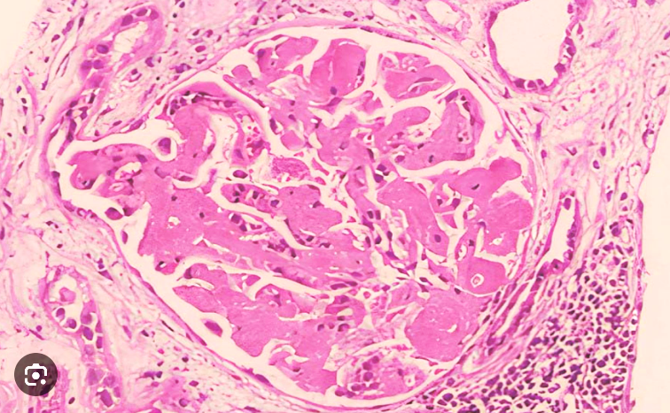
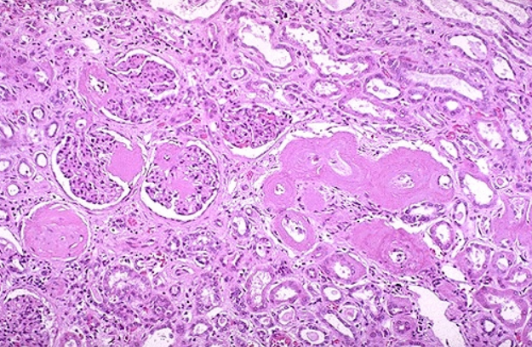
AMYLOIDOSIS KIDNEY

Slide 21
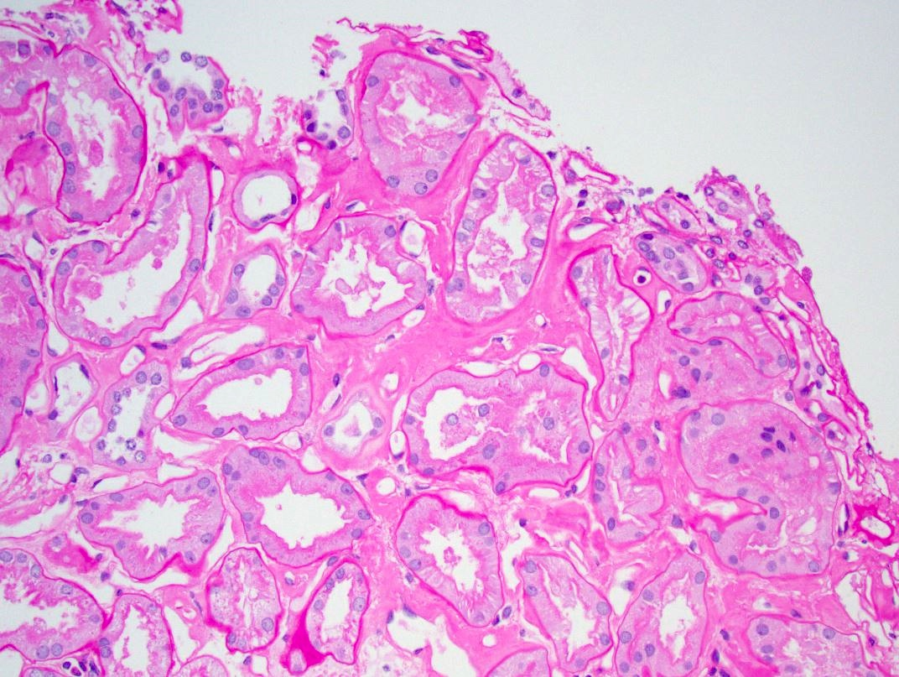
AMYLOIDOSIS KIDNEY

Slide 22
AMYLOIDOSIS SPLEEN
Gross - inapparent or may cause moderate to marked splenomegaly (up to 800 g)
Histologically – two patterns
Sago spleen - deposits are largely limited to the splenic follicles, producing tapioca-like granules on gross inspection, designated sago spleen
Lardaceous spleen -
Amyloid involves the walls of the splenic sinuses and connective tissue framework in the red pulp
Fusion of the early deposits gives rise to large, maplike areas of amyloidosis, creating what has been designated lardaceous spleen

Slide 23
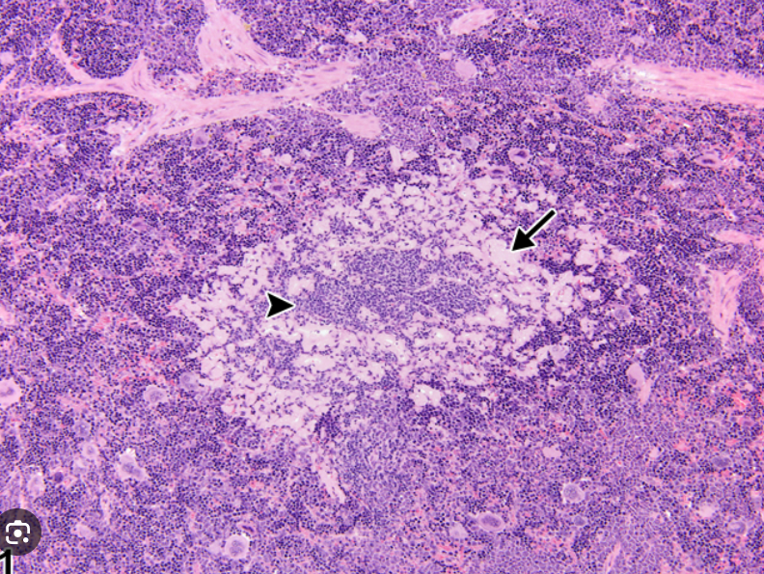
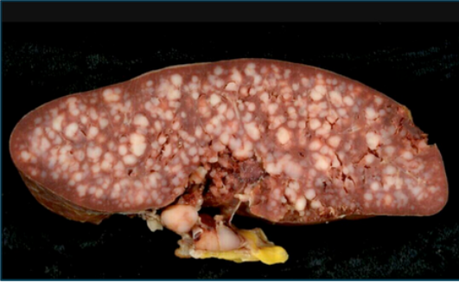
AMYLOIDOSIS SAGOSPLEEN

Slide 24
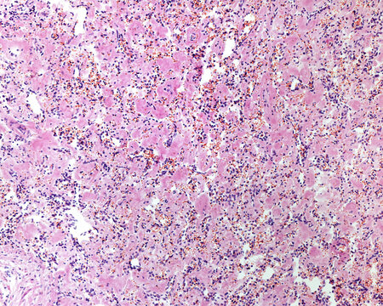
AMYLOIDOSIS LARDACEOUS SPLEEN

Slide 25
AMYLOIDOSIS LIVER
Gross - inapparent or may cause moderate to marked hepatomegaly
Microscopy - Amyloid appears first in the space of Disse and then progressively encroaches on adjacent hepatic parenchymal cells and sinusoids
Pressure atrophy, and disappearance of hepatocytes occur causing total replacement of large areas of liver parenchyma
Vascular involvement is common
Even with extensive involvement, liver function is usually preserved

Slide 26
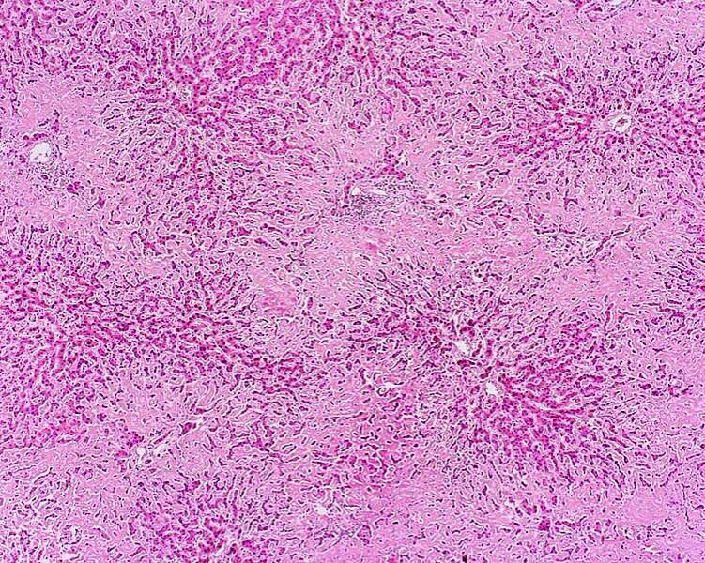
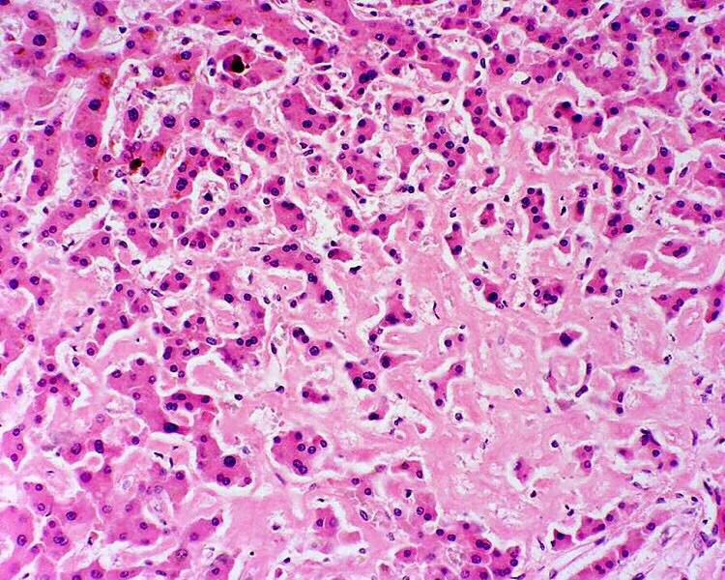
AMYLOIDOSIS LIVER

Slide 27
AMYLOIDOSIS HEART
Major organ involved in senile systemic amyloidosis
Gross - heart may be enlarged and firm or may not show significant changes
Microscopy –
Deposits begin as focal subendocardial accumulations and within the myocardium between the muscle fibers
Myocardial deposits eventually causes pressure atrophy of myocardial fibers
Amyloid deposits in subendocardium causes damage to the conduction system, accounting for the electrocardiographic abnormalities

Slide 28
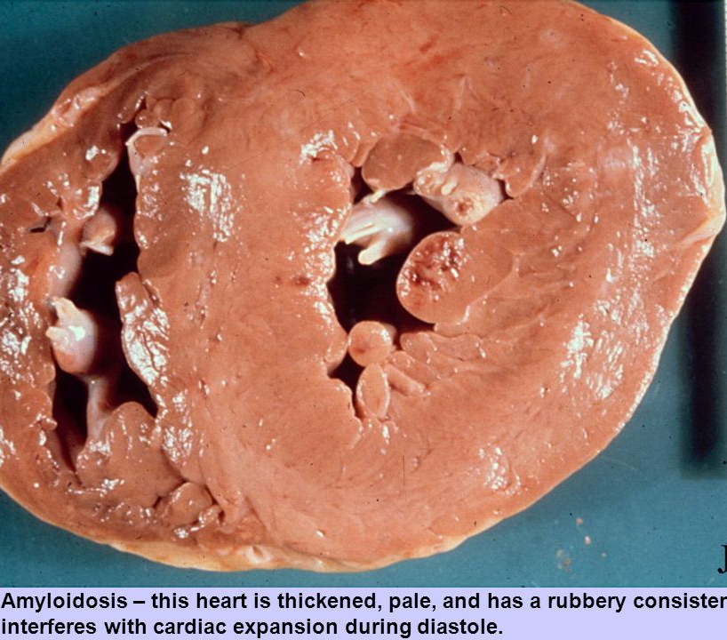
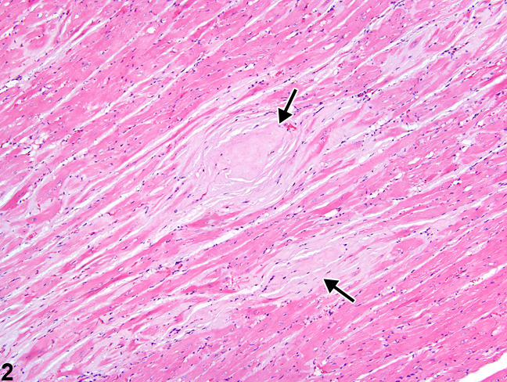
AMYLOIDOSIS HEART

Slide 29
AMYLOIDOSIS SPECIAL STAINS
Special stains for diagnosis of amyloidosis
Congo Red – red pink in color on light microscopy and apple green birefringence on polarized microscopy
Methyl and cresyl violet – pink color
Thioflavin T and S – exhibits fluorescence
Alcian blue – stains blue to the presence of glycosaminoglycans
Periodic Acid Schiff (PAS) – pink
Immunohistochemistry – used for distinguishing AA, AL, ATTR

Slide 30
AMYLOIDOSIS CLINICAL FEATURES
symptoms depend on the amount of the amyloid deposited in the different sites or organs affected
Specific symptoms appear depending on the organ involved
Kidney –
Proteinuria that may be severe enough to cause the nephrotic syndrome
Progressive obliteration of glomeruli in advanced cases ultimately leads to renal failure and uremia
Renal failure is a common cause of death

Slide 31
AMYLOIDOSIS CLINICAL FEATURES
Heart –
Cardiac amyloidosis may present as an
Insidious congestive heart failure.
Conduction disturbances and arrhythmias, which may prove fatal
Occasionally produces a restrictive pattern of cardiomyopathy and masquerades as chronic constrictive pericarditis

Slide 32
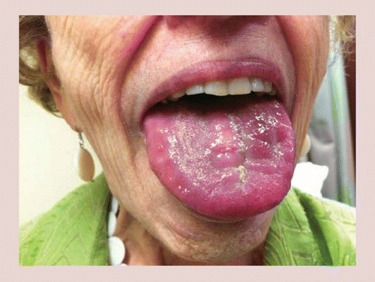
AMYLOIDOSIS CLINICAL FEATURES
Gastrointestinal tract
GIT amyloidosis may be entirely asymptomatic or it may present in a variety of ways
Amyloidosis of the tongue may cause sufficient enlargement and inelasticity to hamper speech and swallowing
Depositions in the stomach and intestine may lead to malabsorption, diarrhea, and disturbances in digestion

Slide 33
AMYLOIDOSIS CLINICAL FEATURES
Blood vessels
Vascular amyloidosis causes vascular fragility that may lead to bleeding
In some cases AL amyloid binds and inactivates factor X, a critical coagulation factor, leading to a life-threatening bleeding disorder

Slide 34
AMYLOIDOSIS Prognostic factors
Generalized amyloidosis – prognosis is poor
Reactive systemic amyloidosis – prognosis is better
AL amyloidosis –
Prognosis is poor
Median survival is 2 years after diagnosis

