Slide 1
INFLAMMATION
Dr.V.Shanthi
Associate professor, pathology
Sri Venkateswara Institute of Medical Sciences, tirupathi

Slide 2
INFLAMMATION
Inflammation is protective response of vascularized tissue to eliminate microbes or toxins from the site of cell damage or sites of infection
Neutrophils
Eosinophils
Lymphocytes
macrophages
Leukocytes
Mediators of host defense
Antibodies and complement proteins

Slide 3
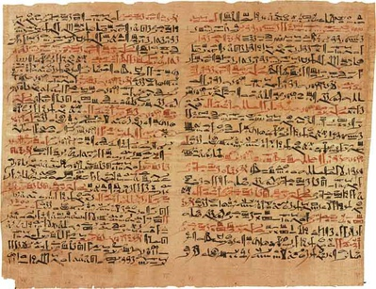
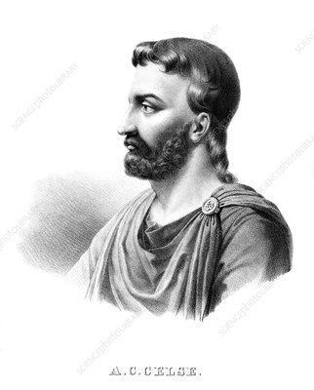
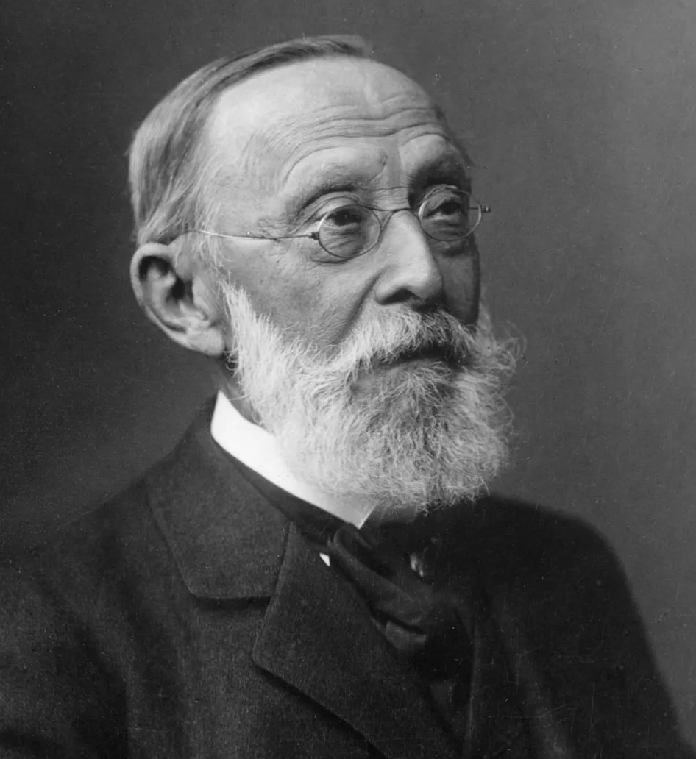
HISTORICAL EVENTS
Inflammation was first described by Egyptian papyrus (around 3000BC)
Rubor (redness)
Later Roman writer, Celsus (1st century AD) first listed 4 cardinal signs of inflammation
Calor (heat)
Dolar (pain)
Tumor (swelling)
Rudolf Virchow added “loss of function (function laesa)” in the 19th century

Slide 4
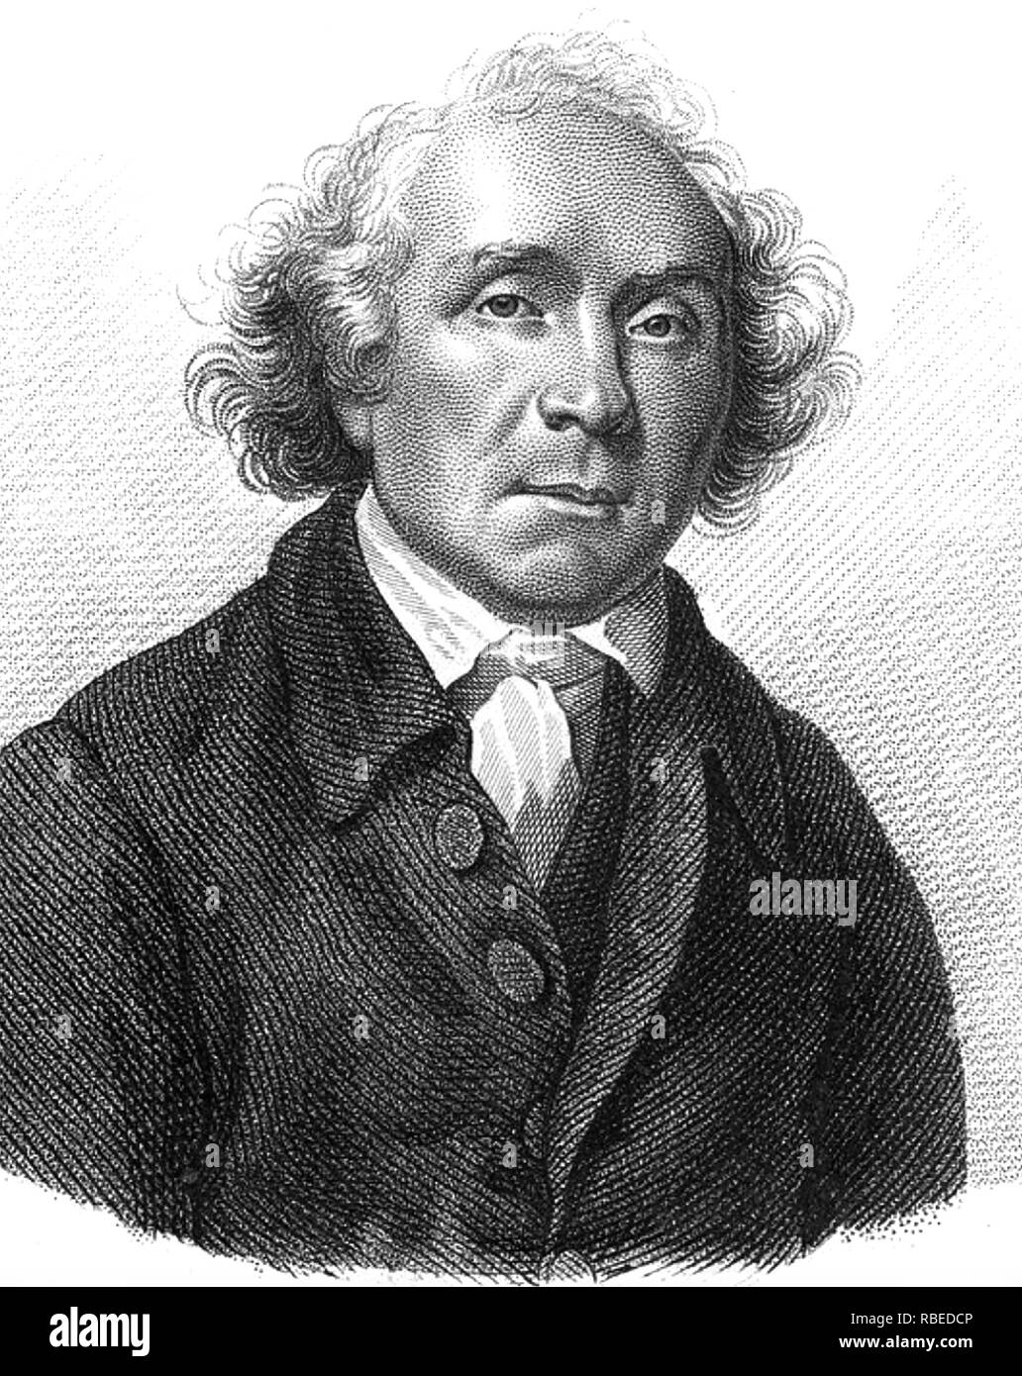
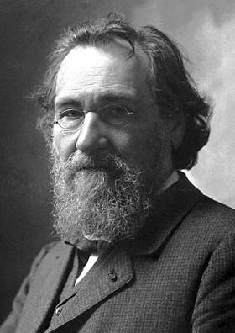
HISTORICAL EVENTS
John Hunter ( Scottish surgeon) – inflammation is not a disease but a stereotypic response to injurious stimuli by host
Elie Metchnikoff - described phagocytosis

Slide 5
INFLAMMATION
CAUSES OF INFLAMMATION
Infections – bacterial, viral, fungal, parasitic and microbial toxins
Physical trauma or blunt injury
Necrotic tissue – molecules released from necrotic cells induce inflammatory reaction
Foreign bodies (splinters, dirt, sutures) – elicit inflammation by themselves or can cause tissue injury . Deposition of endogenous substances like urate crystals, cholesterol crystals, lipids can also produce inflammation
Immune reactions – autoimmune diseases where injurious immune responses are directed against self antigens

Slide 6
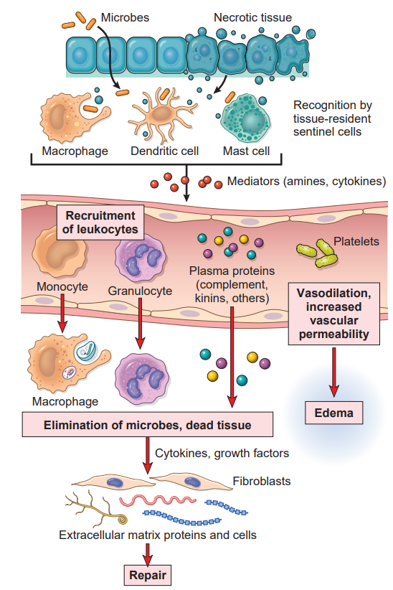
SEQUENCE OF EVENTS IN INFLAMMATION

Slide 7
SEQUENCE OF EVENTS IN INFLAMMATION

Slide 8
TYPES OF INFLAMMATION
Acute inflammation
Types of inflammation
Chronic inflammation
Granulomatous inflammation

Slide 9
DIFFERENCES BETWEEN ACUTE AND CHRONIC INFLAMMATION
FEATURES | ACUTE INFLAMMATION | CHRONIC INFLAMMATION
Onset | Fast : minutes or hours | Slow : days
Cellular infiltrate | Mainly neutrophils | Monocytes / macrophages and lymphocytes
Tissue injury , fibrosis | Usually mild and self limited | Often severe and progressive
Local and systemic signs | Prominent | Less

Slide 10
ACUTE INFLAMMATION
Definition
Acute inflammation is rapid response to injurious agent that serves to deliver mediators of host defense to the site of injury
3 components of Acute inflammation
Alterations in vascular caliber leading to increased blood flow
Structural changes in microvasculature that permits plasma proteins & leucocytes from the microcirculation
Emigration of leucocytes from the microcirculation, their accumulation in focus of injury & their activation to eliminate the offending organism

Slide 11
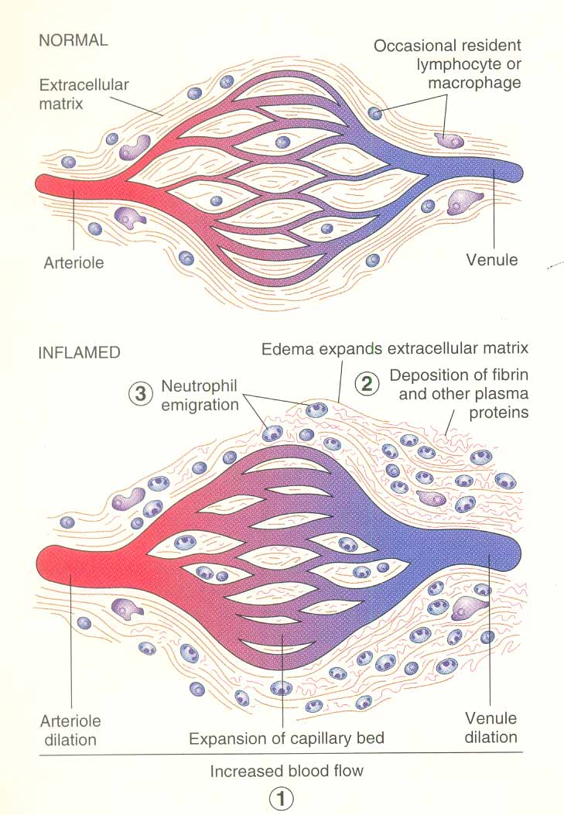
NORMAL
ACUTE INFLAMMATION

Slide 12
ACUTE INFLAMMATION Vascular events
Vasodilation
Earliest vasoconstriction
Followed by vasodilation
Caused by mediators like histamine
REDNESS AND HEAT
CHANGES IN VASCULAR FLOW AND CALIBRE
Increased vascular permeability
Outpouring of protein rich fluid into tissues
Loss of fluid
Conc. Of RBC in blood vessels – increased viscosity of blood
STASIS

Slide 13
ACUTE INFLAMMATION Increased vascular permeability (vascular leakage)
Formation of endothelial gaps in venules
Is mediated by histamine, leucotrienes etc
Fast & short lived (immediate transient response)
Most common & effects mostly veinules

Slide 14
ACUTE INFLAMMATION Increased vascular permeability (vascular leakage)
Binding of the mediators to receptors on endothelium
Activates intracellular signaling pathway
Phosphorylation of contractile & cytoskeletal proteins (myosin)
Contraction of endothelial cells & separation of intercellular junctions
Gaps in venular endothelium which are largely intercellular

Slide 15
ACUTE INFLAMMATION Increased vascular permeability (vascular leakage)
Direct injury
Leads to cell necrosis
Arterioles , capillaries & veinules
Toxins , burns & chemicals
Fast & may be long lived (hours to day))

Slide 16
ACUTE INFLAMMATION Increased vascular permeability (vascular leakage)
Leucocyte – dependent injury
Mostly venules , pulmonary capillaries & glomerular capillaries
Late response & long lived (hours)
Early stage leucocyte adhere to endothelium – activated – release toxic oxygen species & proteolytic enzymes – endothelial injury & detachment – increased permeability

Slide 17
ACUTE INFLAMMATION Increased vascular permeability (vascular leakage)
Increased transcytosis
It occurs across the channels consisting of clusters of interconnected & uncoated vesicles & vacuoles called vesicovacuolar organelles which are located near intercellular junctions
VEGF – increased vascular leakage by increasing the number & size of these channels

Slide 18
ACUTE INFLAMMATION Increased vascular permeability (vascular leakage)
Leakage from new blood vessels
New blood vessel formed are leaky until endothelial cells mature
Factors causing angiogenesis also increase the vascular permeability

Slide 19
ACUTE INFLAMMATION Cellular events – leukocyte extravasation & phagocytosis
Sequence of events in the extravasation of leucocytes
In the lumen – margination , rolling & adhesion to endothelium
Diapedesis - transmigration across the endothelium
Migration in the interstitial tissue towards chemotactic agent

Slide 20
ACUTE INFLAMMATION Leucocyte adhesion & transmigration
Leucocyte adhesion & transmigration is regulated by binding of complementary adhesion molecules on the leukocyte & endothelial surfaces
Chemical mediators – chemoattractants & certain cytokines – affect these processes by modulating the surface expression or avidity of such adhesion molecules

Slide 21
ACUTE INFLAMMATION
E-selectin
L-selectin
P-selectin
Selectins
LFA 1
MAC 1
VLA 4
α4β7
Adhesion molecules
Integrin
Immunoglobulin molecules
CD31

Slide 22
ACUTE INFLAMMATION Leucocyte adhesion & transmigration
Tissue macrophages, Mast cells and Endothelial cells
Encounter Microbes
Express E-selectin and Ligands for L –selectin with in 1 or 2 hours
TNF and IL-1
Endothelial cells
Histamine and Thrombin
Redistribution of P selectin from its intracellular stores to cell surface

Slide 23
ACUTE INFLAMMATION Leucocyte adhesion & transmigration
Selectins – Initial rolling and interaction is mediated by selectins

Slide 24
ACUTE INFLAMMATION Leucocyte adhesion & transmigration
INTEGRINS
Firm adhesion of leukocytes to endothelial cells
These proteins promote cell-cell & cell- matrix interactions
They integrate signals from extra cellular ligand with cytoskeleton dependent motility , shape change & phagocytic responses
Chemokines produced at the site of injury
Binds to endothelial cell proteoglycans on endothelial cell surface
Activate the rolling leukocytes
Conversion to high affinity state

Slide 25
ACUTE INFLAMMATION Leucocyte adhesion & transmigration

Slide 26
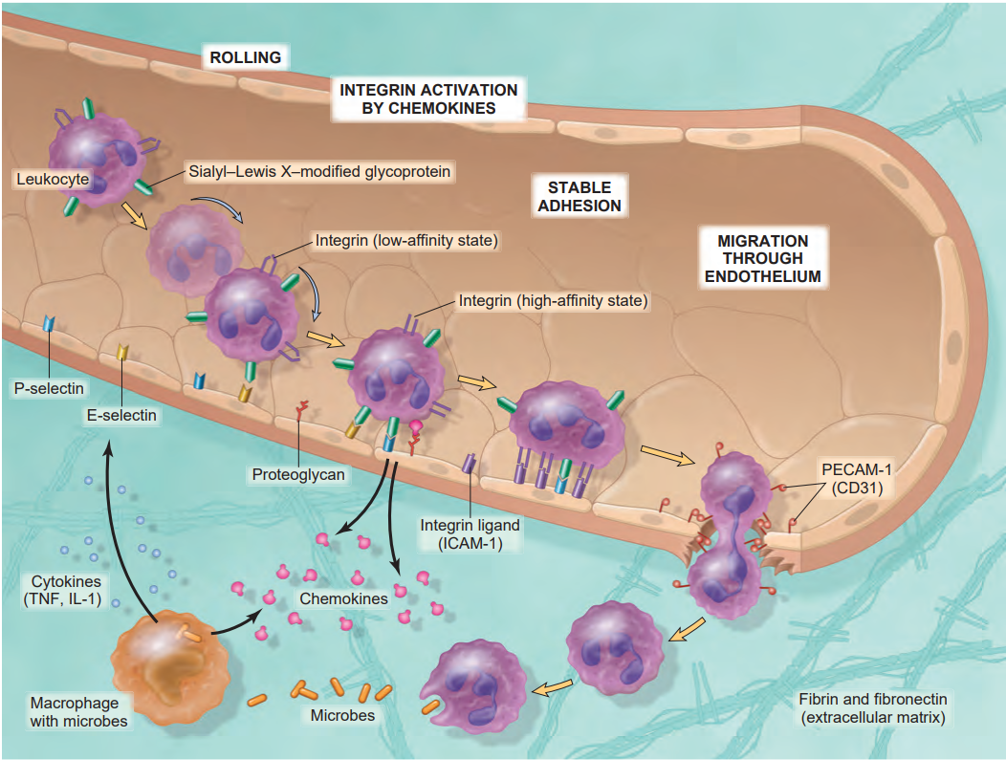
DIAPEDESIS

Slide 27
ACUTE INFLAMMATION CHEMOTAXIS
Definition
Locomotion oriented along the chemical gradient
Chemo attractants
They can be -
Exogenous – Bacterial products
Endogenous – a) components of complement system e.g. C5a
b) Products of Lipoxygenase pathway mainly Leukotrienes
c) Cytokines

Slide 28
ACUTE INFLAMMATION CHEMOTAXIS
Chemotactic agents binds to 7 transmembrane G- coupled receptors
Activation of second messengers
Polymerization of actin at the leading edge of the cell and localization of myosin filaments at the back
This reorganization leads to mobilization of cell

Slide 29
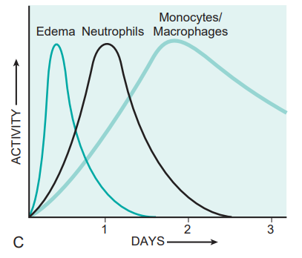
ACUTE INFLAMMATION
Neutrophils respond faster to chemokines and are more in number
Neutrophils are short lived and undergo apoptosis
Monocytes survive longer and proliferate in tissues
Once leukocytes are recruited, they must be activated to perform their functions
Responses of leukocytes depend upon the receptors which deliver the signals to leukocytes

Slide 30
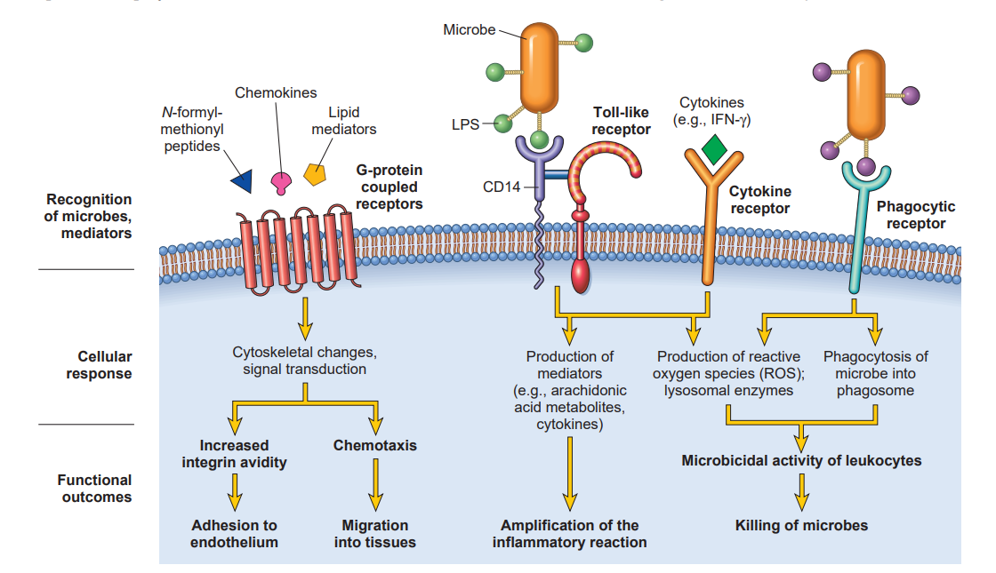
Leukocyte activation due to stimuli by different receptors

Slide 31
ACUTE INFLAMMATION PHAGOCYTOSIS
Phagocytosis involves 3 distinct intercorrelated steps
Recognition & attachment of particles to the ingested leukocyte
Engulfment with subsequent formation of phagocytic vacuole
Killing & degradation of ingested material

Slide 32
ACUTE INFLAMMATION PHAGOCYTOSIS
Phagocytic receptors that enable to recognize and ingest microbes are
Mannose receptors
Scavenger receptor
Receptor for various opsonins
Mannose receptors binds to mannose and fucose residues of glycoproteins and glycolipids which are typically present on microbial cell wall
Where as mammalian glycoproteins and glycolipids contain terminal sialic acid or N-acetyl galactosamine. Therefore these receptors does not recognize the host cells
Scavenger receptors mediate endocytosis of oxidized or acetylated LDL particles and not with conventional LDL receptor and also they recognize the microbes
Notes:
Mammalian glycoproteins and glycolipids contains terminal Sialic acidand N-acetyl galactosamine

Slide 33
ACUTE INFLAMMATION
OPSONIZATION & OPSONINS
The process of coating particle , such as a microbe , to target it for phagocytosis is called Opsonization & substances that coat are called Opsonins
Efficient Opsonins are –
IgG antibodies
Components of complement
Mannose binding Lectin
Fibronectin
Fibrinogen
C- reactive protein

Slide 34
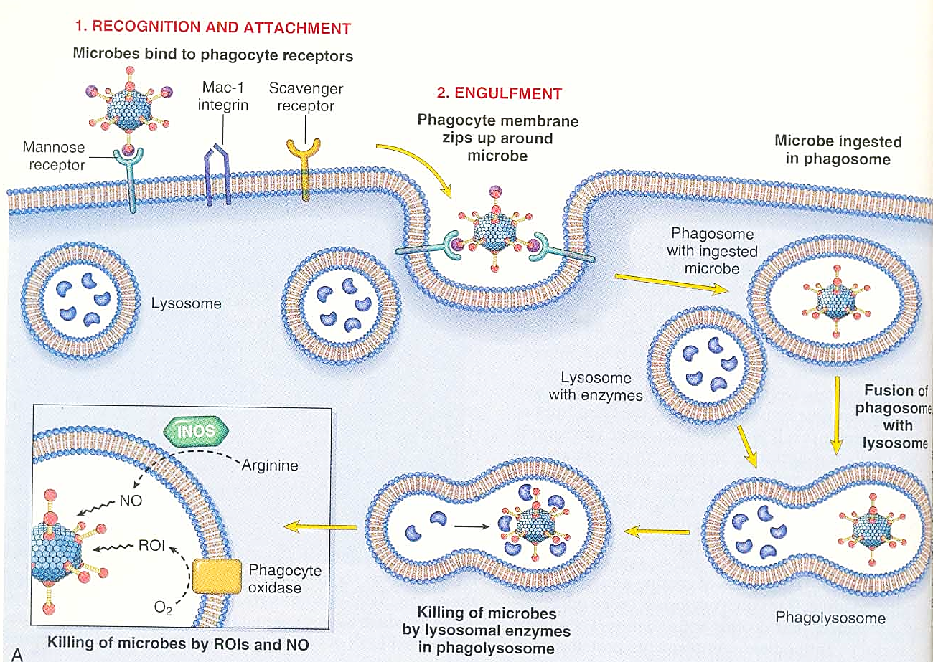
s

Slide 35
ACUTE INFLAMMATION PHAGOCYTOSIS
Killing of microbes is accomplished by
Reactive oxygen species
Reactive nitrogen species mainly derived from nitric oxide
Lysosomal enzymes

Slide 36
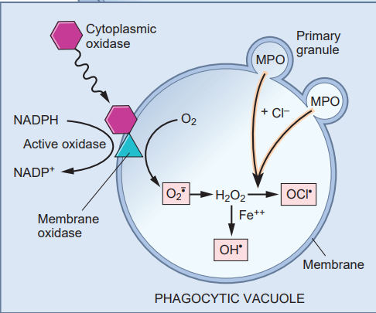
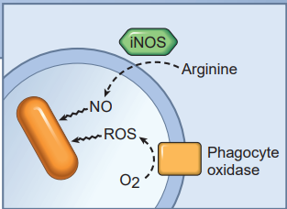
ACUTE INFLAMMATION PHAGOCYTOSIS –KILLING AND DEGRADATION OF MICROBES

Slide 37
NEUTROPHIL EXTRACELLULAR TRAP
NET are extracellular fibrillar meshwork that nuclear chromatin which binds and concentrates antimicrobial peptides and enzymes at the sites of infection
ROS
Activates Arginine deaminase
MPO and Elastase
Arginine
Chromatin decondensation
Cetrulline
Rupture of nuclear envelop
Release of chromatin
In this process neutrophil dies

Slide 38
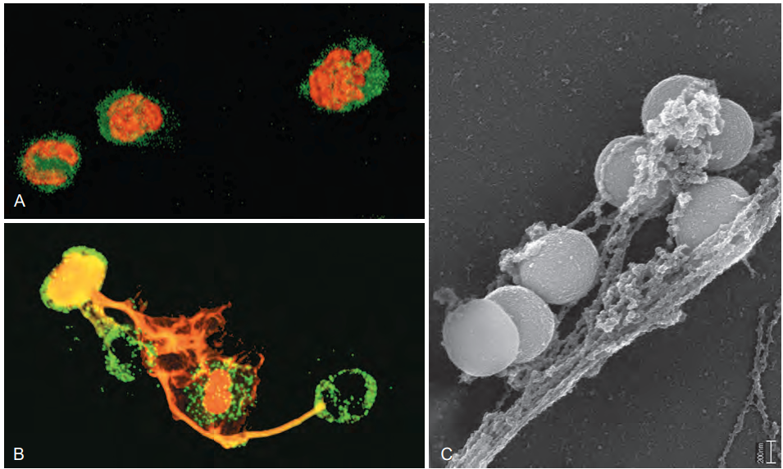
NEUTROPHIL EXTRACELLULAR TRAP

Slide 39
MORPHOLOGICAL PATTERNS OF ACUTE INFLAMMATION
Fluid does not contain microbes or leukocytes
Secreted by mesothelial cells or serous fluid accumulation
Serous inflammation
Increase in permeability, local procoagulant stimulus
Common in inflammation of body cavities like meninges, pericardium and pleura
Fibrinous inflammation
Morphologic pattern of inflammation
Exudate containing neutrophils, liquified debris
Abscess – localized collection of pus
Purulent inflammation
Ulcers

Slide 40
THANK YOU

