Slide 1
CHEMICAL MEDIATORS OF INFLAMMATION
Dr.V.Shanthi
Associate professor, Pathology
Sri Venkateswara Institute of Medical Sciences, Tirupathi

Slide 2
CHEMICAL MEDIATORS
Inflammatory mediators are the substances that initiate and regulate inflammatory reactions
Mediators originate from either –
Plasma - These are present in precursor forms that must be activated by series of proteolytic cleavage to acquire biologic properties
e.g. complement proteins & kinins
Cells – present in intracellular granules that need to be secreted (e.g. Histamine in mast cells) or synthesized denovo in response to stimulus (e.g. Prostaglandins, cytokines)

Slide 3
CHEMICAL MEDIATORS

Slide 4
CHEMICAL MEDIATORS

Slide 5
CHEMICAL MEDIATORS
Mediators perform activity by –
Mostly by binding to receptors on target cells
Direct enzymatic activity e.g. Lysosomal proteases
Mediate oxidative damage e.g. reactive oxygen species & nitrogen intermediates
Mediators can act on –
One or few target cells
Can have diverse targets
Have different effect on different cell types

Slide 6
CHEMICAL MEDIATORS
Once activated & released from the cell the mediators are short lived. They either –
Quickly decay e.g. Arachidonic acid metabolites
Inactivated by enzymes e.g. kininase inactivates Bradykinin
Scavenged e.g. antioxidants scavenge toxic oxygen metabolites
Inhibited e.g. complement regulatory proteins breakup & degrade activated complement components

Slide 7
CHEMICAL MEDIATORS
Vasoactive amines
First mediators to be released during inflammation are -
Histamine
Serotonin

Slide 8
CHEMICAL MEDIATORS
HISTAMINE
Richest source – mast cells
- also in platelets & Basophils
Stimuli for degranulation of Mast cells –
Physical injury such as trauma , cold or heat
Immune reactions involving binding of antibodies to Mast cells
Fragments of complement called Anaphylotoxins (C3a & C5a )
Neuropeptides (substance P )
Cytokines (IL – 1 & IL – 8 )

Slide 9
CHEMICAL MEDIATORS
HISTAMINE
Action of Histamine
Dilation of arterioles ( but constriction of large arterioles )
Increased permeability of veinules
Principle mediator of immediate transient phase of increased vascular permeability
Acts on microcirculation mainly via binding to H1 receptor on endothelial cells

Slide 10
CHEMICAL MEDIATORS
SEROTONIN
Action similar to that Histamine
Source – platelets & Enterochromaffin cells
Release from platelets occurs when platelets aggregate after contact with –
Collagen
Thrombin
ADP
Ag- Ab complexes

Slide 11
CHEMICAL MEDIATORS
PLASMA PROTEINS
Plasma proteins that mediate inflammatory response belong to 3 interrelated systems
Complement system
Kinin system
Clotting systems

Slide 12
CHEMICAL MEDIATORS
COMPLEMENT SYSTEM
Complement system consists of 20 component proteins that are found in greatest concentration in plasma
Complement components causes –
Increasing vascular permeability
Chemotaxis
Opsonisation

Slide 13
CHEMICAL MEDIATORS
Complement system
The early steps in complement activation consists of 3 pathways i.e. –
Classical pathway
Alternate pathway
Lectin pathway

Slide 14
CHEMICAL MEDIATORS
COMPLEMENT SYSTEM
Activation of complement cascade consists of 2 steps i.e. early step & late step
Early steps consists of 3 different pathways & lead to proteolytic cleavage of C3
Late steps – all 3 pathways converge & major breakdown products of C3, C3b activate a series of other complement components

Slide 15
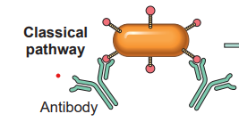
CHEMICAL MEDIATORS - PLASMA PROTEINS classical pathway
Ag-Ab complex
C1
Activated C1
Classical pathway
C3 convertase
C4+C2
C4b2b
C3
Recruitment and activation of leukocytes
C3b
C3a
C4b2b3b
Classical pathway
C5 convertase

Slide 16
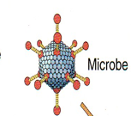
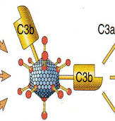
CHEMICAL MEDIATORS- PLASMA PROTEINS
Alternate pathway
Alternate pathway C5 convertase
Recruitment and activation of leukocytes
C3bBb3b
C3
C3b
C3b
C3a
Factor B
Factor D
C3bBb
C3
C3b +microbial polysaccharide
Alternate pathway C3 convetase

Slide 17
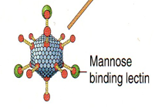
CHEMICAL MEDIATORS- PLASMA PROTEINS
LECTIN PATHWAY
C1
Activated C1
C3 convertase
C4+C2
C4b2b
C3
Recruitment and activation of leukocytes
C3b
C3a
C4b2b3b
C5 convertase

Slide 18
CHEMICAL MEDIATORS- PLASMA PROTEINS
LATE PATHWAY
Classical & Lectin pathway
C5 convertase
Recruitment and activation of leukocytes
C4b2b3b
C5a
C5
C6
C7
C8
C9
Lysis of microbes
C3bBb3b
C5b
C5 - 9
Membrane attack complex
Alternate pathway C5 convertase

Slide 19
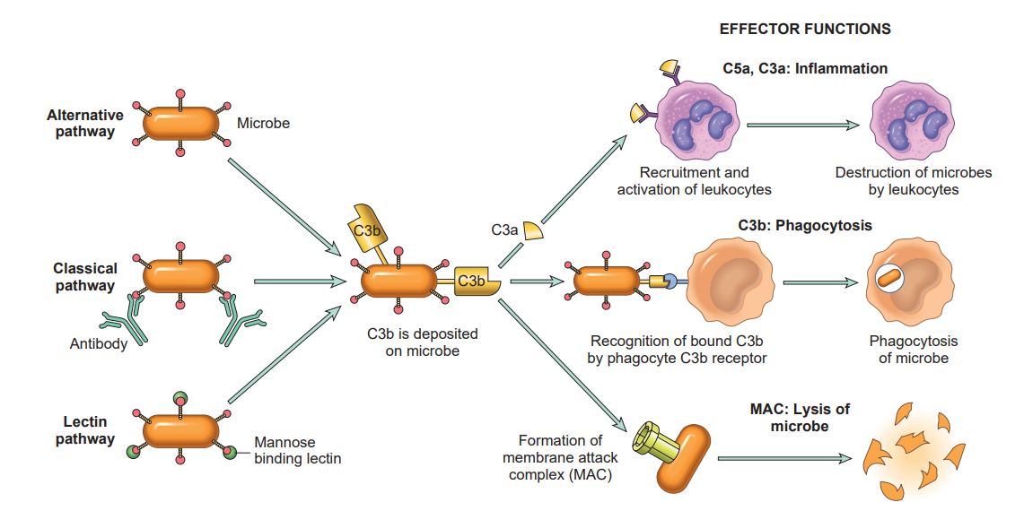
ACTIVATION AND FUNCTIONS OF COMPLEMENT SYSTEM

Slide 20
CHEMICAL MEDIATORS OF INFLAMMATION PLASMA PROTEINS
The biologic function of complement system
Cell lysis by MAC
Vascular phenomenon – increased vascular permeability & vasodilatation
Leukocyte adhesion, chemotaxis & activation
Phagocytosis

Slide 21
CHEMICAL MEDIATORS OF INFLAMMATION PLASMA PROTEINS
Regulation of complement activation
Regulation of C3 & C5 convertase by enhancing dissociation of convertase complex e.g. Decay accelerating factor
Factor H – causes cleavage of C3b and turnover of C3 convertase
Binding of active complement components by specific proteins in plasma
C1 inhibitor interferes with enzymatic activity of C1
Proteins that inhibit MAC formation e.g. CD59 inhibit excessive complement activation

Slide 22
CHEMICAL MEDIATORS OF INFLAMMATION PLASMA PROTEINS
Disorders of complement system
Deficiency of complement components lead to increased susceptibility to infections
Deficiency of C4 & C2 – autoimmune diseases e.g. SLE
Genetic defeciency of complementary regulatory protein – significant disease – e.g. Paroxysmal Nocturnal Hemoglobinuria
Deficiency of C1 inhibitor – Hereditary angioneurotic edema

Slide 23
CHEMICAL MEDIATORS kinin system
FACTOR XII
HMWK
Collagen, Basement membrane, and activated platelets
FACTOR XIIa
Kinin cascade
Clotting cascade
XIIa
Fibrinolytic system
Kallikrein
Prekallikrein
Increased vascular permeability
Causes smooth muscle contraction
Dilation of blood vessels
Pain
High molecular weight kininogen
Bradykinin

Slide 24
CHEMICAL MEDIATORS Clotting system
XIIa
Factor XI
Factor XIa
Factor X
Factor Xa
Protease activated receptors
Thrombin
ACUTE INFLAMMATION
Prothrombin
Factor II
Factor IIa

Slide 25
CHEMICAL MEDIATORS OF INFLAMMATION Clotting system
Protease activated receptors
These are 7- Transmembrane G – protein receptors present on platelets, endothelial cells, smooth muscle cells, etc.
Engagement of PAR by proteases particularly Thrombin triggers several responses like-
Mobilization of P- selectin
Production of chemokines
Expression of endothelial adhesion molecule
Production of Prostaglandins, PAF, & NO
Changes in endothelial shape

Slide 26
CHEMICAL MEDIATORS Clotting system
Kallikrein
Thrombin
Plasminogen
Plasmin
Fibrin
Fibrinogen
Fibrin split products
Fibrinopeptides
C3
C3a
Complement cascade

Slide 27
THANK YOU

