Slide 1
ATHEROSCLEROSIS – RISK FACTORS
Dr.V.Shanthi
Associate professor, Department of pathology
Sri Venkateswara Institute of Medical Sciences
Tirupathi

Slide 2
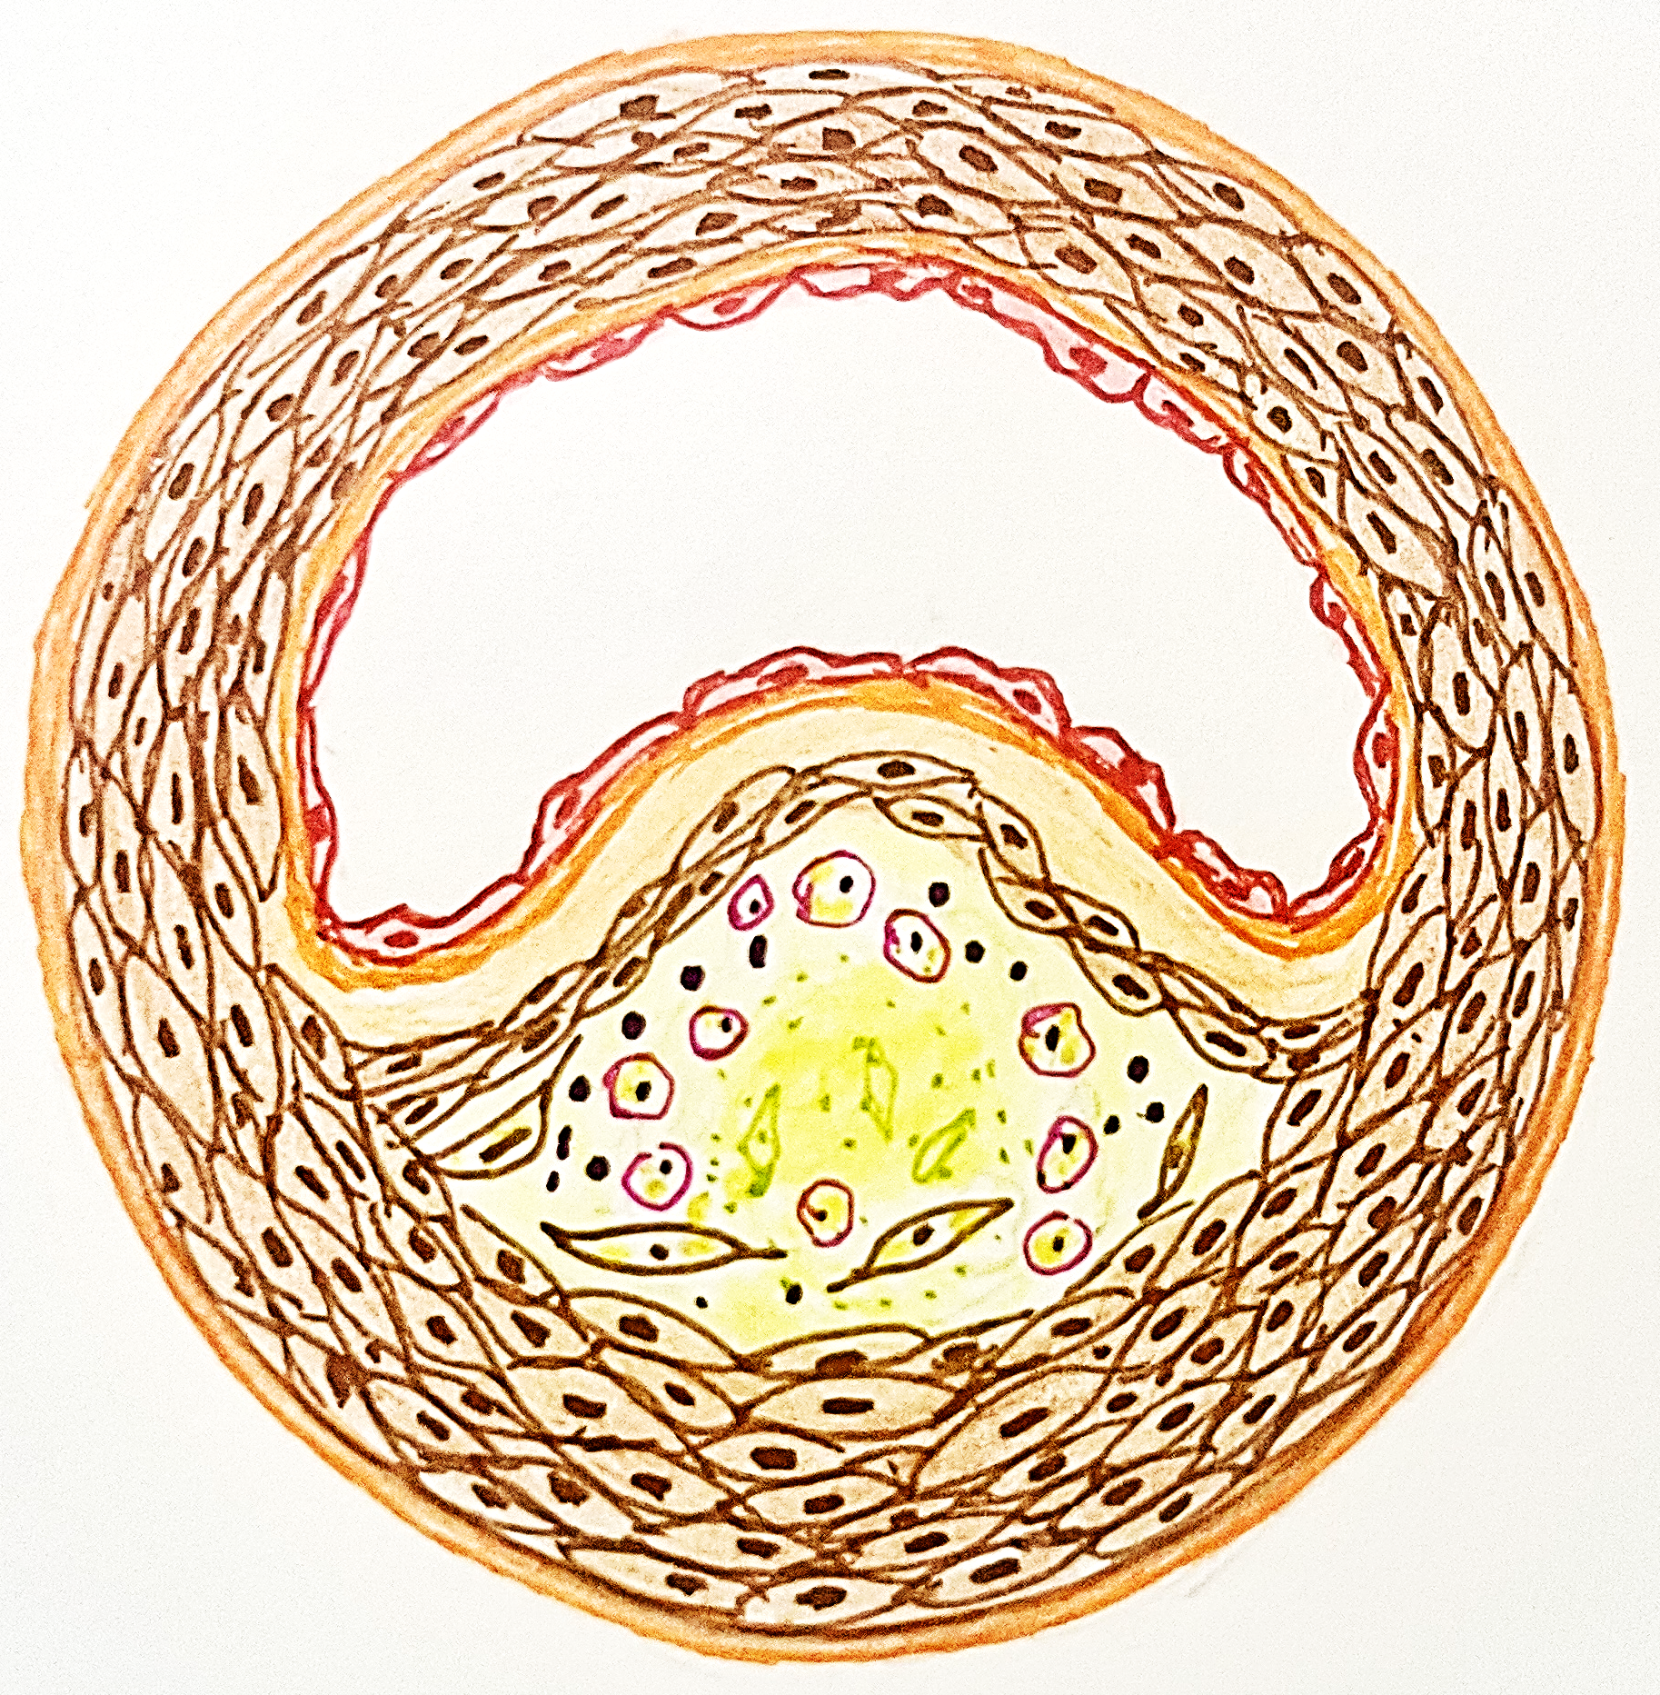
ATHEROSCLEROSIS
Blood vessel
Atherosclerosis means thickening and hardening of medium sized vessel due to involvement of intima
Atherosclerosis is derived from Greek word “athere” means gruel (accumulation of lipid) and “sclerosis” means hardening
Intimal lesions are called “atheroma” which has central soft core containing cholesterol and cholesterol esters covered by fibrous cap
Atheromatous plaque cause obstruction to lumen or may rupture producing thrombus or may weaken the vessel wall producing aneurysm
Fibrous cap
Myometrium
Macrophages and inflammatory cells
Central grumous core with cholesterol and cholesterol esters

Slide 3
ATHEROSCLEROSIS
NON-MODIFIABLE
RISK FACTORS FOR ATHEROSCLEROSIS
MODIFIABLE
ADDITIONAL RISK FACTORS

Slide 4
RISK FACTORS FOR ATHEROSCLEROSIS
Disease process starts early in life
Manifests in middle and later life
Increasing age
Males are at increased risk
After menopause females also have increased risk
At older age risk in females exceeds men
NON MODIFIABLE
Gender
Family history
Familial hypercholesterolemia increases risk
Other familial conditions like HTN, DM also increases risk
Genetic factors

Slide 5
RISK FACTORS FOR ATHEROSCLEROSIS
MODIFIABLE
Hypercholesterolemia
Diabetes mellitus
Excess of LDL cholesterol
Cigarette smoking
ROS
Increased activity of lipoprotein lipase
Increased levels of FFA
Increased oxidized LDL
Shear stress
Toxins
ENDOTHELIAL DAMAGE
Hypertension
ATHEROSCLEROSIS
CD 2H

Slide 6
RISK FACTORS FOR ATHEROSCLEROSIS
ADDITIONAL RISK FACTORS
Stress
Inflammation
Hyperhomocysteinemia
ROS
Increased oxidized LDL
Chemical mediators
Increased oxidized LDL
Production of nuclear factor-κB (NF-κB)
Metabolic syndrome
ENDOTHELIAL INJURY & DYSFUNCTION
Associated with obesity
Insulin resistance
Hypertension
Dyslipidemia
Hypercoagulability
Proinflammatory state
Mitogenic effect
Thrombi formation
Hypercholesterolemia
Breakdown products of thrombi
Increased Lipoprotein a [Lp(a)]
Platelet aggregation
Altered form of LDL that contains the Apo-protein B- 100 portion of LDL linked to apoprotein A
Lack of exercise
Obesity
Factors affecting hemostatsis like hyperfibrinogenemia
Smooth muscle proliferation
Use of exogenous hormones – with progestins increases risk of atherosclerosis
SMILE O 3H

Slide 7
SUMMARY
RISK FACTORS FOR ATHEROSCLEROSIS
NON MODIFIABLE
MODIFIABLE
ADDITIONAL RISK FACTORS
Increasing age
Gender
Genetic factors
Hyperlipidemia
Hypertension
Cigarette smoking
Diabetes mellitus
CD 2H
Stressful life style
Metabolic syndrome
Inflammation
Lipoprotein (a)
Lack of exercise
Obesity
Hyperhomocysteinemia
Factors affecting hemostatsis
Use of exogenous hormones
SMILE O 3H

