Slide 1
ATHEROSCLEROSIS – PATHOGENESIS
Dr.V.Shanthi
Associate professor, Department of pathology
Sri Venkateswara Institute of Medical Sciences
Tirupathi

Slide 2
ATHEROSCLEROSIS
PATHOGENESIS
Various hypotheses have been proposed for the pathogenesis of atherosclerosis. They are
Encrustation hypothesis
Insudation hypothesis
Monoclonal/ oligoclonal hypothesis
Response to injury hypothesis

Slide 3
ATHEROSCLEROSIS
Encrustation hypothesis
This was proposed by Rokitansky in 1852
Thrombus slowly becomes incorporated in the intima and then undergoes lipid degeneration to initiate the lesion
Thrombus formation is primary event
According to the recent concept thrombus formation is not the initial event but plays a role in development and enlargement of the lesion

Slide 4
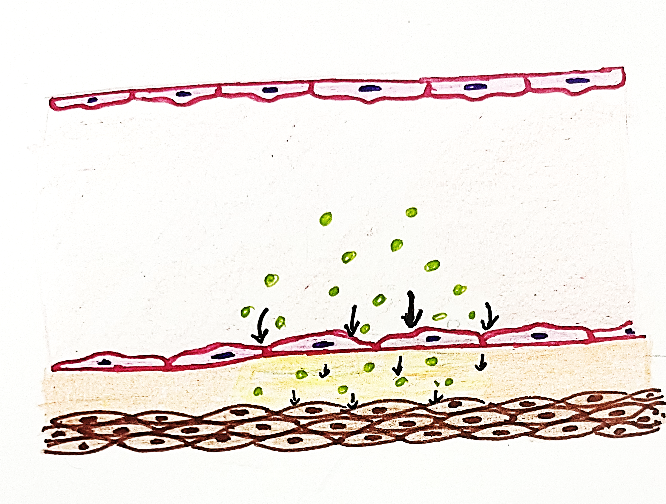
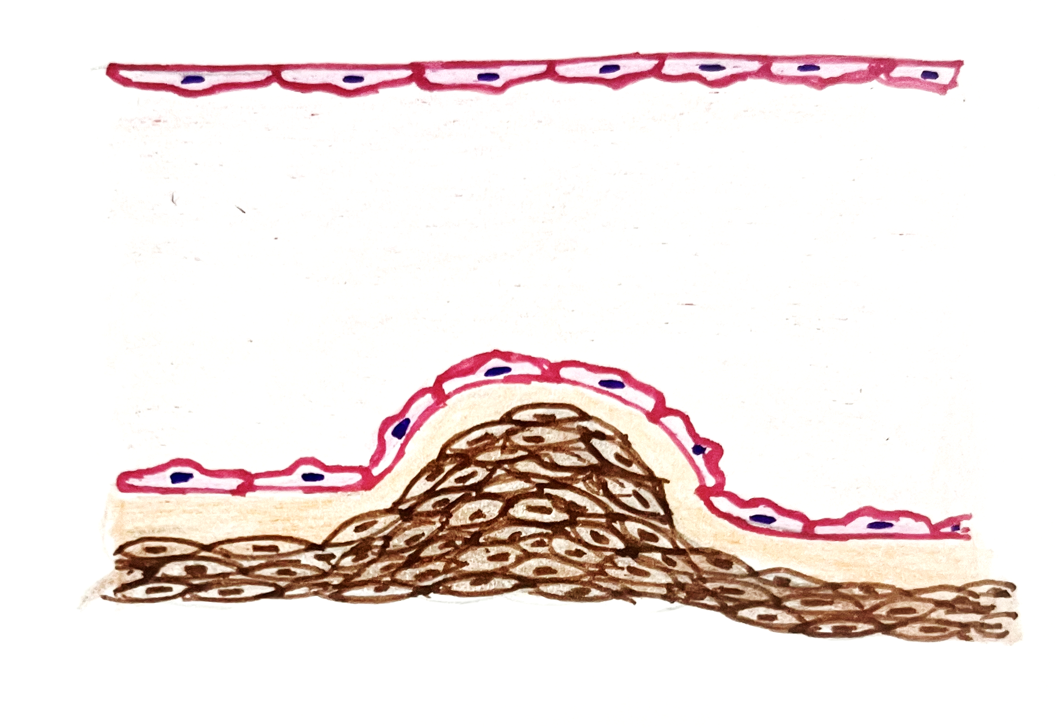
ATHEROSCLEROSIS
INSUDATION HYPOTHESIS
This concept was proposed by Virchow in 1856
Lipid insudation
Stimulates the proliferation of intimal cells
According to this theory there is proliferation of intimal cells due to insudation of lipids and plasma proteins into the vessel wall. However how lipids enter the vessel wall is not clear

Slide 5
ATHEROSCLEROSIS
MONOCLONAL/ OLIGOCLONAL HYPOTHESIS
According to this hypothesis smooth muscle cell proliferation starts either from a single cell (monoclonal) or from few cells (oligoclonal).
Monoclonal proliferation of smooth muscle may be initiated by mutations caused by chemicals like cigarette smoke, endogenous metabolites like lipoproteins and viruses like herpes virus
Cigarette smoke
Lipoproteins
viruses
Mutations
Monoclonal proliferation of smooth muscle
Theory of monoclonality is supported by the evidence that the proliferating smooth muscle cells have one of the two forms of G6PD isoenzyme.

Slide 6
ATHEROSCLEROSIS
Response to injury hypothesis
According to this hypothesis atherosclerosis is a chronic inflammatory and healing response of the arterial wall to the endothelial injury
Lesion progresses by interaction of modified lipoproteins, monocyte derived macrophages and T lymphocytes with endothelial cells and smooth muscle cells of the arterial wall

Slide 7
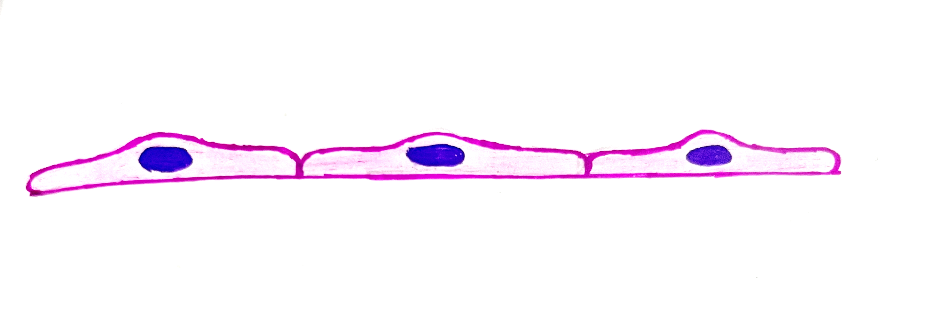
ATHEROSCLEROSIS CAUSE OF ENDOTHELIAL INJURY
Cigarette smoking
Homocysteinemia
Inflammatory cytokines
Infectious agents – herpes, cytomegalo virus, chlamydia pneumonia
Hypercholesterolemia
Hemodynamic disturbances
Normally produces
NO
Prostacyclin
Tissue type plasminogen activator
vasodilators
Normal Endothelial cells
vasoconstrictor substances
Secrete vasoconstrictor substances
Increased vascular permeability
Expression of adhesion molecules
Increased procoagulant activity
Endothelial dysfunction
Adhesion molecules
Increased vascular permeability

Slide 8
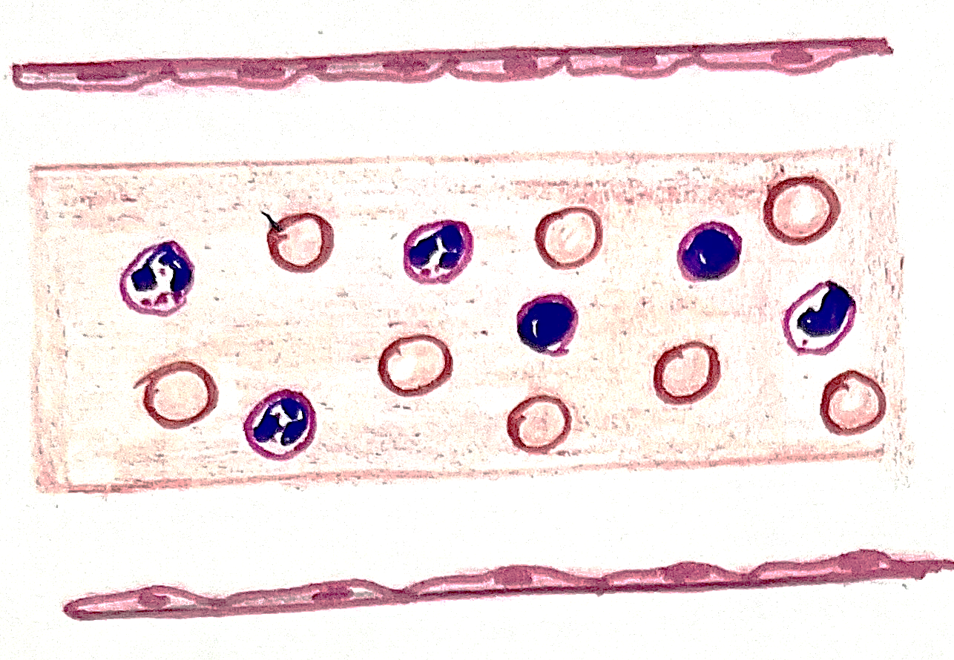
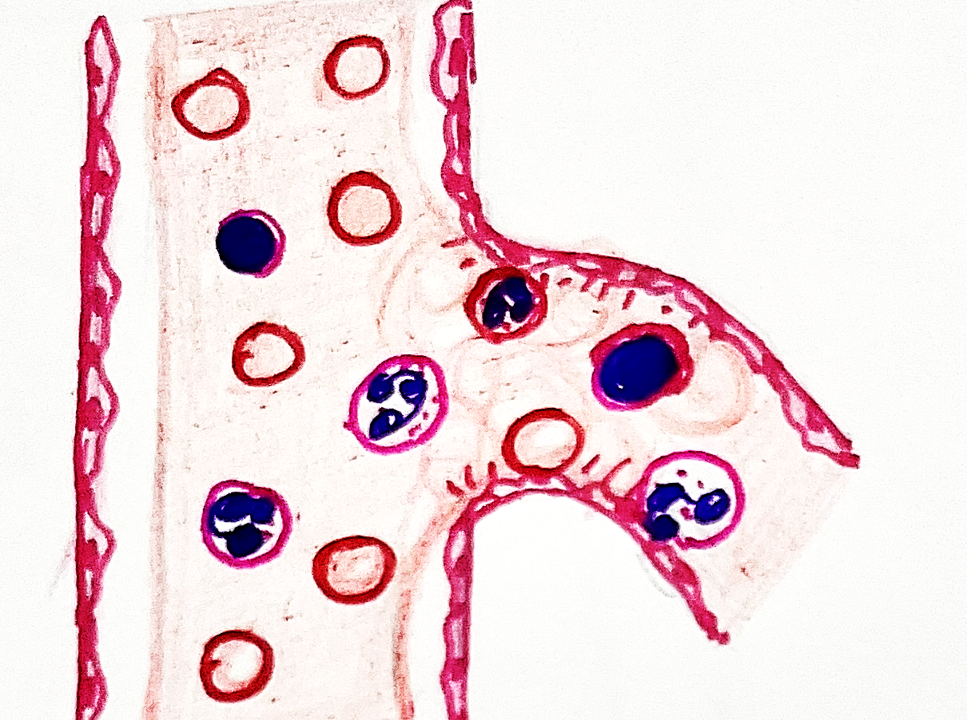
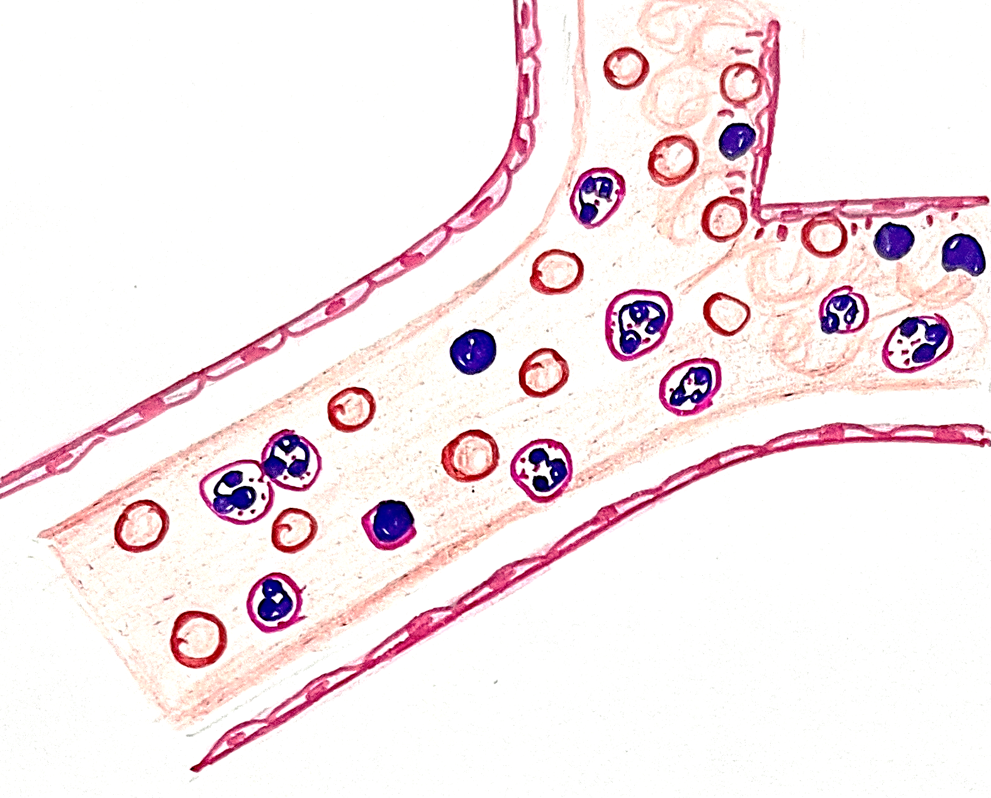
ROLE OF HEMODYNAMICS IN ENDOTHELIAL INJURY
Laminar flow
Turbulence in blood flow
Ostia of exiting vessels, branch points and along the posterior wall of the abdominal aorta
Branch points
Ostia
Cells does not come in contact with endothelial cells
Shear stress on endothelial cells and blood cells come in contact with endothelial cells
Endothelial injury and dysfunction

Slide 9
EFFECTS OF ENDOTHELIAL DYSFUNCTION
Mitogenic for SMC
Chemotactic factors for leukocytes and platelets
Vasoconstrictor
Endothelial injury/dysfunction
Endothelin (ET 1)
Expression of adhesion molecules
ICAM-1
E- selectin
VCAM-1
Causes adhesion of monocytes
Increased vascular permeability
Causes adhesion of T lymphocytes and monocytes
Granulocyte macrophage colony stimulating factor
Plasminogen activator inhibitor
Tissue factor
Adhesion of monocytes and lymphocytes to endothelial surfaces and migration into subendothelial spaces
Growth factors
Neutrophil activation and adhesion
Effects coagulation system
Differentiation and proliferation of SMC
ROS

Slide 10
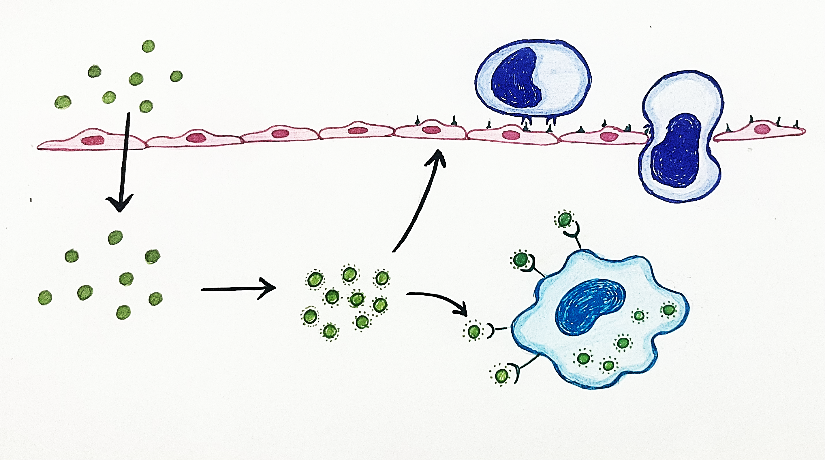
ROLE OF HYPERCHOLESTEROLEMIA
Hypercholesterolemia (Especially LDL)
NO decay
Adhesion
Migration
Cell adhesion molecules
ICAM-1
VCAM-1
E- selectin
Monocytes
Increased ROS
Damaged Endothelial cells produce ROS
Endothelial cell damage leading to increased vascular permeability
Chemoattractant for monocytes and T cells
Oxidized LDL in intima
Inflammatory reaction
Oxidized LDL cannot be degraded by macrophages and are converted into Lipid laden macrophage
RECRUITS LEUKOCYTES INCLUDING MONOCYTES
Produces immune reaction
Scavenger receptors
Foamy Macrophages
Smooth muscle cells can similarly transform into lipid laden foam cells by ingesting modified lipids through LDL receptor related proteins

Slide 11
ROLE OF MACROPHAGE
Secrete tissue factor
ACTIVATES COAGULATION CASCADE
Matrix metallo proteinases (MMPs)
ROS
Oxidizes LDL
Further damages endothelial cells
APOPTOSIS
Cytokines – IL-1
RECRUITS LEUKOCYTES INCLUDING MONOCYTES
Lipid accumulation in atheroma
Activated T cells produce IFN - γ
Inflammatory reaction
Endothelial cells and SMCs
RECRUITS LEUKOCYTES INCLUDING MONOCYTES
Growth factors
SMOOTH MUSCLE PROLIFERATION

Slide 12
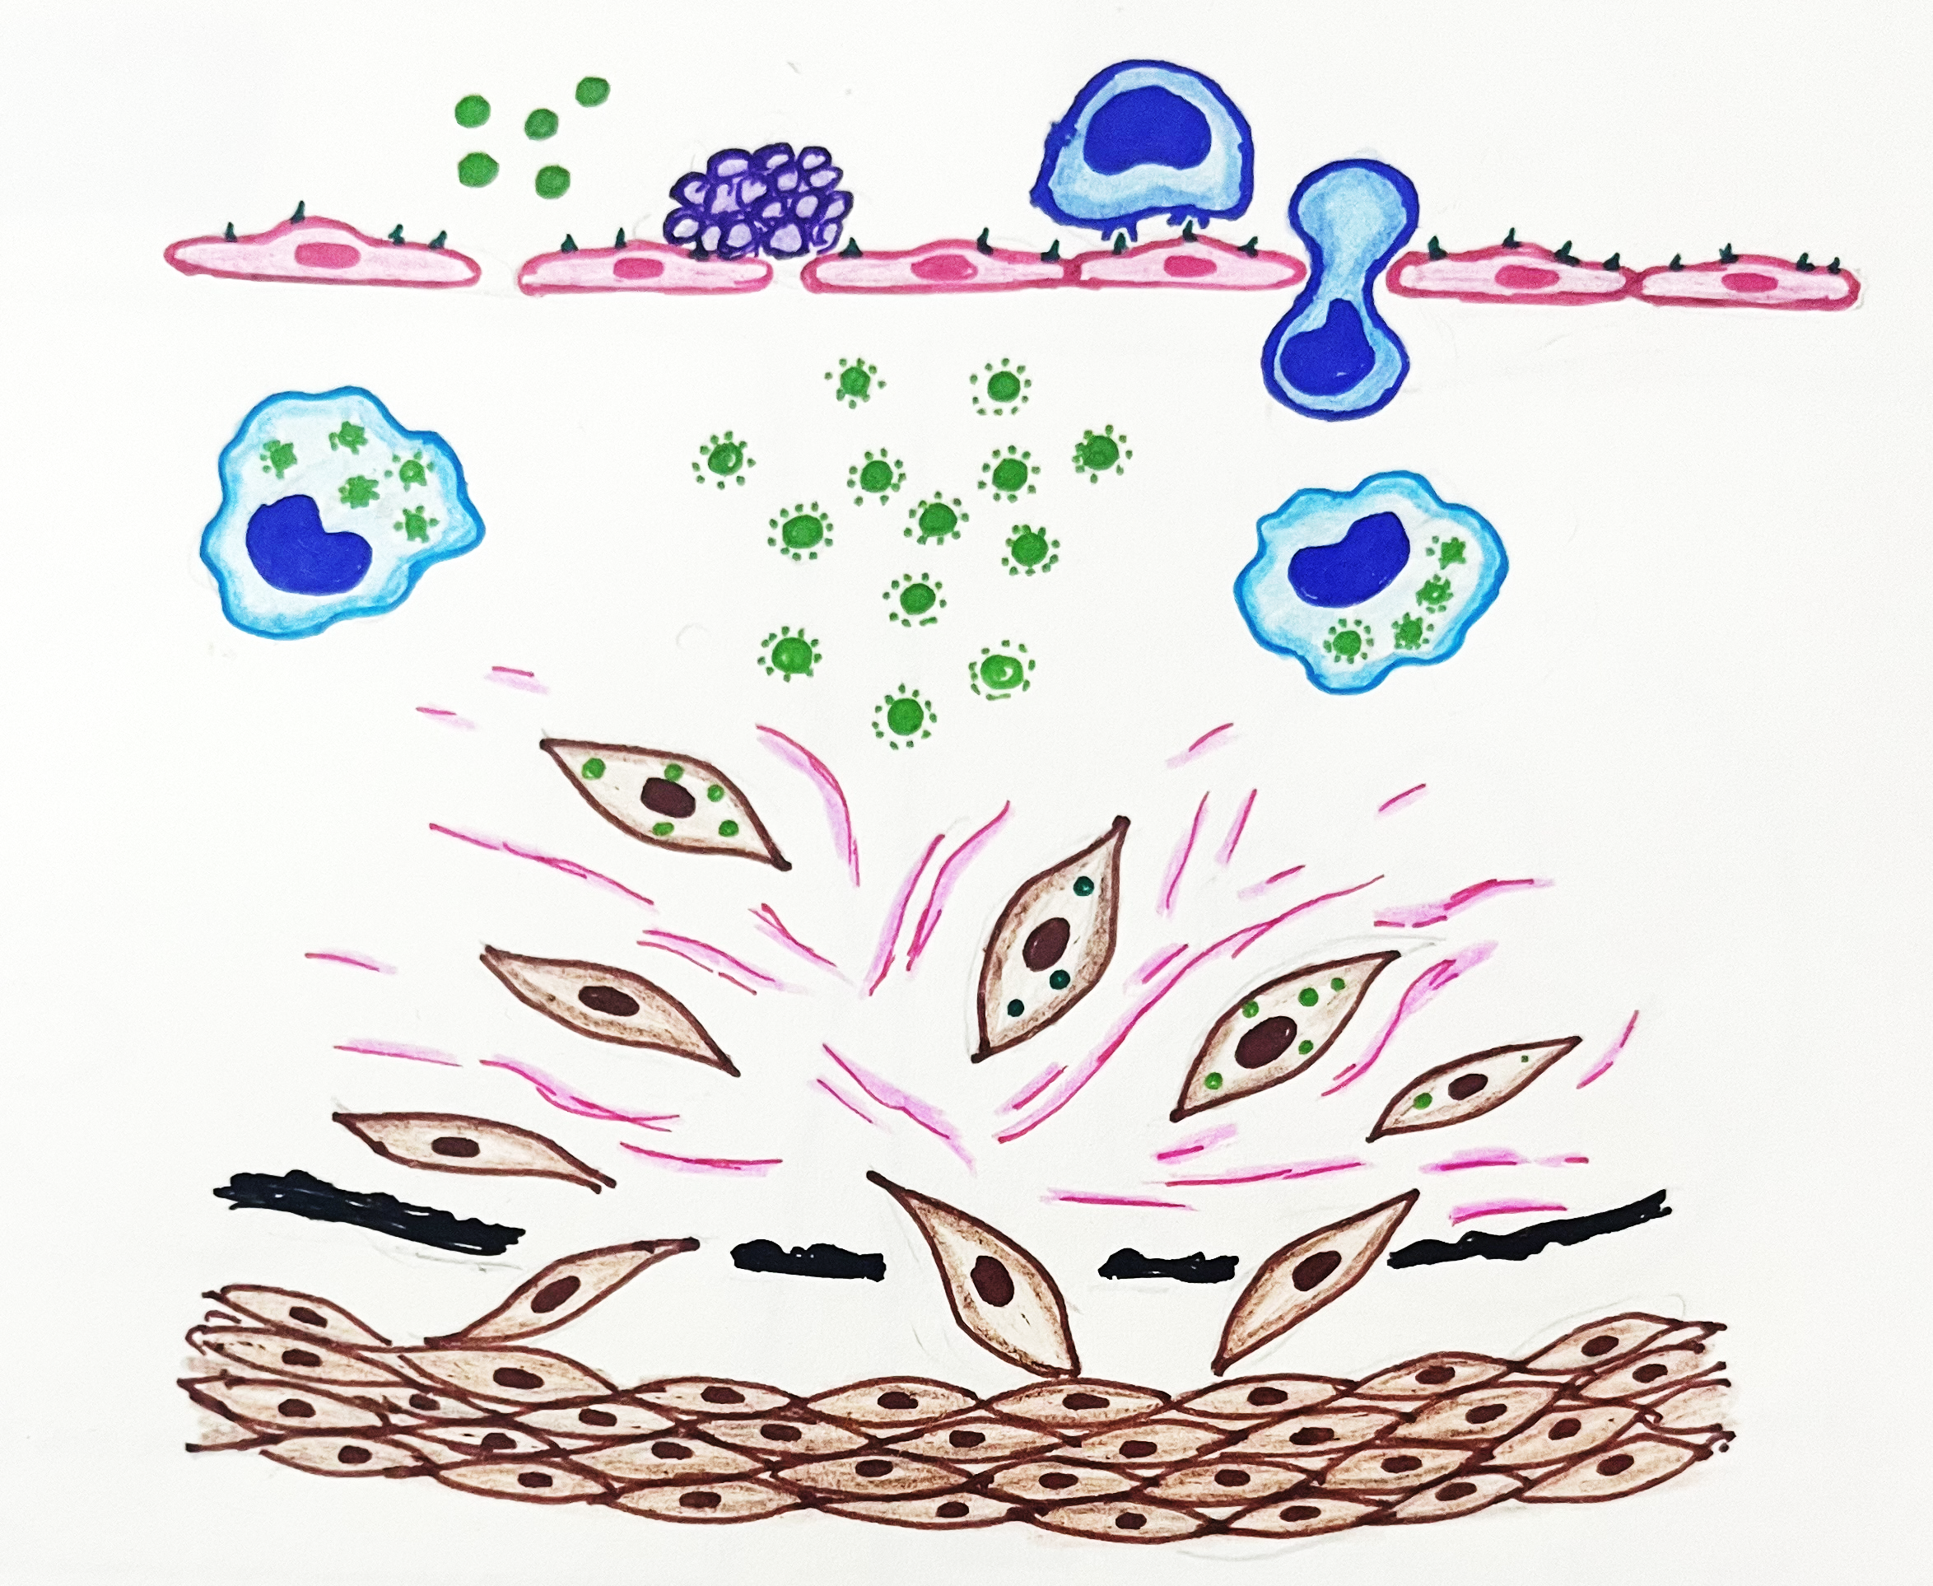
PATHOGENESIS OF ATHEROSCLEROSIS
Growth factors
Monocytes
Growth factors
LDL
platelets
Macrophages, platelets, endothelial cells
Growth factors
Modified LDL
Foam cells
Growth factors
MMPs
Foam cells
Growth factors are
PDGF (Platelet derived Growth Factors)
EGF (Epithelial Growth Factors)
TGF α (Transforming Growth Factor )
Matrix metalloproteinase (MMP-9)
MMPs
Degradation of internal elastic lamina
Smooth muscle migration and proliferation
Smooth muscle cells

Slide 13
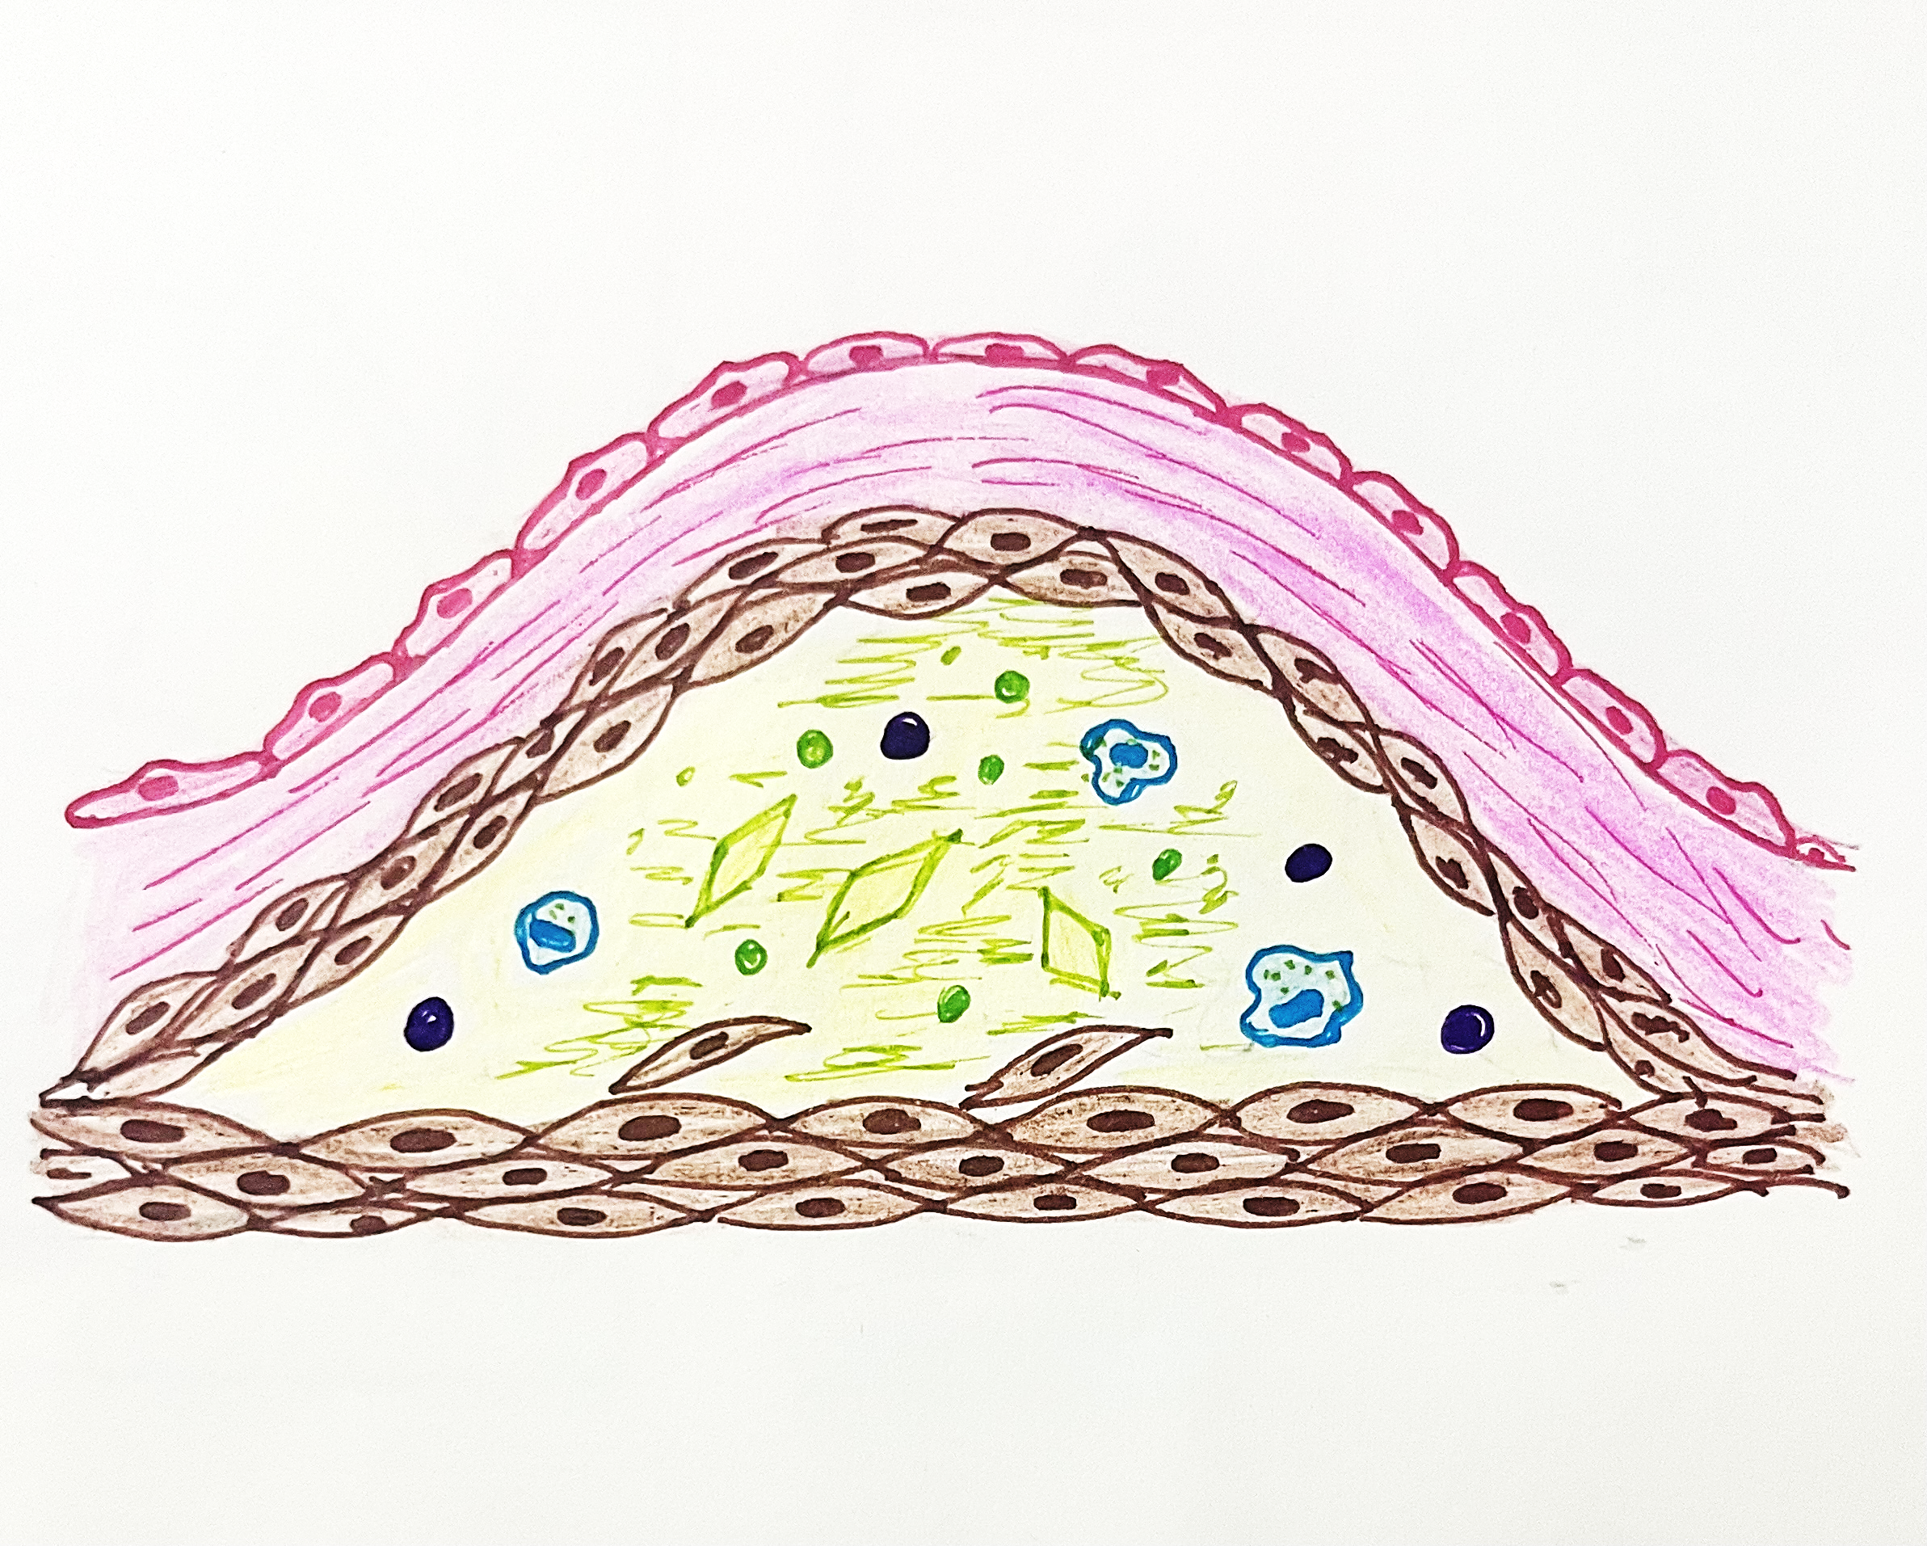
FORMATION AND STABILIZATION OF PLAQUE
Produces fibrous cap which stabilizes the plaque converting fatty streak into atheroma
Cytokines, metalloproteinases, growth factors, matrix proteins
Phenotypic change in SMC which synthesizes collagen, elastin and mucopolysacharides forming extracellular matrix

Slide 14
ANGIOGENESIS
Smooth muscle cells, macrophages and endothelial cells
Endothelial cells
VEGF, TGF - β
FGF-1
Endothelial and smooth muscle proliferation
NEOVASCULARIZATION IN ATHEROMA

Slide 15
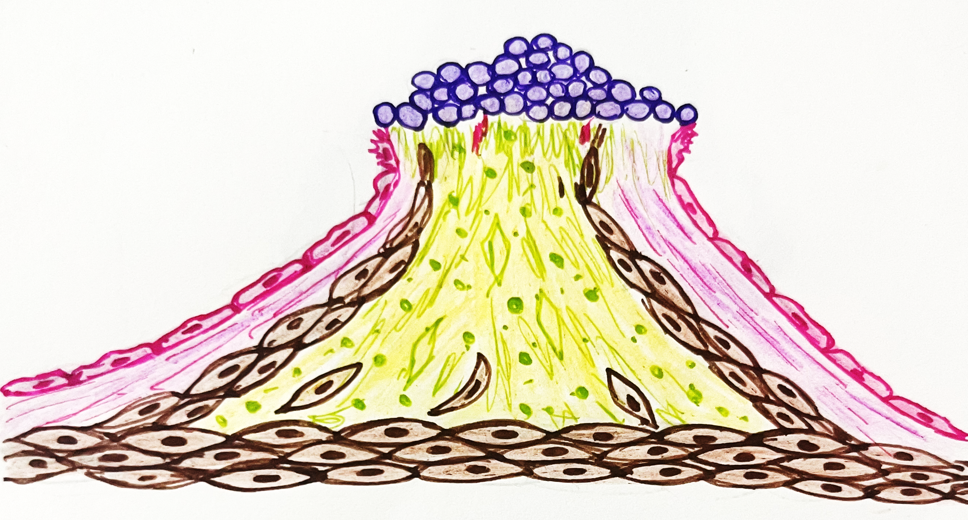
RUPTURE OF PLAQUE
MMP’s especially collagenase, stromelysin produced by macrophages and endothelial cells
Degrades proteoglycans, type IV collagen, fibronectin, and laminin
T cells produce cytokines such as interferon γ
Inhibits collagen formation by SMC
Destroys the matrix proteins and rupture of the cap causing exposure of lipid rich necrotic core
platelets
Intravascular thrombus formation

Slide 16
SUMMARY
Thrombus becomes incorporated in the intima and undergoes lipid degeneration to initiate the lesion
ENCRUSTATION HYPOTHESIS
INSUDATION HYPOTHESIS
Proliferation of intimal cells due to insudation of lipids and plasma proteins into the vessel wall
HYPOTHESIS OF ATHEROSCLEROSIS
MONOCLONAL HYPOTHESIS
Smooth muscle cell proliferation starts either from a single cell (monoclonal) or from few cells (oligoclonal)
RESPONSE TO INJURY HYPOTHESIS
Chronic inflammatory and healing response of the arterial wall to the endothelial injury

Slide 17
SUMMARY
Cigarette smoking
Homocysteinemia
Inflammatory cytokines
Infectious agents – herpes, cytomegalo virus, chlamydia pneumonia
Hemodynamic disturbances
Turbulence of flow
Hypercholesterolemia
Excess of LDL
ENDOTHELIAL INJURY
Chemotactic factors for monocytes and T cells
Increased vascular permeability
Vasoconstrictors substances like Endothelin
Expression of adhesion molecules
LDL enters the vascular space
GMCSF
PAI
TF
GF
ROS
Adhesion and migration of leukocytes into the intima
Neutrophil migration and activation
Affects coagulation
SMC proliferation
Oxidizes LDL
Decays NO
Engulfed by macrophages
Foamy macrophage
Apoptosis
MMP -9
GF
TF
Breakdown of internal elastic lamina
cytokines
ROS
Activates coagulation cascade
Proliferation of SMC
Produces inflammatory reaction
Damage to endothelial
cells
Migration and proliferation of SMC

Slide 18
SUMMARY
Macrophages
platelets, endothelial cells
MMPs
Growth factors are
PDGF (Platelet derived Growth Factors)
EGF (Epithelial Growth Factors)
TGF α (Transforming Growth Factor )
Smooth muscle migration and proliferation
Phenotypic change in SMC which synthesizes collagen, elastin and mucopolysacharides forming extracellular matrix producing fibrous cap converting fatty streak into atheroma
MMP’s especially collagenase, stromelysin produced by macrophages and endothelial cells
Destroys the matrix proteins and rupture of the cap causing exposure of lipid rich necrotic core
Intravascular thrombus formation

