Slide 1
AthEROSCLEROSIS
Dr.V.Shanthi
Professor and HOD
Department of Pathology

Slide 5
OVERVEIW
DEFINITION OF ATHEROSCLEROSIS
RISK FACTORS
HYPOTHESIS REGARDING PATHOGENESIS
COMPLICATIONS
CLINICAL MANIFESTATIONS

Slide 6
ATHEROSCLEROSIS
Atherosclerosis means thickening and hardening of medium sized vessel due to involvement of intima.
Atherosclerosis term is derived from Greek word. “Athero” means “gruel or porridge” and “sclerosis” means “hardening”.
Incidence – high in developed countries and low in Africa, Asia, Central and south America
Sites – large and medium sized arteries are involved. Most commonly involved are aorta, coronary arteries, carotid artery and iliac arteries

Slide 7
ATHEROSCLEROSIS
RISK FACTORS
Risk factors for atherosclerosis can divided into
Modifiable risk factors
Non-modifiable risk factors
Other associated risk factors

Slide 8
ATHEROSCLEROSIS
NON MODIFIABLE RISK FACTORS
Increasing age – progresses with age and manifests in middle age
Gender – males are at increased risk. After menopause females also have increased risk.
Genetic factors- family history and familial clustering of other established risk like hypertension or diabetes or hyperlipidemia

Slide 9
ATHEROSCLEROSIS
MODIFIABLE RISK FACTORS
Hyperlipidemia
Hypertension
Diabetes mellitus
Cigarette smoking

Slide 10
ATHEROSCLEROSIS
MODIFIABLE RISK FACTORS
Hyperlipidemia
Hypercholesterolemia is major risk factor
LDL transports cholesterol to peripheral tissue whereas HDL transports cholesterol from the periphery to the liver for excretion in bile. Hence high levels of HDL correlates with reduced risk
Omega – 3 fatty acids are abundant in fish oils which are beneficial where as unsaturated fats (produced by hydrogenation of polyunsaturated oils) in baked foods adversely affect cholesterol profiles.

Slide 11
ATHEROSCLEROSIS
MODIFIABLE RISK FACTORS
Hyperlipidemia
Exercise and moderate consumption of ethanol raises HDL where as obesity and smoking lowers it
Statins – drugs which lowers circulating cholesterol by inhibiting hydroxymethyl glutaryl coenzyme A (HMG CoA) reductase, the rate limiting step in hepatic synthesis of cholesterol

Slide 12
ATHEROSCLEROSIS
MODIFIABLE RISK FACTORS
Hypertension
It is a major risk factor, probably because it causes vessel wall damage due to increased pressure. Increases the risk of IHD by 60%
Cigarette smoking
One or more packs of cigarette /day increases the risk of ischemic heart disease to 70% to 80%
Diabetes mellitus – induces hypercholesterolemia and marked increase in the risk of hypertension

Slide 13
ATHEROSCLEROSIS
ADDITIONAL RISK FACTORS
Inflammation
Hyperhomocysteinemia
Metabolic syndrome
Abnormal apoproteins
Lipoprotein a [LP(a)]
Factors affecting hemostasis

Slide 14
ATHEROSCLEROSIS
OTHER RISK FACTORS
Lack of exercise
Stressful life style (type A personality)
Obesity
Use of exogenous hormones

Slide 15
ATHEROSCLEROSIS
PATHOGENESIS
Various hypotheses have been proposed for the pathogenesis of atherosclerosis. They are
Encrustation hypothesis
Insudation hypothesis
Monoclonal/ oligoclonal hypothesis
Response to injury hypothesis

Slide 16
ATHEROSCLEROSIS
Encrustation hypothesis
This was proposed by Rokitansky in 1852
According to this theory thrombus formation is primary event
Thrombus slowly becomes incorporated in the intima and then undergoes lipid degeneration to initiate the lesion
According to the recent concept thrombus formation is not the initial event but plays a role in development and enlargement of the lesion

Slide 17
ATHEROSCLEROSIS
Insudation hypothesis
This concept was proposed by Virchow in 1856
According to this theory there is proliferation of intimal cells due to insudation of lipids and plasma proteins into the vessel wall. However how lipids enter the vessel wall is not clear

Slide 18
ATHEROSCLEROSIS
Monoclonal/ oligoclonal hypothesis
According to this hypothesis smooth muscle cell proliferation starts either from a single cell (monoclonal) or from few cells (oligoclonal).
Theory of monoclonality is supported by the evidence that the proliferating smooth muscle cells have one of the two forms of G6PD isoenzyme. Monoclonal proliferation of smooth muscle may be initiated by mutations caused by chemicals like cigarette smoke, endogenous metabolites like lipoproteins and viruses like herpes virus

Slide 19
ATHEROSCLEROSIS
Response to injury hypothesis
According to this hypothesis atherosclerosis is a chronic inflammatory and healing response of the arterial wall to the endothelial injury
Lesion progresses by interaction of modified lipoproteins, monocyte derived macrophages and T lymphocytes with endothelial cells and smooth muscle cells of the arterial wall

Slide 20
ATHEROSCLEROSIS
Response to injury hypothesis
Endothelial injury
Endothelial cell loss and dysfunctional endothelial cells play major role
Intact but dysfunctional endothelial cells exhibit increased endothelial permeability, enhanced leukocyte adhesion and altered gene expression
Two most important causes of endothelial dysfunction are hemodynamic disturbances and hypercholesterolemia
Some of the factors which are contributing to endothelial cell dysfunction are cigarette smoke, homocysteine and even infectious agents and inflammatory cytokines (eg. TNF)

Slide 21
ATHEROSCLEROSIS
Response to injury hypothesis
Hemodynamic disturbances
Non-turbulent laminar flow leads to the induction of the endothelial genes whose products (eg. Antioxidant superoxide dismutase ) which actually protect against atherosclerosis
Sites like ostia of exiting vessels, branch points and along the posterior wall of the abdominal aorta have turbulent flow which causes endothelial dysfunction leading to atherosclerosis

Slide 22
ATHEROSCLEROSIS
Response to injury hypothesis
Hypercholesterolemia
Chronic hyperlipidemia, particularly hypercholesterolemia can directly impair endothelial function by increasing local reactive oxygen species production.
These oxygen free radicals cause membrane, mitochondrial damage and accelerate nitric oxide decay, damping its vasodilator effect
With chronic hyperlipidemia, lipoproteins accumulate within the intima, where they aggregate or become oxidized by free radicals produced by inflammatory cells

Slide 23
ATHEROSCLEROSIS
Response to injury hypothesis
Hypercholesterolemia
Endothelial dysfunction causes increased expression of adhesion molecules like
ICAM 1
E- Selectin
VCAM 1 - Causes adhesion of T lymphocytes and monocytes
Causes adhesion of monocytes

Slide 25
ATHEROSCLEROSIS
Response to injury hypothesis
Hypercholesterolemia
Such modified LDL is then accumulated in macrophages through a variety of receptors.
As these modified lipoproteins cannot be degraded, they accumulate in macrophages forming foam cells
Smooth muscle cells can similarly transform into lipid laden foam cells by ingesting modified lipids through LDL receptor related proteins

Slide 26
ATHEROSCLEROSIS
Response to injury hypothesis
Hypercholesterolemia
Modified lipoproteins are not only toxic to endothelial cells, smooth muscle cells and macrophages but their binding and uptake also stimulates the release of growth factors, cytokines and chemokines that create a vicious cycle of monocyte recruitment and activation

Slide 27
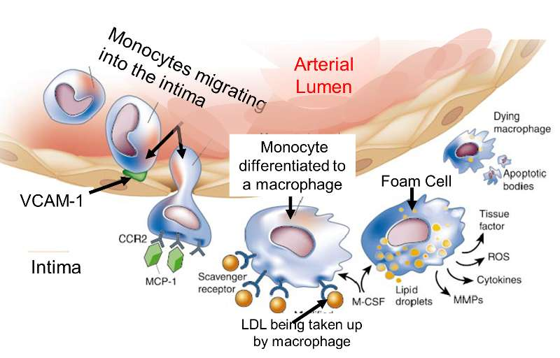
ATHEROSCLEROSIS

Slide 28
ATHEROSCLEROSIS
Response to injury hypothesis
Inflammation
Chronic inflammation contributes to the initiation and progression of atherosclerotic lesions
Inflammation is triggered by accumulation of cholesterol crystals and free fatty acids in macrophages and other cells
These cells release proinflammatory cytokines IL-1, which serves to recruit leukocytes, including monocytes

Slide 29
ATHEROSCLEROSIS
Response to injury hypothesis
Inflammation
Activated macrophages produce reactive oxygen species that enhance LDL oxidation and elaborate growth factors that drive smooth muscle cell proliferation
Activated T cells in the growing intimal lesions elaborate inflammatory cytokines (IFN γ) which in turn activates macrophages, endothelial cells and smooth muscle cells and in turn they release growth factors which causes smooth muscle cell proliferation .

Slide 30
ATHEROSCLEROSIS
Response to injury hypothesis
Infection
Though Herpes virus, cytomegalovirus, chlamydia pneumoniae are thought to be associated but no established causal role of infection is established

Slide 31
ATHEROSCLEROSIS
Response to injury hypothesis
Smooth muscle proliferation and matrix synthesis
Adhesion of platelets and macrophages activates them and they secrete growth factors
Growth factors are also secreted by endothelial cells
Growth factors are
PDGF (Platelet derived Growth Factors)
EGF (Epithelial Growth Factors)
TGF α (Transforming Growth Factor α )
Growth factors lead to smooth muscle migration and proliferation
Smooth muscle cells synthesize collagen, elastin and mucopolysacharides forming extracellular matrix converting fatty streak into atheroma

Slide 32
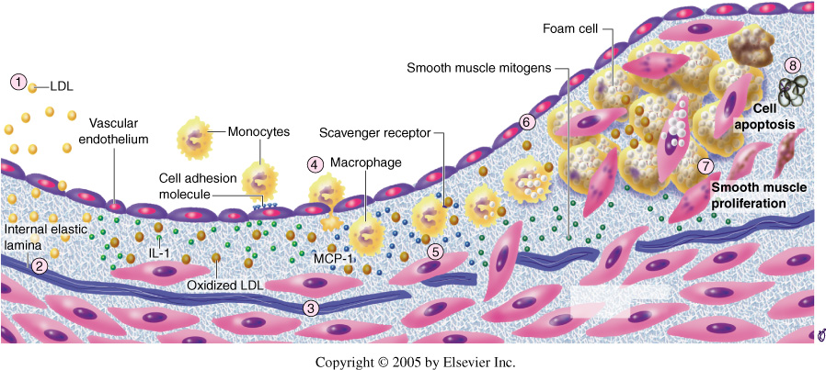
ATHEROSCLEROSIS

Slide 33
ATHEROSCLEROSIS
MORPHOLOGY
Fatty streaks
Composed of lipid filled foamy macrophages
Grossly begin as multiple minute flat yellow spots which eventually coalesce into elongated streaks of 1cm long
Fatty streaks are not much raised to cause significant flow disturbances
All the fatty streaks may not progress to advanced lesions

Slide 34
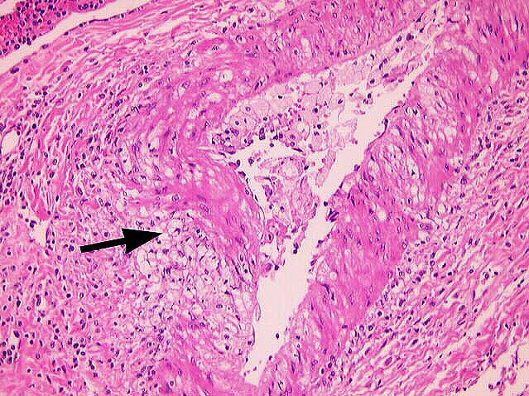
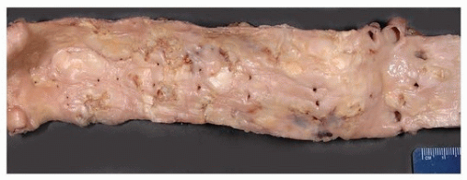
FATTY STREAKS

Slide 35
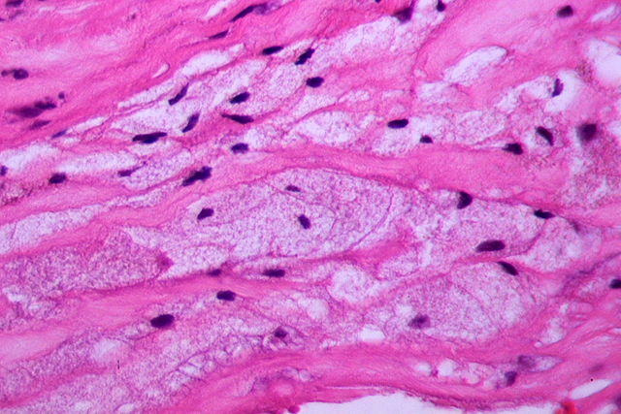
FATTY STREAKS

Slide 36
ATHEROSCLEROSIS
Atherosclerotic plaque
Intimal thickening and lipid accumulation together form plaques
Grossly atherosclerotic plaques are white yellow and encroach on the lumen of the artery. Later ulcerated plaques are superimposed by thrombus
Atherosclerotic plaques are patchy involving only portion of the arterial wall and rarely circumferential on cross section

Slide 37
ATHEROSCLEROSIS
Atherosclerotic plaque
Common sites of formation of atherosclerotic plaques in descending order are
Lower abdominal aorta
Coronary arteries
Popliteal arteries
Internal carotid arteries
Vessels of circle of Willis

Slide 38
ATHEROSCLEROSIS
Atherosclerotic plaques have 3 principle components
Smooth muscle cells, macrophages and T cells
Extracellular matrix including collagen elastic fibres and proteoglycans
Intracellular and extracellular lipids

Slide 39
ATHEROSCLEROSIS
Atherosclerotic plaques
Typically atherosclerotic plaque have superficial fibrous cap composed of smooth muscle cells and relatively dense collagen
Beneath and side of cap shows more cellular area containing macrophages, T cells and smooth muscle cells
Deep to the fibrous cap is a necrotic core containing lipid (primarily cholesterol and cholesterol esters) debris from dead cells, foam cells (lipid laden macrophages and smooth muscle cells) fibrin, variably organized thrombus and other plasma proteins
Cholesterol presents as crystalline aggregates and are washed out during routine processing and leave behind empty “clefts”
Periphery of the lesion shows neovascularization

Slide 40
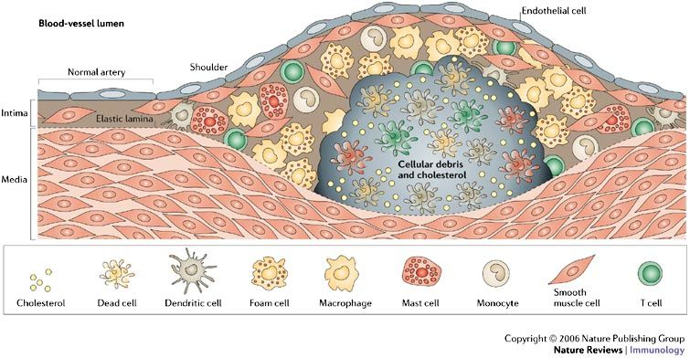

Slide 41
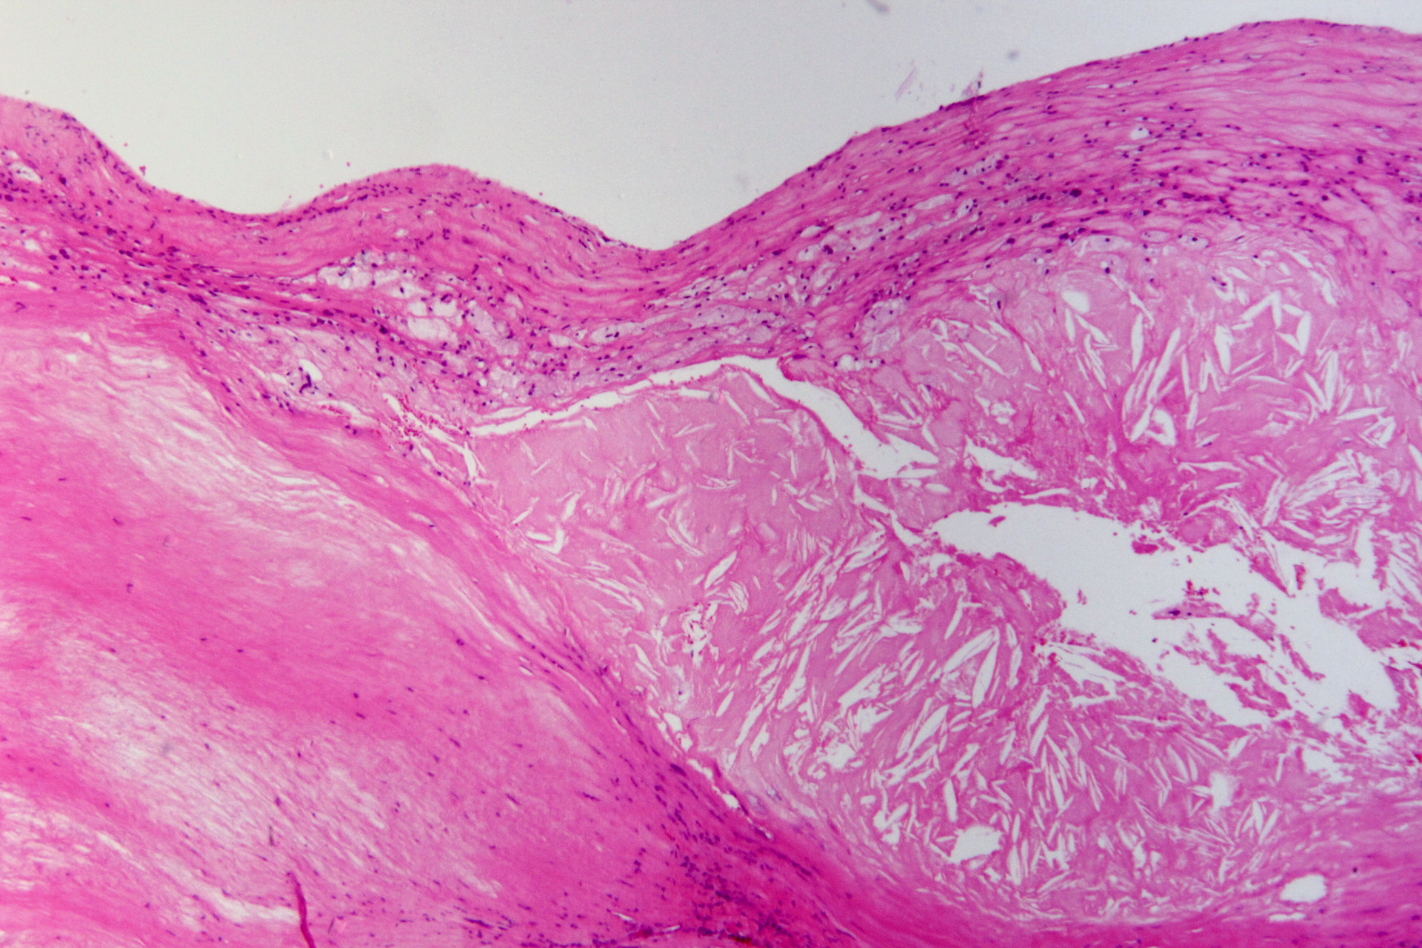

Slide 42
ATHEROSCLEROSIS
CONSEQUENCES OF ATHEROSCLEROTIC PLAQUE
Atherosclerotic stenosis
Acute plaque changes - Rupture, ulceration or erosion – of the surface leads to exposure of highly thrombogenic substances which causes thrombosis producing obstruction of the lumen
Hemorrhage into plaque – occurs due to rupture of the overlying fibrous plaque or blood vessels of neovascularization leading to intraplaque hemorhage producing expansion of the plaque due to hematoma

Slide 43
ATHEROSCLEROSIS
CONSEQUENCES OF ATHEROSCLEROTIC PLAQUE
Atheroembolism – Plaque rupture release contents of atherosclerotic debris into the blood stream producing microemboli
Aneurysm formation – atherosclerosis induced pressure or ischemic atrophy of the underlying media, with loss of elastic tissue causes weakness and potential rupture
Calcification - dystrophic calcification occurs in atherosclerotic plaques

Slide 44
ATHEROSCLEROSIS
CLINICAL MANIFESTATIONS
Atherosclerosis produces manifestations depending upon the blood vessel involved
Coronary artery produces myocardial infarction
Mesenteric artery – produces bowel ischemia
Carotid artery – produces cerebral infarction and stroke
Vessels supplying lower extremities produces gangrene and intermittent claudication

Slide 45
SUMMARY
RISK FACTORS FOR ATHEROSCLEROSIS
NON MODIFIABLE
MODIFIABLE
ADDITIONAL RISK FACTORS
Increasing age
Gender
Genetic factors
Hyperlipidemia
Hypertension
Cigarette smoking
Diabetes mellitus
Inflammation
Hyperhomocysteinemia
Metabolic syndrome
Abnormal apoprotiens
Lipoprotein (a)
Factors affecting hemostatsis
Lack of exercise
Stressful life style
Obesity
Use of exogenous hormones

Slide 46
Thrombus becomes incorporated in the intima and undergoes lipid degeneration to initiate the lesion
ENCRUSTATION HYPOTHESIS
Proliferation of intimal cells due to insudation of lipids and plasma proteins into the vessel wall
INSUDATION HYPOTHESIS
HYPOTHESIS OF ATHEROSCLEROSIS
MONOCLONAL HYPOTHESIS
Smooth muscle cell proliferation starts either from a single cell (monoclonal) or from few cells (oligoclonal)
RESPONSE TO INJURY HYPOTHESIS
Chronic inflammatory and healing response of the arterial wall to the endothelial injury

Slide 47
PATHOGENESIS OF ATHEROSCLEROSIS
HEMODYNAMIC DISTURBANCES (TURBULENT FLOW)
CIGARETTE SMOKE
HOMOCYSTEINEMIA
INFLAMMATION
Due to accumulated lipids and cholesterol
Cytokines released by activated macrophages and T lymphocytes
HYPERLIPIDEMIA
Causes accumulation of LDL in intima
Accumulation of oxygen free radicles
INFECTIONS
Herpes infection
Cytomegalovirus
Chlamydia pneumonia
ENDOTHELIAL DAMAGE
Expression of adhesion molecules like
ICAM 1
E-Selectin
VCAM 1

Slide 48
ENDOTHELIAL DAMAGE
Express adhesion molecules
MACROPHAGES
T CELLS
PLATELETS
Engulf lipids
IFN-γ
Secrete growth factors like PDGF, EGF, and TNF α
Produce cytokines IL-1
Foamy cells
Activating macrophages, endothelial cells and smooth muscle cells
Foam cells die spilling lipid producing inflammatory reaction
Migration and proliferation of smooth muscle cells and matrix production
Fatty streaks
ATHEROSCLEROTIC PLAQUE

Slide 50
MORPHOLOGY
FATTY STREAKS
ATHEROMATOUS PLAQUE
Rupture, ulceration or erosion and thrombus formation
COMPLICATION
Aneurysm formation
Hemorrhage into plaque
Atheroembolism

Slide 51
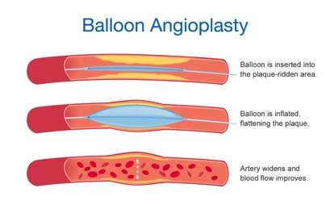
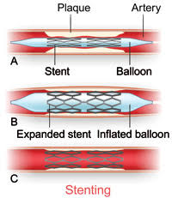
TREATMENT OF CAD

Slide 52
THANK YOU

