Slide 1
NEPHRITIC SYNDROME PATHOPHYSIOLOGY
Dr. V.Shanthi, MD
Associate Professor, Pathology
Sri Venkateswara Institute of Medical Sciences
Tirupathi

Slide 2
NEPHRITIC SYNDROME
Nephritic syndrome comprises group of glomerular diseases characterized by inflammation in glomeruli
Hematuria
Proteinuria (usually subnephrotic range )
Clinical features of nephritic syndrome
Hypertension
Edema
Oliguria
Azotemia

Slide 3
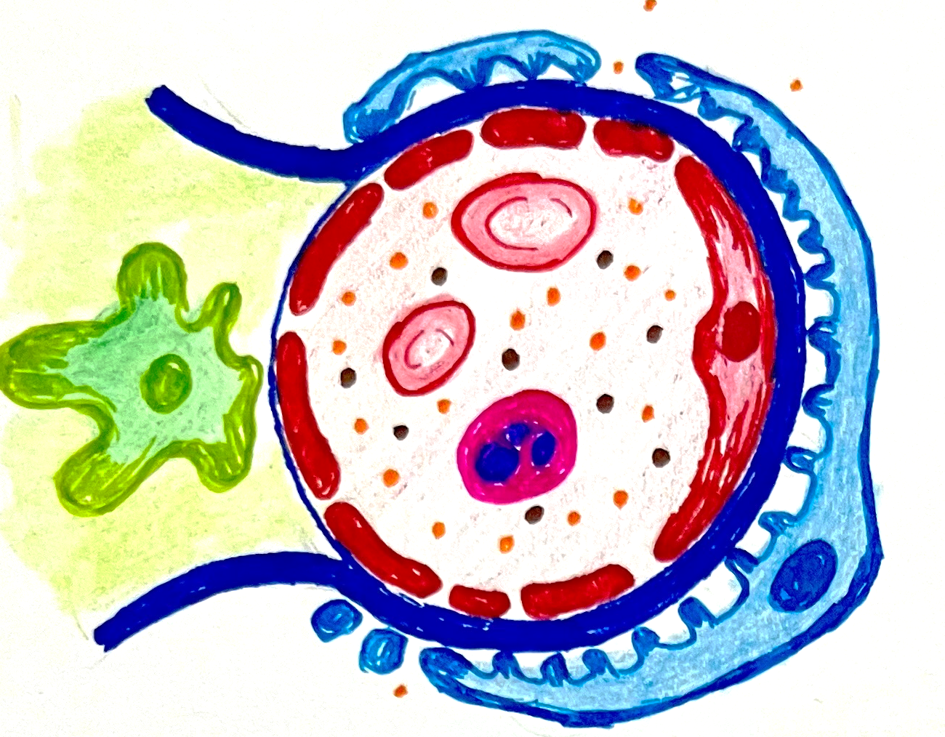
NEPHRITIC SYNDROME
Normal glomerular filtration barrier is formed by endothelium, basement membrane and podocytes
In nephritic syndrome glomerular filtration barrier is damaged by various mechanisms like
Damage to endothelial cells by inflammatory cells and mediators which are the result of immune complex deposition
Primary renal and secondary systemic diseases causing damage to glomerular basement membrane
Damage to podocytes
Basement membrane
Mesangial cell
Podocyte
Endothelium

Slide 4
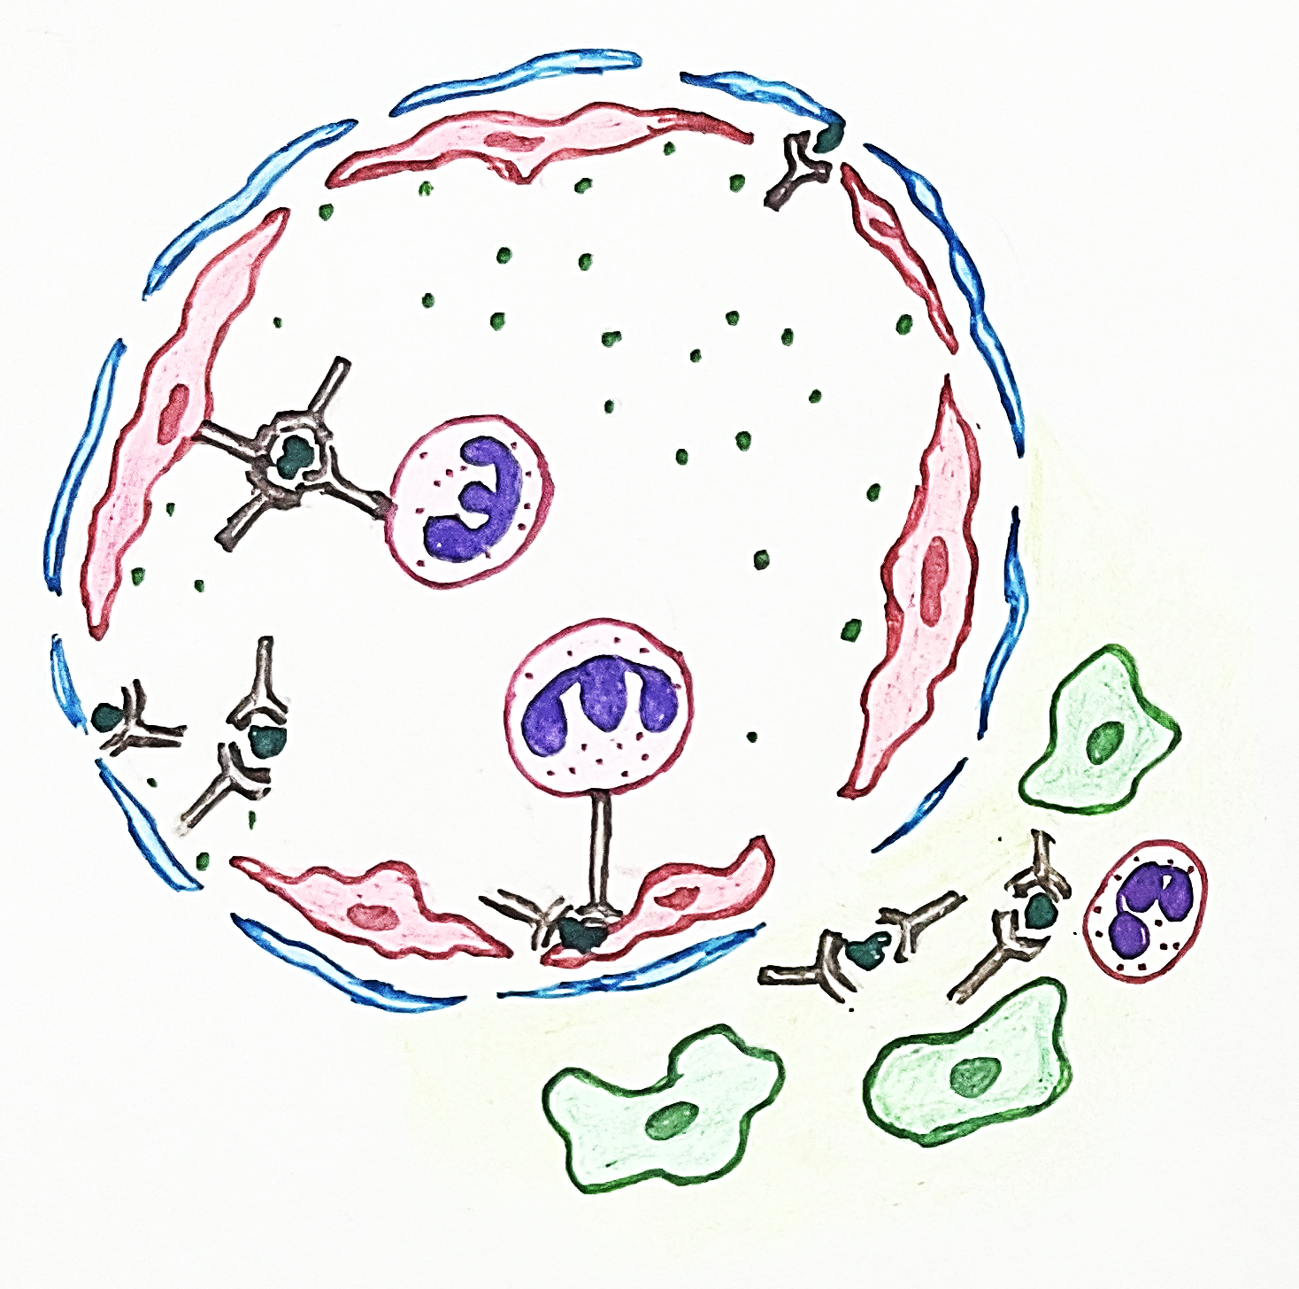
NEPHRITIC SYNDROME Pathogenesis
Ag-Ab complexes in circulation
Hydrolytic enzymes and inflammatory mediators
Complement activation
C5a
C3a
Products of complement causes chemotaxis and attracts inflammatory cells
Immune complexes, Hydrolytic enzymes and inflammatory mediators released by leukocytes cause damage to endothelial cells, podocytes and basement membrane
Ab forming complex with nephritogenic antigen

Slide 5
NEPHRITIC SYNDROME causes
Pauci immune glomerulonephritis
Small vessel vasculitis
Immune complex deposition
Anti GBM mediated disease
Unknown cause
Post infectious glomerulonephritis
Lupus nephritis
RPGN
Henoch-Schonlein purpura
Membranoproliferative glomerulonephritis
Good pasture syndrome
RPGN
IgA nephropathy

Slide 6
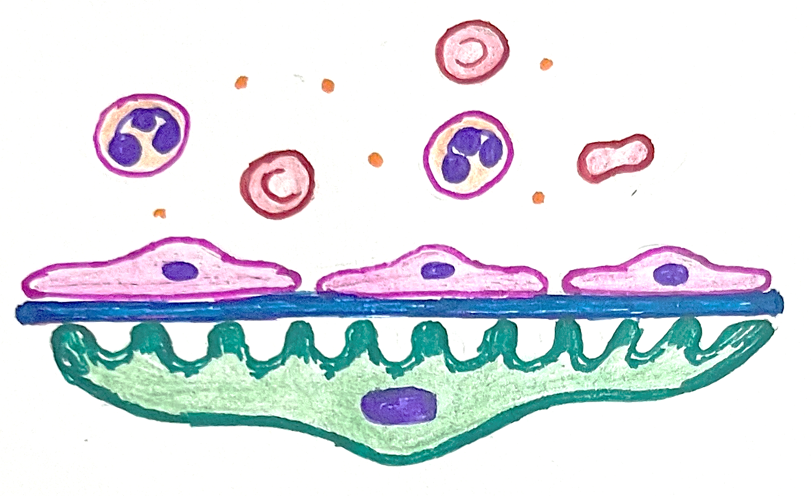
NEPHRITIC SYNDROME Hematuria and albuminuria
Normal glomerular filtration barrier
Glomerular filtration barrier in nephritic syndrome
Albumin
Endothelium
Basement membrane
Podocyte
Swelling of Endothelial cells
Widened foot processes
Damaged endothelial cells swell, basement membrane damage and widening of foot process of podocytes causes RBC’s, inflammatory cells and albumin to leak out of capillaries

Slide 7
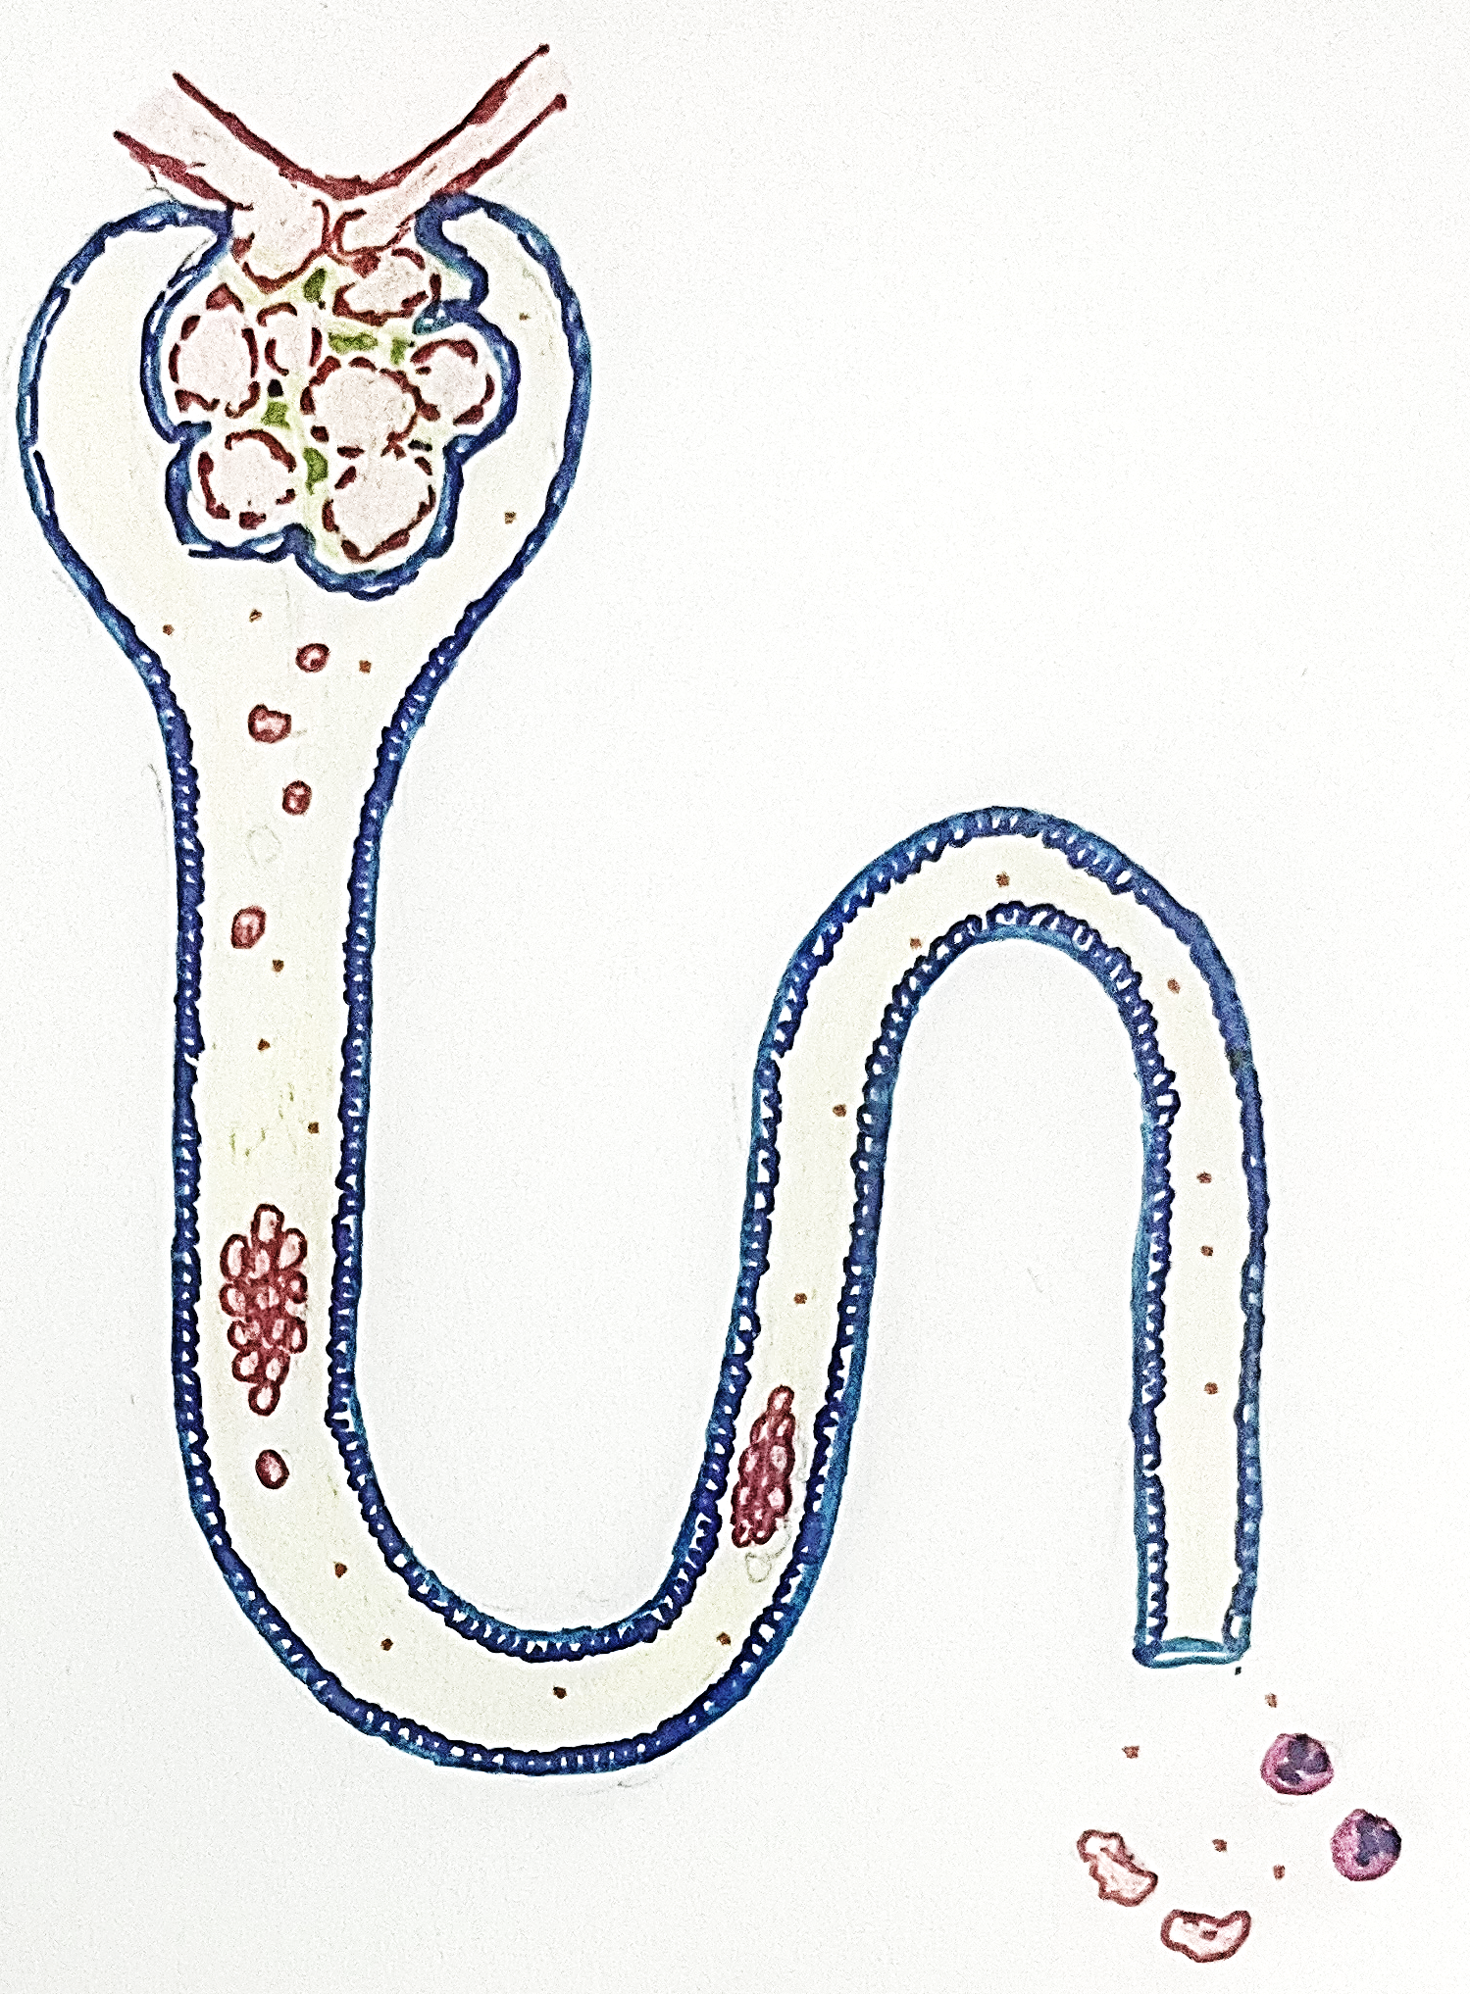
NEPHRITIC SYNDROME
Clinical manifestations
Disruption of the glomerular filtration barrier allows red blood cells, albumin and large molecules to get filtered into urine
Dysmorphic RBCs, acanthocytes and RBC casts are pathognomonic of glomerulonephritis
RBC casts are formed when deformed and distorted RBCs and WBCs are encased by Tamm-Horsfall protein which is secreted by renal tubular cells and excreted in urine normally
Glomerulus
Albumin
RBC
WBC
RBC cast
Dysmorphic RBC, acanthocytes

Slide 8
NEPHRITIC SYNDROME Oliguria
Normal glomerulus
Glomerulus in nephritic syndrome
Swelling of endothelial cells
Leukocytic infiltration
Increased number of mesangial cells
Lumen of the capillaries in glomerulus are narrowed leading to oliguria. It is due to
Swelling of endothelial cells
Increased cellularity in mesangial cells
Leukocytic infiltrate

Slide 9
NEPHRITIC SYNDROME
Reduced blood flow into glomerulus
Reduced GFR
Reduced filtration of urea, nitrogen and creatinine
Compensatory secretion of aldosterone
Enhanced renin secretion
Stimulation of sympathetic system
Increased secretion of ADH
AZOTEMIA
HYPERTENSION
EDEMA

Slide 10
SUMMARY
NEPHRITIC SYNDROME
Immune complex deposition in glomerular capillaries
Activation of complement
Chemotaxis of leukocytes
Leukocytes release hydrolytic enzymes and chemical mediators
Releases C3a and C5a
Infiltration of leukocytes
Proliferation of mesangial cells
Swelling up of endothelial cells
Damage to endothelial cells, BM and podocytes
Decrease in capillary lumen
HEMATURIA
ALBUMINURIA
Decreased GFR
OLIGURIA
Reflux secretion of renin, aldosterone
Sympathetic stimulation
Increased ADH secretion
AZOTEMIA
RBC casts and dysmorphic RBCs in urine
HYPERTENSION
EDEMA

