Slide 1
TESTICULAR TUMORS
Dr.V.Shanthi
Associate Professor, Pathology
Sri Venkateswara Institute of Medical Sciences
Tirupathi

Slide 2
TESTIS AND EPIDIDYMIS CONGENITAL ANOMALIES
Anomalies include
Cryptorchidism
Aplasia
Fusion (synorchism)
a variety of developmental cysts

Slide 3
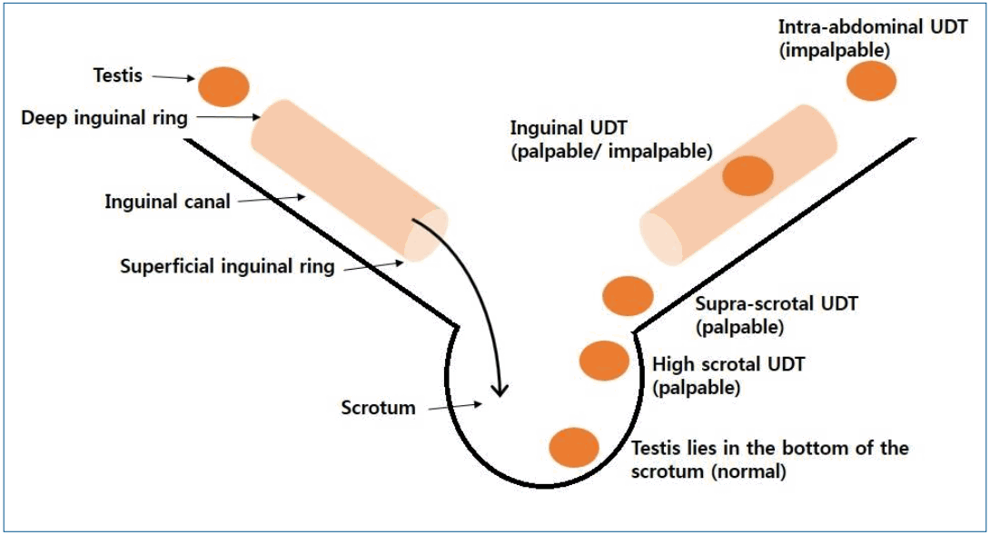
CRYPTORCHIDISM
Cryptorchidism represents failure of descent
Testes may be found anywhere along the normal path of descent, from the abdominal cavity to the inguinal canal

Slide 4
CRYPTORCHIDISM
Cryptorchidism affects 1% of 1-year-old boys.
Most cases are idiopathic
other causes include
Genetic abnormalities (e.g., trisomy 13)
Hormonal abnormalities

Slide 5
CRYPTORCHIDISM
Most cases are unilateral. 25% are bilateral.
Histologic change
Cryptorchid testes are small and firm
may be apparent as early as 2 years of age
Changes include decreased germ cell development, thickening and hyalinization of seminiferous tubular basement membrane, interstitial fibrosis, and relative sparing of Leydig cells.
Regressive changes may also occur in the contralateral descended testis.

Slide 6
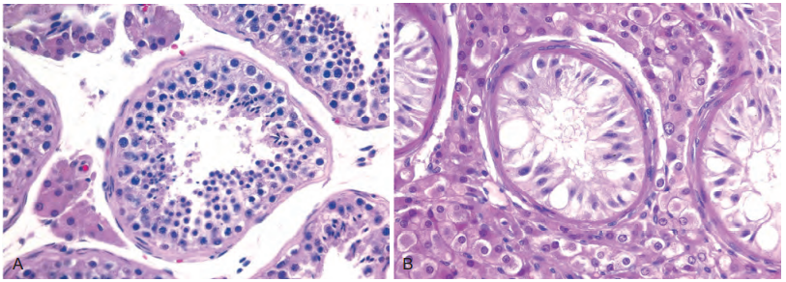
NORMAL TESTIS CRYPTORCHID TESTIS

Slide 7
CRYPTORCHIDISM
Clinical Significance
Related to high prevalence of inguinal hernias sterility, and a 5 -to 10-fold increased incidence of testicular neoplasm’s
Surgical correction (orchiopexy) decreases the likelihood of sterility if performed early but does not decrease the risk neoplasia, which may occur in either testis

Slide 8
ATROPHY
Atrophy may be secondary to
Cryptorchidism
Vascular disease
Inflammatory disorders
Hypopituitarism
Malnutrition
Obstruction of outflow of semen
Elevated levels of female sex hormones (endogenous or exogenous)
Radiation and chemotherapy

Slide 9
ATROPHY
May also be encountered as a primary developmental abnormality in patients Klinefelter syndrome.
Morphologic alterations identical to those in cryptorchidism

Slide 10
TESTICULAR TUMORS
They are divided into two categories –
a. Germ cell tumors
b. Non germinal tumors – derived from stroma or sex cord
Germ cell tumors are highly aggressive cancers capable of rapid & wide dissemination
Non germinal tumors are generally benign, but some elaborate steroids

Slide 11
TESTICULAR TUMORS
Germ cell tumors
Sex cord – stromal tumors
Tumor containing both Germ cell and Sex cord stromal tumor
Seminoma
Spermatocytic seminoma
Embryonal carcinoma
Yolk sac tumor
Choriocarcinoma
Teratoma
Leydig cell tumor
Sertoli cell tumor
Gonadoblastoma

Slide 12
GERM CELL TUMORS
Seminomatous tumors
Non-seminomatous tumors
Resembles primordial germ cells or early gonocytes
Composed of undifferentiated cells that resemble embryonic stem cell and can differentiate into other cell lineages generating yolk sac tumors, choriocarcinoma and teratomas

Slide 13
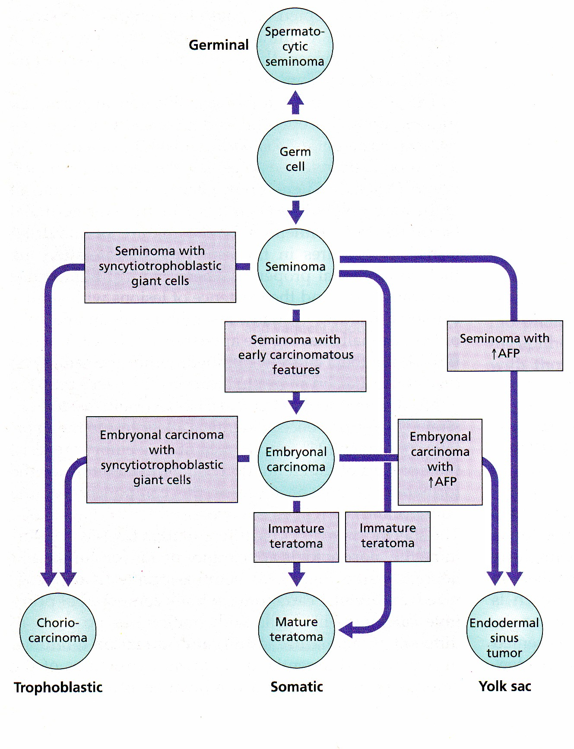

Slide 14
TESTICULAR TUMORS
Germ cell tumors
Common age group – 15 to 34 years
Causes approximately 10% of all cancer deaths
Germ cells are multipotential and can differentiate in any line once they become cancerous

Slide 15
GERM CELL TUMORS
Predisposing factors:
Cytoptorchidism
Testicular dysgenesis (klinefelters syndrome)
Genetic factor – chromosome of the short arm of chromosome 12
Undescended testes – higher the location increases the risk of developing cancer

Slide 16
GERM CELL TUMORS
Pathogenesis of germ cell tumors involves both
Environmental exposures
Inherited and acquired genetic abnormalities

Slide 17
GERM CELL TUMORS
Genetic factors
Risk of GCT is 4 times higher in father and sons of affected patients and 8 to 10 times higher in brothers
Genes associated are those encoding the ligand for the receptor tyrosine kinase KIT and BAK which are inducers of apoptotic cell death
KIT and BAK genes also play a role in gonadal development

Slide 18
STEPS IN DEVELOPMENT OF GERM CELL TUMORS
Cell of origin of GCT is primordial germ cell with an acquired defect in differentiation
Activation of growth factor receptor signaling, often by activating mutations in the KIT receptor tyrosine kinase
Stimulates proliferation
GERM CELL NEOPLASIA IN SITU
GCNIS arises in utero and stay dormant until puberty, when hormonal influences may stimulate germ cell growth

Slide 19
GERM CELL TUMORS
GCT derived from Germ cell Neoplasia
GCT unrelated from Germ cell Neoplasia
Non invasive
Germ cell neoplasia insitu
Tumors of single histologic type
Seminoma
Non-seminomatous germ cell tumors
Embryonal carcinoma
Yolk sac tumor
Choriocarcinoma
Teratoma post pubertal
Teratoma with somatic type malignancy
Non-seminomatous germ cell tumors of more than one histologic types
Spermatocytic tumor
Teratoma prepubertal type
Yolk sac tumor prepubertal type
Mixed teratoma and yolk sac tumor, prepubertal type

Slide 20
GERM CELL TUMORS
Lesional cells retain the expression of transcription factors OCT3/4 and NANOG, which are important in maintenance of pluripotent stem cells
Development of full blown GCTs is strongly associated with reduplication of short arm of chromosome 12, regardless of histologic type
70% of individuals with GCNIS develop invasive GCTs with 7 years of diagnosis

Slide 21
GERM CELL TUMORS
SEMINOMA
Most common type of germ cell tumor
Peak age – in 4th decade
Never occur in infants
Identical tumor in the ovary – dysgerminoma

Slide 22
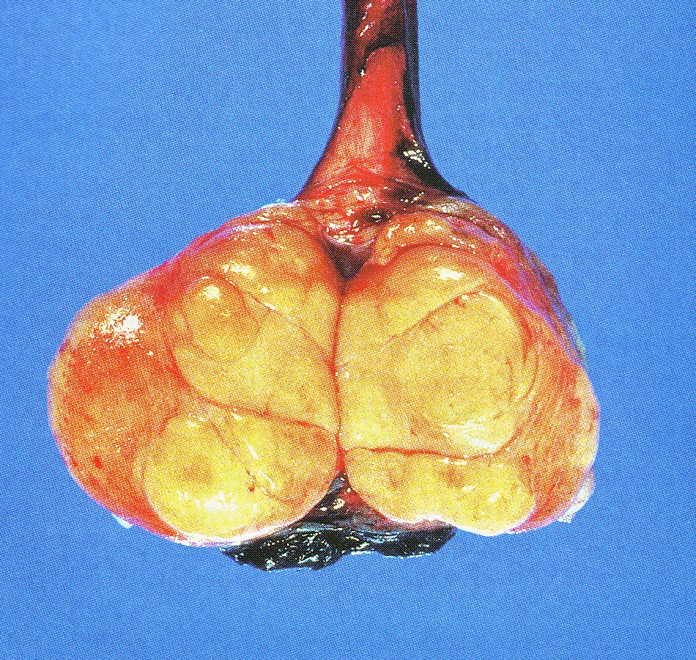
GERM CELL TUMORS SEMINOMA
Morphology:
Gross:
produces bulky mass about 10 times the
size of the normal testes.
C/S – homogenous, grey white, fleshy & lobulated mass usually devoid of hemorrhage or necrosis
Tunica albuginea is not penetrated but
occasionally extends to the epididymis, spermatic cord or scrotal sac occurs

Slide 23
GERM CELL TUMORS SEMINOMA
Microscopically:
Sheets of uniform cells divided into poorly demarcated lobules by delicate septa of fibrous tissue.
Classic seminoma cells – large & round to polyhedral and has a distinct cell membrane, clear or watery appearing cytoplasm & large central nucleus with one or two prominent nucleoli.
Fibrous septa are usually infiltrated by T lymphocytes

Slide 24
SEMINOMA

Slide 25
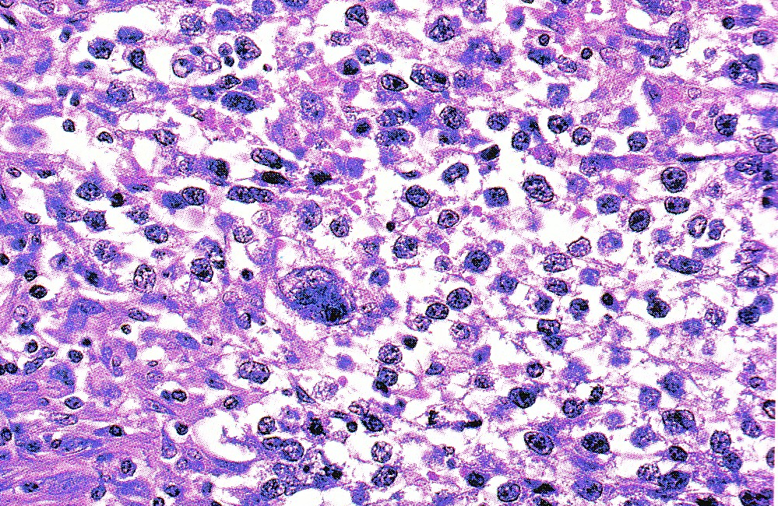
ANAPLASTIC SEMINOMA
Seminoma with greater cellularity, nuclear irregularities and more frequent tumour giant cells

Slide 26
GERM CELL TUMORS SPERMATOCYTIC SEMINOMA
This is an uncommon tumor representing about 1% to 2% of all testicular germ cell neoplasms and do not arise from intratubular germ cell neoplasia
Age of involvement is much later than the testicular tumors ( >65 years of age)
It is a slow growing tumor and rarely metastasizes so excellent prognosis
Does not arise from GCN insitu, lacks isochromosome 12p and is characteristically associated with 9q

Slide 27
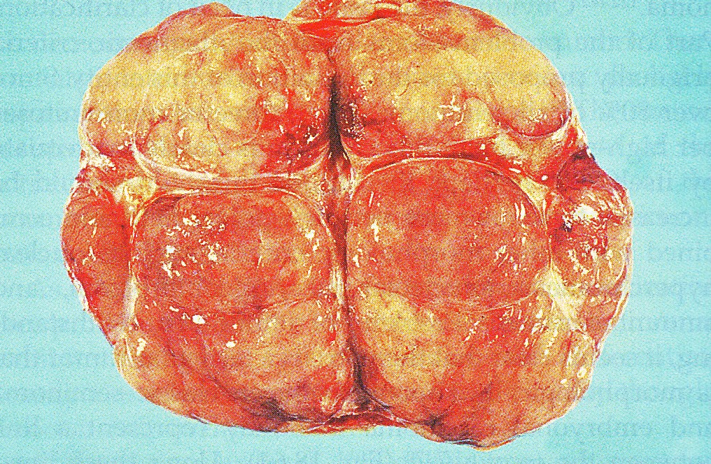
SPERMATOCYTIC SEMINOMA
Morphology –
Grossly it is circumscribed fleshy large pale, soft, and with myxoid areas. Sometimes cystic regions may be present

Slide 28
GERM CELL TUMORS SPERMATOCYTIC SEMINOMA
Morphology –
Microscopically three cell populations are seen all intermixed-
a. medium sized cells with round nucleus & eosinophilic cytoplasm
b. smaller cells with rim of cytoplasm & spireme chromatin
c. scattered giant cells

Slide 29
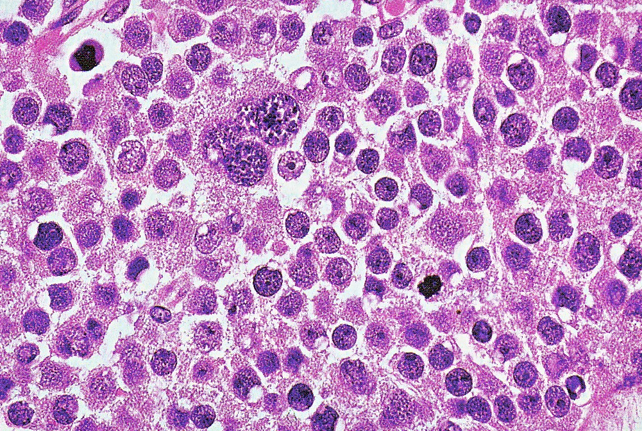
Spermatocytic seminoma

Slide 30
Spermatocytic seminoma Spireme chromatin

Slide 31
SPERMATOCYTIC SEMINOMA
In contrast to seminoma, spermatocytic seminoma lacks
Inflammatory infiltrate
Syncytiotrophoblasts
Does not occur at extratesticular sites
Never admixed with other GCTs

Slide 32
GERM CELL TUMORS EMBRYONAL CARCINOMA
It occurs mostly in the 20 to 30 year age group
Grossly –
Tumor is locally aggressive
Extension through the tunica albuginea into the epididymis or cord may occur
c/s often variegated, foci of hemorrhage or necrosis

Slide 33
Embryonal carcinoma

Slide 34
GERM CELL TUMORS EMBRYONAL CARCINOMA
Microscopically
The cells grow in alveolar or tubular pattern and some times with papillary convulsions
Undifferentiated lesions may present sheets of cells
Tumor cells are large anaplastic with hyperchromatic nuclei having prominent nucleoli and with indistinct cell borders
Mitotic figures and tumor giant cells are seen

Slide 35
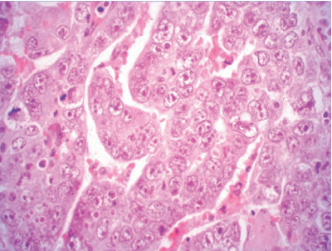
Embryonal carcinoma

Slide 36
Germ Cell tumors Embryonal carcinoma
The tumor cells contain HCG, AFP or both which may be detected by immunoperoxidase techniques
Immunohistochemistry –
Positive for – OCT3/4, cytokeratin
Negative for – KIT and podoplanin

Slide 37
GERM CELL TUMORS YOLK SAC TUMOR
Also known as endodermal sinus tumor
Age- common in infants and children up to 3 years of age and in this age has a very good prognosis
In adults pure form is rare instead it occurs in combination with embryonal carcinoma

Slide 38
GERM CELL TUMORS YOLK SAC TUMOR
Morphology –
Grossly the tumor is non encapsulated and on cut section it is homogenous, yellow white, with mucinous appearance

Slide 39
GERM CELL TUMORS YOLK SAC TUMOR
Morphology –
Microscopically lace like network of medium sized cuboidal or elongated cells
Sciller duval bodies are seen –they consist of central capillary & a visceral and parietal layer of cells resembling primitive glomeruli
Present with in and outside the cytoplasm are eosinophilic, hyaline like globules in which AFP and alpha 1 antitrypsin can be demonstrated by immunocytochemical staining

Slide 40
Yolk sac tumor Sciller duval bodies

Slide 41
Yolk sac tumor

Slide 42
GERM CELL TUMORS CHORIOCARCINOMA
It is a highly malignant form of testicular tumor that is composed of both cytotrophoblastic and syncytiotrophoblastic cells
Pure form of choriocarcinoma is rare (constitutes <1% of GCT)
Morphology –
They cause no testicular enlargement and presents as small palpable nodule

Slide 43
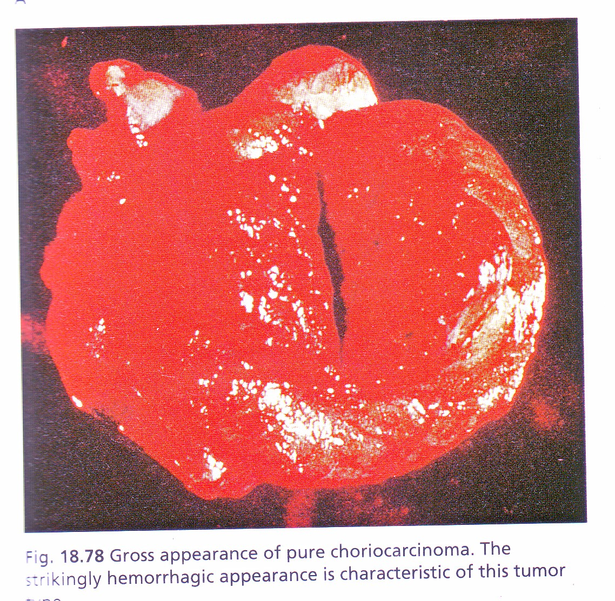
GERM CELL TUMORS CHORIOCARCINOMA
Morphology –
They are rapidly growing and may outgrow their blood supply so that sometimes the primary tumor is replaced by a small fibrous scar leaving only wide spread metastasis
Hemorrhage and necrosis are extremely common

Slide 44
Germ Cell tumors Choriocarcinoma
Microscopically –
The tumor contains two cell types i.e synciotrophoblast & cytotrophoblast
Syncitiotrophoblastic cells are large and has many irregular or lobular hyperchromatic nuclei and an abundant eosinophilic vacuolated cytoplasm & HCG can be readily demonstrated in them
Cytotrophoblast are regular polygonal cells with clear cytoplasm & single fairly uniform nuclei. They grow in cords or masses

Slide 45
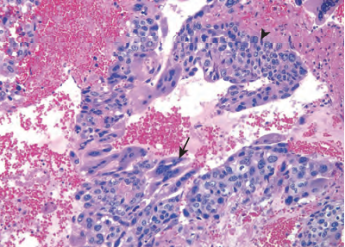
Choriocarcinoma

Slide 46
GERM CELL TUMORS TERATOMA
These tumors have various cellular or organoid components remniscent of normal derivative from more than one germ cell layer
Age – infant to adult life
Pure form common in the infants
In adults pure form are rare

Slide 47
GERM CELL TUMORS TERATOMA
Morphology –
Grossly they are large ranging from 5 to 10 cms in diameter
Gross appearance is heterogenous with solid, sometimes cartilagenous and cystic areas
Hemorrhage and necrosis usually indicate admixture with embryonal carcinoma, choriocarcinoma or both

Slide 48
Teratoma

Slide 49
GERM CELL TUMORS TERATOMA
Microscopically these tumors are composed of heterogenous structures like neural tissue, muscle bundles, islands of cartilage, clusters of squamous epithelium, structures remniscent to thyroid gland, bronchiolar epithelium, & bits of intestinal wall or brain substance embedded in the fibrous or myxoid stroma
Elements may be mature or immature

Slide 50
Teratoma

Slide 51
GERM CELL TUMORS TERATOMA
Teratomas with malignant transformation – non germ cell tumor arising in the teratoma E.g. squamous cell carcinoma, mucin secreting adenocarcinoma, or sarcoma. These secondary tumors are chemoresistant
In children mature teratomas behave like benign tumors where as in adults teratomas are regarded as malignant & capable of metastatic behavior

Slide 52
GERM CELL TUMORS MIXED TUMORS
60% of testicular tumors are composed of more than one of the pure patterns
Common mixtures include
Teratoma, embryonal carcinoma and yolk sac tumor
Other patterns include seminoma with embryonal carcinoma
embryonal carcinoma with teratoma
Prognosis is worsened by the inclusion of more aggressive elements

Slide 53
GERM CELL TUMORS
METASTASIS
Lymphatic spread – common in seminomas - retroperitoneal paraaortic lymphnodes and subsequently to mediastinal and supraclavicular lymphnodes
Hematogenous spread –common in non-seminomatous GCT - to lungs, liver, brain and bones
Histology of metastasis may differ from primary as GCTs are derived from pluripotent germ cells
Minor component of primary tumor may survive the chemotherapy and becomes subsequent dominant histologic type

Slide 54
GERM CELL TUMORS
Three clinical stages of testicular are defined –
Stage I – tumor confined to the testis, epididymis, or spermatic cord
Stage II – distant spread confined to retroperitoneal lymph nodes below the diaphragm
Stage III – metastases outside the retroperitoneal nodes or above the diaphragm

Slide 55
GERM CELL TUMORS Tumor markers
Germ cell tumors of the testis often secrete polypeptide hormones and certain enzymes that can be detected in blood. They are –
Alpha Feto Protein (AFP)
Human Chorionic Gonadotrophin (HCG)
Placental alkaline phosphatase
Placental lactogen
Lactate dehydrogenase

Slide 56
TESTICULAR TUMORS
Tumors of sex cord – Gonadal stroma
Two most important members of this group are –
a. Leydig cell tumors
b. Sertoli cell tumors

Slide 57
LEYDIG ( INTERSTITIAL ) CELL TUMORS
Arise at age – 20 and 60 years
These tumors elaborate – androgens & estrogens & some elaborate corticosteroids
Commonest presentation – testicular swelling & gynecomastia
In children – manifested as sexual precocity

Slide 58
LEYDIG ( INTERSTITIAL ) CELL TUMORS
Morphology –
Grossly – circumscribed nodules, usually less than 5mm in diameter
C/s – distinctive, golden brown, homogenous

Slide 59
LEYDIG ( INTERSTITIAL ) CELL TUMORS
Histologically –
Tumorous leydig cells are large and round or polygonal & have an abundant granular eosinophilic cytoplasm with a round central nucleus
Cytoplasm contains lipid granules, vacuoles or lipofuscin pigment & characteristically Reinke crystalloids
Most tumors are benign & 10% of them in adults are invasive

Slide 60
Leydig cell tumors

Slide 61
Leydig cell tumors

Slide 62
SERTOLI CELL TUMOR ( ANDROBLASTOMA )
Tumor is composed entirely of sertoli cells or may have a component of granulosa cells
Estrogens and androgens may be elaborated
Morphology –
Grossly the tumor is a firm, small nodules with a homogenous gray white to yellow cut surface
Histologically tumor cells are arranged in distinctive trabeculae with a tendency to form cord like structures resembling immature semniferous tubules

Slide 63
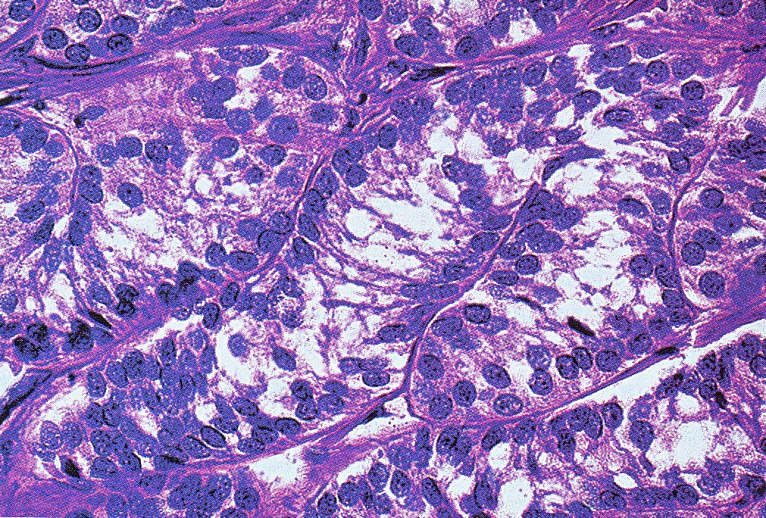
SERTOLI CELL TUMOR ( ANDROBLASTOMA )

Slide 64
GONADOBLASTOMA
It is a rare neoplasm containing a mixture of germ cells and gonadal stromal elements

Slide 65
THANK YOU

