Slide 1
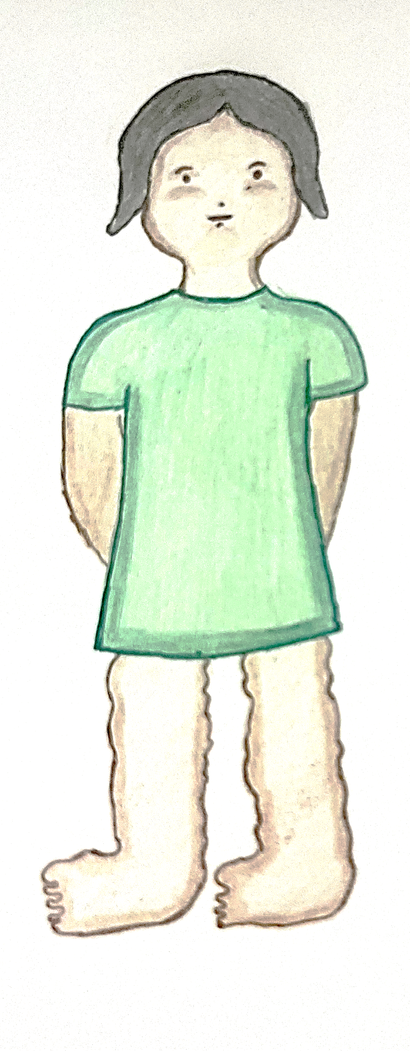
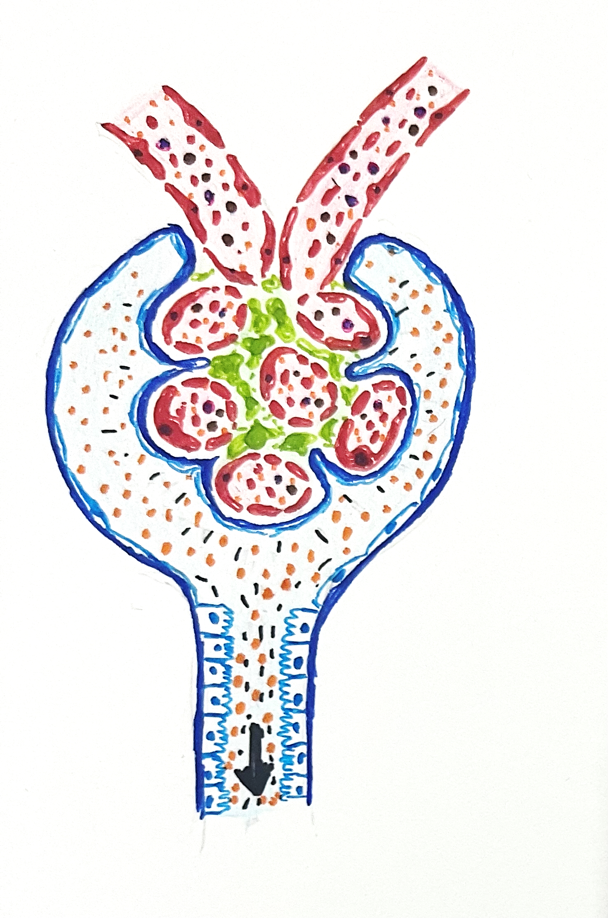
NEPHROTIC SYNDROME PATHOPHYSIOLOGY
Dr. V.Shanthi, MD
Associate Professor, Pathology
Sri Venkateswara Institute of Medical Sciences
Tirupathi

Slide 2
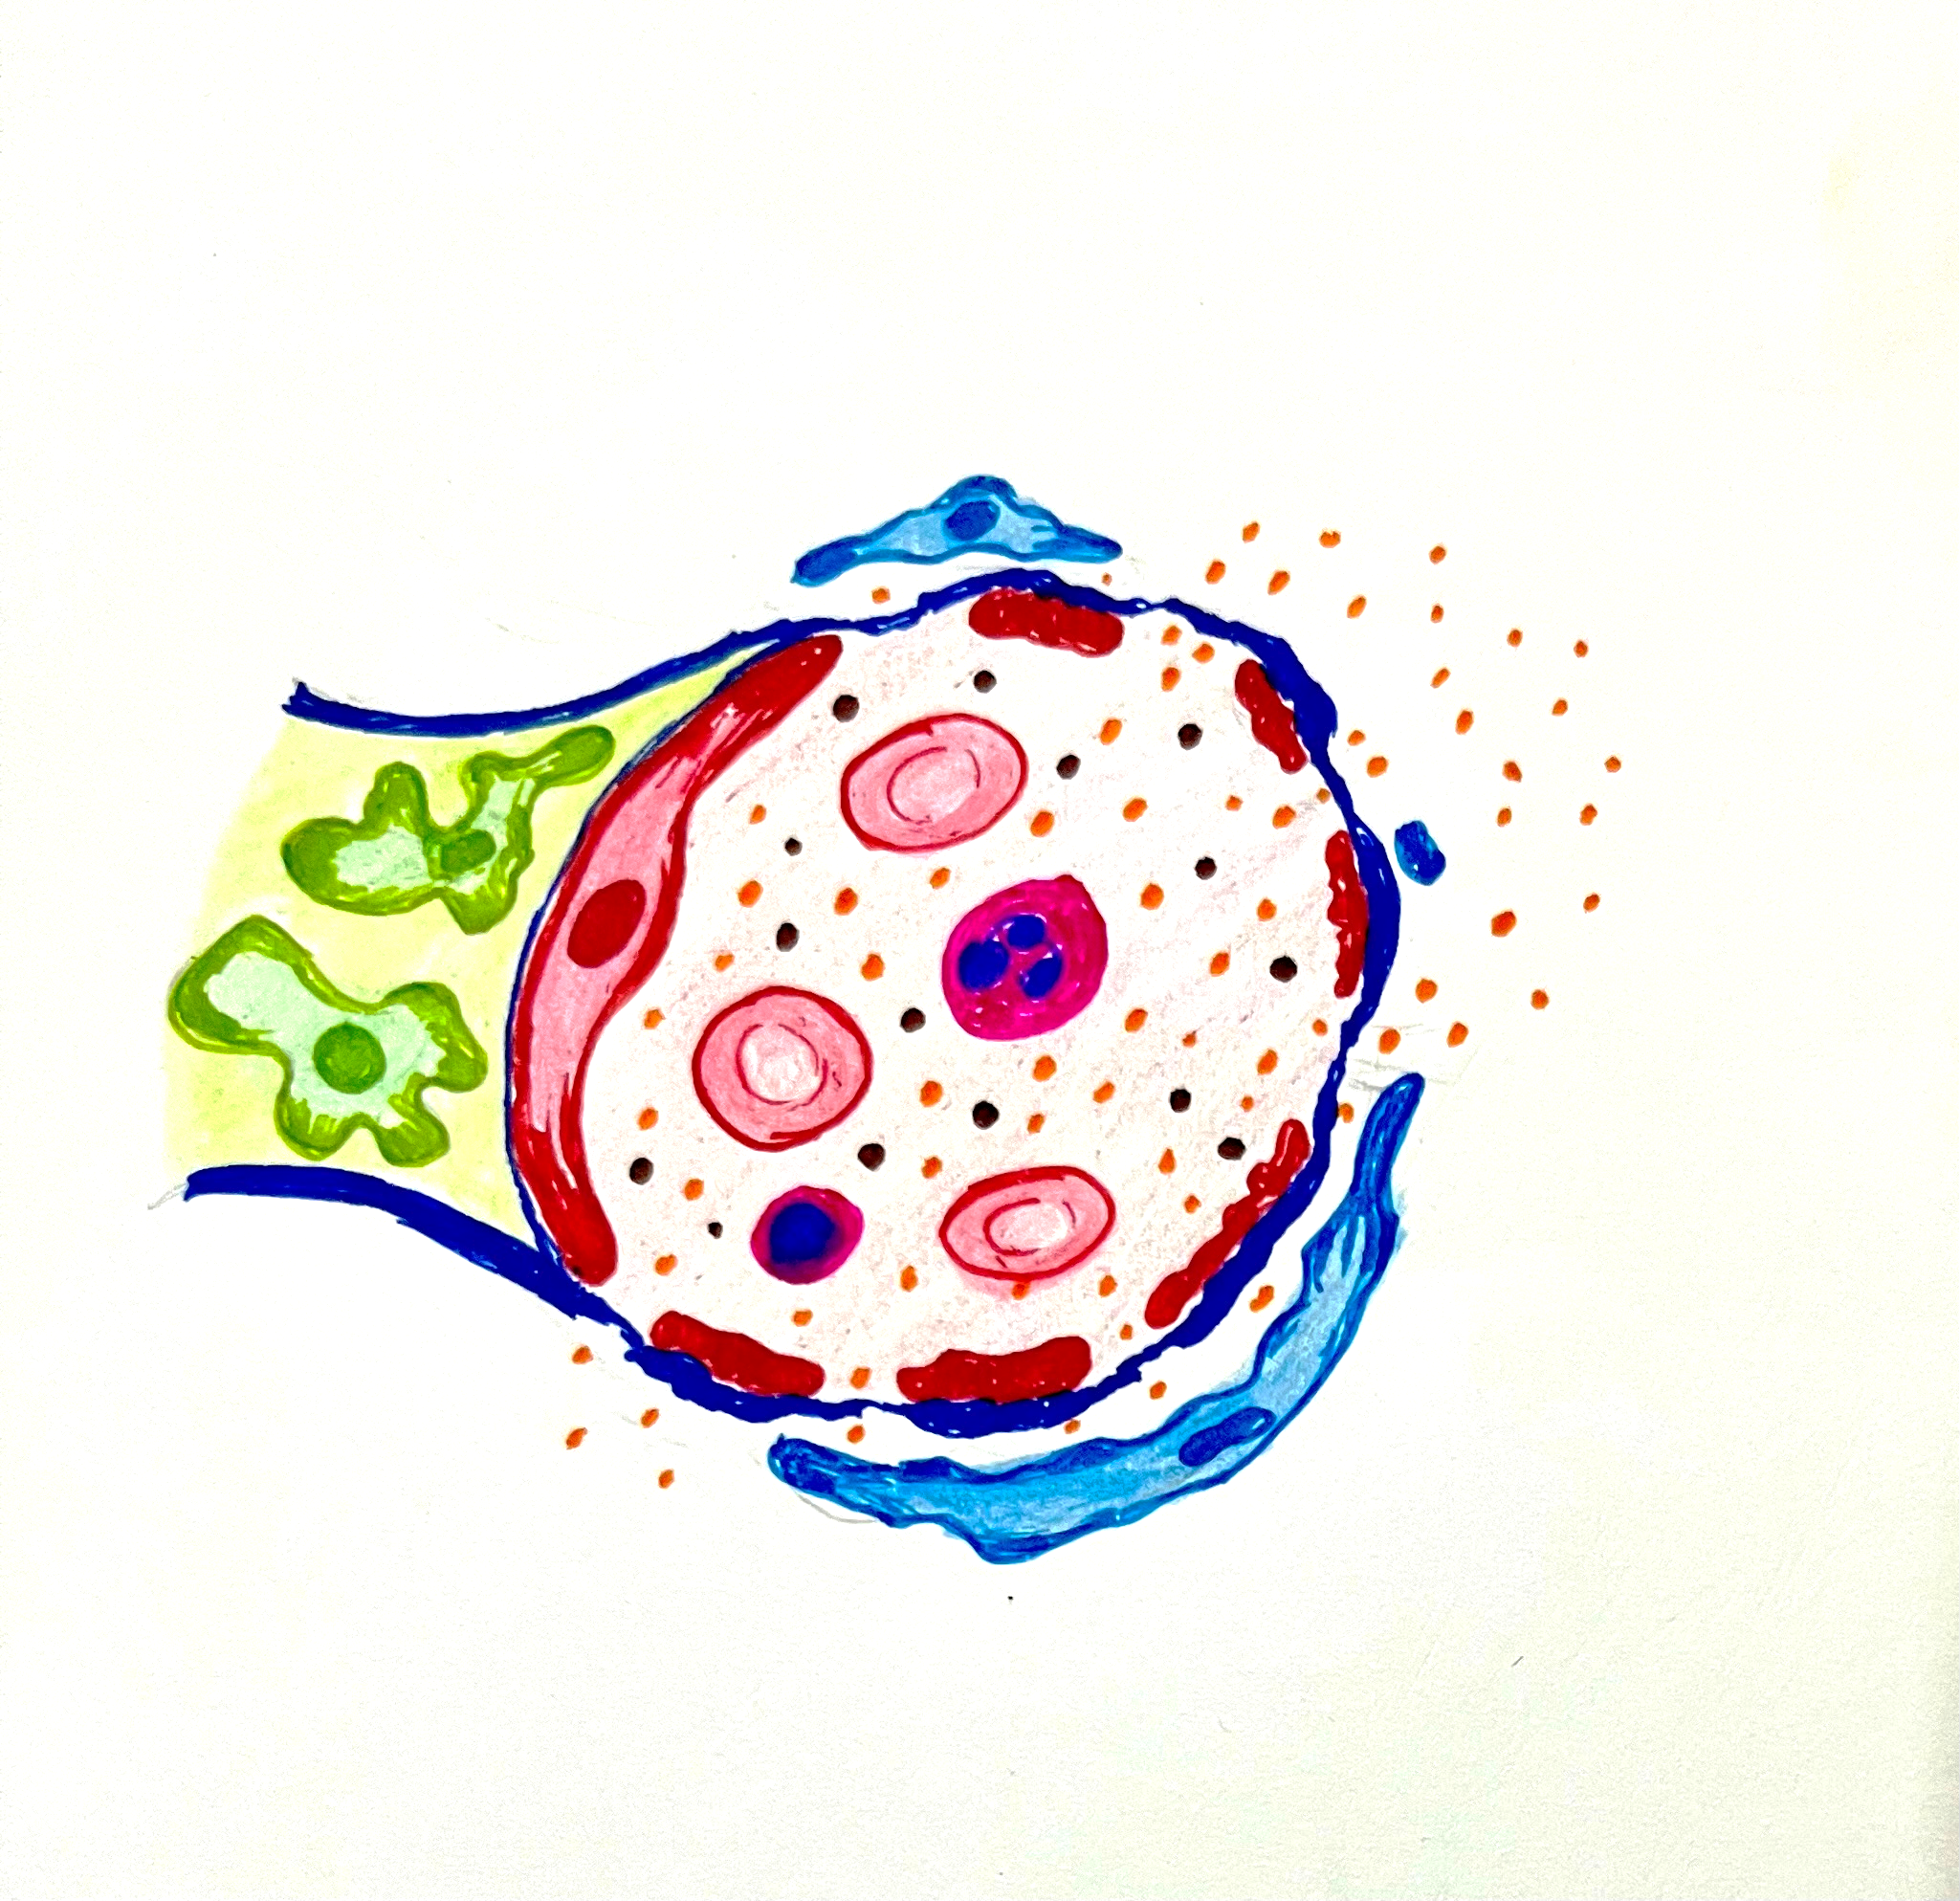
NEPHROTIC SYNDROME
Nephrotic syndrome is not a specific diagnosis, but instead represents a group of abnormalities caused by a derangement in glomerular capillary walls or podocyte damage resulting in charge barrier disruption leading to increased permeability to plasma proteins
Endothelial cells
Albumin
Podocyte

Slide 3
NEPHROTIC SYNDROME - CAUSES
PRIMARY CAUSES
SECONDARY CAUSES
Membranous nephropathy
Minimal change disease
Focal segmental glomerulonephritis
Membranoproliferative glomerulonephritis
Other proliferative glomerulonephritis (Ig A nephropathy)
Diabetes Mellitus
Amyloidosis
SLE
Drugs (NSAID, Pencillamine, heroine)
Infections (malaria, syphilis, hepatitis B and C, HIV)
Malignant disease (carcinoma, lymphoma)
Miscellaneous (Bee-sting allergy, hereditary nephritis)

Slide 4
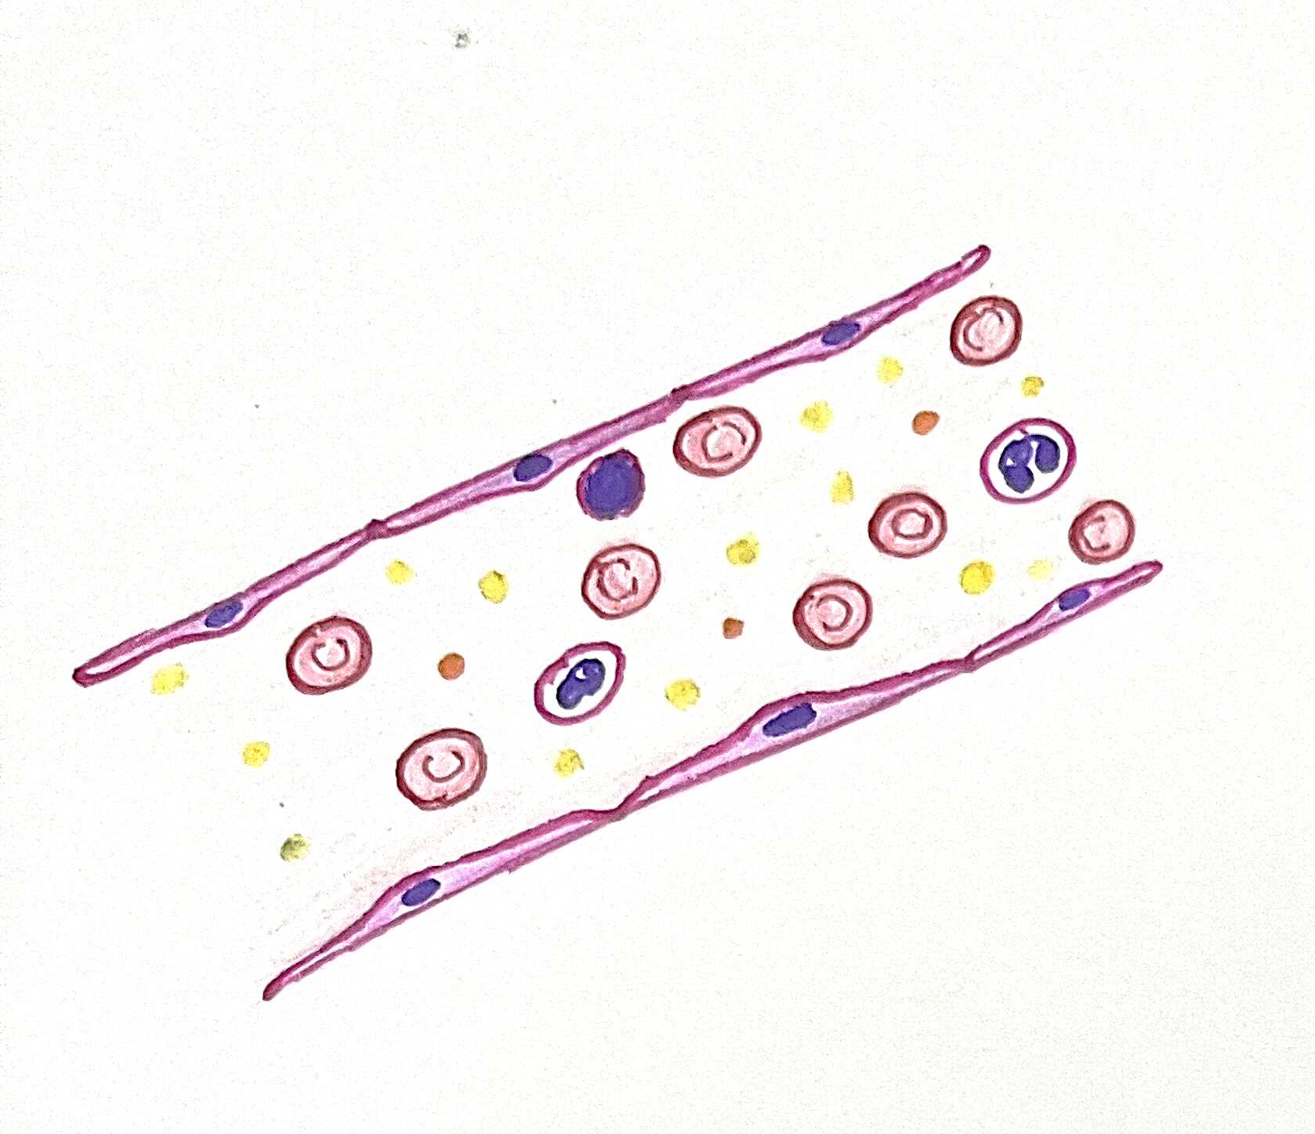
NEPHROTIC SYNDROME
Manifestation of nephrotic syndrome
Heavy proteinuria
Hypoalbuminemia
Hyperlipidemia and lipiduria
Generalized edema
Albumin
Blood vessel
Triglycerides
loss of 3.5g or more of protein/24hrs

Slide 5
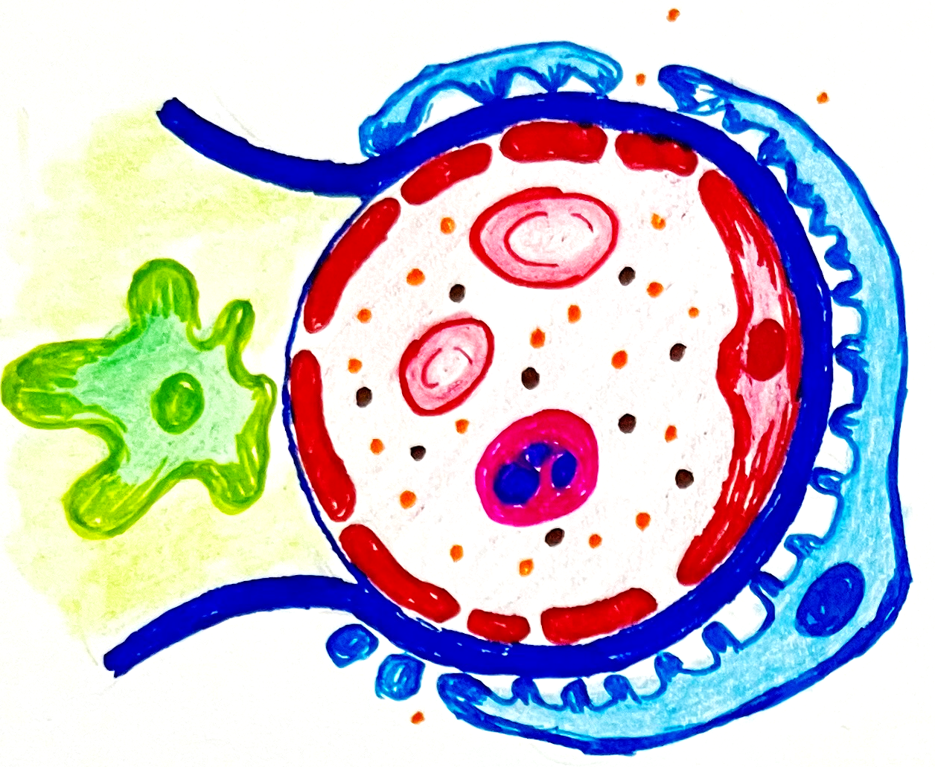
PROTEINURIA
Albumin
Endothelial cells
Normally a small amount of protein i.e. 20 to 150 mg/day passes through the glomerular filtration barriers and is reabsorbed by the tubules
Mesangial cells
If excess of protein is filtered exceeding the capacity of tubules for reabsorption, these proteins appear in urine
Globulin
Podocyte

Slide 6
NEPHROTIC SYNDROME
Highly selective proteinuria consists of low molecular weight proteins (albumin, 70KD, transferrin, 76KD molecular weight)
Poorly selective proteinuria - high molecular weight globulins in addition to albumin
Endothelial cells
Albumin
In nephrotic syndrome there is loss of albumin (molecular weight 66,000)
Massive proteinuria –with daily loss of 3.5g or more of protein/24hrs
Globulin
Podocyte

Slide 7
NEPHROTIC SYNDROME - HYPOALBUMINEMIA
Increased loss of albumin
Hypoalbuminemia
Albumin
plasma albumin levels less than 2.5g/dl
Inadequate hepatic synthesis of protein

Slide 8
NEPHROTIC SYNDROME - EDEMA
Reflux reaction for hypovolemia
Compensatory secretion of aldosterone
Enhanced renin secretion
Stimulation of sympathetic system
Reduction in the secretion of natriuretic factors such as atrial peptides
Na and H2O retention
Hypoalbuminemia
Puffiness of face
Generalized edema
Albuminuria
Decreased colloid osmotic pressure

Slide 9
NEPHROTIC SYNDROME – HYPERLIPIDEMIA NORMAL FATTY ACID UTILIZATION IN TISSUE
Dietary intake
Adipose tissue
Stored triglycerides
Long chain fatty acids (>12 carbon)
Medium chain fatty acids (8 – 12 carbon)
Triglyceride lipase
FFA - Albumin
FFA release
Circulating triglyceride
FFA
Endothelium bound Lipoprotein lipase
Albumin
Lipoprotein lipase in tissue
FFA release
FFA uptake in skeletal muscle, heart, adipose tissue
Notes:
Endothelium bound lipoprotein lipase and also

Slide 10
NEPHROTIC SYNDROME – HYPERLIPIDEMIA
Dietary intake
Adipose tissue
Stored triglycerides
Triglyceride lipase
Long chain fatty acids (>12 carbon)
Medium chain fatty acids (8 – 12 carbon)
FFA - Albumin
FFA release
Circulating triglyceride
Albuminuria
Inactivates Lipoprotein lipase
FFA uptake in skeletal muscle, heart, adipose tissue
Plasma triglyceride level
FFA release
FFA uptake in skeletal muscle, heart, adipose tissue
Upregulation of Angptl4 (Angiopoietin Like 4) production
HYPERTRYGLYCERIDEMIA
Notes:
Endothelium bound lipoprotein lipase and also

Slide 11
NEPHROTIC SYNDROME – HYPERLIPIDEMIA
Other mechanism for increased secretion of Angptl4
Heavy proteinuria
Stimulates Angptl4 (Angiopoietin Like 4) release from skeletal muscle, heart and adipose tissue into circulation
Inactivates Lipoprotein lipase
Angptl4 binds to glomerular endothelial α_{v} β₅ integrins
Hypertriglyceridemia
Reduces proteinuria

Slide 12
NEPHROTIC SYNDROME – HYPERLIPIDEMIA
Paraprotein convertase
Degradation of LDL receptor
Decrease in uptake of cholesterol rich LDL from circulation by hepatocytes
Nephrotic liver
Stimulates cholesterol synthesis in nephrotic liver
HYPERCHOLESTEROLEMIA
Urinary loss of plasma proteins like lecithin-cholesterol acyltransferase
Notes:
Nephrotic liver have elevated total and LDL cholesterol levels due to acquired LDL receptor deficiency, which limits the removal of Cholesterol-rich LDL particles from the circulation. This reduction stimulates the cholesterol biosynthesis in nephrotic liver
In nephrotic liver there is degradation of LDL receptors by a proprotein convertase
Urinary loss of proteins like lecithin – cholesterol acyl transferase also contributes to hypercholesterolemia
Lecithin –cholesterol acyltransferase that converts free cholesterol into cholesteryl ester (a more hydrophobic form of cholesterol), which is then sequestered into the core of a lipoprotein particle

Slide 13
NEPHROTIC SYNDROME – HYPERLIPIDEMIA AND LIPIDURIA
Hypertriglyceridemia
Hyperlipidemia
Lipiduria
Hypercholesterolemia

Slide 14
NEPHROTIC SYNDROME - HYPERCOAGULATION
Increased production of prothrombotic factors
Urinary loss of antithrombotic factors
Increased platelet activity
Decreased fibrinolytic activity
Increased levels of Thromboxane A 2 (TXA 2)
Increased fibrinogen
Increased cholesterol
Increased VwF
Increased urinary loss of plasmin (fibrinolytic protein)
Increased levels of plasminogen activator inhibitor -1
Fibrinogen
Factor V
Factor VII
Von Willebrand factor
Alpha 2- macroglobulin
Antithrombin III
Protein S
Decrease in Antithrombin III levels effects the activity of heparin
Protein S is cofactor for protein C that inactivates coagulation factor V and VII
Plasminogen activator inhibitor 1 , is inhibitor of conversion of plasminogen to plasmin
Increased liver synthesis mediated by hypoalbuminemia
Arachidonic acid, precursor of TXA2 combines with albumin and is unavailable for platelets normally
In NS when albumin levels are low free AA is available which can be converted to TXA2, which causes platelet activation

Slide 15
NEPHROTIC SYNDROME DIAGNOSTIC CRITERIA
Heavy proteinuria - > 3.5 g of protein / 24 hours urine collection
Hypoalbuminemia- serum albumin < 2.5g/ dL
Peripheral edema
Hyperlipidemia - total cholesterol often > 200mg /dL

Slide 16
SUMMARY
NEPHROTIC SYNDROME - PATHOPHYSIOLOGY
Increased production of prothrombotic factors
Derangement in glomerular capillary walls or podocyte damage
Decreased hepatic protein synthesis
ALBUMINURIA
FFA:albumin ratio
Urinary loss of antithrombotic factors
HYPERCOAGULABILITY
HYPOALBUMINEMIA
FFA uptake by Skeletal muscle, heart and adipose tissue
Increased platelet activity
Decreased colloid osmotic pressure
Angptl4 secretion by skeletal muscle, heart and adipose tissue
Decreased fibrinolytic activity
Na and water retention
EDEMA
Inactivation of lipoprotein lipase
Degradation of LDL receptors in nephrotic liver
Hypercholesterolemia
Increased Triglycerides
HYPERLIPIDEMIA AND LIPIDURIA

