Slide 1
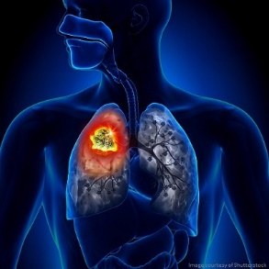
LUNG TUMORS -2
Dr. V.Shanthi,
Associate Professor, Department of Pathology
Sri Venkateswara Institute Of Medical Sciences

Slide 2
LUNG CARCINOMA
TOBACCO SMOKING
INDUSTRIAL HAZARDS
CHRONIC SCARRING
ASBESTOS
ARSENIC
CHROMIUM
URANIUM
NICKLE
VINYL CHLORIDE
MUSTARD GAS
OLD TB, CHRONIC INTERSTITIAL FIBROSIS, OLD INFARCT
ADENOCARCINOMA
ETIOLOGICAL FACTORS
AIR POLLUTION
DIETARY FACTORS
AIR PARTICULATES
RADON
VIT A DEFICIENCY
MOLECULAR GENETIC ABERRATIONS

Slide 3
SQUAMOUS CELL CARCINOMA - CARCINOGENESIS

Slide 4
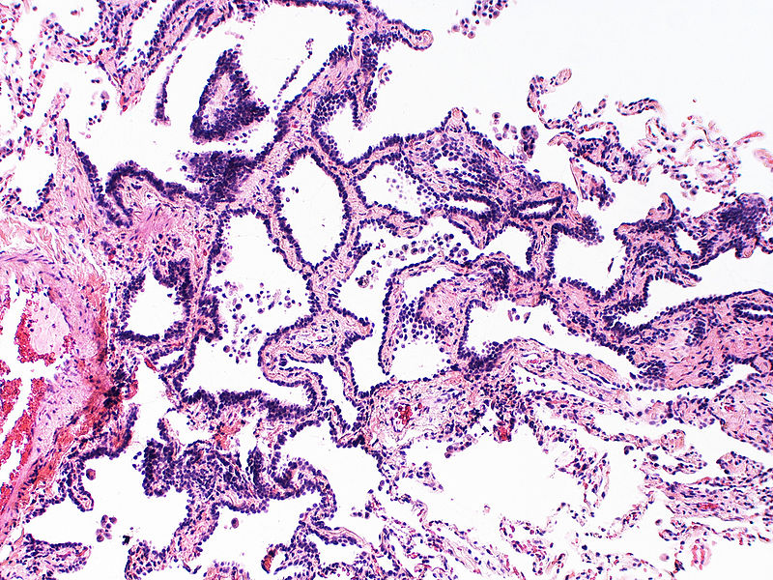
ATYPICAL ADENOMATOUS HYPERPLASIA

Slide 5
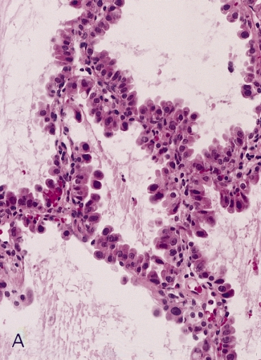
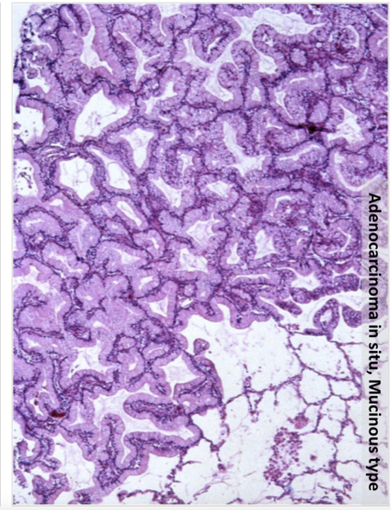
ADENOCARCINOMA IN-SITU

Slide 6
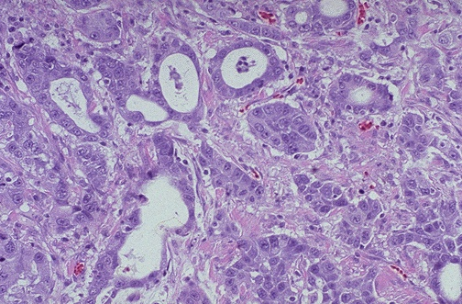
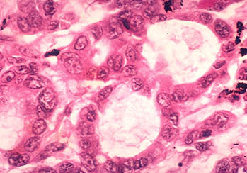
Adenocarcinoma

Slide 7
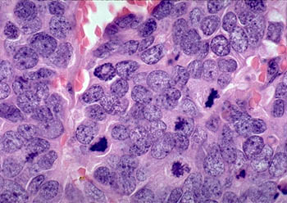
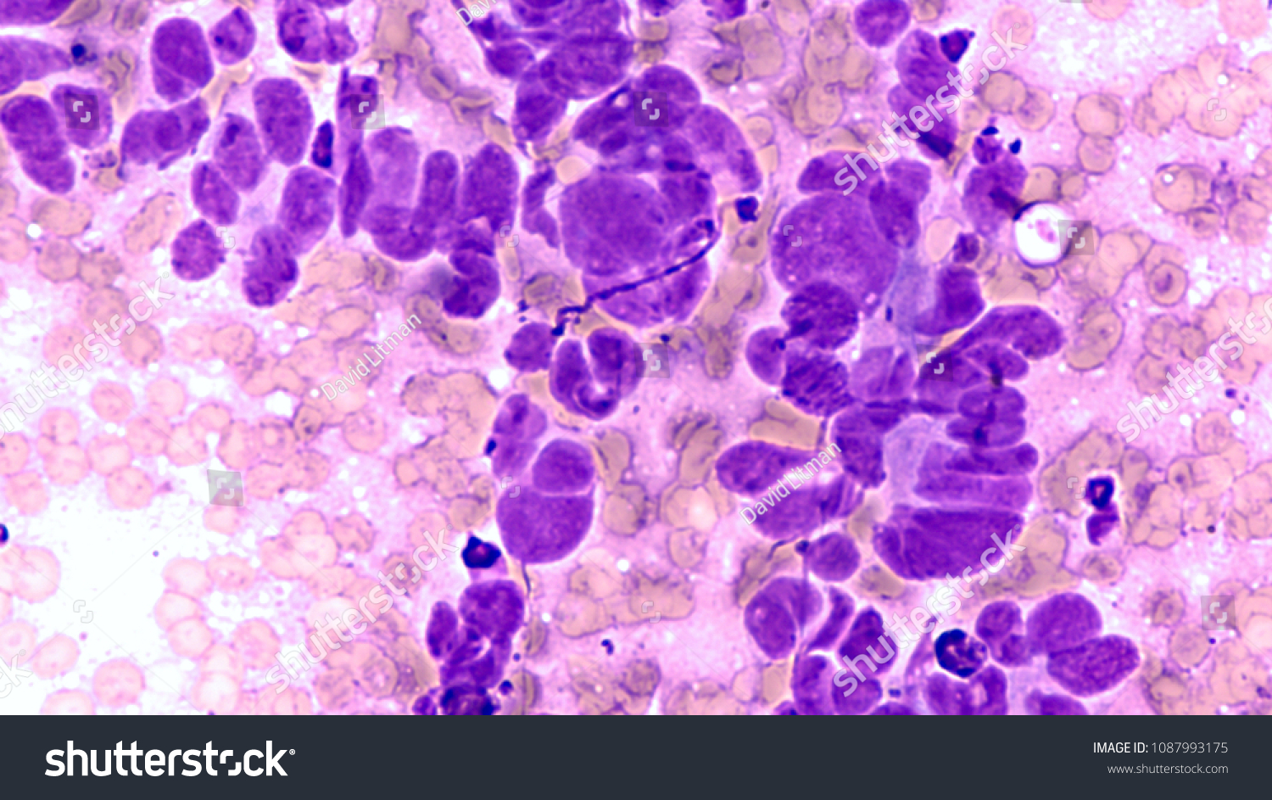
Small cell
Carcinoma
Small cell Carcinoma

Slide 8
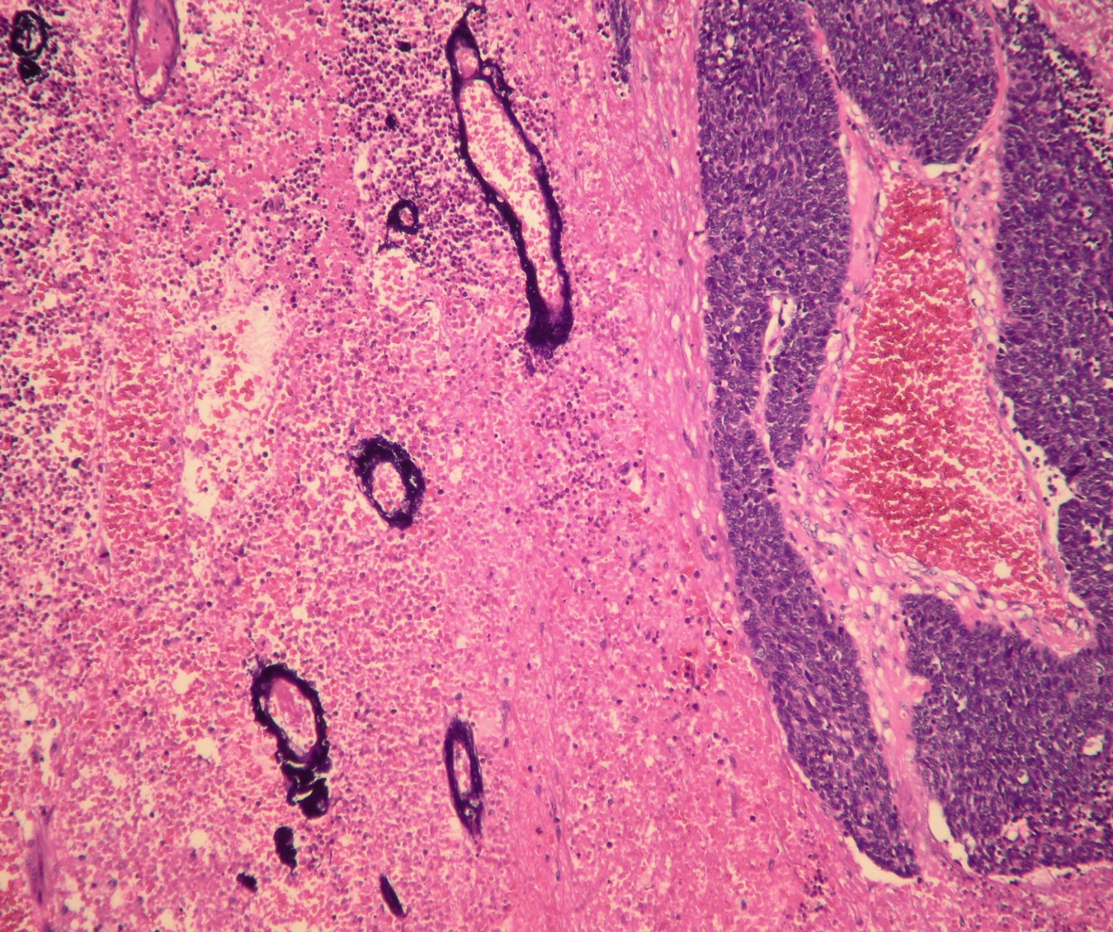
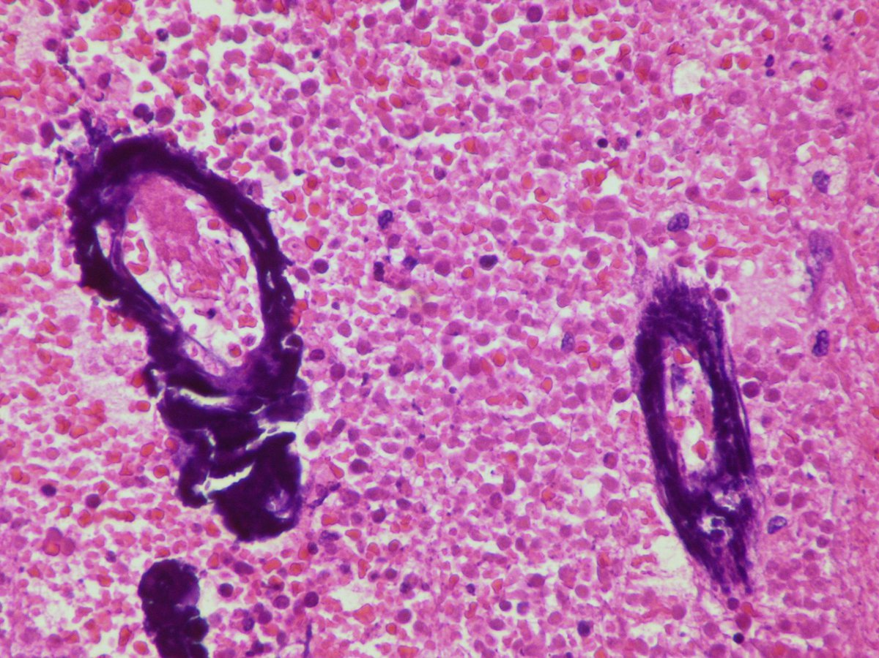
Small cell Carcinoma

Slide 9
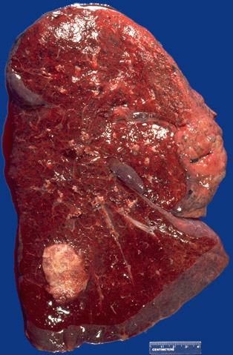
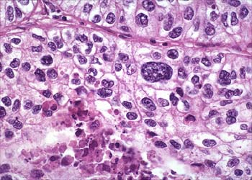
Large cell Carcinoma

Slide 10
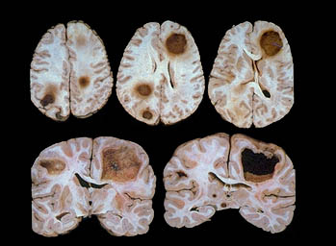
CARCINOMA LUNG-SPREAD
To pleural surface, Pleural cavity / pericardium
Tracheal, bronchial, mediastinal nodes
Distant metastasis – can occur through hematogenous and lymphatic route
No organ is spared: Adrenals(>50%), Liver (30-50%), Brain (20%) & bone (20%)

Slide 11
Carcinoma Lung Secondary Pathology
Pathologic Basis
Tumor obstruction of airway
Tumor obstruction; accumulation of cellular lipid in foamy macrophages
Tumor spread into pleura
Recurrent laryngeal nerve invasion
Esophageal invasion
Clinical Feature
Pneumonia, abscess, lobar collapse
- Lipid pneumonia
- Pleural effusion
- Hoarseness
- Dysphagia

Slide 12
Carcinoma Lung Secondary Pathology
Pathologic Basis
Phrenic nerve invasion
Chest wall invasion
SVC compression by tumor
Sympathetic ganglia invasion (Pancoast tumor)
Pericardial involvement
Clinical Feature
- Diaphragm paralysis
- Rib destruction
- SVC syndrome
- Horner syndrome (Enophthalmos, Ptosis, Miosis, Anhidrosis)
- Pericarditis, tamponade

Slide 13
PARANEOPLASTIC SYNDROMES
Ectopic hormone production
ACTH → Cushing Syndrome Small cell Carcinoma
ADH → Hyponatremia Small cell carcinoma
Parathormone, PGE, Some cytokines → Hyper calcemia } common in Squamous cell Ca
Calcitonin → Hypocalcemia
Gonadotropins → Gynecomastia
Serotonin & Bradykinin → Carcinoid syndrome

Slide 14
Carcinoma Lung
Other systemic manifestations of lung carcinoma include
Lambert Eaton myasthenic syndrome – muscle weakness due to antibodies (possibly elicited by tumor ionic channels) directed to the neuronal calcium channels
Peripheral neuropathy – purely sensory
Dermatologic abnormalities – including Acanthosis nigricans
Hematologic abnormalities – such as leukemoid reaction
Hypercoagulable state – deep vein thrombosis and thromboembolism(Trousseau syndrome)
Abnormality of connective tissue – hypertrophic pulmonary osteoarthropathy associated with clubbing of fingers

Slide 15
NEUROENDOCRINE PROLIFERATIVE TUMORS
Lung contains neuroendocrine cells with in the epithelium as single cells or as clusters , the neuroepithelial bodies
Pulmonary neuroendocrine hyperplasia are secondary to airway fibrosis or inflammation
Diffuse idiopathic pulmonary neuroendocrine cell hyperplasia – precursor to the development of multiple tumor lets and typical or atypical carcinoids

Slide 16
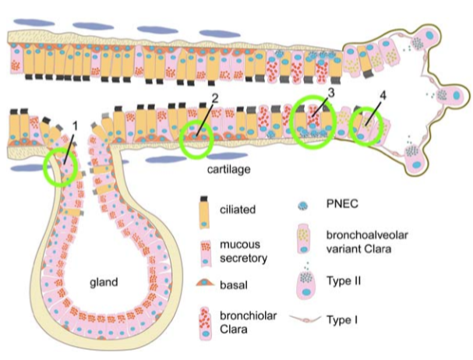

Slide 17
NEUROENDOCRINE PROLIFERATIVE TUMORS
Neoplasms of neuroendocrine cells in lungs are –
Tumorlets – small inconsequential, hyperplastic nests of neuroendocrine cell seen in areas of scarring
Carcinoids
Small cell carcinoma
Large cell neuroendocrine carcinoma

Slide 18
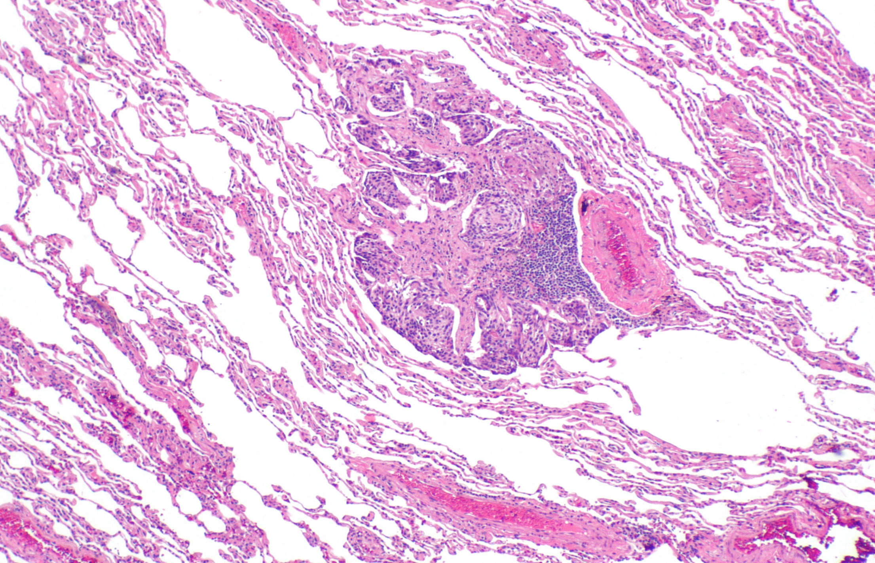
NEUROENDOCRINE CELL TUMORLETS

Slide 19
Carcinoid Tumors
1-5% of all lung tumors
Equal in both sexes
Age – younger than 40 yrs
Low grade malignant epithelial neoplasms classified as
Typical
Atypical

Slide 20
Carcinoid Tumors
Gross:
Central Tumors :
Intra luminal polypoid masses
Confined to main stem bronchi
Can penetrate the wall of bronchus to fan out in the peribronchial tissue producing “Collar button lesion”
Peripheral :
Solid & nodular

Slide 21
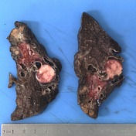
Carcinoid Tumors

Slide 22
CARCINOID - MORPHOLOGY
Histopathology:
Organoid / Trabecular / Ribbons/ Rosette-like patterns
Tumor cells have uniform round nuclei with moderate eosinophilic cytoplasm
Typical carcinoids - < 2 mitosis /10 HPF
Atypical Carcinoids :2-10 Mitosis /10 HPF, foci of necrosis
↑Cellularity, prominent nucleoli, grow in disorganized fashion, Lymphatic invasion
EM : Dense-core granules (Serotonin, NSE etc.)

Slide 23
CARCINOID
Organoid pattern

Slide 24
CARCINOID TUMORS
Clinical features
Intrabronchial growth – produces persistent cough, hemoptysis, impairment of drainage of respiratory passage with secondary infections, bronchiectasis, emphysema and atelectasis
Functional tumors – carcinoid syndrome – intermittent attacks of diarrhea, flushing and cyanosis
10% of carcinoids give rise to syndrome
Most Bronchial carcinoids – do not have metastasis and have benign course for long period

Slide 25
CARCINOID TUMORS
5 year survival rate
95% for typical carcinoid
70% for atypical carcinoid
30% for large cell neuroendocrine carcinoma
5% for small cell carcinoma

Slide 26
MISCELLANEOUS TUMORS
Inflammatory myofibroblastic tumor
Fibroma
Fibrosarcoma
Lymphangioleiomyoma
Leiomyoma
Leiomyosarcoma
Lipoma
Hematopoietic tumors - lymphoma

Slide 27
METASTATIC TUMORS
Lung is the most common site of metastatic neoplasms
Metastases from extra pulmonary cancer sites are more frequent than are primary lung cancers
Carcinomas & Sarcomas arising anywhere in the body may spread to lungs
Direct spread / lymphatics/ hematogenous

Slide 28
METASTATIC TUMORS
Multiple discrete nodules (Cannon ball Lesions) scattered through out all lobes
Tend to occur in the periphery

Slide 29
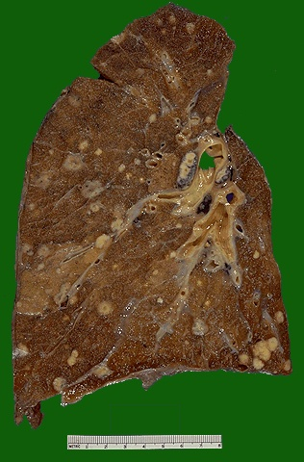
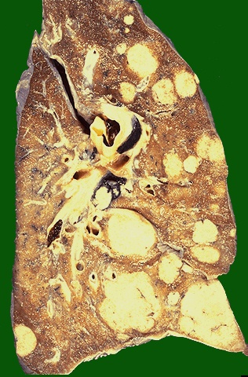
METASTATIC TUMORS

Slide 30
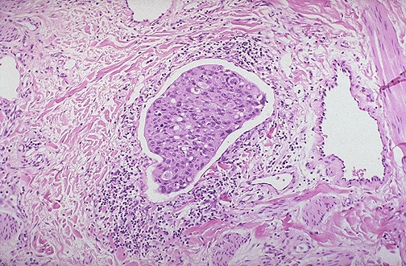
METASTATIC TUMORS
Nest of metastatic infiltrating ductal carcinoma from breast is seen in a dilated lymphatic channel in the lung

Slide 31
PLEURAL LESIONS

Slide 32
PLEURA – NORMAL STRUCTURE
Pleural cavity is a potential space lined by mesothelium of the visceral & parietal pleura
Visceral pleura covers the lungs & extends into the fissures
Parietal pleura covers the dome of diaphragm & inner aspect of the chest wall
Normal pleural fluid is a transudate, containing <15 ml of clear serous fluid, relatively acellular

Slide 33
PLEURA – NORMAL STRUCTURE
PLEURAL FLUID TRANSUDATE EXUDATE
Appearance
Pleural fluid/Serum
protein ratio
Pleural fluid/ serum
LD ratio
Pleural fluid
cholesterol
Clear, pale yellow
< 0.5
< 0.6
< 60 mg/dl
Cloudy, turbid,
Purulent or bloody
> 0.5
> 0.6
> 60 mg/dl

Slide 34
PLEURAL SPACE FLUID ACCUMULATIONS
Common Associations
Inflammation in adjacent lung
Collagen vascular disease
Suppurative infection in adjacent lung
Tumors, Bleeding disorders & Rickettsial diseases
Condition
Inflammatory
Serofibrinous pleuritis
Suppurative pleuritis (empyema)
Hemorrhagic pleuritis
Type of Fluid
Serofibrionus exudate
Pus
Bloody exudate

Slide 35
PLEURAL SPACE FLUID ACCUMULATIONS
Condition
Noninflammatory
Hydrothorax
Hemothorax
Chylothorax
Pneumothorax
Type of Fluid
Transudate
Blood
Chyle (lymph)
Air
Common Associations
Congestive heart failure, Renal failure, cirrhosis of liver, Meig’s syndrome, tumors of lung
Ruptured aortic aneurysm, trauma
Tumor obstruction of normal lymphatics, rupture of the thoracic duct by trauma
Spontaneous pneumothorax

Slide 36
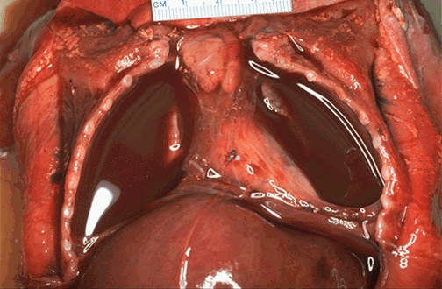
serosanguinous pleural effusion (between the parietal pleura on the lung and the visceral pleura on the chest wall )

Slide 37
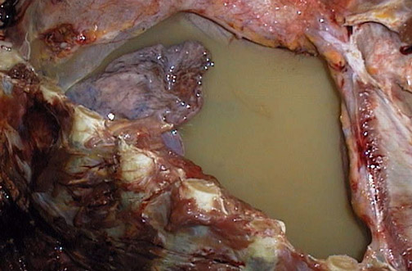
Chylothorax - right pleural cavity filled with chyle which contains emulsified fats

Slide 38
PLEURAL TUMORS
Metastatic tumors are more common than primary tumors
Most frequently metastasis arises from primary neoplasms lung & Breast
Primary tumors - Solilary fibrous tumors - Malignant Mesotheliomas

Slide 39
SOLITARY FIBROUS TUMOR (Benign Mesothelioma/Localized fibrous Tumor)
Small (1 to 2cm) to enormous size
Gross : Solitary, circumscribed firm mass attached to pleural surface by pedicle.
C/S : Whorls of dense fibrous tissue with occasional cysts filled with viscid fluid
Microscopy : Whorls of reticulin & collagen fibers interspersed with spindle cells resembling fibroblasts
No relationship to asbestos exposure

Slide 40
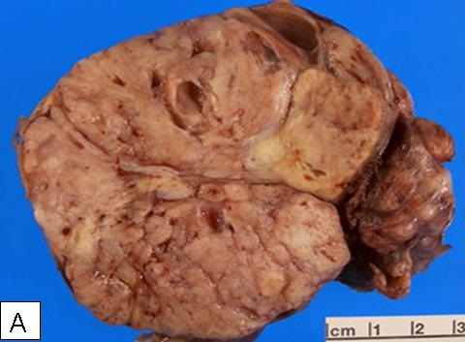
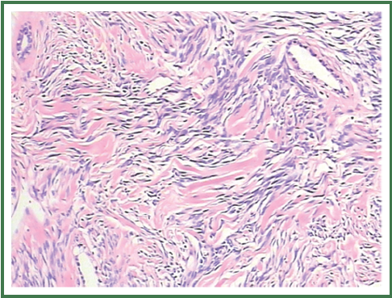
SOLITARY FIBROUS TUMOR

Slide 41
SOLITARY FIBROUS TUMOR
Features suggesting malignant change are – pleomorphism, mitotic activity, necrosis and large size ( >10cms)
Tumor cells are positive for CD34, and negative for keratin.
Cytogenetics – Associated with a cryptic inversion of chromosome 12 involving the genes NAB2 and STAT6 creating NAB2-STAT6 fusion gene which is unique to this tumor

Slide 42
MALIGNANT MESOTHELIOMA
Arises from either visceral or parietal pleura
90% are asbestos – related
Latent period of 25 to 45 years for the development of Asbestos related mesotheliomas.
Cytogenetic abnormalities - deletions of tumor suppression gene CDKN2A/INK4a involving chromosome 9p.
SV40 (simian virus 40) viral DNA + in 60 to 80% of pleural malignant mesotheliomas

Slide 43
MALIGNANT MESOTHELIOMA-MORPHOLOGY
Gross :
Diffuse forming thick, white fleshy coating over parietal & visceral surfaces

Slide 44
MALIGNANT MESOTHELIOMA-MORPHOLOGY
Epithelial Pattern :-
- cuboidal, flattened or columnar cells forming tubular or papillary structures
- Resembles adeno carcinoma
Sarcomatoid pattern:
- Resembles fibrosarcoma
- Storiform pattern
Biphasic pattern :
- Mixed growth having epithelial & sarcomatoid pattern
- Slit like spaces lined by neoplastic mesothelial cells separated by spindle shaped tumor cells

Slide 45
Malignant Mesothelioma
- Immunohistochemistry :
CEA negative
positivity for keratin proteins, calretinin, WT-1, cytokeratin 5/6 and D 2-40
Electron Microscopy :
Gold standard : Long slender microvilli and abundant tonofilaments

Slide 46
Malignant Mesothelioma-Morphology

Slide 47
MALIGNANT MESOTHELIOMA
Clinical features –
Patient presents with chest pain, dyspnea and pleural effusion.
Lung is directly invaded and it can spread to hilar lymphnodes and to the liver and distant organs
50% of patients die within 12 months of diagnosis.
Aggressive therapy with extrapleural pneumonectomy, chemotherapy and radiation therapy improves the prognosis

Slide 48
THANK YOU

