Slide 1
DIFFERENCES BETWEEN CROHNS DISEASE AND ULCERATIVE COLITIS
Dr.V.Shanthi, M.D
Professor & HOD, Department of Pathology
Narayana Medical College, Nellore
www.Histopathology.guru

Slide 2
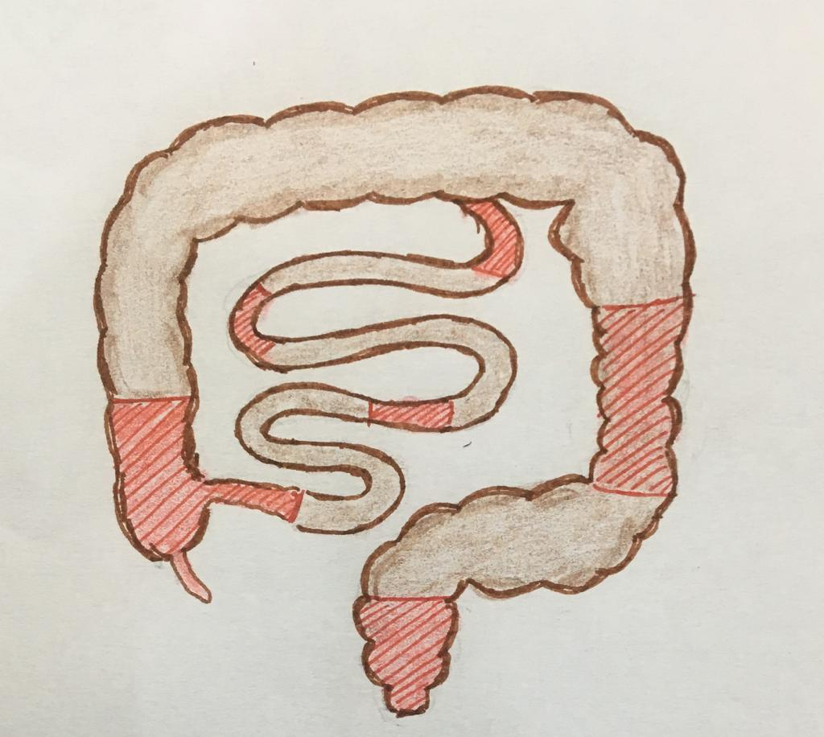
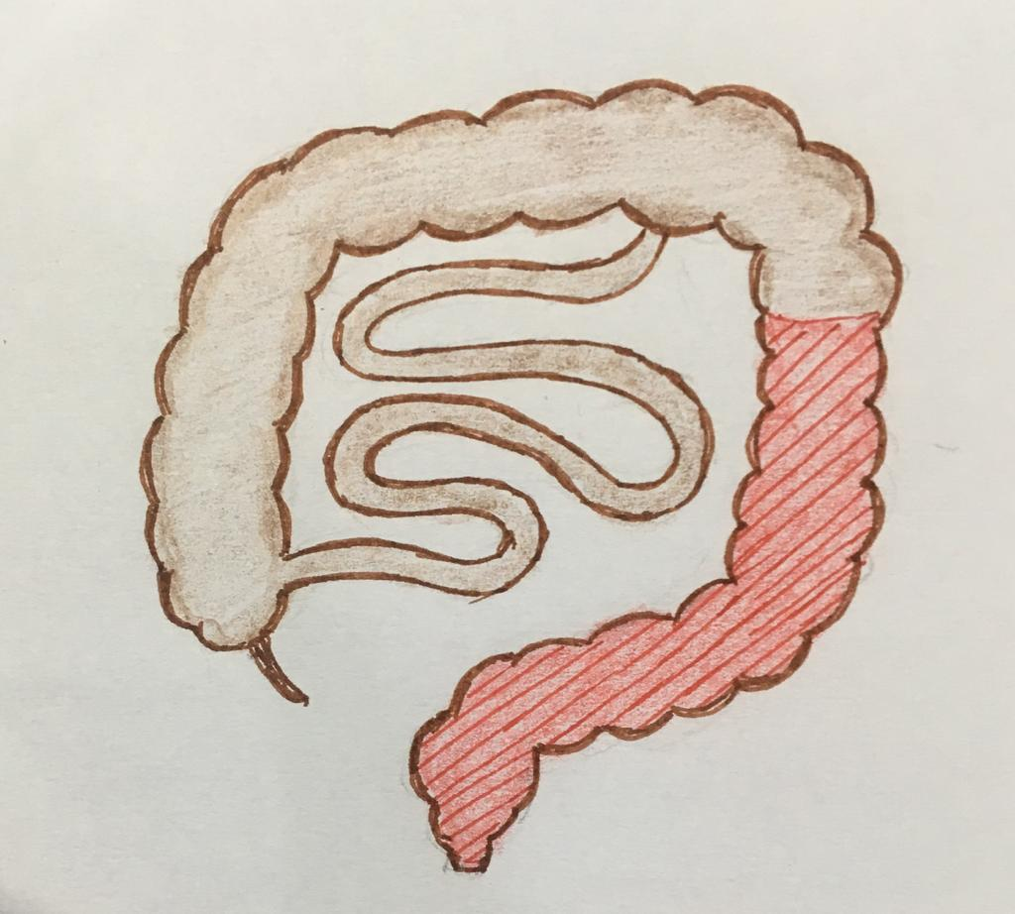
DIFFERENCES BETWEEN CROHNS DISEASE AND ULCERATIVE COLITIS
FEATURES | CROHN’S DISEASE | ULCERATIVE COLITIS
Location | Commonly terminal ileum and colon | Colon
Distribution | Skip lesions with focal involvement | Continuous involvement

Slide 3
DIFFERENCES BETWEEN CROHNS DISEASE AND ULCERATIVE COLITIS
FEATURES | CROHN’S DISEASE | ULCERATIVE COLITIS
Wall thickness | Thickened | Thin
Lumen dilation | Narrowed due to increased wall thickness | Lumen dilated
Creeping fat | Present | absent
Active disease
Skip lesions
Healed atrophic mucosa

Slide 4
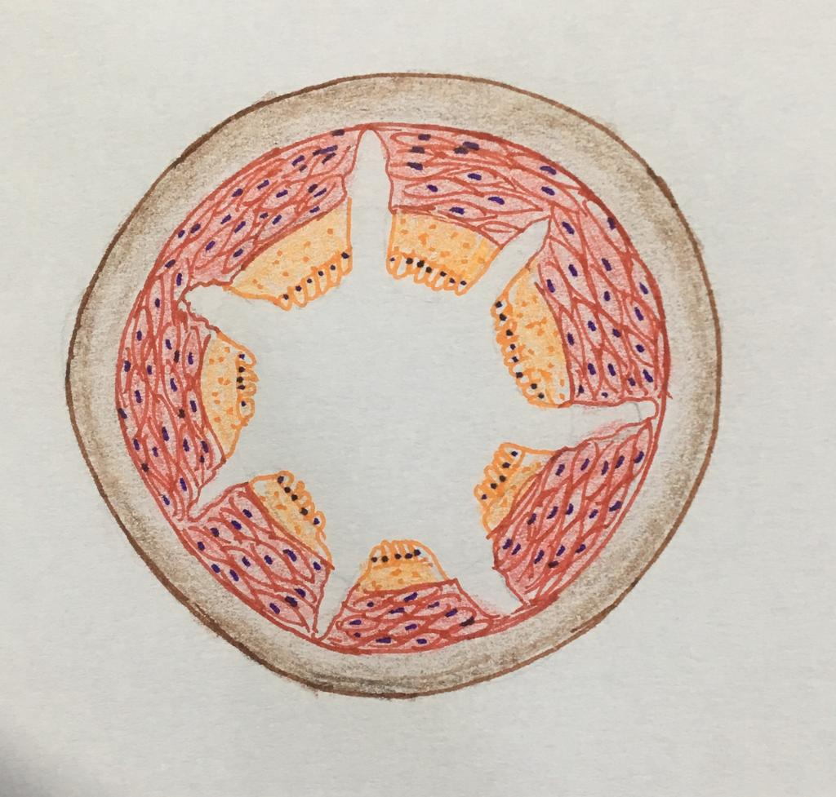
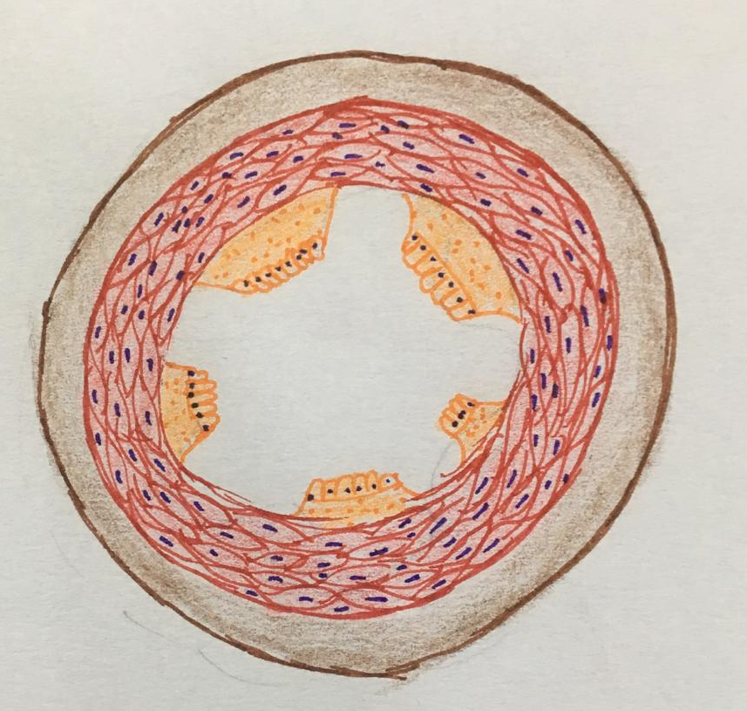
DIFFERENCES BETWEEN CROHNS DISEASE AND ULCERATIVE COLITIS
FEATURES | CROHN’S DISEASE | ULCERATIVE COLITIS
Ulcers | Deep and fissuring ulcers extending into muscularis | Broad based ulcers confined to mucosa and submucosa

Slide 5
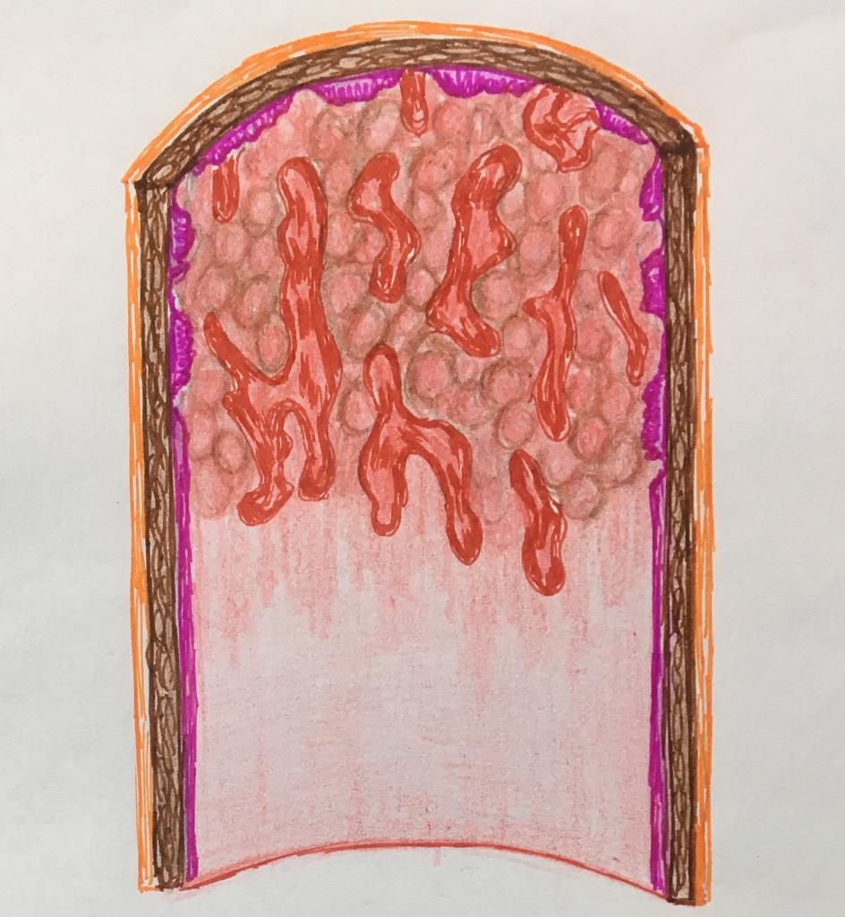
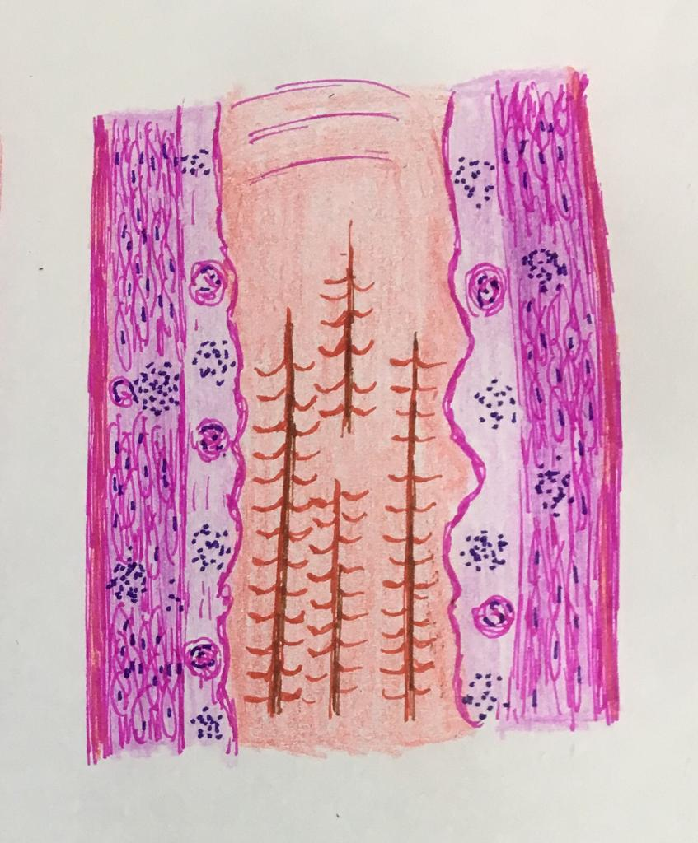
DIFFERENCES BETWEEN CROHNS DISEASE AND ULCERATIVE COLITIS
FEATURES | CROHN’S DISEASE | ULCERATIVE COLITIS
Pseudopolyps | rare | Present
Cobblestone appearance | Present | Absent

Slide 6
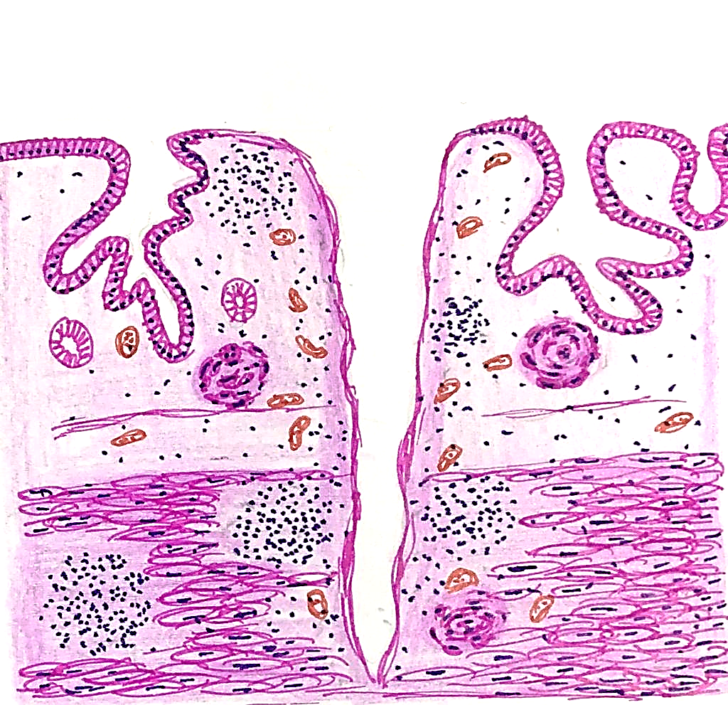
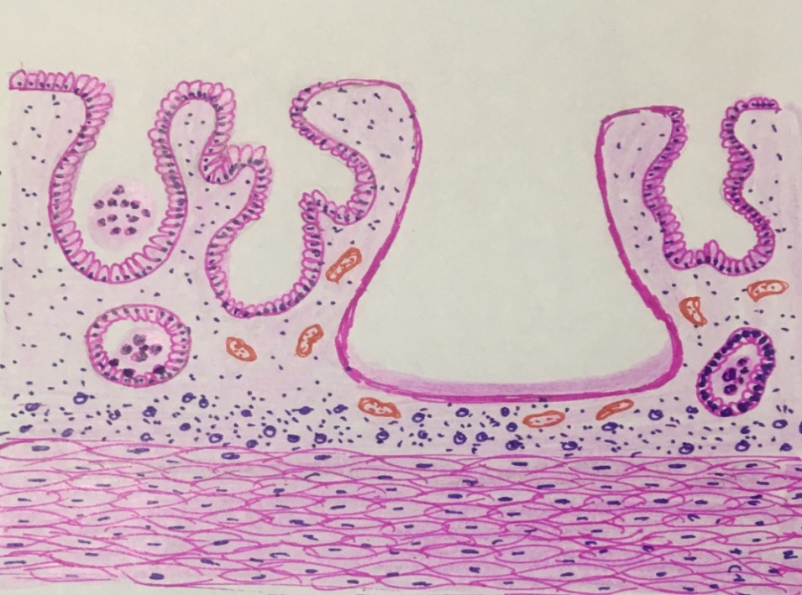
DIFFERENCES BETWEEN CROHNS DISEASE AND ULCERATIVE COLITIS
DIFFERENCES BETWEEN CROHNS DISEASE AND ULCERATIVE COLITIS
FEATURES | CROHN’S DISEASE | ULCERATIVE COLITIS
Inflammation | Transmural | Limited to mucosa and submucosa
Lymphoid reaction | Marked with lymphoid aggregates in mucosa, submucosa and muscularis | Mild
Granulomas | Present | Absent
Goblet cell depletion | Not seen | Seen
Cryptitis and crypt abscess | Not seen (rarely in early stages) | Often seen

Slide 7
DIFFERENCES BETWEEN CROHNS DISEASE AND ULCERATIVE COLITIS
FEATURES | CROHN’S DISEASE | ULCERATIVE COLITIS
Fissures and fistulae | Common | Not seen
Stricture formation | Seen due to fibrosis produced by healing deep fissuring ulcers | Not seen
Fibrosis | Present | Not present
Risk of carcinoma | Low | High
Type of malignancy | Lymphoma more common than carcinoma | Adenocarcinoma

Slide 8
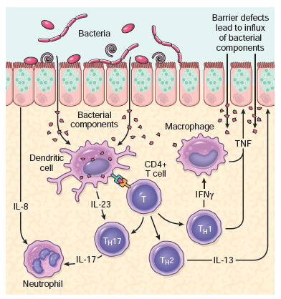
DIFFERENCES BETWEEN CROHNS DISEASE AND ULCERATIVE COLITIS
IMMUNOLOGIC FEATURES | CROHN’S DISEASE | ULCERATIVE COLITIS
Lymphocyte type | CD4+ TH1 | CD4+TH2
Cytokines | INF-γ, TNF, IL-12 | TGF-β, IL-4, IL-5, IL-13
Perinuclear Anti neutrophil cytoplasmic antibody (ANCA-p) | Seen in very few cases | Positive in most of the cases
Anti-Saccharomyces cerevisiae antibody (ASCA) | Positive | Not seen

Slide 9
INFLAMMATORY BOWEL DISEASE
Lab investigations
Blood tests
CBC – Anemia and increase in WBC count
Antibody tests
Anti-Saccharomyces cerevisiae antibody test (ASCA) – positive in crohn’s disease
Perinuclear Anti neutrophil cytoplasmic antibody test (ANCA p) – in Ulcerative Colitis
Anti-CBir1 (anti-flagellin antibody) and anti-Omp C (anti-outer membrane protein antibody) – positive in Crohns disease
C Reactive protein – will be elevated
Electrolyte panel – potassium may be low due to Crohns related diarrhoea
Notes:
Anti-Saccharomyces cerevisiae antibodies (ASCA) are immune proteins that are frequently present in people who have inflammatory bowel disease (IBD). This test detects ASCA in the blood.
S. cerevisiae are common yeast found in various foods

Slide 10
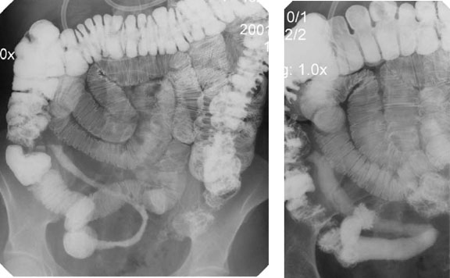
INFLAMMATORY BOWEL DISEASE
Lab investigations
Blood tests
ESR – raised due to inflammation
Iron and B 12 levels – low due to malabsorption
Imaging studies
Barium X-rays –
String sign due to narrowing of lumen and thickening of wall
Ulcers, abnormal fistulas between the organs in crohns disease

Slide 11
INFLAMMATORY BOWEL DISEASE
Investigations
Imaging studies
Colonoscopy or sigmoidoscopy
Ulcerated mucosa with cobble stone appearance – crohns disease
Broad based ulcers with pseudopolyps – ulcerative colitis
CT scanning – helpful for finding abscesses
MRI – useful to detect abscesses or fistulas

