Slide 1
CLASSIFICATION OF BREAST CARCINOMA
Dr.V.Shanthi
Associate Professor, Pathology
Sri Venkateswara Institute of Medical Sciences
TIRUPATHI

Slide 2
NORMAL BREAST MORPHOLOGY
TERMINAL DUCT LOBULAR UNIT
Interlobular stroma
Lobule
Intralobular stroma
Lactiferous ducts
Ductal epithelial cells
Myoepithelial layer
Most of the carcinomas arise from terminal duct lobular unit

Slide 3
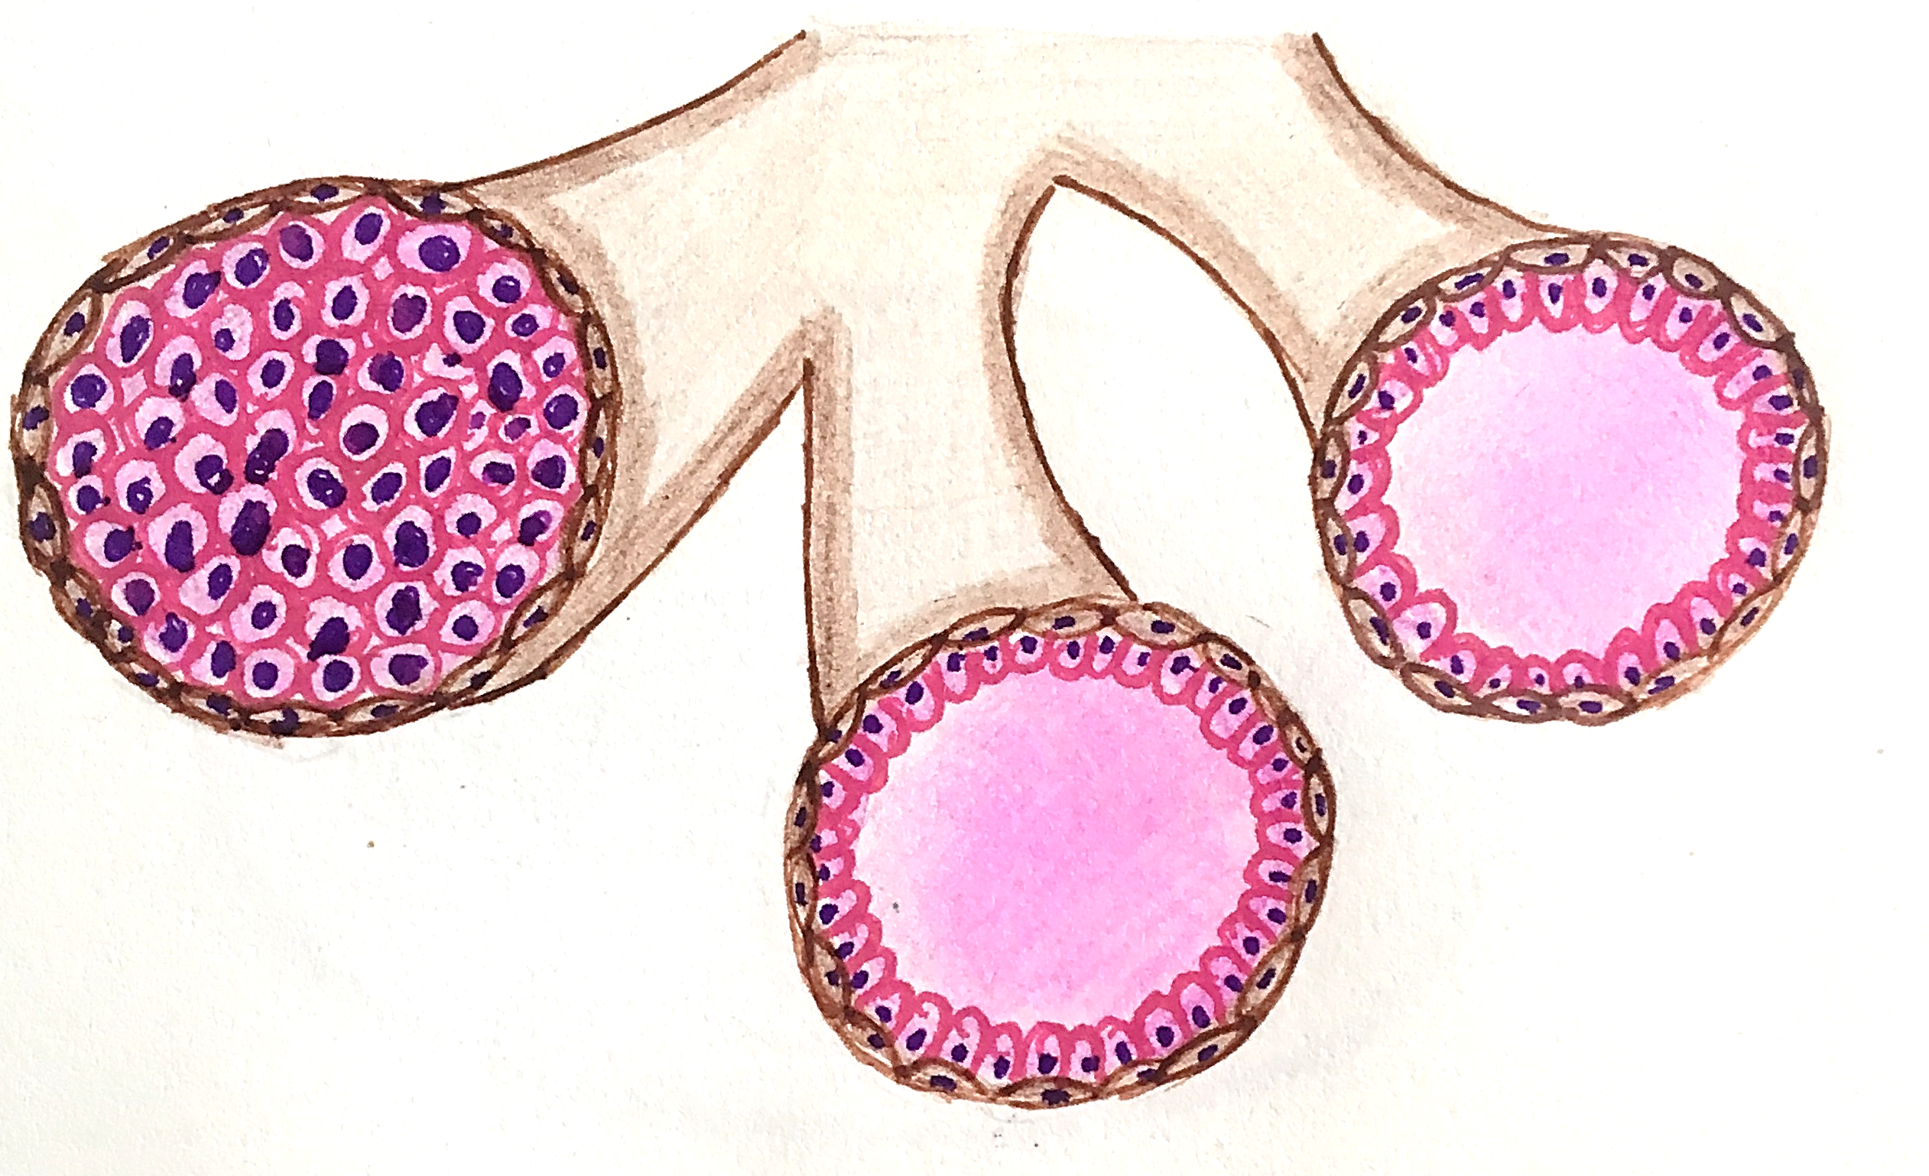
BREAST TUMORS
BENIGN LESIONS
MALIGNANT LESIONS
INSITU
INVASIVE
Basement membrane intact
DUCTAL CARCINOMA INSITU
LOBULAR CARCINOMA INSITU

Slide 4
BREAST TUMORS
MALIGNANT LESIONS
BENIGN LESIONS
INSITU
INVASIVE
MOLECULAR CLASSIFICATION
MORPHOLOGICAL CLASSIFICATION
Based on expression of
Estrogen receptor (ER)
Progesterone receptor (PR)
HER2/neu
Ki67
No special type
Special type

Slide 5
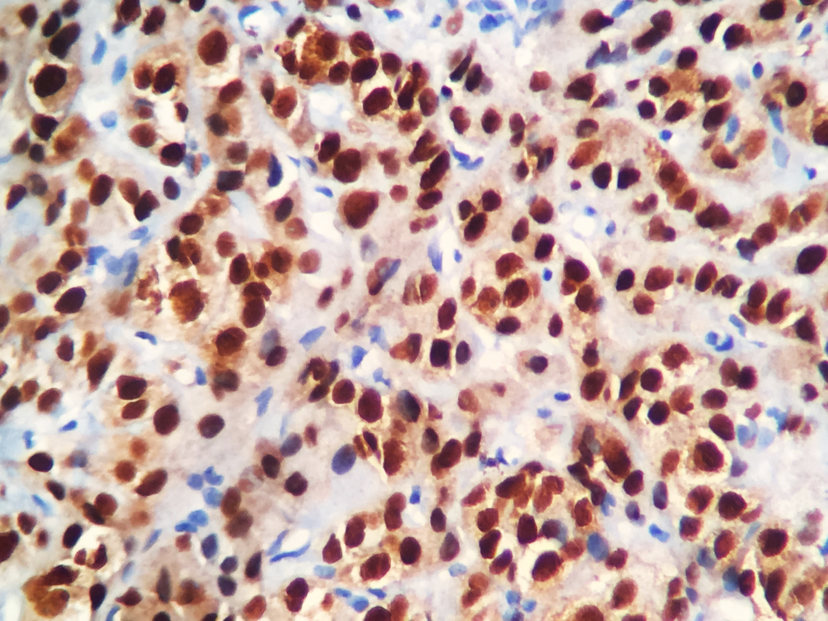
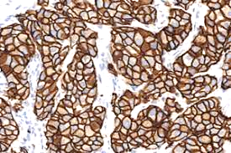
HER2/neu
Human epidermal growth factor Receptor 2
Also known as CD340, proto-oncogene Neu, ERBB2 (Erythroblastic oncogene B)
ER receptor or PR receptor

Slide 6
BREAST TUMORS
BENIGN LESIONS
MALIGNANT LESIONS
INSITU
INVASIVE
MOLECULAR CLASSIFICATION
MORPHOLOGICAL CLASSIFICATION
Based on expression of ER,PR, HER2/neu and Ki67
No special type
Special type
Luminal A
Luminal B
HER2 rich
Basal type

Slide 7
MOLECULAR TYPE OF CLASSIFICATION
Molecular type | ER | PR | Her2/neu | ki67 | Response to endocrine therapy | Prognosis
Luminal A | + | + | - | Low | present | Good
Luminal B | + | + | - | High | Not as good as luminal A | Not as good as Luminal A
 | + | + | + | Low/high
Her2 enriched | - | - | + | Low/high | Response to Herceptein | Unfavourable prognosis
Basal like (Triple negative) | - | - | - | high | No response | Worst prognosis

Slide 8
BREAST TUMORS
BENIGN LESIONS
MALIGNANT LESIONS
INSITU
INVASIVE
MOLECULAR CLASSIFICATION
MORPHOLOGICAL CLASSIFICATION
No special type
Special type
Papillary carcinoma
Invasive lobular carcinoma
Tubular carcinoma
Medullary carcinoma
Inflammatory carcinoma
Mucinous carcinoma
Metaplastic carcinoma
Cribriform carcinoma
Invasive ductal carcinoma
Paint me In MMC

Slide 9
BREAST TUMORS
Molecular types | Morphological types
Luminal A | Low grade Invasive carcinoma NOS, ductal Classic lobular carcinoma Cribriform carcinoma Tubular carcinoma Mucinous carcinoma
Luminal B | Invasive carcinoma NOS, ductal Micropapillary carcinoma
Her2/neu enriched | High grade invasive carcinoma NOS, ductal
Basal like (Triple negative) | High grade invasive carcinoma NOS, ductal Metaplastic carcinoma Medullary carcinoma
Inflammatory carcinoma – mostly Her2 enriched or triple negative

Slide 10
BREAST TUMORS
SUMMARY
BENIGN LESIONS
MALIGNANT LESIONS
INSITU
INVASIVE
DUCTAL CARCINOMA INSITU
LOBULAR CARCINOMA INSITU
MOLECULAR CLASSIFICATION
MORPHOLOGICAL CLASSIFICATION
Based on expression of ER,PR, HER2neu and Ki67
No special type
Special type
Invasive ductal carcinoma
Papillary carcinoma
Invasive lobular carcinoma
Tubular carcinoma
Medullary carcinoma
Inflammatory carcinoma
Mucinous carcinoma
Metaplastic carcinoma
Cribriform carcinoma
Luminal A
Luminal B
HER2 rich
Basal type (Triple negative)

