Slide 1
BREAST CARCINOMA ETIOPATHOGENESIS
Dr.V.Shanthi
Associate Professor, Pathology
Sri Venkateswara Institute of Medical Sciences
TIRUPATHI

Slide 2
BREAST CARCINOMA
Incidence – 1.7 million women/ year and 1 in 3 of those affected die of disease
It is second most common cause of cancer death in women, first being lung cancer
Age – rare in younger females than 25 years and increased incidence rapidly after age 30 Years

Slide 3
BREAST CARCINOMA
FEMALE GENDER
HIGH ALCOHOL CONSUMPTION
RISK FACTORS
PHYSICAL INACTIVITY
INCRAESING AGE
EXOGENOUS HORMONE REPLACEMENT THERAPY
HIGH DOSE OF RADIATION TO CHEST AT YOUNGER
ABSENCE OF BREAST FEEDING
GENETIC MUTATIONS
LATE FIRST PREGNANCY (>35YEARS)
NULLIPARITY
FAMILY HISTORY
INCREASED BREAST DENSITY
EARLY MENARCHY(AGE <12 YEARS)
LATE MENOPAUSE (>55YEARS)
FARM HAD FIRM MPN

Slide 4
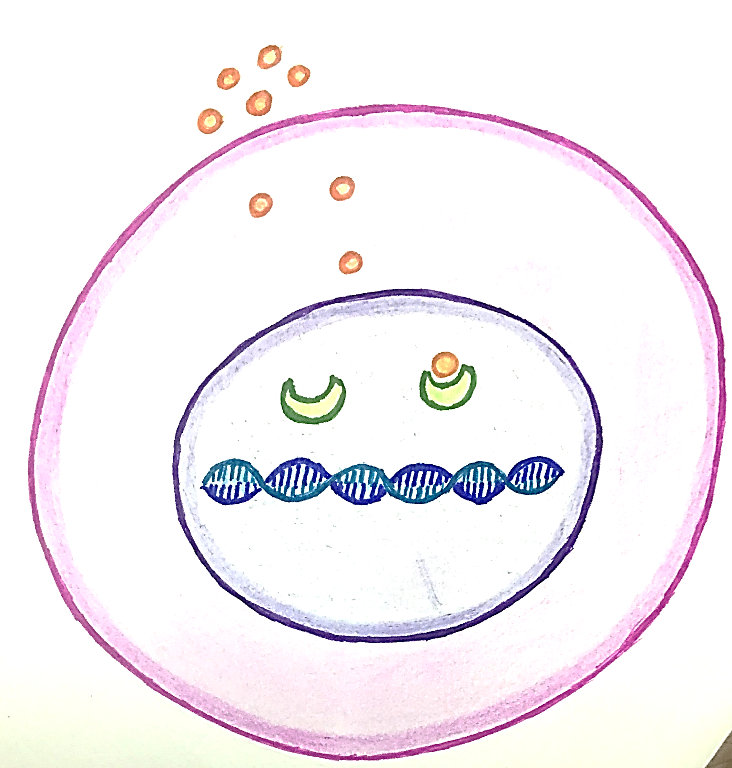
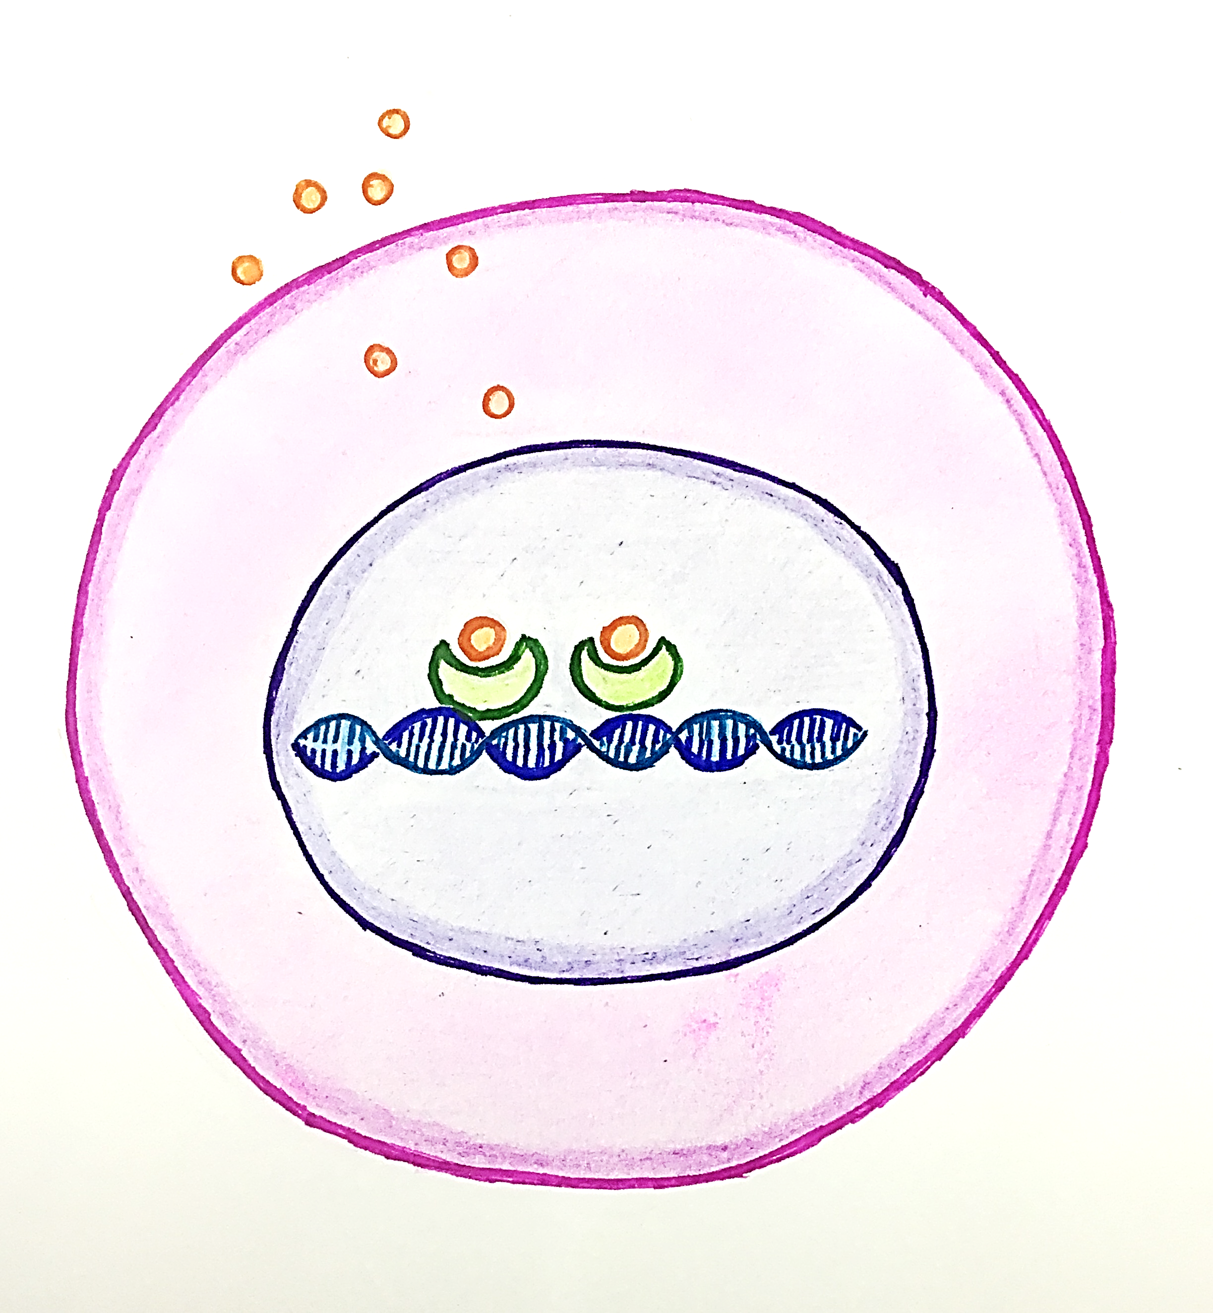
EFFECT OF ESTROGEN ON EPITHELIAL CELLS
Exposure to estrogen stimulates breast ductal cell proliferation
Ductal epithelial cell
Estrogen receptor complex
Estrogen hormone
Estrogen receptor
Estrogen receptors present in the nucleus combines with estrogen which enters the cell
Estrogen receptor complex attaches to Transcription factors which bind to DNA leading to increased expression of genes and triggers cell proliferation

Slide 5
CARCINOMA BREAST
GENETIC CUASES
Germline mutations
Sporadic mutations
Minority (3%to 6% of breast cancers)
Majority of breast cancers
Age - Younger
Age – old age
Notes:
SPORADIC genetic mutation is not inherited from parents but arises via mutation in the cell and later may or may not be inherited to offsprings
Germline mutations is any detectable variation within the germ cells. Mutations in these cells can be passed on to offsprings

Slide 6
MUTATIONS IN BREAST CARCINOMA
GENETIC CUASES
Germline mutations
Sporadic mutations
Tumor suppressor genes
BRCA1
BRCA 2
TP53
PTEN
PALB2
ATM
CHEK 2
CDH1
STK 11
Random
Most common P53

Slide 7
BRCA 1 and BRCA2
DNA DAMAGE DUE TO EXTRINSIC / INTRINSIC FACTORS
Normal cell
Cell with BRCA mutations
Cell with damaged DNA
Abnormal BRCA protein cannot repair damaged DNA
BRCA protein with other proteins
Cell with damaged DNA
Repair of DNA
If cannot be repaired
Apoptosis
Normal cell DNA
Neoplastic cell
Neoplastic cell

Slide 8
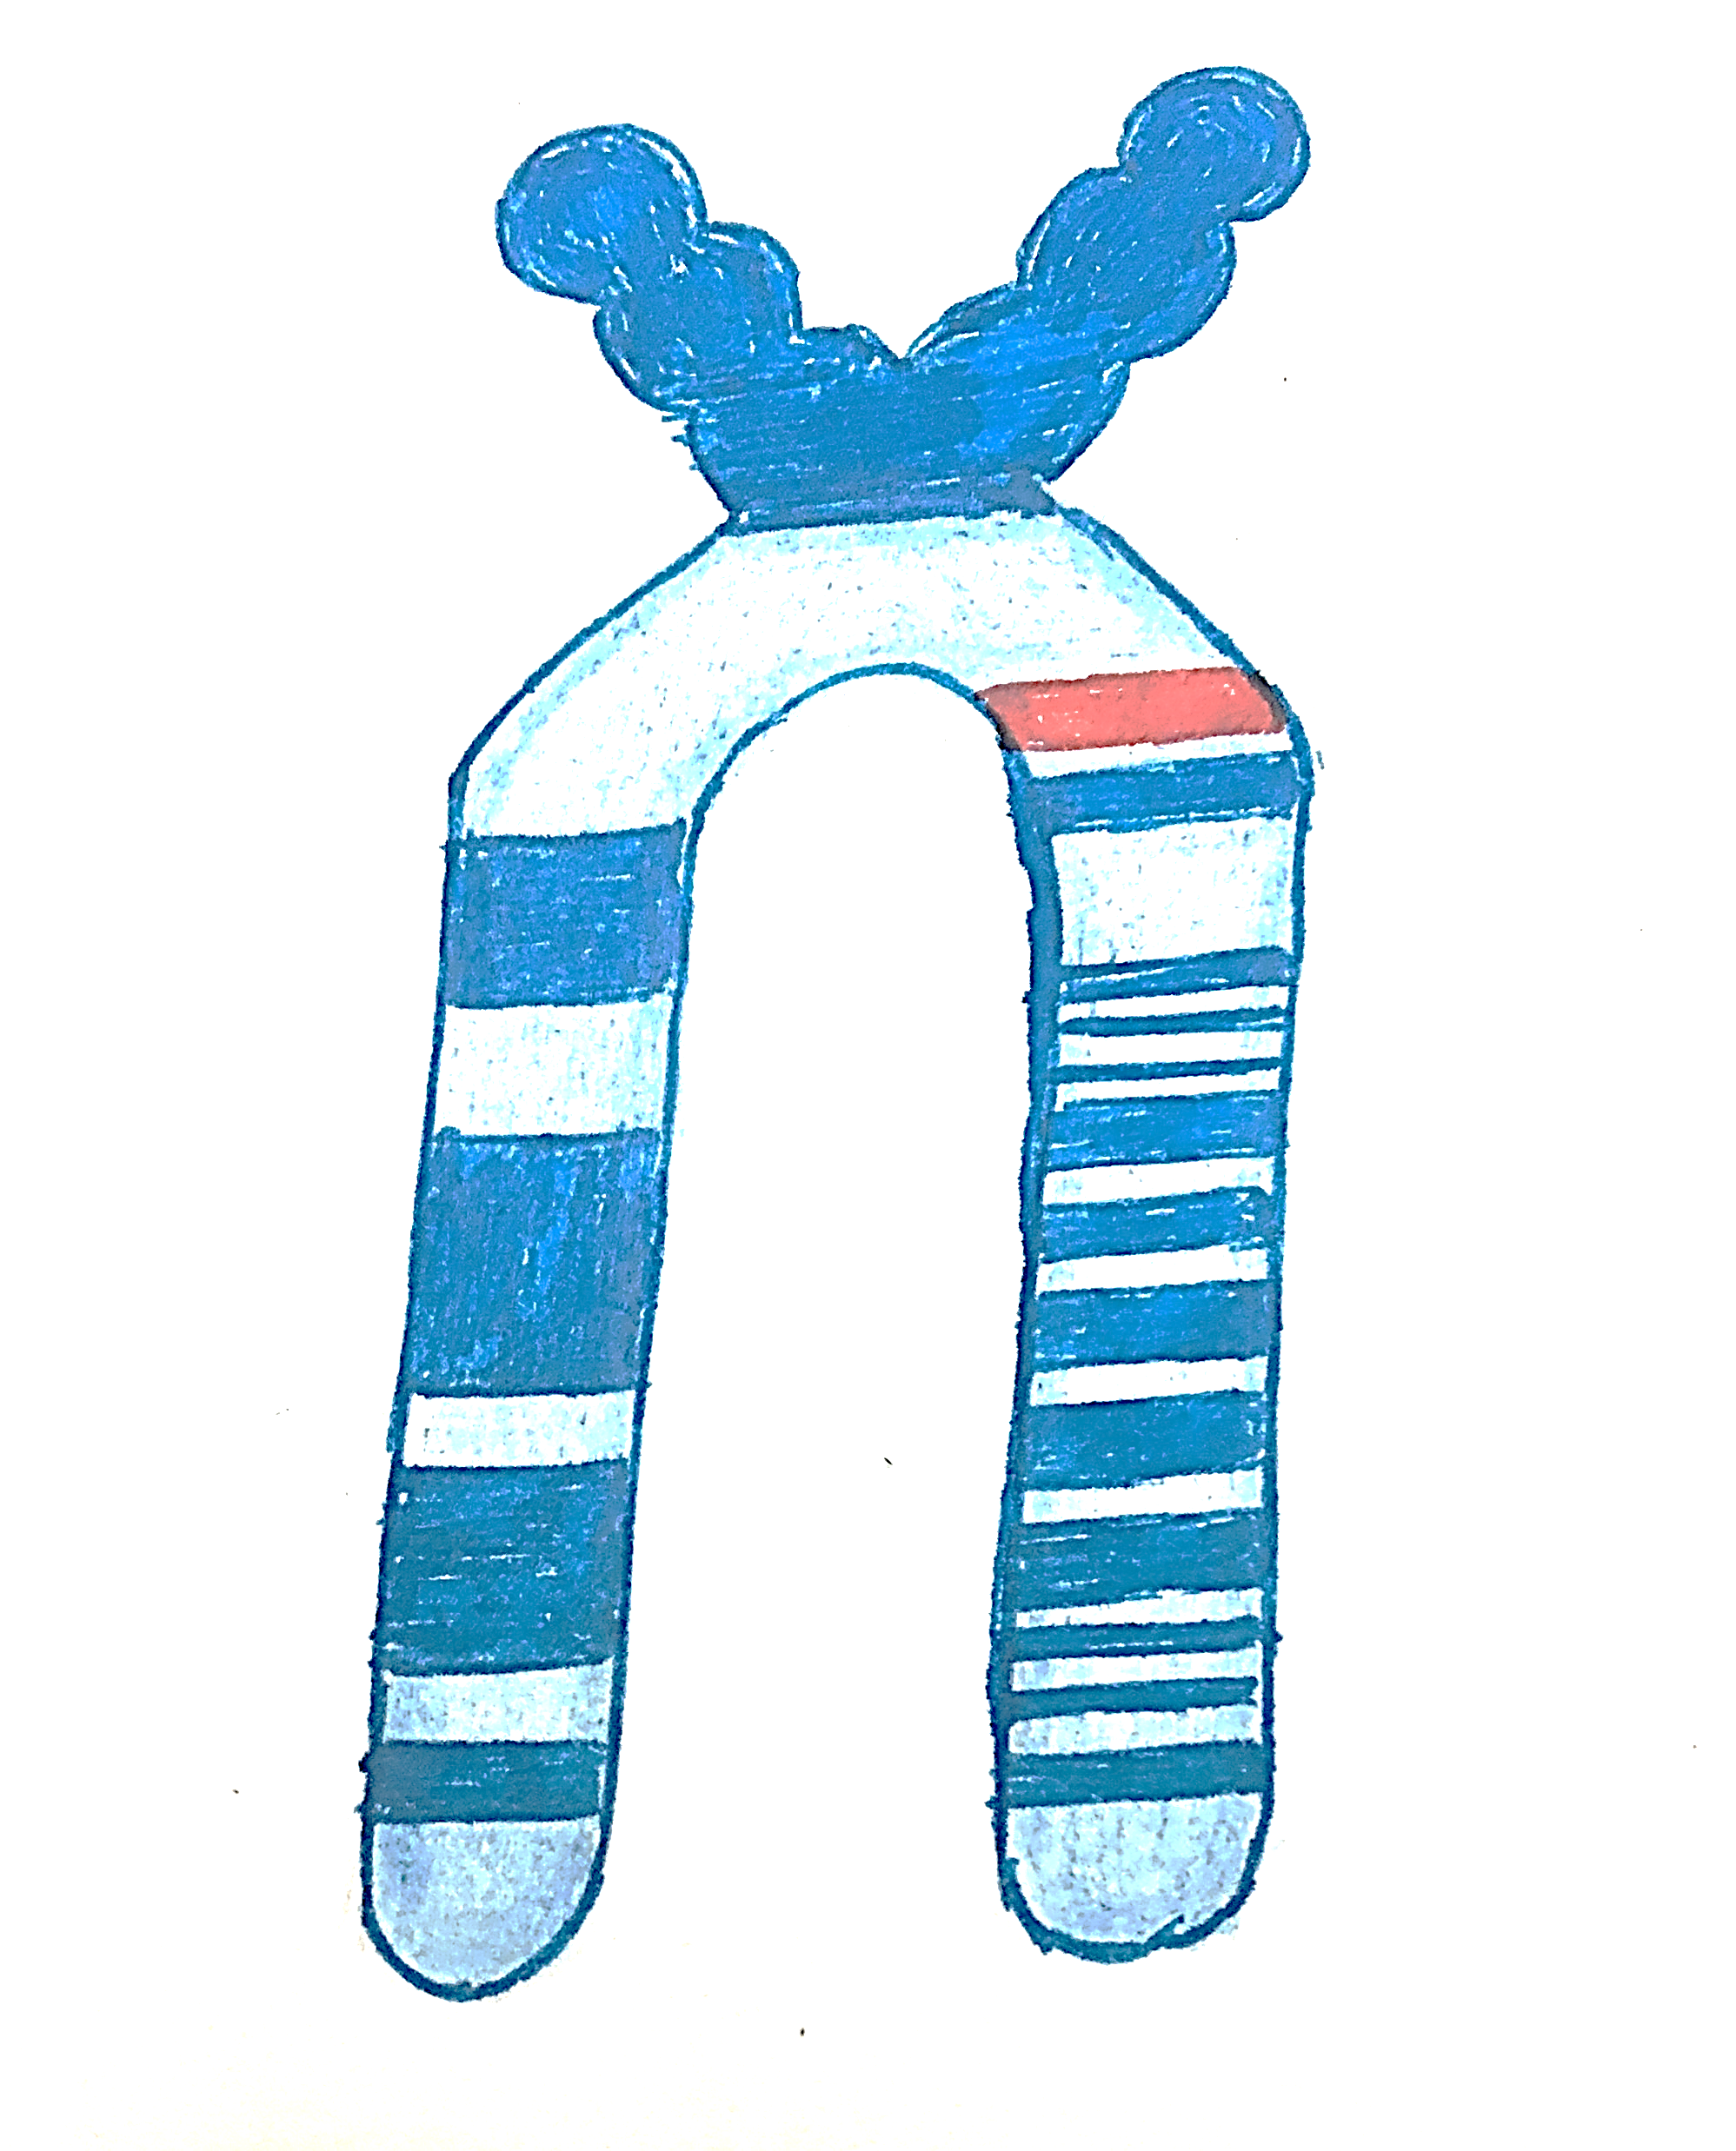
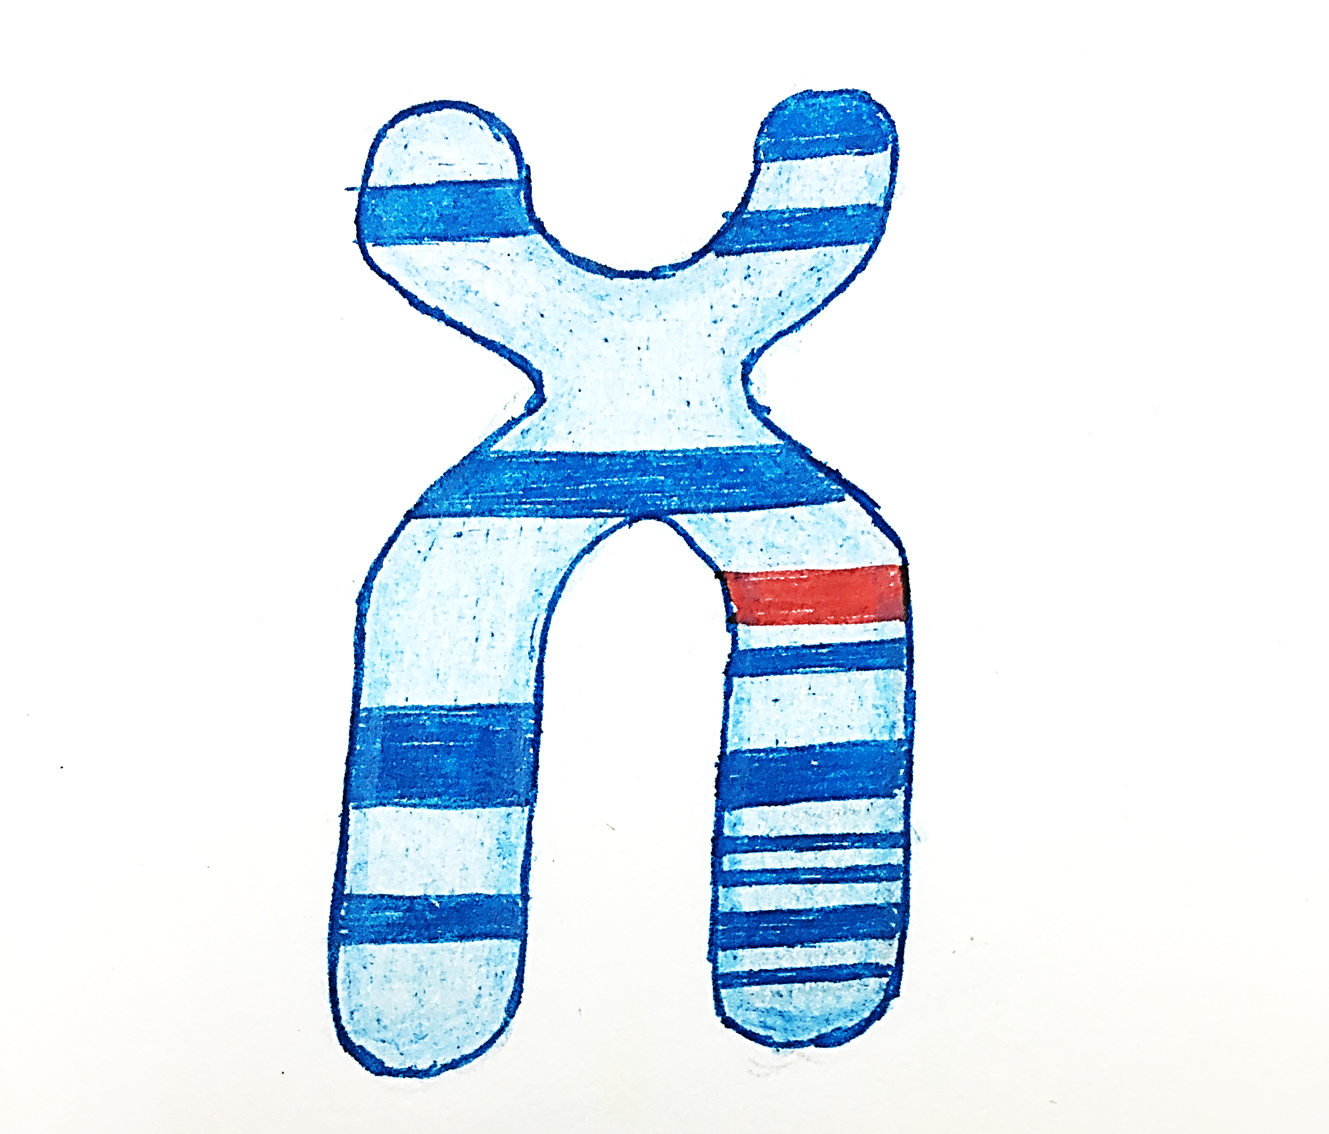
GERMLINE MUTATIONS
BRCA 2
BRCA 1
Chromosome 17q21
Chromosome 13q12.3
BRCA 1 |  | BRCA 2
Females – more common than BRCA 2 (50 – 65%) Age – 30 to 50 yrs |  | Females – less common than BRCA1 (40-55%) Age – 40 to 70 Years
Males – less common (1 –2 %) |  | Males – more common (upto 9%)
Pancreatic cancer - 1-3% of cases |  | Pancreatic cancer –2 to 7 % of cases (more than BRCA 1)
Ovarian carcinoma – more common (40%-65%) |  | Ovarian carcinoma – less common (15 - 25%)
Prostate carcinoma – 9% |  | Prostate carcinoma – 15% ( more common than BRCA 1)
BRCA1 -FBO
BRCA2 -MBPs

Slide 9
GERMLINE MUTATIONS
TP 53
- Tumor suppressor protein attaches to the breaks in DNA and helps to repair or if not repaired activates apoptosis
- Associated with Fraumeni syndrome
PTEN gene
- Produces phosphatase and tensin enzyme that stops proliferation and triggers apoptosis
- Mutation is associated with Cowden syndrome
PALB2 gene
Called the localizer of BRCA2. produces protein that works with BRCA2 protein to repair damaged DNA
Other genes associated with Breast carcinoma
ATM gene
- Cell cycle check point kinase which controls the cell cycle checkpoint signaling pathway
- Associated with Ataxia – Telangiectasia syndrome
CDH1
- Produces protein called E – cadherin (tumor suppressor protein )
- Associated with Hereditary diffuse gastric carcinoma
CHEK 2(check point kinase 2)
Involved in DNA repair, cell cycle arrest or apoptosis in response to DNA damage
STK 11 (Serine threonine kinase 11)
- Plays role in apoptosis, DNA damage, cell metabolism and cell polarity
- Associated with Peutz-Jeghers syndrome
T- 2PACCS

Slide 10
ETIOPATHOGENESIS OF BREAST CARCINOMA
SUMMARY
Risk factors – F A R M H A D F I R M M P N
Genetic mutations
Associated with exposure to estrogen
Germline mutations
Minority
Sporadic mutations
Majority
Tumor suppressor genes
BRCA1 - Chromosome 17q21; FBO
BRCA 2- Chromosome 13q12.3; MBPs
TP53
PTEN
PALB2
ATM
CHEK 2
CDH1
STK 11
Random;
Most common TP53 gene mutation
T 2PACCS
Notes:
P 53 is found inside the nucleus of cells and plays a keep role in controlling cell division and cell death.
Also called as TP53 protein.
Mutation in p53 gene causes cancer cells to grow and spread in the body

Slide 11
ETIOPATHOGENESIS OF BREAST CARCINOMA
SUMMARY
Environmental factors
Hormonal factors
Genetics
Radiation
Obesity
Alcohol
Increased estrogen exposure
Early menarchy
Late menopause
Nulliparity
Late pregnancy
HRT
Age and gender
Germ line mutation (BRCA 1, BRCA2, Tp53, PTEN, PALB2, ATM, CDH1, CHEK 2, STK11)
Family history
Dysregulated cell proliferation
Reduced cell death, Failure to repair damaged DNA, prolonged cell life
Cell proliferation with damaged DNA
Neoplasm

