Slide 1
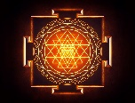
TYPES & FATE OF THROMBI
Dr.V.Shanthi
Associate professor, Department of Pathology
Sri Venkateswara Institute of Medical sciences
Tirupathi

Slide 2
OVERVIEW
TYPES OF THROMBI
FATE OF THROMBI
DIFFERENCE BETWEEN ANTEMORTEM AND POST MORTEM CLOT

Slide 3
THROMBOSIS
TYPES OF THROMBI
Arterial thrombi
Venous thrombi
Capillary thrombi
Cardiac thrombi

Slide 4
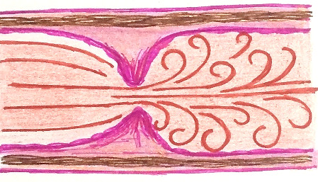
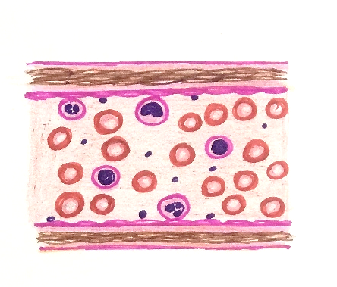
DIFFERENCES BETWEEN ARTERIAL AND VENOUS THROMBUS
FEATURE | ARTERIAL THROMBI | VENOUS THROMBI
Pathogenesis | Formed from endothelial injury due to turbulence of blood flow | Stasis
 | Formed in rapidly – flowing blood of arteries and heart | formed in slow flowing blood

Slide 5
DIFFERENCES BETWEEN ARTERIAL AND VENOUS THROMBUS
FEATURES | ARTERIAL THROMBI | VENOUS THROMBI
Growth of thrombi | Grow retrogradely in reverse direction of flow of blood | In the direction of blood flow
Both of them propagate towards heart . Propagating portion of thrombus is poorly attached and may be fragmented or embolize

Slide 6
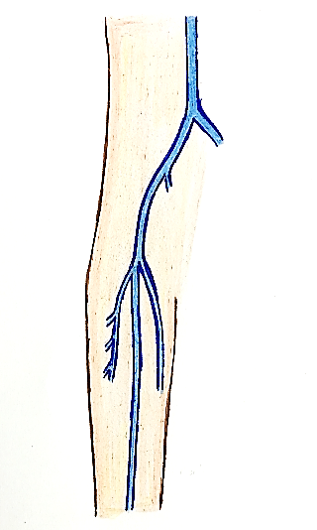
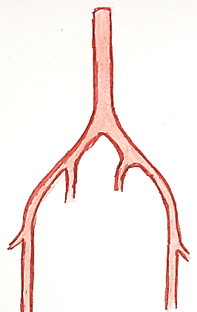
DIFFERENCES BETWEEN ARTERIAL AND VENOUS THROMBUS
FEATURES | ARTERIAL THROMBI | VENOUS THROMBI
Sites | Coronary, cerebral and femoral arteries | Common - Veins of lower extremities Other sites are – veins of upper extremity. Periprostatic plexus, or periuterine or ovarian plexus
Circle of willis
Abd aorta
Common iliac vein
Arch of aorta
ACA
Internal iliac vein
Common iliac artery
Coronary arteries
MCA
Internal iliac artey
External iliac vein
Femoral vein
Abd aorta
PCA
Cerebral arteries
Great saphenous vein
Femoral arteries
Popliteal vein

Slide 7
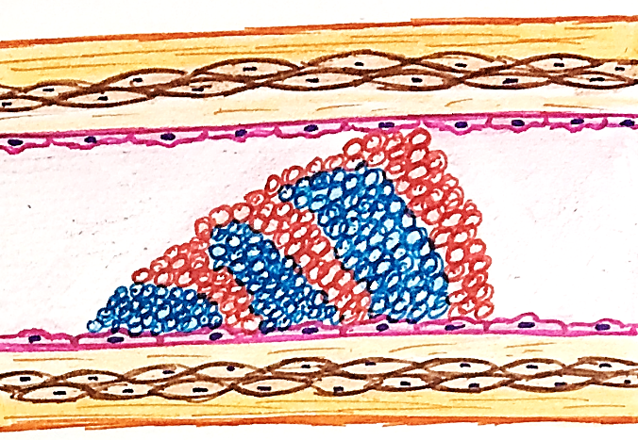
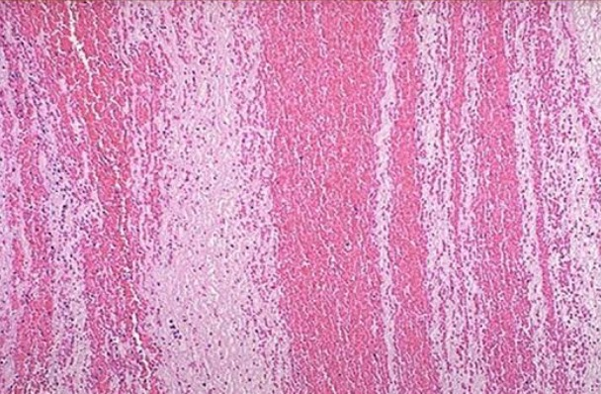
DIFFERENCES BETWEEN ARTERIAL AND VENOUS THROMBUS
Features | Arterial thrombi | Venous thrombi
Gross | Grey-white, friable with lines of zahn | Red – blue with fibrin strands
Microscopy | More prominent with alternating pale platelet and fibrin deposition alternating with darker RBC rich area | Lines of zahn with more abundant red cells hence also called as Red thrombi or stasis thrombi
Composition | Consists of fibrin meshwork of platelets , fibrin,red cells, degenerating leukocytes | More enmeshed RBC s hence also called as Red thrombi or stasis thrombi
Platelets and fibrin deposition
RBC rich areas

Slide 8
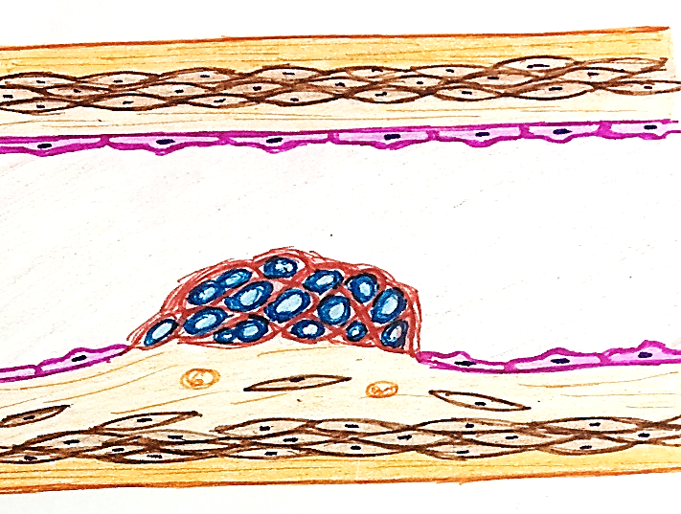
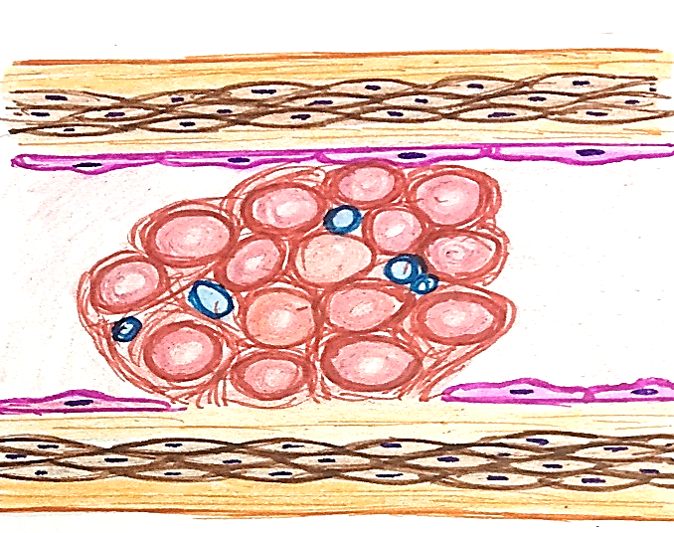
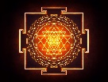
DIFFERENCES BETWEEN ARTERIAL AND VENOUS THROMBUS
FEATURE | ARTERIAL THROMBI | VENOUS THROMBI
Occlusion | Usually mural, not occluding the lumen completely | Usually occlusive, take the cast of vessel in which it is formed
Effects | Ischemia leading to infarct | Thromboembolism

Slide 9
THROMBOSIS
Capillary thrombi
Thrombi composed mainly of packed red cells are formed in capillaries in acute inflammatory lesions, vasculitis and in DIC

Slide 10
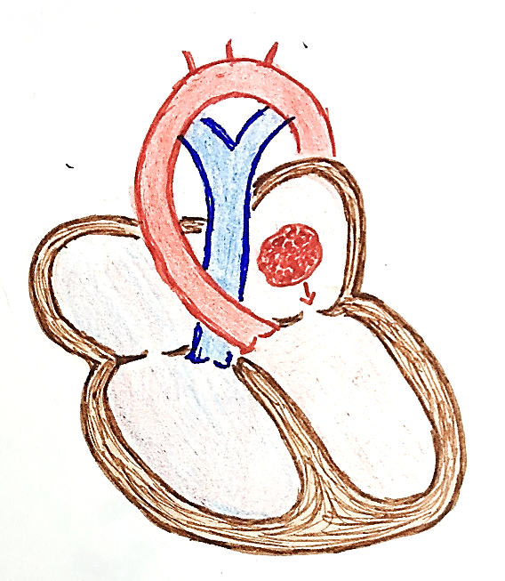
THROMBOSIS
Cardiac thrombi
Formed in any chamber of heart and on the valve cusps
Common in atrial appendages, especially in right atrium
Also on – vegetations on mitral and aortic valves
They are usually mural (non-occlusive)
Ball-valve thrombus – large round thrombus obstructing mitral valve
Agonal thrombi – composed mainly of fibrin and are formed shortly before death in either or both ventricle
Ball-valve thrombus

Slide 11
FATE OF THROMBUS
PROPAGATION
RESOLUTION
THROMBO EMBOLISM:
ORGANIZATION
Many enlarge in size
Thrombus activates fibrinolytic system
Obstruction of blood vessel
Phagocytosis of fibrin & cell debris by neutrophils & macrophages
Detachment from vessel wall
Release of plasmin
Capillaries grow into thrombus
Released into blood stream as emboli
Dissolves thrombus
Fibrovascular granulation tissue

Slide 12
THROMBOSIS
FEATURES | ANTEMORTEM THROMBI | POSTMORTEM CLOT
Origin | As hemostasis or coagulation | Due to settling and sedimentation of clotted blood
Gross | Dry granular, firm and friable | Gelatinous, soft and rubbery
Relation to vessel wall | Adherent to vessel wall | Weakly attached to the vessel wall
Shape | May or may not fit their vascular contours | Take the shape of vessel or its bifurcation
Microscopy | Surface contains apparent lines of zahn | Surface is “chicken fat” yellow covering the underlying red ‘currant jelly’

Slide 13
THROMBOSIS
SUMMARY
Fate of thrombus
Resolution
Arterial thrombi
Propagation
Venous thrombi
TYPES OF THROMBI
Capillary thrombi
Organization
Cardiac thrombi
Thrombo embolism

Slide 14
DIFFERENCES BETWEEN ARTERIAL AND VENOUS THROMBI
SUMMARY
FEATURES | ARTERIAL THROMBI | VENOUS THROMBI
Cause | Endothelial injury due to turbulence | stasis
Type of blood flow | Formed in rapidly flowing blood | Formed in slow flowing blood
Growth of thrombi | Grows retrogradely | Grows in direction of blood flow
Sites | Cerebral, coronary and femoral | Veins of lower leg more commonly
Lines of zahn | More prominent | Less prominent
Occlusion | Not occlusive (mural) | Usually occlusive
Effects | Ischemia and infarction | Thromboembolism

