Slide 1
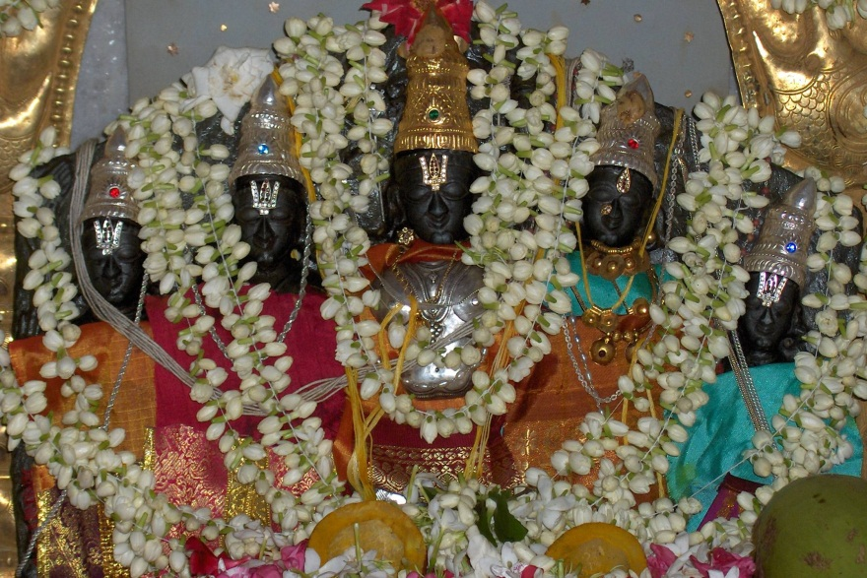
MYELOID LEUKEMIAS
Dr. B.V.Vydehi M.D
PROFESSOR OF PATHOLOGY
NARAYANA MEDICAL COLLEGE,NELLORE

Slide 2
Leukemias - Definition
Uncontrolled & abnormal proliferation of one of white blood cells & their precursors in the bone marrow and peripheral blood

Slide 3
Acute Vs Chronic Leukemia
Acute :
Rapid onset, Aggressive disease
Cells involved are mostly poorly differentiated
(>20% Blasts )
Eg :AML, ALL
Chronic :
Insidious onset, less aggressive disease
Cells involved are mostly mature &
differentiated cells
Eg: CML, CLL

Slide 4
Myeloid Neoplasms
Arise from hematopoietic progenitor cells that differentiate to cells of myeloid series (Erythrocytes, Granulocytes, Monocytes & Platelets)
Primarily involve Bone marrow
Other less common sites : Spleen, liver & lymph nodes

Slide 5
Myeloid Neoplasms – Broad Categories
I. Acute Myeloid Leukemias :
Excessive immature myeloid forms (20% Myeloblasts) in the bone marrow
Suppression of normal hematopoiesis
II. Myeloproliferative disorders :
Increased Production of one or more mature blood cells
III.Myelodysplastic Syndromes :
Defective maturation of Myeloid Progenitors
Ineffective hematopoiesis leading to cytopenias

Slide 6
Etiology of white cell Neoplasia
Exact cause is not known
Host factors
Environmental factors
Oncogenic Viruses
Iatrogenic Factors

Slide 7
Etiology of white cell Neoplasia
I. Host factors :
1. Chromosomal abnormalities :
- Translocations : common in myeloid neoplasms
- Rearrangements: Lymphoid neoplasms
2. Inherited genetic factors : ↑ risk for acute leukemia
- Ataxia telangiectasia
- Bloom syndrome
- Down syndrome (Trisomy 21)
- Neurofibromatosis Type 1
3. Chronic marrow dysfunction :
- MDS, MPD, Aplastic anemia, PNH

Slide 8
Etiology of white cell Neoplasia
II. Environmental factors : Agents causing chronic inflammation → lymphoid neoplasia
Eg : - H.pylori infection :
Gastric B-cell lymphoma
- Gluten- sensitive enteropathy:
Intestinal T-cell lymphoma
Sustained B-cell stimulation due to immune dysregulation
Eg : HIV → polyclonal B-cell activation → B-cell lymphomas

Slide 9
Etiology of white cell Neoplasia
III. Oncogenic Viruses :
HTLV -1
-Adult T-cell leukemia / lymphoma
EBV
- Burkitt lymphoma /HL
Kaposi sarcoma Herpes Virus (KSHV / HHV-8)
-Kaposi Sarcoma
-B-cell lymphoma presenting as primary malignant effusion (Primary effusion lymphoma)
-Multiple Myeloma

Slide 10
Etiology of white cell Neoplasia
IV.Iatrogenic Factors :
Exposure to Ionizing Radiation
Certain chemotherapeutic drugs
Exposure to mutagenic chemicals

Slide 11
Leukemias – Age groups
ALL - 2 to 8 yrs
AML - 15 to 40 yrs
CML - 25 to 60 yrs
CLL - > 50 yrs

Slide 12
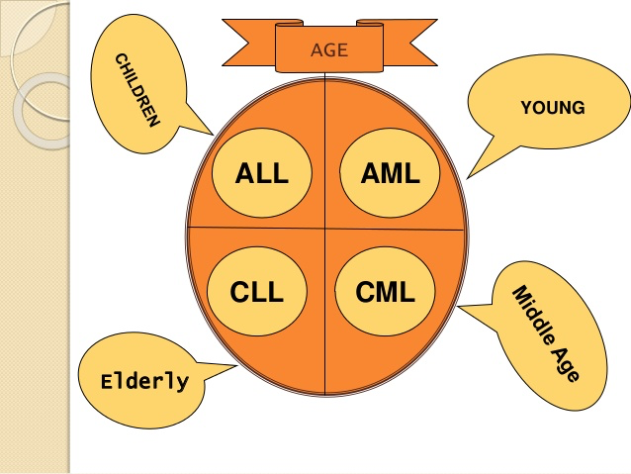

Slide 13
Acute Leukemias – Clinical Features
1. Abrupt onset :
Patients present within days to few weeks
2. Symptoms related to depression of normal marrow function :
Fatigue : Due to anemia
Fever : Due to infections because of absence of mature leucocytes
Bleeding : Due to Thrombocytopenia (Epistaxis, Gum bleeding, Petechiae, Ecchymoses)

Slide 14
Acute Leukemias – Clinical Features
3. Bone pains & tenderness :
Results from marrow expansion
4. Generalized lymphadenopathy more
5. Hepatosplenomegaly common
6. Testicular involvement in ALL
7. C.N.S manifestations :
Headache, vomiting & nerve palsies
resulting from meningeal spread
(more common in ALL than in AML)

Slide 15
Bone
Marrow
Pleuripotent Hematopoietic Stem Cell
Committed hemopoietic stem cells
Myeloid progenitor cell
Gran-monoprogenitor cell
Erythro-MK progenitor cell
Myeloblast
Promyelocyte
Monoblast
Myelocytes
Metamyelocytes
ProMonocyte
Band granulocytes
Neutrophil
Eosinophil
Basophil
Monocyte

Slide 16
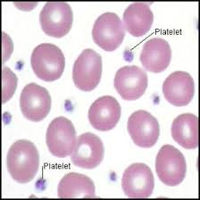
Hematopoietic Stem Cell
Bone
Marrow
Committed Hematopoietic Stem cell
Myeloid progenitor cell
Erythro-MK progenitor cell
Pro-erythroblast
(pro-normoblast)
Mk.- blast (stage -1)
Basophilic erythroblast (early)
Pro –MKcyte (stage -2)
Polychromatic erythroblast (intermediate)
Granular MKcyte (stage -3)
Ortho erythroblast (late)
Platelets
Reticulocyte
Erythocyte

Slide 17
Revised FAB classification AML
M0 (Minimal differentiation)
M1 (With out maturation)
M2 (With maturation) – Most common
M3 (APML/Acute Promyelocytic leukemia)
M4 (Acute Myelomonocytic leukemia)
M5 (Acute Monocytic leukemia)
M6 (Acute Erythro leukemia)
M7 (Acute Megakaryocytic leukemia)

Slide 18
WHO Classification - AML
Based on molecular pathogenesis & prognosis :
Class Prognosis
AML with Genetic Aberrations
AML with t(8;21) Favorable
AML with inv (16) Favorable
AML with t (15;17) Intermediate
AML with t(11q23;) Poor
II. AML with Multilineage Dysplasia
With prior myelodysplastic syndrome Poor
Without prior myelodysplastic syndrome Poor
III.AML Therapy Related
Alkylator/Radiation therapy (2-8 yrs latency) Very poor
Etoposide therapy related (1-3 yrs latency) Very poor
IV. AML, not Otherwise Specified Variable (All FAB subtypes except AML M3)

