Slide 1
MYELOID LEUKEMIAS-II
Dr. B.V.Vydehi M.D
PROFESSOR OF PATHOLOGY
NARAYANA MEDICAL COLLEGE,NELLORE

Slide 2
WHO Classification - AML
Based on molecular pathogenesis & prognosis :
Class Prognosis
AML with Genetic Aberrations
AML with t(8;21) Favorable
AML with inv (16) Favorable
AML with t (15;17) Intermediate
AML with t(11q23;) Poor
II. AML with Multilineage Dysplasia
With prior myelodysplastic syndrome Poor
Without prior myelodysplastic syndrome Poor
III.AML Therapy Related
Alkylator/Radiation therapy (2-8 yrs latency) Very poor
Etoposide therapy related (1-3 yrs latency) Very poor
IV. AML, not Otherwise Specified Variable (All FAB subtypes except AML M3)

Slide 3
Acute Myeloid leukemia
Myeloid blasts > 20% of cells in the marrow – diagnostic of AML
Myeloblast: - Fine nuclear chromatin
- 2 to 4 prominent nucleoli
- More cytoplasm, often with fine
azurophilic granules
Auer rods (Abnormal azurophilic granules)

Slide 5
AML – M0(Minimal Differentiation)
Blasts lack definitive cytologic and cytochemical markers of myeloblasts
Myeloperoxidase - Negative
Flow Cytometry- Express myeloid lineage antigens
Eg: CD33+, a marker of immature myeloid cells

Slide 6
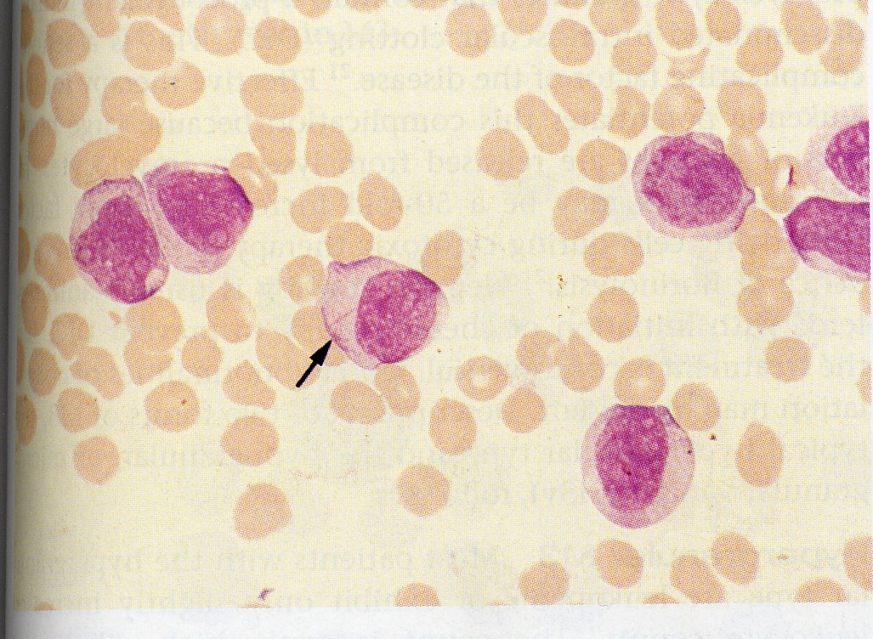
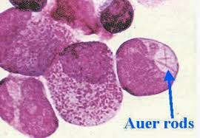
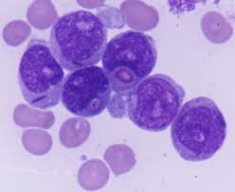
AML – M1(Without Maturation)
≥ 90 % myeloblasts ± scant granules

Slide 7
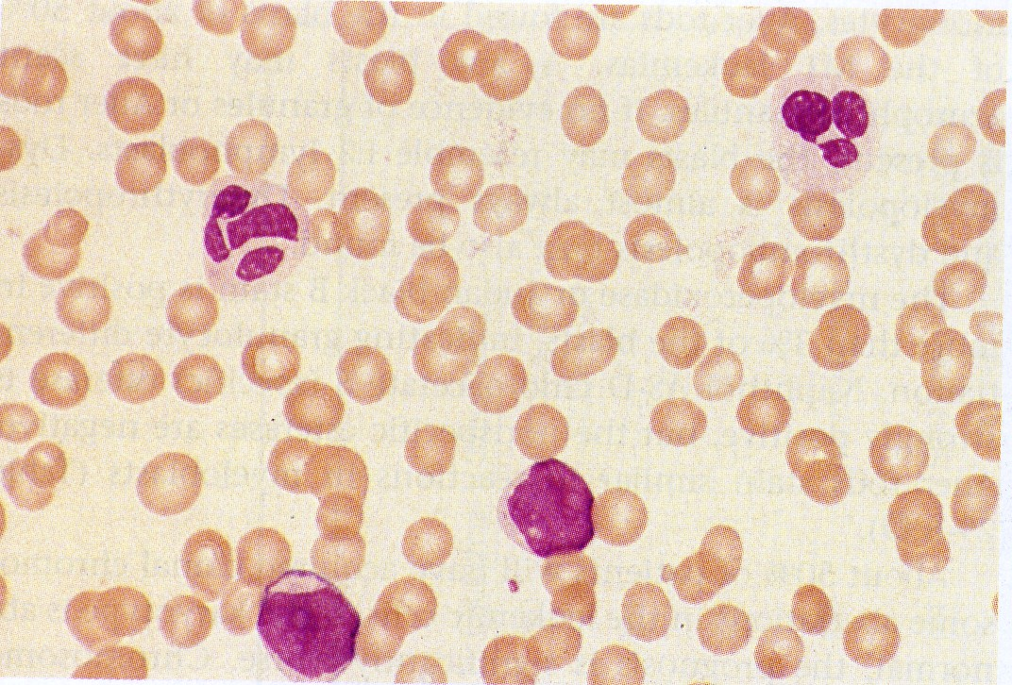
AML – M2 ( With Maturation)
Characterized by 8 & 21 translocations
Auer rods + , myelocytic maturation

Slide 8
AML – M3 (APML)
More virulent than other forms
Occurs usually in young with median age of 30-38 yrs
90% of patients present with hemorrhagic manifestations secondary to DIC
Strong association with translocation 15 & 17
>20 % myeloblasts & marked preponderance of promyelocytes
Auer rods may be seen in bundles(Faggots)

Slide 9
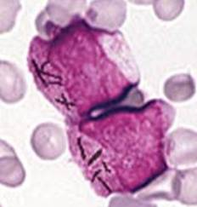
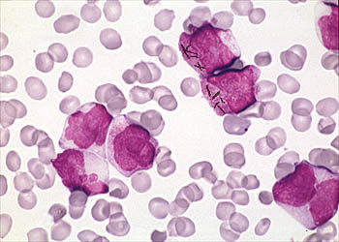
APML
Faggots

Slide 10
AML – M4 (Acute Myelomonocytic leukemia)
Myeloblasts of > 20% of total marrow cells
Monocytic differentiation also seen
Peripheral blood monocytosis (≥ 5000 / cumm)
Infiltration of extramedullary sites is more common
Monoblasts are positive for NSE
Association with Inversions 16

Slide 11
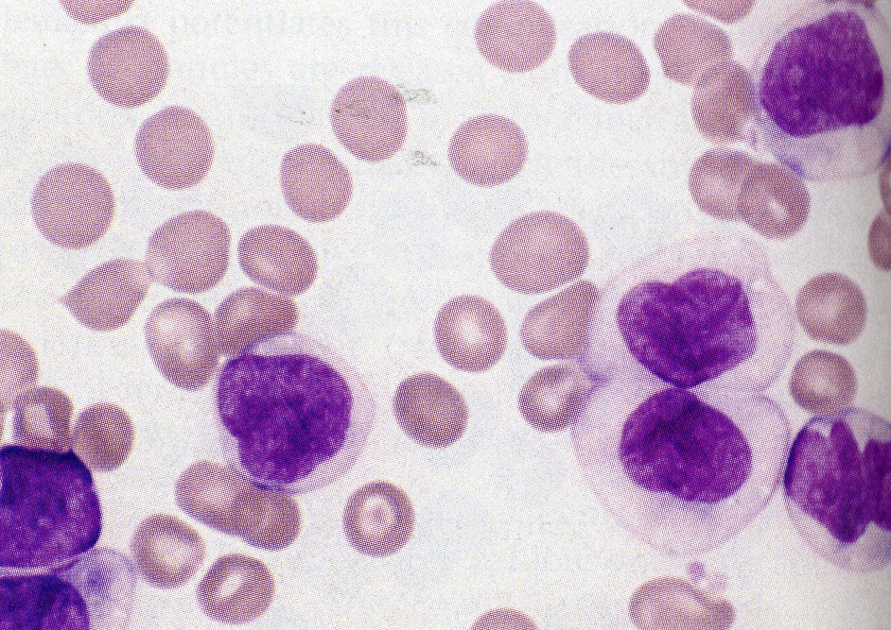

Slide 12
AML – M5
>80% of leukemic cells are of monocytic lineage, including monoblasts, promonocytes & monocytes
Non Specific Esterase ++
High incidence of organomegaly, lymphadenopathy & tissue infiltration

Slide 13
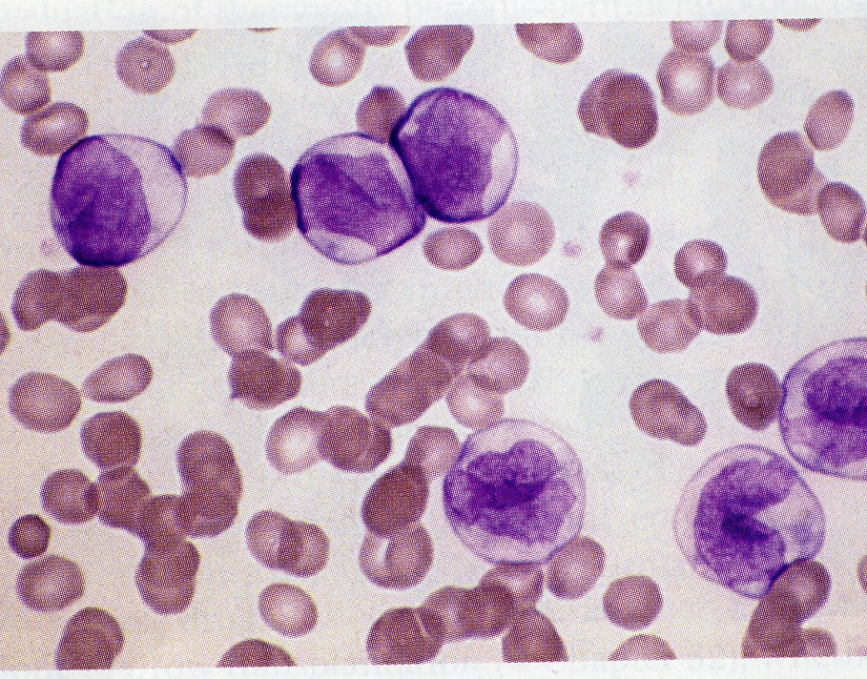
AML – M5
Monoblasts, promonocytes, and monocytes:

Slide 14
AML – M6 (Acute Erythroleukemia)
Advanced age group
Constitutes 1% of de novo AML & 20 % of therapy related AML
Pure Erythroid leukemia/DiGuglielmo's syndrome / Erythraemic myelosis : >80% Erythroid precursors with >30% proerythroblasts

Slide 17
AML – M7 (Acute Megakaryocytic leukemia)
Characterized by extensive proliferation of megakaryoblasts & atypical megakaryocytes
Blasts react with platelet specific antibodies against GP II b / III a or VWF
Myelofibrosis
Most common AML in Down syndrome

Slide 18
Acute Leukemias – Cytochemistry
Myeloperoxidase :
MPX found in primary
granules of granulocytic cells
starting from late blasts stage

Slide 19
Acute Leukemias – Cytochemistry
Sudan black : stains phospholipids, neutral fats & sterols found in primary & secondary granules of granulocytic cells

Slide 20
Acute Leukemias – Cytochemistry
Nonspecific esterase : used to identify monocytic cells which are diffusely positive

Slide 21
Summary of Diagnostic modalities of Acute Myeloid Leukemias
Light Microscopy:
Routine :
Leishman/Giemsa stain (FAB Classification )
Cytochemistry :
MPX, Sudanblack, NSE

Slide 22
Summary of Diagnostic modalities of Acute Myeloid Leukemias
Immunophenotyping:
(Flowcytometry )
CD34: Marker of multipotent stem cells
CD33: Marker of immature myeloid cells
CD64&15: Markers of mature myeloid cells

Slide 23
Summary of Diagnostic modalities of Acute Myeloid Leukemias
Cytogenetics : (Chromosomal abnormalities)
Present in 90 % of all AML pts
I)Denovo AML
M2 t (8,21) ; M3 t (15,17 ) ; M4 Inv (16)
II)With prior MDS/ exposure to DNA Damaging agents- Deletions or monosomies of 5 &7

Slide 24
Prognostic factors in acute myeloid leukemia
Factors Favorable Unfavorable
Age < 45 yrs < 2 yrs, > 60yrs Leukocytosis < 25 x 10⁹ /L > 100 x 10⁹ /L CNS involvement Absent Present Response to therapy Rapid Delayed /incomplete Auer rods Present Absent FAB type M2, M3, M4 M5, M6, M7 Cell markers CD2 or CD19 CD13, CD14, CD33 Cytogenetics t(15;17), t(8;21) -7; del (7q), -5; inv (16) /del (16q) del (5q), 11q23 abnormalities, 3q21 complex karyotypic abnormalities

