Slide 1
CELL INJURY
NECROSIS
Dr.V.Shanthi,
Professor, Department of Pathology
Sri Venkateswara Institute of medical sciences
Tirupathi

Slide 2
CELL INJURY
Cellular responses to stress & injurious stimuli
Normal cell (homeostasis)
Injurious stimuli like reduced oxygen supply, chemical injury and microbial infection
Altered physiologic stimuli and non lethal injurious stimuli
CELL INJURY
CELL ADAPTATIONS
Acute and transient
Progressive and severe
HYPERPLASIA
HYPERTROPHY
ATROPHY
METAPLASIA
DYSPLASIA
IRREVERSIBLE CELL INJURY
REVERSIBLE CELL INJURY
CELL DEATH
NECROSIS AND APOPTOSIS

Slide 3
NECROSIS
Definition
Necrosis refers to spectrum of morphologic changes that follow cell death in living tissue, largely resulting from the progressive degradative action of enzymes on lethally injured cell

Slide 4
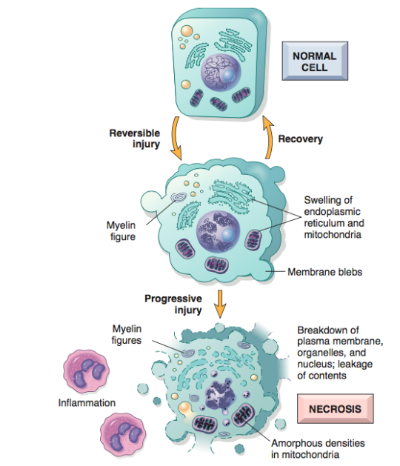

Slide 5
NECROSIS
The morphologic appearance of necrosis is the result of denaturation of intracellular proteins & enzymatic digestion of the cell
leakage of cellular contents through damaged membranes leads to local inflammation
The enzymes are derived from either lysosomes of the dead cells themselves (Autolysis) or from the lysosomes of the immigrant leukocytes (heterolysis )

Slide 6
NECROSIS
Specific substances released from injured cells have been called damage-associated molecular patterns (DAMPs). These include
  ATP (released from damaged mitochondria)
  Uric acid (a breakdown product of DNA)
  Numerous other molecules that are normally confined within healthy cells
Release of these substances is an indicator of severe cell injury
These molecules are recognized by receptors present in macrophages and most other cell types and trigger phagocytosis of the debris as well as the production of cytokines that induce inflammation

Slide 7
NECROSIS
Microscopic appearance
Cytoplasmic changes
Increased eosinophilia – Due to denatured proteins and loss of cytoplasmic RNA
Glassy homogenous appearance – loss of glycogen particles
Moth eaten appearance of cytoplasm – enzymatic digestion of cytoplasmic organelles
Whorled phospholipid masses derived from damaged cell membranes – myelin figures
Calcifications – fatty acids derived from phospholipid masses

Slide 8
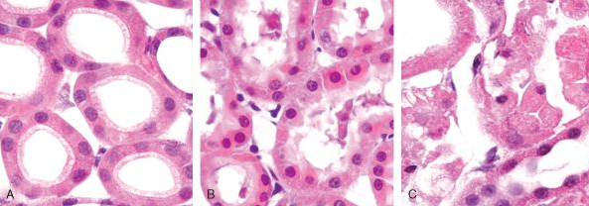
NECROSIS

Slide 9
NECROSIS
Electron microscopic findings
Necrotic cells are characterized by
Discontinuities in plasma and organellar membrane
Swollen mitochondria with large amorphous densities
Intracytoplasmic myelin figures
Aggregates of fluffy material representing denatured proteins

Slide 10
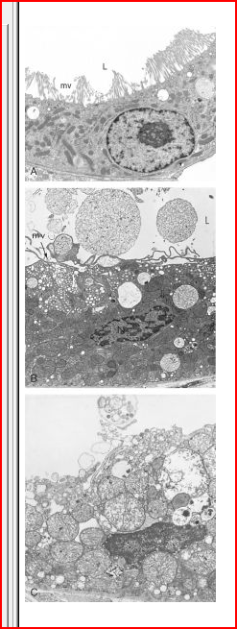
ELECTRON MICROSCOPIC FINDINGS

Slide 11
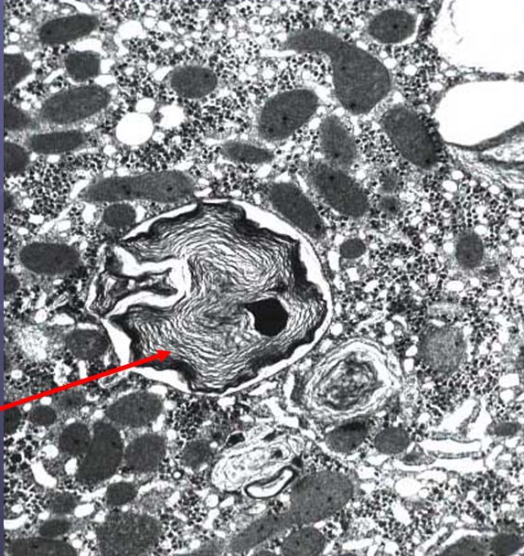
ELECTRON MICROSCOPIC FINDINGS
MYELIN FIGURES

Slide 12
NECROSIS
Microscopic appearance
Nuclear changes
Due to non-specific break down of DNA , 3 patterns are identified
Karyolysis – fading of basophilia of chromatin due to enzymatic degradation of DNA by endonucleases
Pyknosis – nuclear shrinkage & increased basophilia
Karyorrhexis – pyknotic nucleus undergoes fragmentation

Slide 13
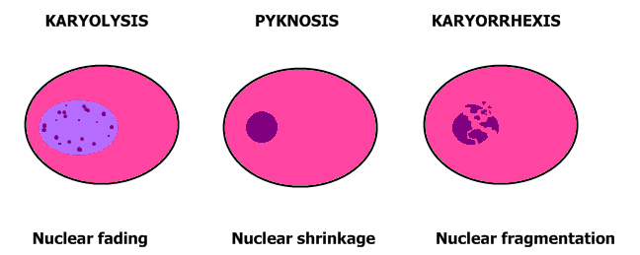
NECROSIS

Slide 14
NECROSIS
Types of necrosis
        Coagulative necrosis
        Liquefactive necrosis
        Caseous necrosis
        Fat necrosis
        Fibrinoid necrosis

Slide 15
NECROSIS
COAGULATIVE NECROSIS
There is preservation of basic outline of the cell
The increasing intracellular acidosis denatures not only structural proteins but also the enzymes & so blocks the proteolysis of the cell
E.g. Myocardial infarct
This is characteristic of hypoxic death of cells in all tissues except the brain

Slide 16
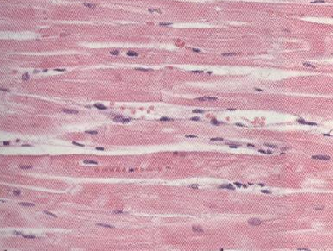
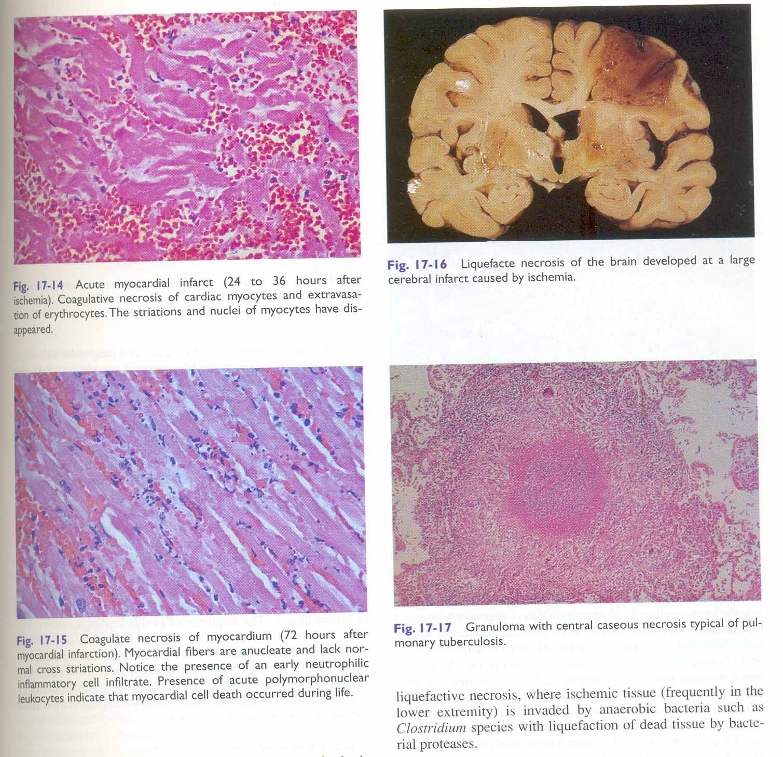
COAGULATIVE NECROSIS

Slide 17
COAGULATIVE NECROSIS

Slide 18
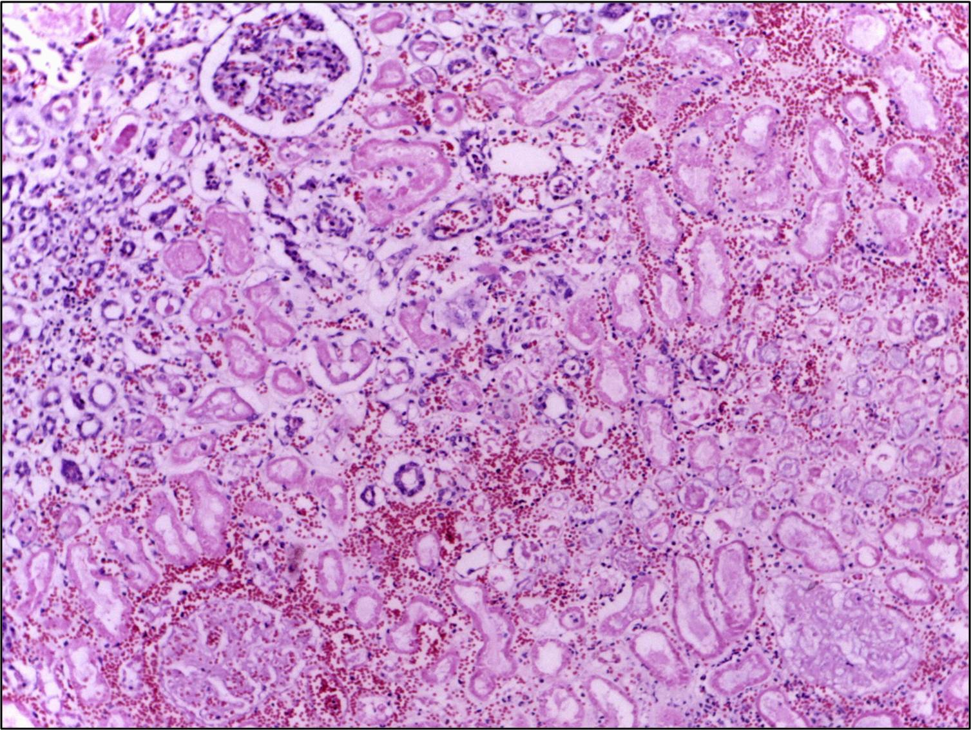
COAGULATIVE NECROSIS

Slide 19
NECROSIS
LIQUEFACTIVE NECROSIS
Characterized by digestion of dead cells resulting in transformation of the tissue into a liquid viscous mass
Is characteristic of focal bacterial, or occasional fungal infections because microbes stimulate the accumulation of inflammatory cells
If the process is initiated by acute inflammation, the material is creamy yellow because of the presence of dead white cells & called pus
E.g. hypoxic death in central nervous system – unknown reason

Slide 20
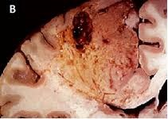
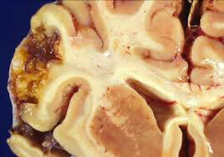
LIQUEFACTIVE NECROSIS

Slide 21
NECROSIS
GANGRENOUS NECROSIS
The term is applied to a limb , usually lower leg that has lost its blood supply & has undergone coagulation necrosis.
When bacterial infection is superimposed , coagulative necrosis is modified by the liquefactive action of the bacteria & the attracted leukocytes (wet gangrene )

Slide 22
GANGRENE
Types of the gangrenes
Dry gangrene – dead necrotised tissue remains uninfected.
Wet gangrene -necrotic tissue becomes infected.
Gas gangrene – Wet gangrene infected by one of the gas forming Clostridia

Slide 23
DRY GANGRENE
Gangrene begins in distal part of limb due to ischemia
Causes-
  Atherosclerosis of arteries supplying limb
  Thromboangitis obliterans
  Raynauds disease
  Trauma
  Ergot poisoning
Due to ischemia tissues undergoes infarction and line of separation is formed between the necrotic tissue and healthy tissue
At the margins of necrotic tissue, granulation tissue develops

Slide 24
DRY GANGRENE
Morphology
Grossly the affected part is dry shrunken and dark in color resembling the mummified foot.
Black color is due to release of hemoglobin from the hemolysed RBC’s which are acted upon by the hydrogen disulfide produced by bacteria which results in the formation of black iron sulphide
Gradually the gangrenous tissue falls from the healthy tissue at the line of separation.
Because of the risk of infection it should be surgically separated

Slide 25
WET GANGRENE
Wet gangrene typically occurs in the
Organs with venous blockage or both venous and arterial blockage like bowel (due to strangulated hernia, volvulus or intusscesception ) lung, mouth, cervix and vulva
Diabetic foot –High glucose content in the necrosed tissue favours bacterial growth
Bed sores –In bed ridden patients at the pressure on the sites like sacrum, buttocks and heel

Slide 26
WET GANGRENE
Morphologic features:
Grossly the affected part is black, rotten, and soft and pulpy
The affected part is dark due to same reason as in dry gangrene
Microscopically the tissue shows coagulative necrosis with extensive areas of hemorrhage
Line of demarcation between variable and necrosed tissue is absent

Slide 27
GANGRENOUS NECROSIS
 | Dry gangrene | Wet gangrene
Site | Lower limbs | More common in bowel
Mechanism | Arterial occlusion | More commonly venous occlusion, less often arterial occlusion
Macroscopy | Organ is dry, shrunken and black | Moist, soft swollen and dark
Line of demarcation | Present between gangrenous and healthy part | No line of demarcation
Presence of bacteria | Bacteria fail to survive | Numerous bacteria is present
Prognosis | General better due to little septicemia | Generally poor due to profound toxemia

Slide 28
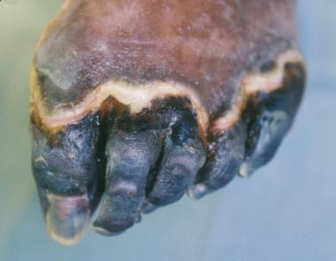
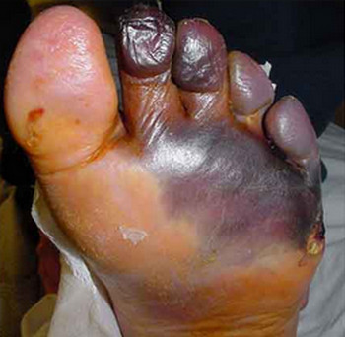
GANGRENOUS NECROSIS
DRY GANGRENE
WET GANGRENE

Slide 29
GAS GANGRENE
It is wet gangrene infected by one of the gas forming Clostridia (Gram positive anaerobic bacteria)
Gas forming Clostridia enters the tissue through a contaminated wound or as a complication of operation on colon which normally contains Clostridia
Clostridia rapidly spreads through tissues especially in muscles and cause extensive necrosis and massive edema

Slide 30
Gas gangrene
Morphology
Gross – the affected part is edematous, swollen and has crepitations on palpation due to accumulation of gas in tissues
Microscopically
  Muscle fibres undergo coagulative necrosis with liquefaction
  At the periphery, a zone of leukocytic infiltration, oedema and congestion are found

Slide 31
CASEOUS NECROSIS
Distinctive form of coagulative necrosis most often encountered in tuberculous infection
The term caseous is derived from cheesy white gross appearance of area of necrosis which is friable and white
Microscopic appearance
Necrotic focus – collection of fragmented or lysed cells and amorphous granular debris enclosed with in distinctive inflammatory border – granulomatous reaction

Slide 32
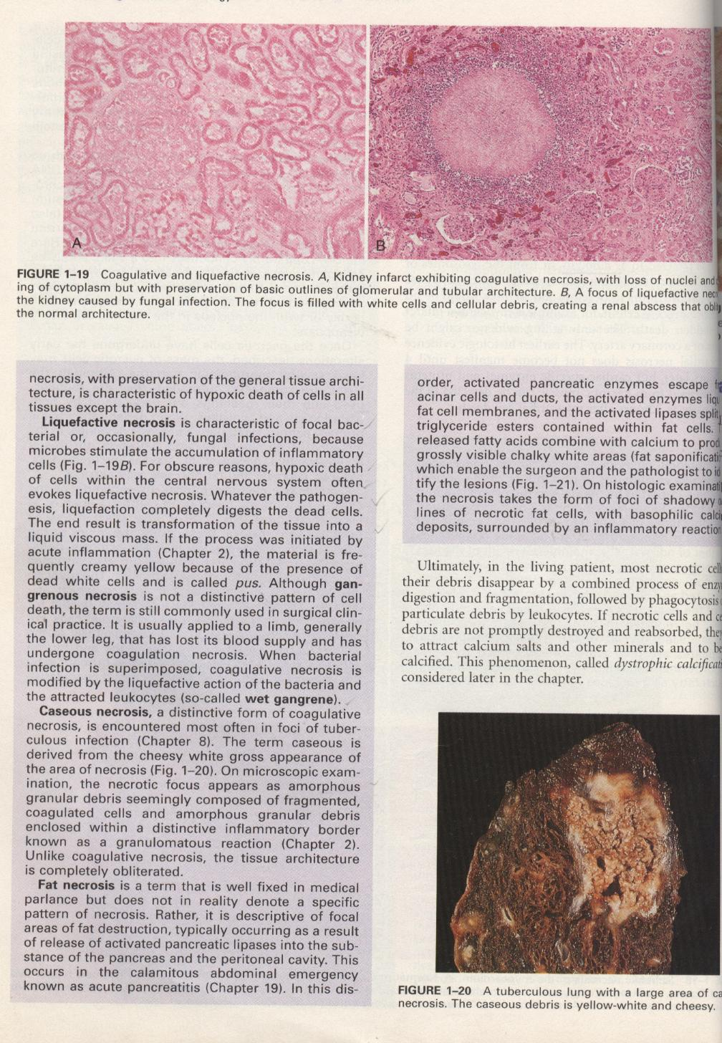
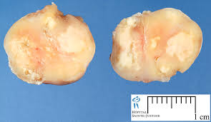
CASEOUS NECROSIS

Slide 33
GRANULOMA FORMATION IN CASEOUS NECROSIS

Slide 34
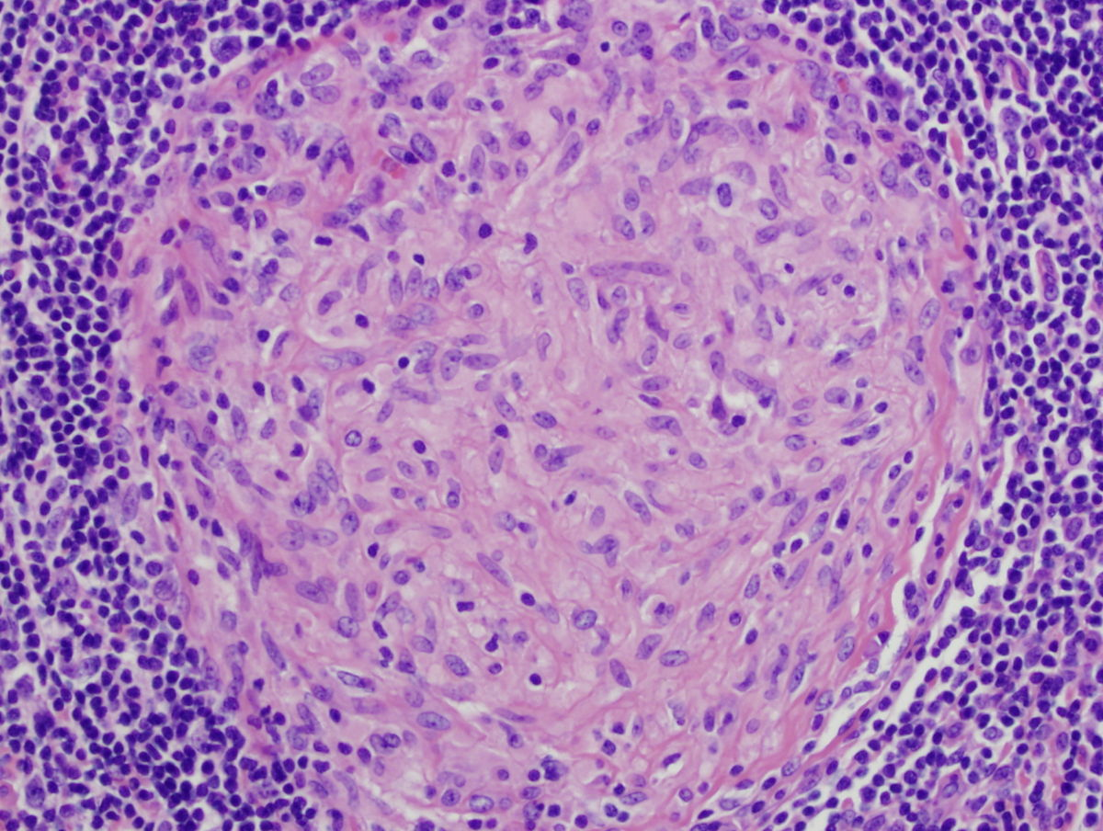
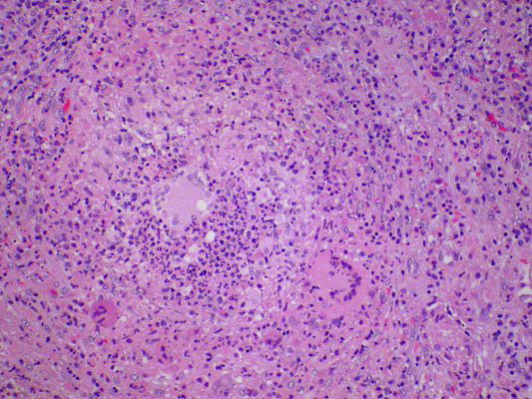
GRANULOMA

Slide 35
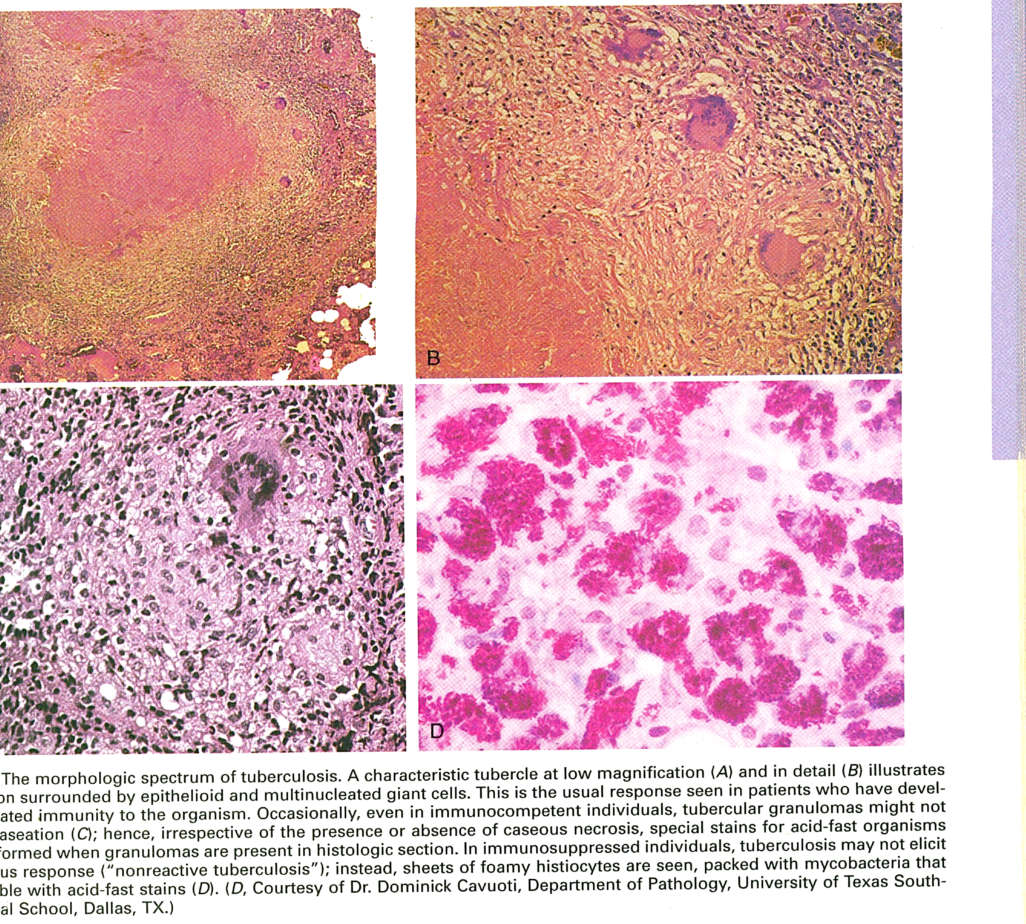
GRANULOMA

Slide 36
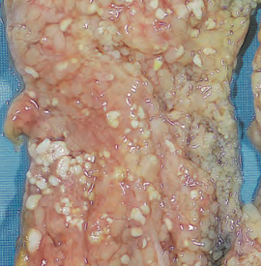
FAT NECROSIS
It is descriptive term for focal areas of fat destruction , typically occurring as a result of release of activated pancreatic lipases into the substance of pancreas & the peritoneal cavity
The fatty acids released combine with calcium to produce grossly visible chalky white areas (fat saponification)

Slide 37
FAT NECROSIS
Microscopic appearance
Necrosis take the form of shadowy outlines of necrotic fat cells, with basophilic calcium deposits surrounded by an inflammatory reaction

Slide 38
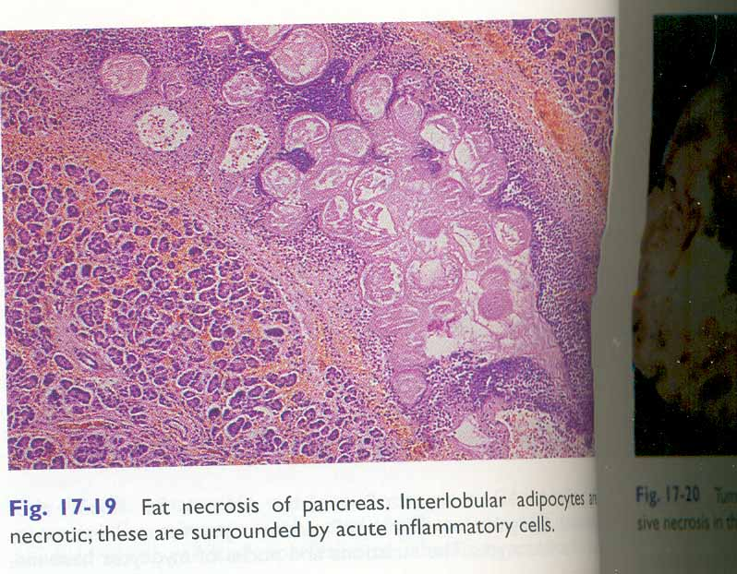
FAT NECROSIS

Slide 39
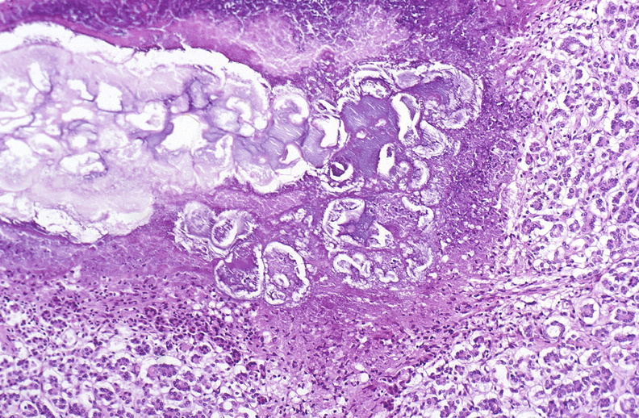
FAT NECROSIS

Slide 40
FIBRINOID NECROSIS
Special form of necrosis seen in immune reactions involving blood vessels
Occurs when complexes of antigens and antibodies are deposited in the walls of arteries
Along with these complexes fibrin which has leaked out of vessels give bright pink amorphous appearance called fibrinoid (Fibrin like)

Slide 41
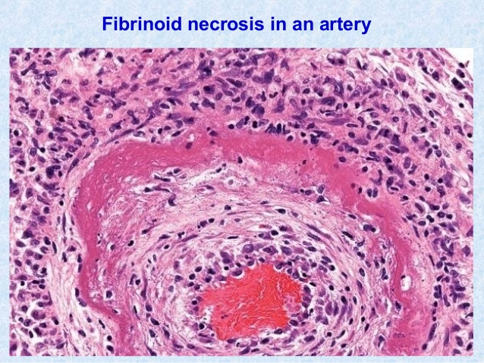
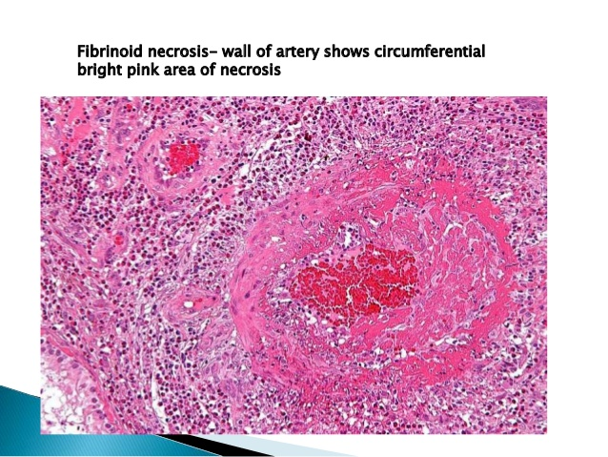
FIBRINOID NECROSIS

Slide 42
THANK YOU

