Slide 1
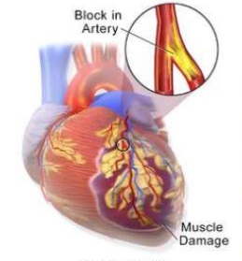
ISCHEMIC HEART DISEASE
Dr.V.Shanthi,
Professor, Pathology
Sri Venkateswara Institute of Medical Sciences
Trupathi

Slide 2
ISCHEMIC HEART DISEASE (IHD)
IHD represents a group of patho physiologically related syndromes resulting from myocardial ischemia – an imbalance between myocardial supply (perfusion) and cardiac demand for oxygenated blood
90% of cases – due to atherosclerotic lesion in coronary arteries
Other causes – cardiac emboli, myocardial vessel inflammation or vascular spasm

Slide 3
ISCHEMIC HEART DISEASE (IHD) Etiopathogenesis
Etiology of IHD has been categorized into
Coronary atherosclerosis
Superadded changes in coronary atherosclerosis
Non-atherosclerotic causes

Slide 4
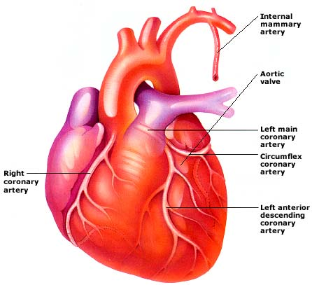
ISCHEMIC HEART DISEASE (IHD) Etiopathogenesis - Coronary atherosclerosis
90% cases of IHD – due to atherosclerosis
Distribution
Can occur in one or more of the three major coronary arteries
Highest incidence is in anterior descending branches of left coronary
Next in decreasing frequency is right coronary artery and circumflex branches of left coronary artery
Location – area of severest involvement is about 3 to 4 cm from the coronary ostia and at or near the bifurcation of arteries

Slide 5
ISCHEMIC HEART DISEASE (IHD) Etiopathogenesis
Superadded changes in atherosclerosis
Acute coronary syndromes including acute MI, unstable angina and sudden ischemic death are due to superadded changes in pre existing atherosclerotic plaque
These changes are
Acute changes in ahtheromatous plaque – hemorrhage, fissuring ulceration- thombosis
Coronary artery thrombosis lading to emboli formation
Local platelet aggregation, which releases thromboxane A 2 causing vaso spasm coronary spasm

Slide 6
ISCHEMIC HEART DISEASE (IHD) Etiopathogenesis
Non-atherosclerotic causes
Vasospasm
Stenosis of coronary ostia- in conditions like aortic atherosclerotic plaque encroaching on opening of coronary ostia or extension of syphilitic aortitis
Arteritis – as in rheumatic arteritis, poly arteritis nodosa, thromboangitis obliterans, or other bacterial infection
Embolism – emboli from else where in the body may occlude coronary arteries and their branches

Slide 7
ISCHEMIC HEART DISEASE (IHD) Etiopathogenesis
Non-atherosclerotic causes
Thrombotic diseases – conditions with hypercoagulability of blood such as in shock, polycythemia vera, sickle cell anemia and thrombotic thrombocytopenic purpura
Trauma
Aneurysm –
dissecting aneurysm of the aorta into the coronary artery may produce thrombotic coronary occlusion
Rarely congenital, mycotic and syphilitic aneurysms may occur in coronary arteries
Compression – from outside by primary or secondary tumors of the heart may result in occlusion

Slide 8
Etiopathogenesis of IHD
Coronary atherosclerosis
Superadded changes in coronary atherosclerotic plaque
Non-atherosclerotic causes
Acute changes in plaque
Coronary artery thrombosis
Local platelet aggregation
Vasospasm
Stenosis of coronary ostia
Arteritis
Embolism
Thrombotic diseases
Trauma
Aneurysms
Compression

Slide 9
ISCHEMIC HEART DISEASE
IHD can present as one of the following clinical syndrome
Myocardial ischemia – Ischemia Cardiac necrosis
Angina pectoris(Chest pain) – Ischemia does not cause infarction but symptoms infarction risk
Chronic IHD with heart failure
Sudden cardiac death

Slide 10
ANGINA PECTORIS
Transient myocardial ischemia that is insufficient to induce myocyte necrosis
Characterized by paroxysmal and usually recurrent attacks of substernal or precordial chest discomfort with or without physical exertion
Caused by ischemic induced release of Adenosine, bradykinin, and other molecules that stimulate sympathetic and vagal afferent nerves
Types :
Stable angina
Prinzmetal or variant angina
Unstable angina

Slide 11
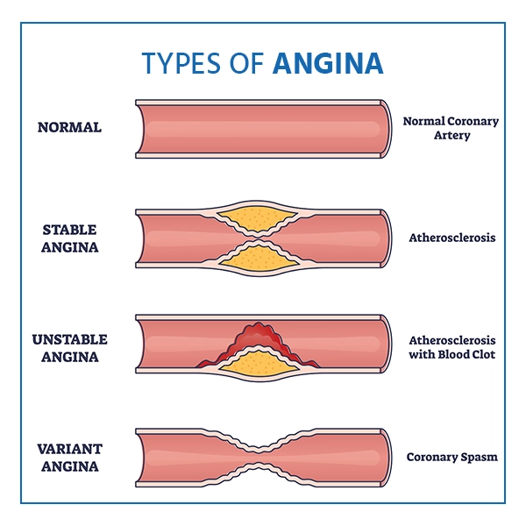

Slide 12
ANGINA PECTORIS Stable (typical) angina
Most common
Imbalance in coronary perfusion (chronic stenosing coronary atherosclerosis) and myocardial demand
Most common cause is atherosclerosis – demand is normal but supply is reduced
Other causes can be
Hypertension
Hypertrophy
sometimes – increased demand and decreased supply
Increased demand but normal supply

Slide 13
ANGINA PECTORIS Stable (typical) angina
Produced by - Physical activity, emotional excitement or psychological stress (not at rest)
Presents as - Deep, poorly localized pressure, squeezing, or burning sensation (like indigestion), but unusually as pain
ST segment depression- less than1mm
Relieved with rest/ vasodilators

Slide 14
ANGINA PECTORIS Prinzmetal variant angina
Uncommon
Intermittent coronary artery vasospasm at rest with or without atherosclerosis
Episodic myocardial ischemia
Caused by coronary artery spasm
Not related to physical activity
ST segment elevation
Responds promptly to vasodilators
Pathogenesis
Platelets within the trombus
Endothelium
Increased Thrombaxane A2
Endothelin
vasoconstriction
Prinzmetal angina

Slide 15
ANGINA PECTORIS Unstable or crescendo angina
Prolonged, or severe angina or chest discomfort for > 20 minutes with minimal exertion or even at rest
Multivessel coronary artery disease with disrupted atherosclerotic plaque causing superimposed partial thrombosis and possibly embolization or vasospasm
Frank pain, precipitated by progressively lower levels of physical activity or even at rest
Evidence of myocardial necrosis
High risk of acute MI

Slide 16
Ischemic heart disease
Coronary thrombosis
Transient coronary ischemia
Myocardial infarction
Angina pectoris
Atherosclerosis and exertion
Acute vasospasm
Typical angina
Variant angina
Disrupted plaque and multivessel involvement
Stable angina
Unstable angina

Slide 17
MYOCARDIAL ISCHEMIA
Referred to as “Heart attack” due to death of cardiac muscle due to prolonged severe ischemia
Can occur at any age- 10% of MI occur in people younger than 40 years and 45% in younger than 65 years
Risk increases with age as there is increased incidence of risk factors
Males are more affected than females in middle age
In elderly age – both are equally affected

Slide 18
MYOCARDIAL ISCHEMIA PATHOGENESIS
MI is caused by
Coronary atherosclerosis
Coronary emboli - from left atrium in association with atrial fibrillation, vegetations of infective endocarditis, intracardiac prosthetic material, paradoxical emboli from the right side of the heart or the peripheral veins
Intramural coronary vessel disorders – vasculitis, amyloid deposition in vessel wall, sickle cell disease or lowered systemic blood pressure
Vasospasm – with or without atherosclerosis in association with platelet aggregation or in cocaine abuse

Slide 19
CONSEQUENCES OF MYOCARDIAL ISCHEMIA
Ischemia
Cessation of aerobic metabolism
Inadequate production of ATP and Creatinine phosphate
Accumulation of Lactic acid
Decrease in myocardial contractility
Heart failure
Myocyte death

Slide 20
TIME OF ONSET OF EVENTS IN IHD
FEATURES | TIME
Onset of ATP depletion | Seconds
Loss of contractility | < 2 minutes
ATP reduced
to 50% of normal | 10 minutes
to 10% of normal | 40 minutes
Irreversible cell injury | 20-40 minutes
Microvascular injury | > 1 hour

Slide 21
CONSEQUENCES OF MYOCARDIAL ISCHEMIA Ultra structural changes
Reversible changes occur with in 60 seconds
Myofibrillar relaxation
Glycogen depletion
Cell and mitochondrial swelling
Irreversible changes occur if ischemia lasts for 20 to 40 minutes or more – necrosis of cardiac myocyte

Slide 22
MYOCARDIAL ISCHEMIA
Myocardial perfusion is from epicardium to endocardium
Ischemic changes are more pronounced in subendocardium
With increase of ischemia, ischemic cell death occurs in entire thickness of myocardium
Half thickness of myocardium undergoes necrosis in - 2hours
Full thickness / transmural necrosis in – 6 hours

Slide 23
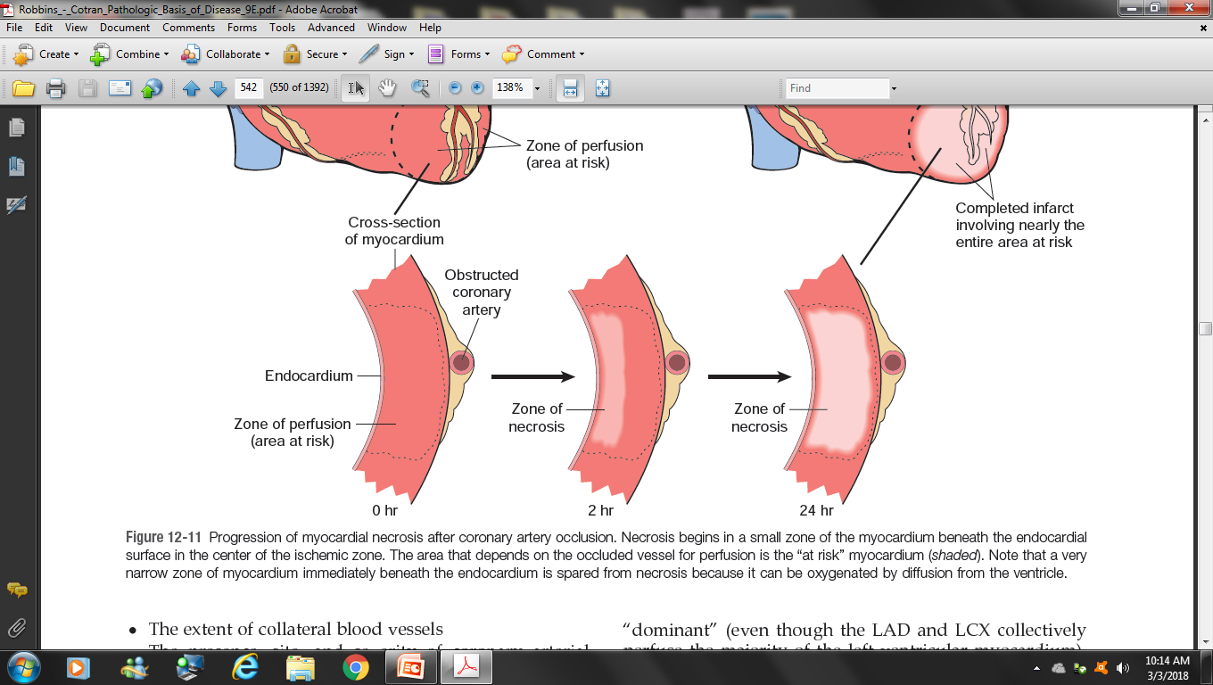
MYOCARDIAL ISCHEMIA

Slide 24
MYOCARDIAL ISCHEMIA
Location size and specific morphologic features of acute MI depends upon
Location, severity and rate of development of coronary obstruction
Size of vascular bed perfused by obstructed vessel
Duration of occlusion
Metabolic or oxygen needs of myocardium at risk
Extent of collateral blood vessels
Other factors such as cardiac rate, blood oxygenation etc

Slide 25
MYOCARDIAL ISCHEMIA
Common Location of infarcts
Most commonly located in left ventricle
Atrial infarcts are more common in right atrium. Left atrium is protected due to the supply of oxygenated blood to left atrium
Region of infarction depends upon the obstructed coronary artery
Stenosis of anterior descending artery –
Most common (40-50%). Region infarcted – apex and anterior 2/3rd of interventricular septum
Stenosis of right coronary artery
Next in frequency (30 -40%). Region infarcted – posterior part of left ventricel and posterior 1/3rd of interventricuular septum
Stenosis of left circumflex coronary artery
Less frequent (15-20%). Region infarcted – lateral wall of left venrticle

Slide 26
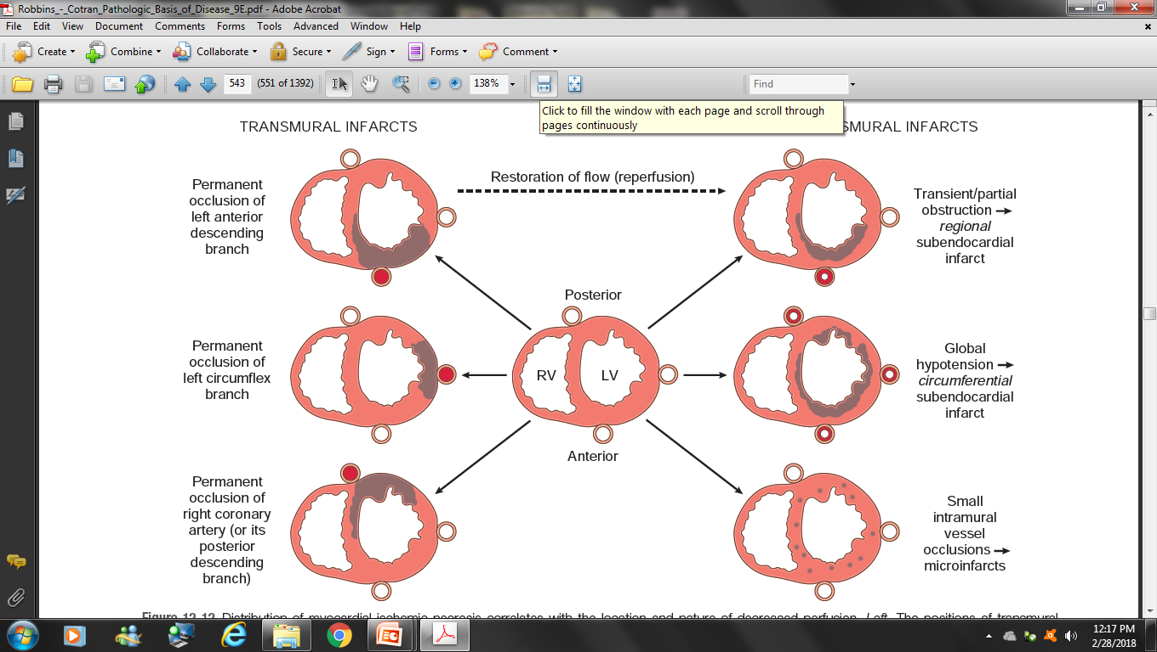
PATTERNS OF INFARCTION
Transmural – Necrosis involves full thickness of cardiac wall
Subendocardial – Necrosis involves the least perfused area → subendocardial region – inner 1/3rd of ventricular wall (caused by plaque disruption followed by coronary thrombus or in shock)
Multifocal microinfarction – occurs when smaller intramural vessels are involved ← microembolization, vasculitis, vasospasm

Slide 27
PATTERNS OF INFARCTION
TRANSMURAL SUBENDOCARDIAL MULTIFOCAL
INFARCTION INFARCTION MICROINFARCTION
Transmural infarcts – ST segment elevation on ECG and
hence termed – STEMI
Other infarcts – no ST segment elevation → NSTEMI

Slide 28
MORPHOLOGY OF MI
Development of Gross and Microscopic features depends on the survival of the patients post MI
Gross changes - < 4 hrs, Not apparent
Microscopic changes - < 4 hrs, not significant

Slide 29
MORPHOLOGY OF MI
TIME | MICROSCOPIC CHANGES | GROSS CHANGES
2-3 hrs 0- ½ hr ½ - 4 hr | none Waviness of fibres at the border | Triphenyl tetrazolium chloride Normal heart → brick red (stain of Lactate dehydrogenase) MI area → unstained
4 - 12 hrs | Early coagulation necrosis, edema and hemorhage | Dark mottling
12 - 24 hrs | Coagulation necrosis with neutrophilic infiltration | Dark mottling
1- 3 days | Coagulation necrosis with loss of nuclei and striations. Interstitial infiltrate of neutrophils. | Mottling with yellow – tan infarct center
3 – 7 days | Beginning of disintegration of dead myofibres with dying neutrophils. Early phagocytosis of dead cells by macrophages | Hyperemic border, and central yellow tan softening

Slide 30
MORPHOLOGY OF MI
TIME | MICROSCOPIC CHANGES | GROSS CHANGES
7 – 10 days | Well developed phagocytosis of dead cells. Granulation tissue at margins | Maximally yellow tan and soft, with depressed red-tan margins
10 – 14 days | Well – established granulation tissue with new blood vessels and collagen deposition | Red – gray depressed infarct borders
2 – 8 week | Increased collagen deposition, with decreased cellularity | Grey-white scar, progressive from border toward core of infarct
> 2 month | Dense collagenous scar | Scarring complete

Slide 31
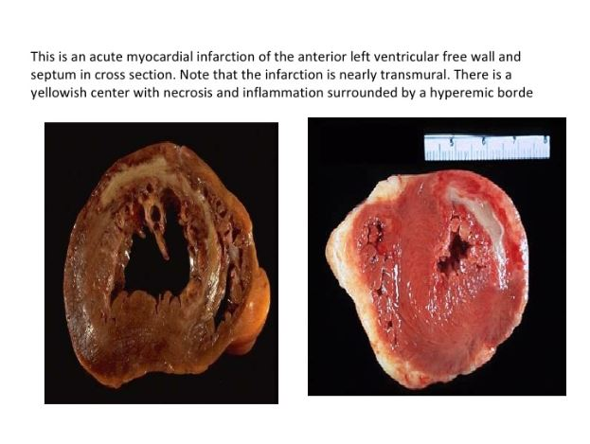
MORPHOLOGY OF MI
Trans mural infarct with yellowish necrotic centre and surrounding hyperemic border

Slide 32
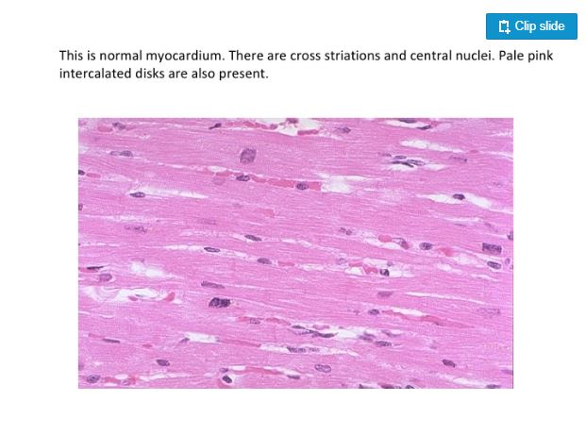
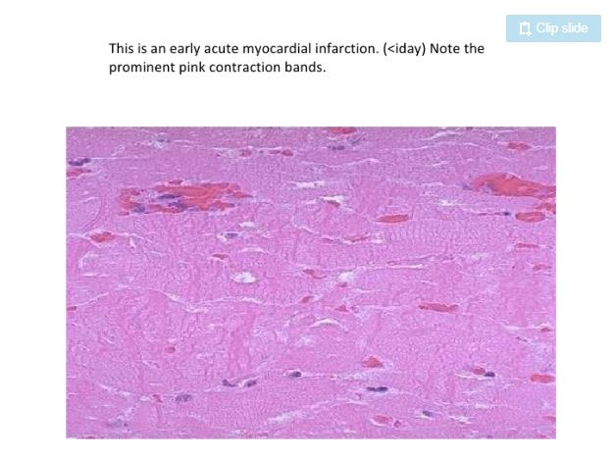
MORPHOLOGY OF MI
Normal myocardium with Cross striations and central nuclei
Acute MI. Prominent pink contraction bands are seen

Slide 33
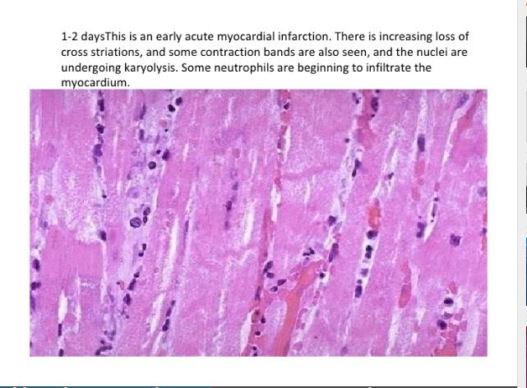
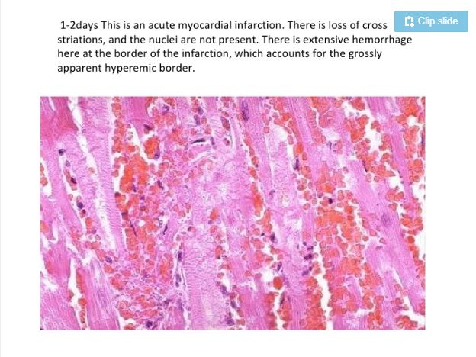
MORPHOLOGY OF MI
Early acute MI: increasing loss of cross striations and nuclei undergoing karyolysis. Some neutrophilic infiltrate is seen
Early acute MI: near the hyperemic border

Slide 34
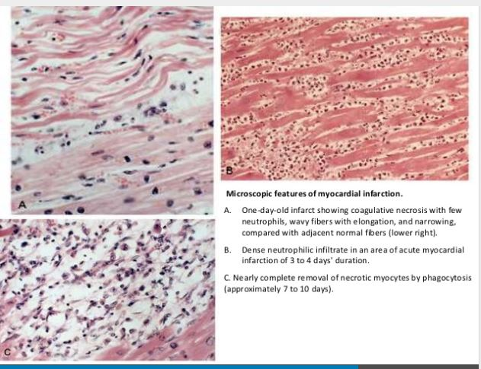
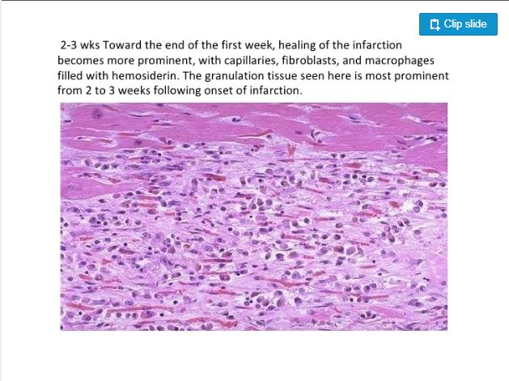
MORPHOLOGY OF MI

Slide 35
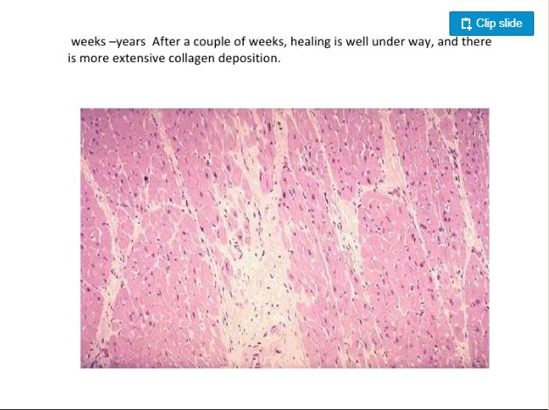
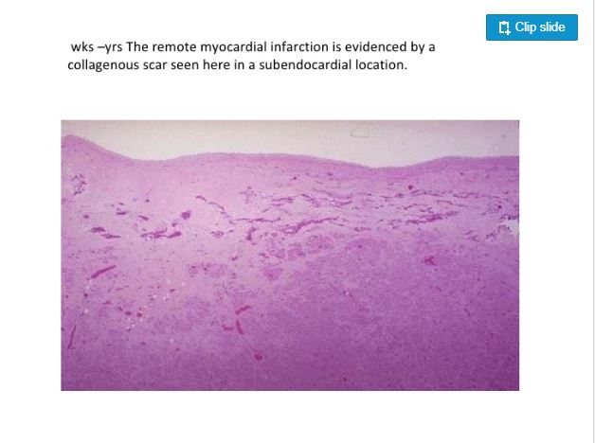
MORPHOLOGY OF MI

Slide 36
INFARCT MODIFICATION BY REPERFUSION
Reperfusion is the restoration of blood flow to ischemic myocardium threatened by infarction
This is done to :
- Restore cardiac muscle at risk
- Limit the infarct size
Done by - Thrombolysis, angioplasty, stent placement, Coronary Atery Bypass Graft (CABG) surgery

Slide 37
INFARCT MODIFICATION BY REPERFUSION
Though the reperfusion is beneficial, can trigger deleterious complications- arrhythmias
Reperfusion injury can is mediated by
Oxidative stress
Calcium overload
Inflammatory cells recruited after reperfusion
Swelling of endothelial cells can occlude the capillaries causing further damage

Slide 38
DIAGNOSIS
Clinical features
Laboratory tests
ECG findings

Slide 39
CLINICAL FEATURES
Rapid, weak pulse and profuse sweating
Chest pain- Crushing, stabing, squeezing pain
Nausea & vomiting
Left upper arm pain
Dyspnoea due to impaired contractility of ischemic myocardium with resultant pulmonary congestion and edema
10% – 15% - asymptomatic

Slide 40
LABORATORY INVESTIGATIONS
Diagnosis is based on blood levels of proteins that are leaked out from irreversibly damaged myocyte
These molecules include -
Cardiac specific troponins T and I (cTnT & cTnI)
MB fraction of creatine kinase (CK-MB)
Lactate Dehydrogenase (LDH)
Myoglobin

Slide 41
LABORATORY INVESTIGATIONS
Cardiac-specific troponins (cTn)
Most sensitive & specific biomarkers of MI
Troponins – regulate calcium mediated contraction of cardiac and skeletal muscle
Cardiac troponin T (cTnT) & Cardiac troponin I (cTnI)
Not found in the blood normally
Post MI - begin to rise at 3-12 hours
cTnT levels peak - 12-48 hours
cTnI levels peak - 24 hours

Slide 42
LABORATORY INVESTIGATIONS
Creatine kinase
Enzyme present in brain, myocardium and skeletal muscle
It is a dimer composed of two isoforms designated as “M” and “B”.
MM homodimer – in cardiac muscle and skeletal muscle
BB homodimer – in brain, lung and many other tissues
MB heterodimer – in cardiac muscle (lesser amount in skeletal muscle)
MB form of creatine kinase is sensitive but not specifc

Slide 43
LABORATORY INVESTIGATIONS
Creatine kinase (CK)
Rises within 3-12 hrs of onset of MI,
Peaks in approximately 24 hrs
Returns to normal by 72 hrs
But elevated Troponin levels persists for approximately 7 to 10 days after acute MI

Slide 44
LABORATORY INVESTIGATIONS
Summary
Time of elevation of CKMB, cTnt and cTnI - 3 to12 hours
CKMB and cTnI peaks at 24 hours
Returns to normal
CKMB – 48 - 72hours
cTnI - 5 to 10 days
cTnT – 5 to 14 days

Slide 45
LABORATORY INVESTIGATIONS
Lactate dehydrogenase (LDH)
Lacks sensitivity
Enzyme is present in various tissues – myocardium, skeletal muscle, kidneys, liver, lungs and red blood cells
It has 2 forms LDH 1 & 2
LDH 1 – more myocardial specific
LDH1:LDH2 > 1 --- Indicates MI
LDH peaks in 3 days and persists for 4 to 7 days

Slide 46
LABORATORY INVESTIGATIONS
Myoglobin
First marker to be elevated after MI
Lacks cardiac specificity
Excreted rapidly in urine
Its levels return to normal within 24 hrs post acute MI

Slide 47
Enzyme | Time of rise | Peak level time | Fall to normal
Troponin I and T | 3 to 12 hrs | 24 hrs | 2 weeks
Creatine kinase | 3 to 12 hrs | 24hrs | 48 to 72 hrs
Lactate dehydrogenase | After 24hrs | 72hrs | 14 days
Myoglobin | Within first few hrs | 7 – 8hrs | Within 24hrs

Slide 48
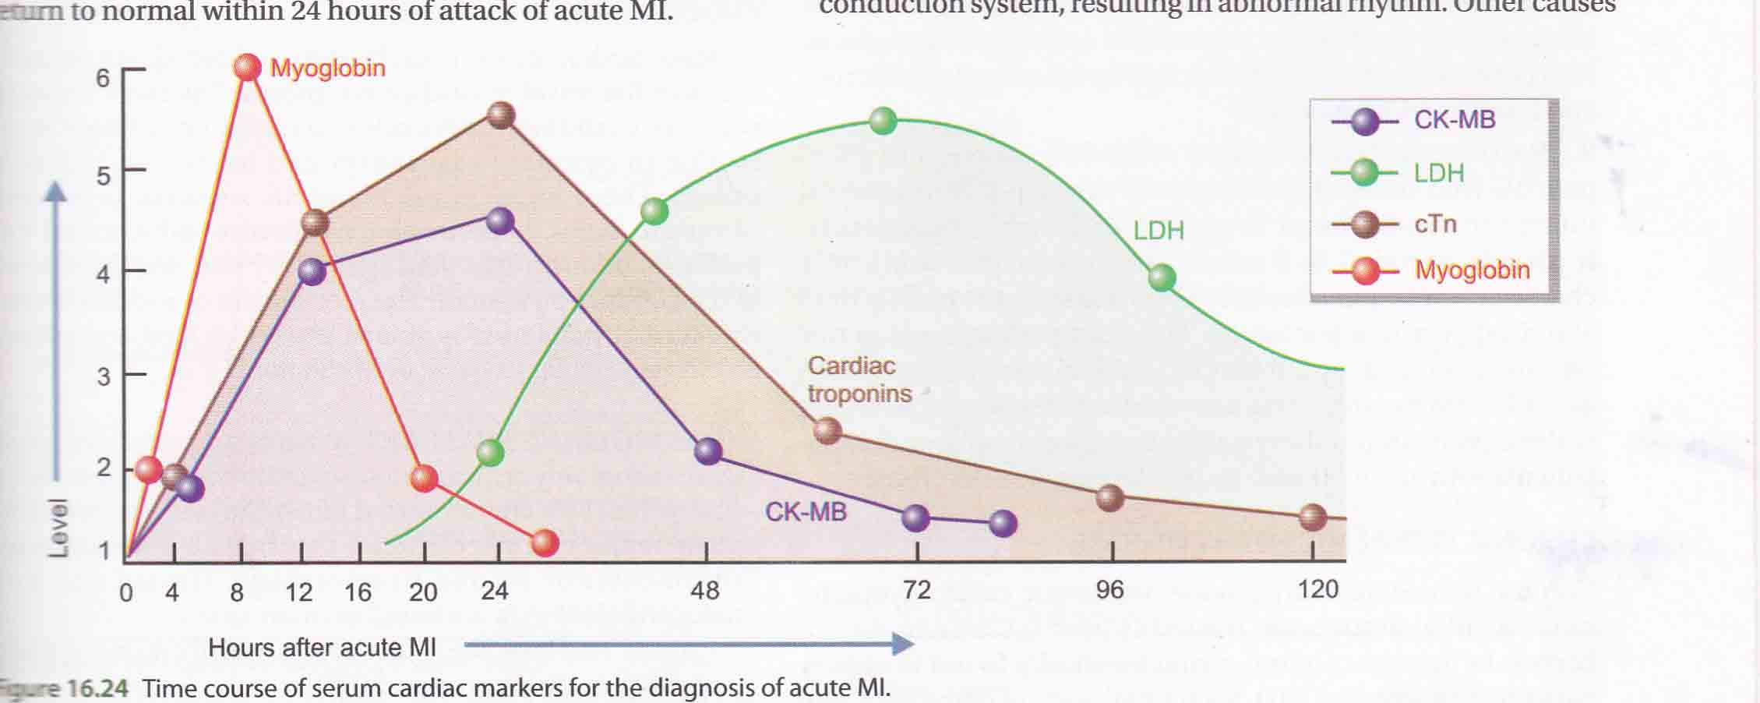
ENZYME MARKERS OF MI

Slide 49
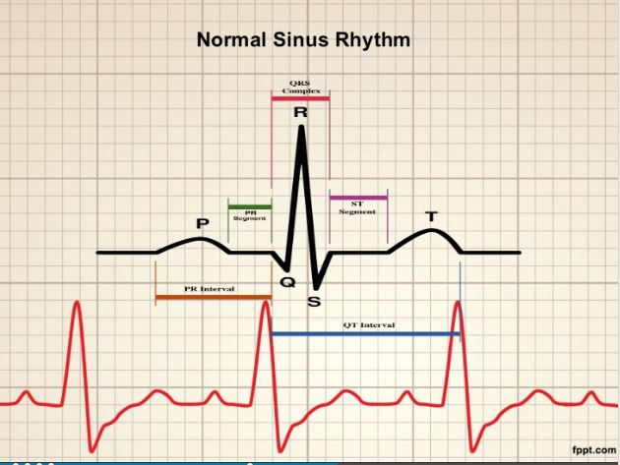
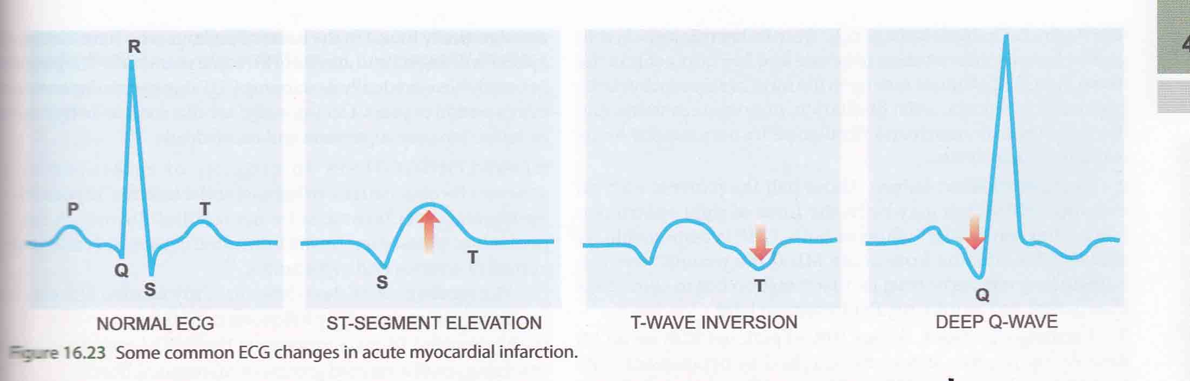
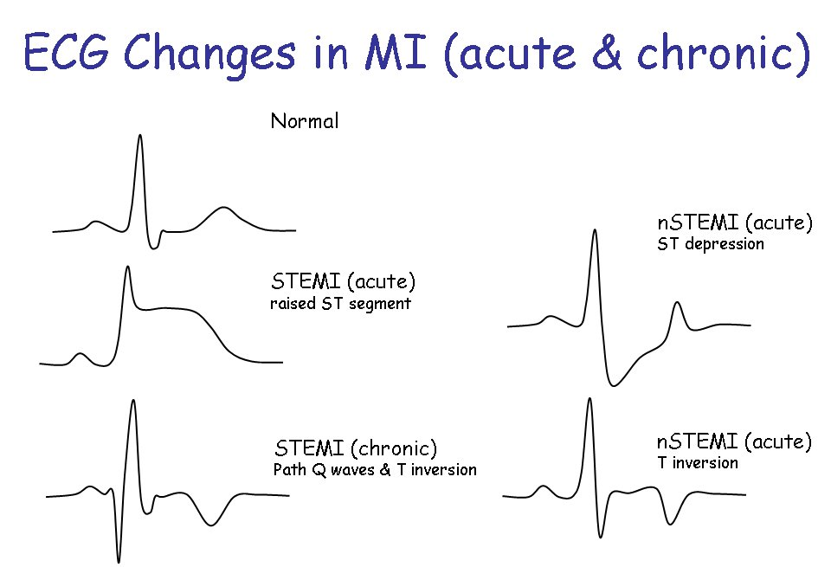
INVESTIGATIONS
ECG – Electrocardiography
ST segment elevation
T wave inversion
Appearance of wide deep Q waves

Slide 50
COMPLICATIONS
Arrhythmias - Occur due to ischaemic injury or irritation to the conduction system
Congestive heart failure
Cardiogenic shock
Mural thrombosis & thromboemboli
Rupture –
Rupture of the ventricular free wall → hemopericardium and cardiac tamponade
Rupture of the ventricular septum → acute VSD → left-to-right shunt
Papillary muscle rupture → acute onset of severe mitral regurgitation
Cardiac aneurysm
Pericarditis

Slide 51
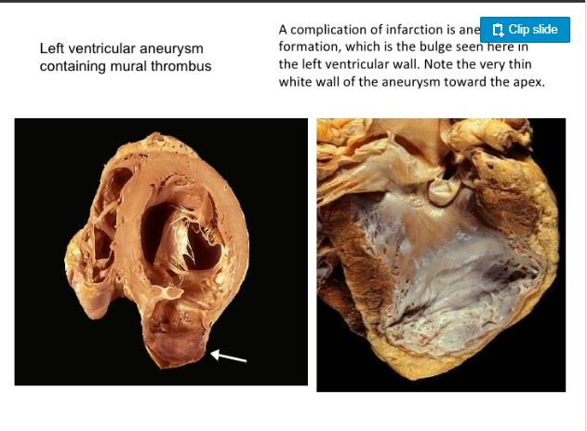

Slide 52
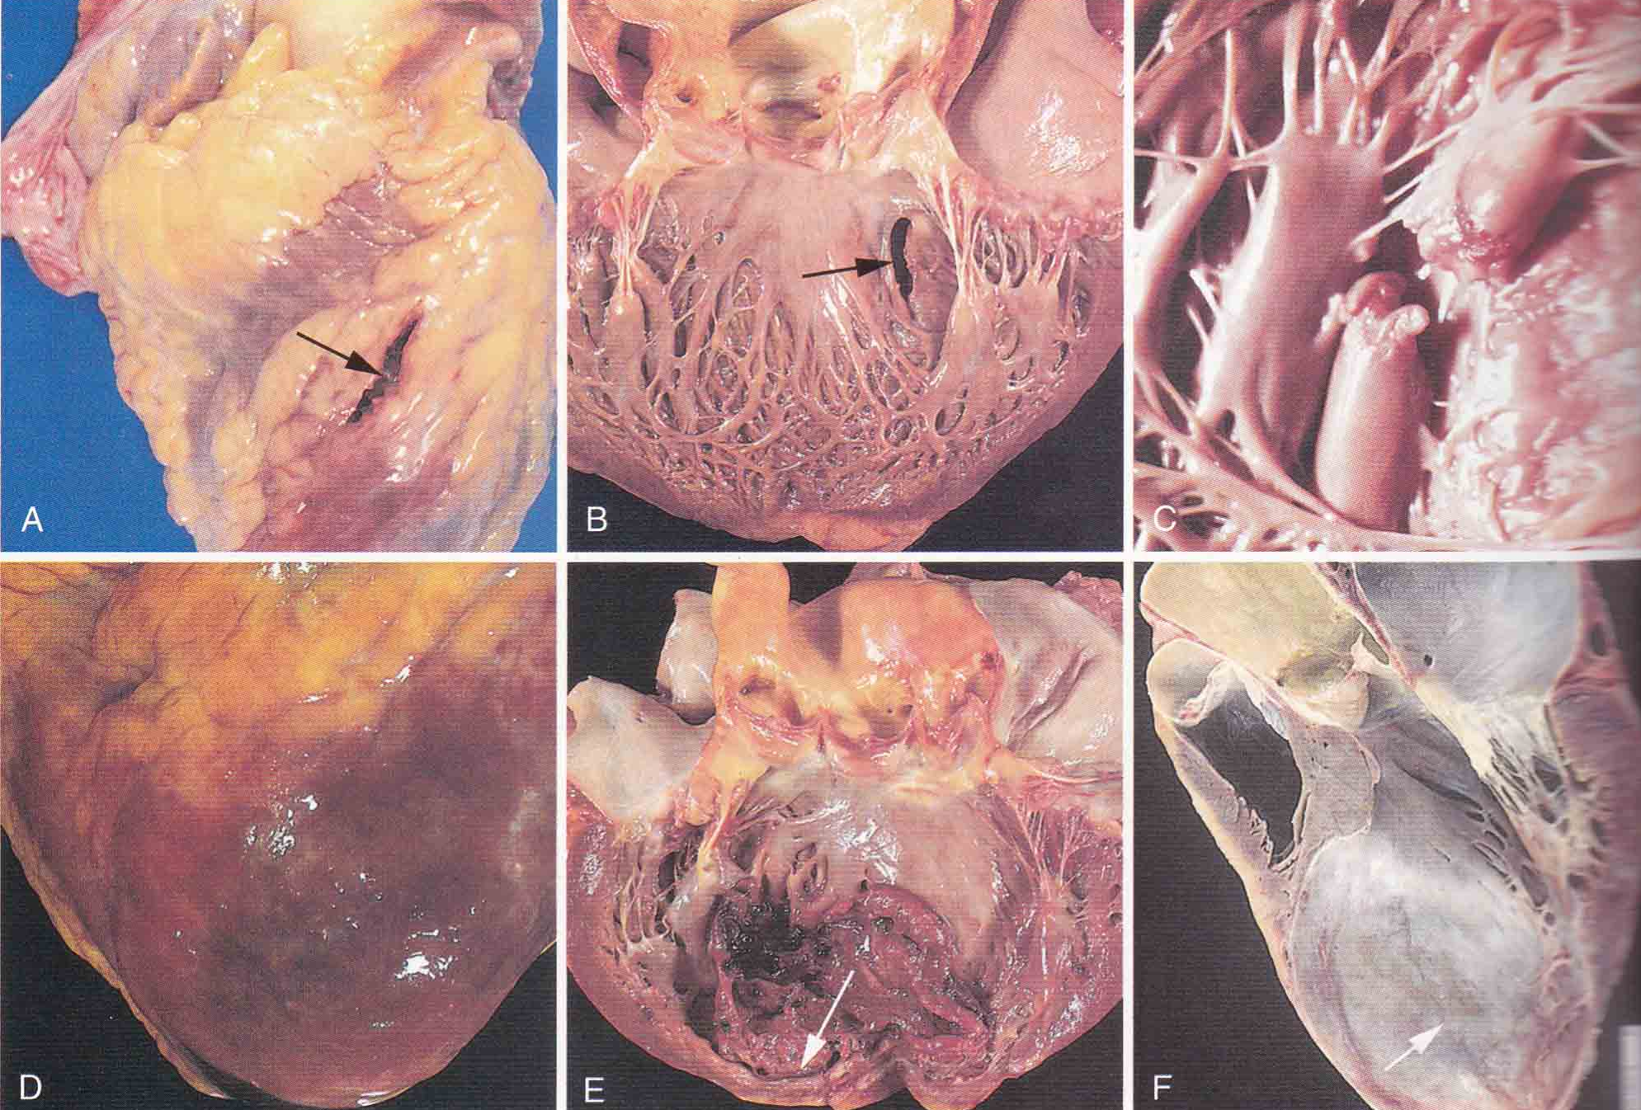

Slide 53
CHRONIC ISCHEMIC HEART DISEASE
Ischemic cardiomyopathy
Progressive ischemic myocardial damage/ inadequate compensation → progressive congestive heart failure
Usually post infarct due to decompensated hypertrophied uneffected myocardium
Morphology – cardiomegaly, LVH and dilation
Microscopy – myocardial hypertrophy and fibrosis

Slide 54
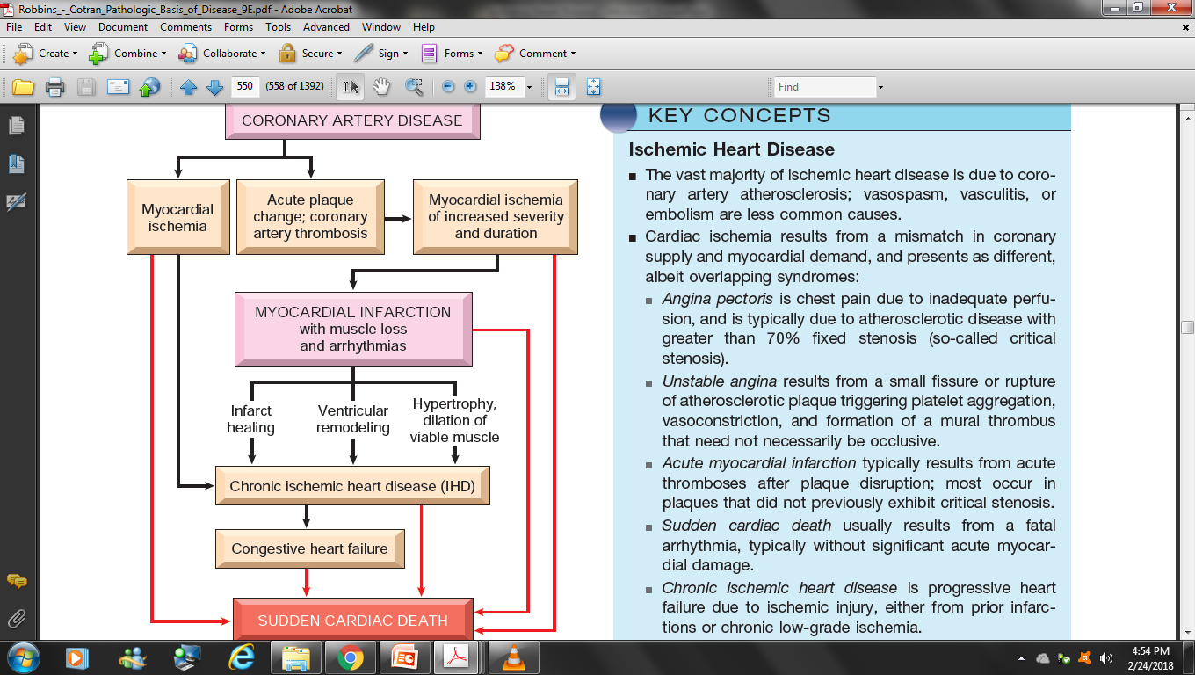

Slide 55
PREVIOUS QUESTIONS
A 59 year old man was admitted with history of chest pain of half an hour duration. Pain was in the precordial area with radiation in the left arm. Pain was severe in nature and was accompained by vomitting. ECG showed ST segment elevation with T wave inversion.
a. what is the most likely diagnosis
b. What biochemical investigations are useful in such a case
c. What complications can occur
d. What are the predisposing factors of this disease

Slide 56
PREVIOUS QUESTIONS
45 year old man was rushed to the hospital following sudden onset of an episode of crushing substernal chest pain. He received advanced life support measures. His course was marked by intractable cardiogenic shock and he died 4 days later. At autopsy, a large transmural anterolateral area of coagulative necrosis was found in the anterolateral wall of left ventricle.
a. What is your diagnosis?
b. What microscopic findings are most likely to be present in this area?
c. What are the risk factors leading to this condition?
d. What are the complications of this disease?

Slide 57
THANK YOU

