Slide 1
HYPOTHYROIDISM
Dr.V.Shanthi,
Professor, Department of pathology
Sri Venkateswara Institute Of Medical Sciences,
Tirupathi

Slide 2
HYPOTHYROIDISM
Decreased T3 and T4 levels
Primary
Decreased T3 and T4, increased TSH
Cause is in thyroid
CAUSES
Secondary
Decreased T3 and T4, Decreased TSH
Cause is outside the thyroid, mostly can be in the pituitary or hypothalamus

Slide 3
HYPOTHYROIDISM
Hashimotos
Post partum
Reidels thyroiditis
Autoimmune
Thyroid destruction
De querveins thyroiditis / granulomatous thyroiditis
Infectious
Thyroidectomy
External irradiation
Radioiodine therapy, iodides (Wolff- Chaikoff effect )
Drugs: lithium, p-aminosalicylic acid
CAUSES
Iatrogenic
Primary
Iodine deficiency
Decreased T3 and T4, increased TSH
Genetic defects in thyroid development (PAX8, FOXE1, TSH receptor mutations (rare)
Thyroid hormone resistance syndrome (THRB mutations (rare)
Congenital biosynthetic defect (dyshormonogenetic goiter (rare)
Genetic abnormalities

Slide 4
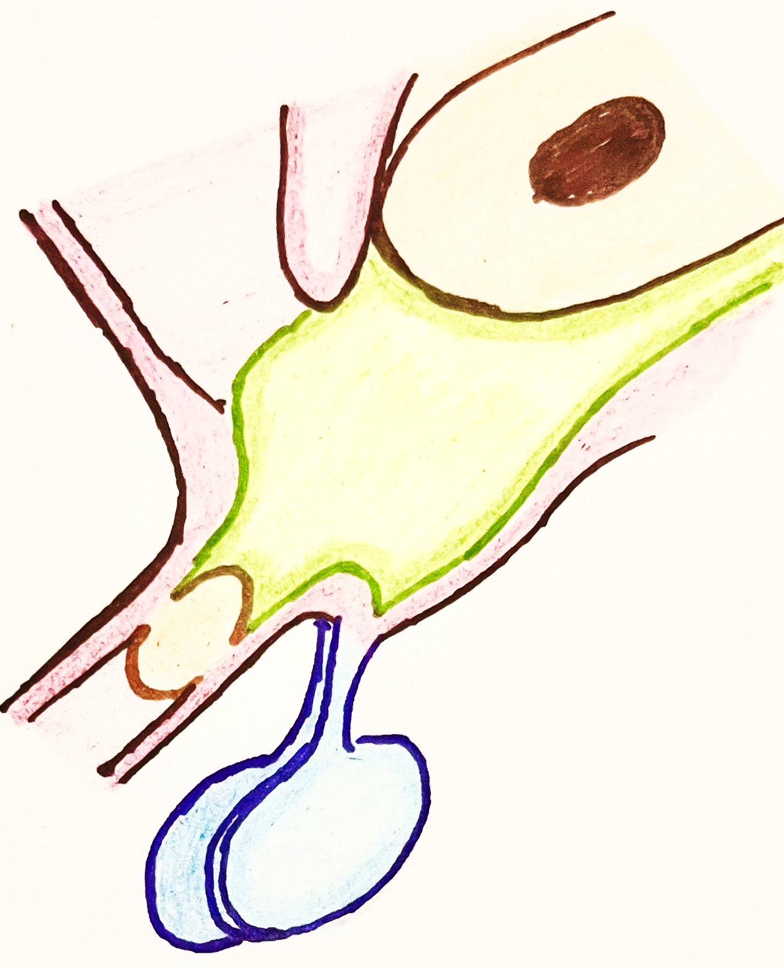
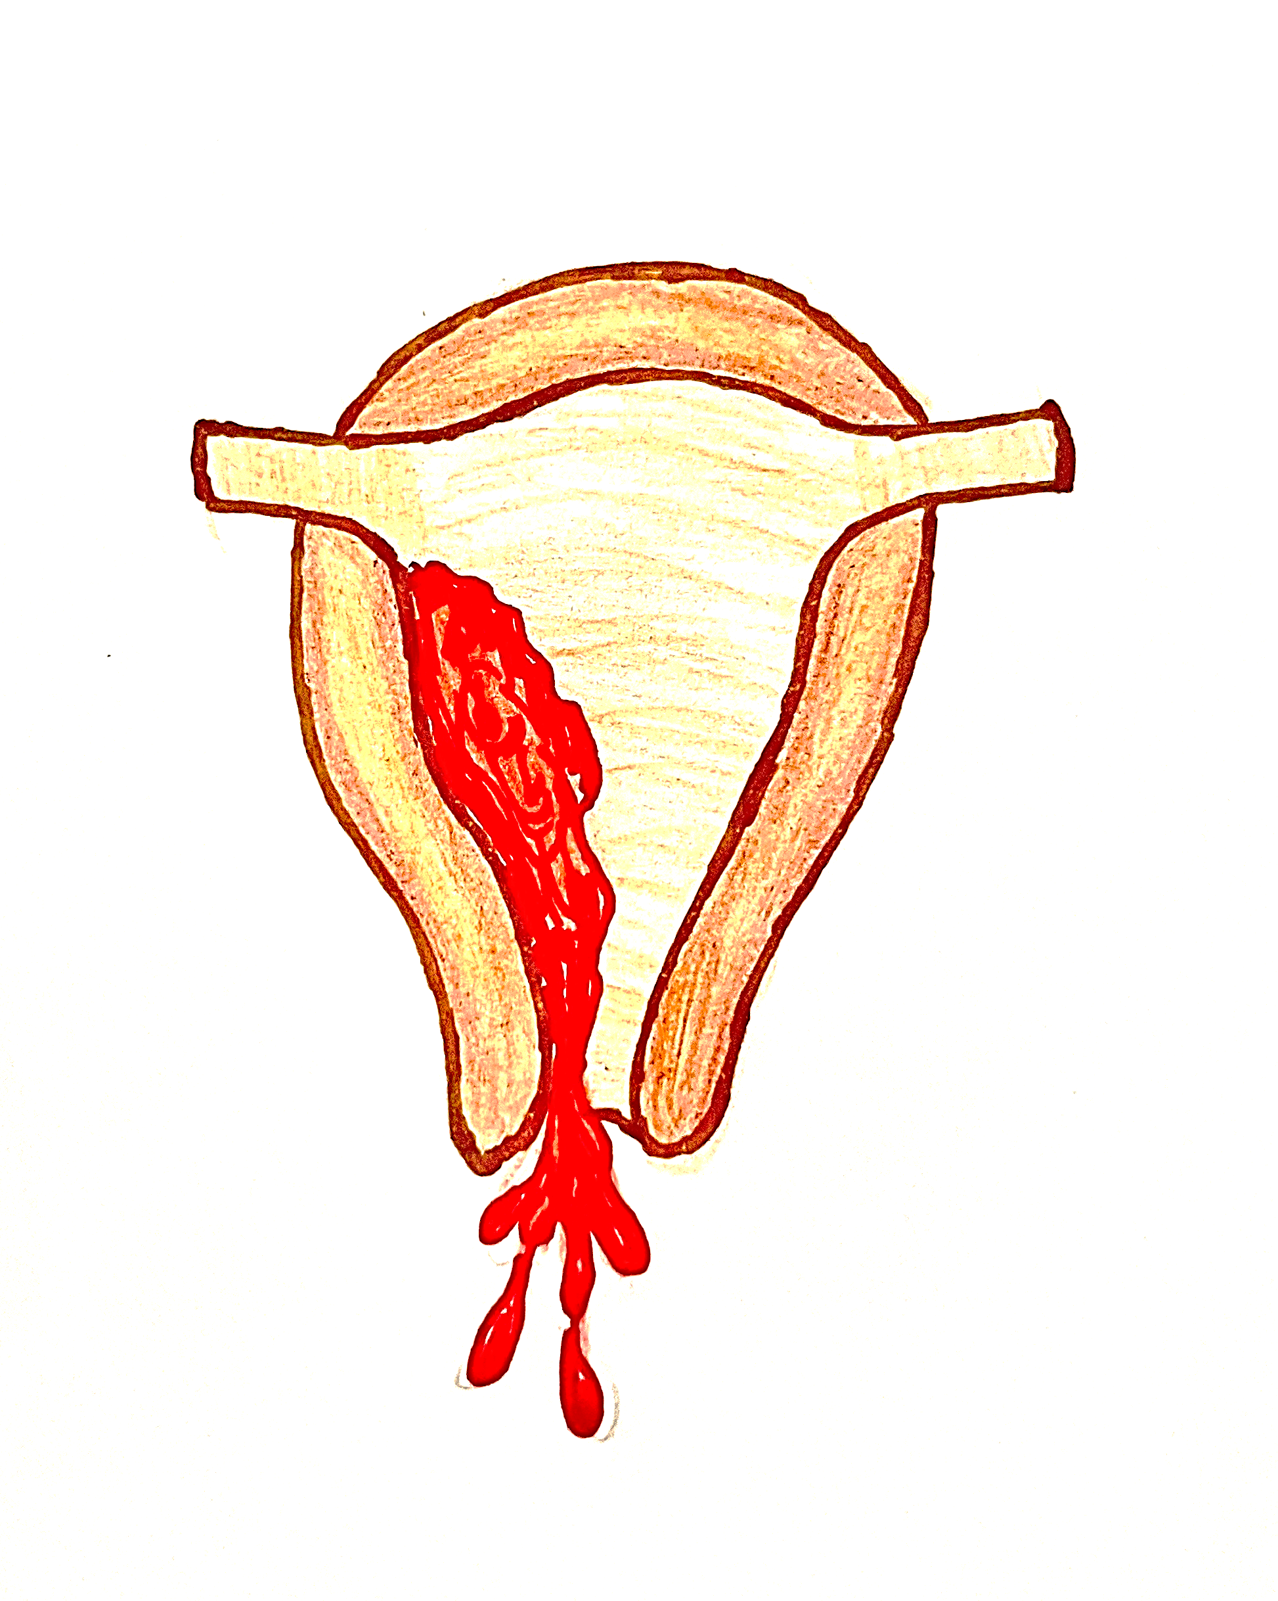
HYPOTHYROIDISM
Pituitary failure
Pituitary adenomas compressing the normal pituitary
CAUSES
Secondary
Hypothalamic failure (rare)
TSH
Decreased T3 and T4,
Decreased TSH
TRH
Decreased T3 and T4
TSH
Sheehan syndrome
Massive hemorrhage during or after delivery
Reduced blood supply to anterior pituitary
Decreased TSH
Hypovolemic shock
Ant. Pituitary necrosis

Slide 5
HASHIMOTO THYROIDITIS
It is an autoimmune disease that results in destruction of the thyroid gland and gradual and progressive thyroid failure
Common cause of hypothyroidism where iodine levels are sufficient

Slide 6
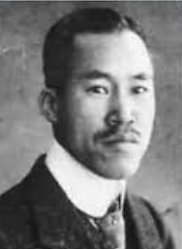
HASHIMOTO THYROIDITIS
Name is derived as it was first reported by Japanese physician Haraku Hashimoto in 1912 and he described it as struma lymphomatosa in which thyroid gland was enlarged and had lymphocytic infiltrate
Age : prevalent in 45-65 years
Gender : common in women than men (10: 1 to 20:1)
Can occur in children as a major cause of non-endemic goitre
(1881-1934)

Slide 7
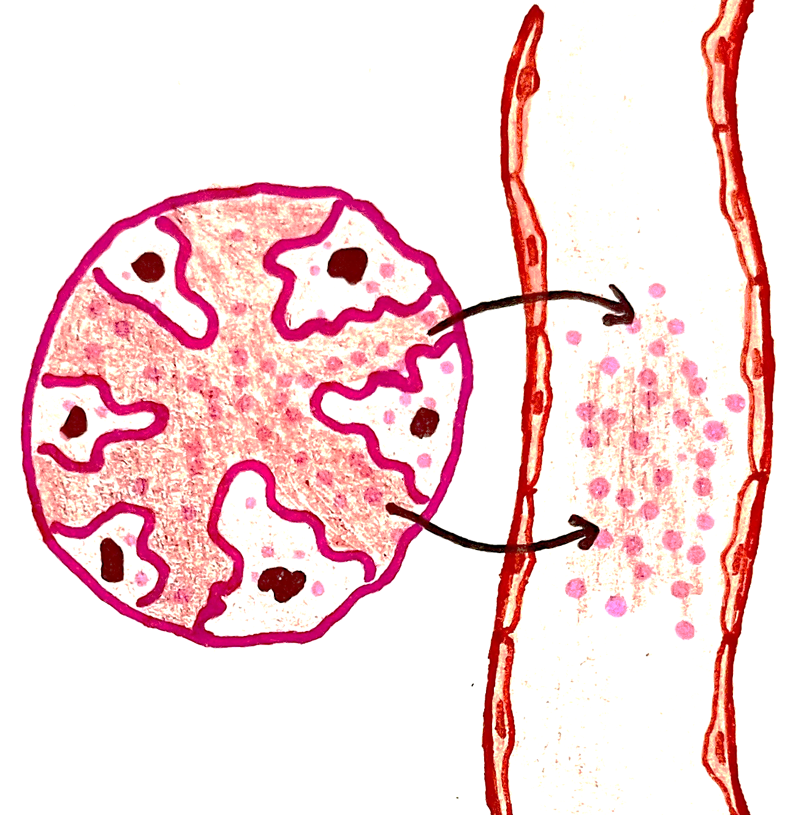
HASHIMOTO THYROIDITIS
Autoimmune disease
Release of T3,T4 and thyroglobulin leading to hyperthyroidism in initial stages
Destruction of follicles
Initial hyperthyroism and later hypothyroidism
Later due to destruction of follicles, amount of T3, T4 produced is reduced leading to hypothyroidism

Slide 8
HASHIMOTO THYROIDITIS- PATHOGENESIS
Breakdown in self tolerance to thyroid autoantigen
Genetic susceptibility is associated with polymorphism in immune regulatory genes: CTLA 4, PTPN22, and IL2RA
Abnormalities of regulatory T cells
Exposure of normal sequestered thyroid antigen
Notes:
CTLA 4- cytotoxic T lymphocyte Associated antigen-; PTPN 22- protein tyrosine phosphatase 22,

Slide 9
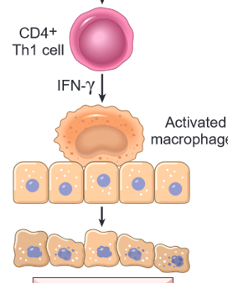
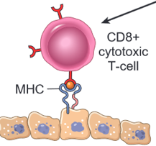
HASHIMOTO THYROIDITIS- PATHOGENESIS
Breakdown in self tolerance to thyroid autoantigen
Exposure of normal sequestered thyroid antigen
Abnormalities of regulatory T cells
CD4+Th1 cells
CD8+ cytotoxic T cells
Destruction of follicular cells
Thyrocyte injury
Notes:
Increased susceptibility is associated with polymorphisms in several immune regulation–associated genes, such as
Cytotoxic T lymphocyte–associated antigen-4 (CTLA4)
Protein tyrosine phosphatase-22 (PTPN22) Encode regulators of T-cell responses
Interleukin-2 receptor α chain (IL2RA)

Slide 10
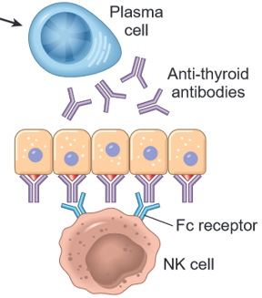
HASHIMOTO THYROIDITIS- PATHOGENESIS
Breakdown in self tolerance to thyroid autoantigen
Abnormalities of regulatory T cells
Exposure of normal sequestered thyroid antigen
Antibodies directed against
Thyroglobulin
TSH receptors
Thyroid peroxidase
Antibody dependent cell mediated cytotoxicity
Notes:
Increased susceptibility is associated with polymorphisms in several immune regulation–associated genes, such as
Cytotoxic T lymphocyte–associated antigen-4 (CTLA4)
Protein tyrosine phosphatase-22 (PTPN22) Encode regulators of T-cell responses
Interleukin-2 receptor α chain (IL2RA)

Slide 11
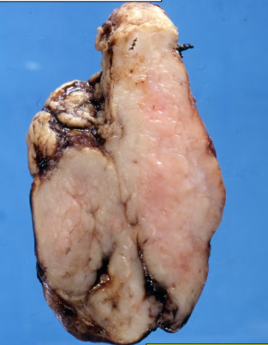
HASHIMOTO THYROIDITIS
Morphology
Gross -
Size of thyroid gland is diffusely enlarged
Cut section - pale, yellow-tan, to gray-white firm, and somewhat nodular

Slide 12
HASHIMOTO THYROIDITIS
Microscopy –
Extensive infiltration of the parenchyma by a mononuclear inflammatory infiltrate containing small lymphocytes, plasma cells, and well-developed germinal centers
Thyroid follicles are atrophic and are lined in many areas by epithelial cells with abundant eosinophilic, granular cytoplasm, termed Hürthle cells, which represent a metaplastic response of the normally low cuboidal follicular epithelium to chronic injury

Slide 13
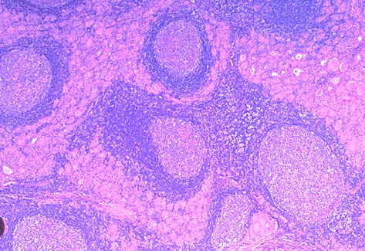
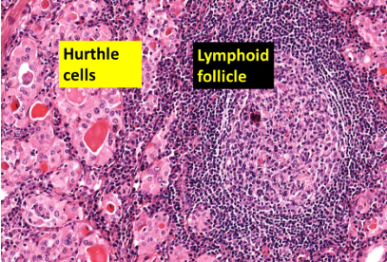
HASHIMOTO THYROIDITIS

Slide 14
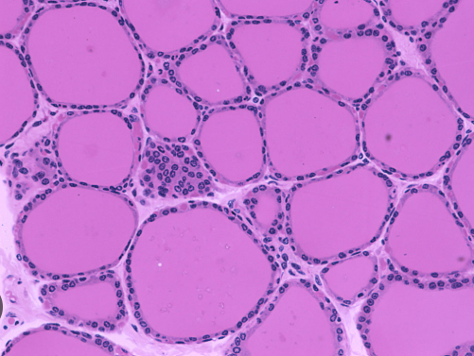
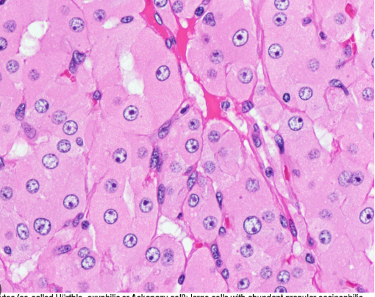
Follicles lined by normal follicular epithelial cells
Follicles lined by hurthle cells

Slide 15
HASHIMOTO THYROIDITIS
In “classic” Hashimoto thyroiditis, interstitial connective tissue is increased and may be abundant
Unlike Reidel thyroiditis, the fibrosis does not extend beyond the capsule of the gland

Slide 16
HASHIMOTO THYROIDITIS
Clinical features
Diffuse, symmetrical and Painless enlargement of thyroid gland associated with hypothyroidism
Transient thyrotoxicosis caused by disruption of thyroid follicles and release of thyroid hormones (hashitoxicosis) – initial phase
As hypothyroidism supervenes, T4 and T3 levels fall, accompanied by a compensatory increase in TSH- later stages

Slide 17
HASHIMOTO THYROIDITIS
Type 1 diabetes
Autoimmune adrenalitis
Endocrine
Risk of developing other autoimmune diseases
Systemic lupus erythematosus
Myasthenia gravis
Sjögren syndrome
Non-endocrine

Slide 18
HASHIMOTO THYROIDITIS
They are also at increased risk for development of malignancy
Extranodal marginal zone B-cell lymphoma
Papillary carcinoma

Slide 19
SUB ACUTE LYMPHOCYTIC THYROIDITIS
Also referred to as painless thyroiditis, is a presumed autoimmune disease
Seen in post partum period (in upto 5% of women) and patients have antithyroid peroxidase antibodies
Morphology
Gross - mild symmetric enlargement of the thyroid
Microscopic examination reveals lymphocytic infiltration with large germinal centers within the thyroid parenchyma and patchy disruption and collapse of thyroid follicles.
Unlike Hashimoto thyroiditis, however, fibrosis and Hürthle cell metaplasia are not prominent

Slide 20
SUB ACUTE LYMPHOCYTIC THYROIDITIS
Clinical features
Presents as painless goiter
Age – mostly seen in middle aged
Sex- more common in women
Starts initially with hyperthyroidism and subsequently develops hypothyroidism (over 10 year period) and finally return to euthyroid state

Slide 21
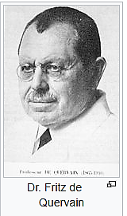
GRANULOMATOUS THYROIDITIS
also called De Quervain thyroiditis
occurs much less frequently than does Hashimoto thyroiditis
Most common between 40 and 50 years
Sex- more commonly affects females (4:1)
Dr.Fritz de Quervain 1868-1940
Swiss surgeon

Slide 22
GRANULOMATOUS THYROIDITIS
Pathogenesis –
Triggered by a viral infection (coxsackievirus, mumps, measles, adenovirus, and other viral infections)
Majority of patients have a history of an upper respiratory tract infection just before the onset of thyroiditis
Cytotoxic T lymphocytes
Substances released after the destruction of cell which act as antigen
Virus particles acting as antigen
Damaged follicular epithelial cells

Slide 23
GRANULOMATOUS THYROIDITIS
Viral infection provides an antigen, which is either viral or a thyroid antigen that is released secondary to virus induced host tissue damage
This antigen stimulates cytotoxic T lymphocytes which then damage thyroid follicular cells
In contrast to autoimmune thyroid disease, the immune response is virus-initiated and not self-perpetuating, so the process is limited
Disease is seasonal, with occurrences peaking in the summer

Slide 24
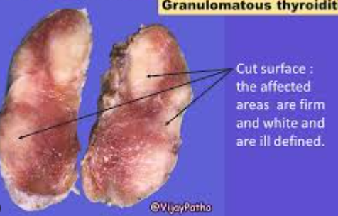
GRANULOMATOUS THYROIDITIS
Morphology
Gland may be unilaterally or bilaterally enlarged and firm, with an intact capsule that may adhere to surrounding structures
On cut section, the involved areas are firm and yellow-white and stand out from adjacent normal rubbery, brown thyroid gland

Slide 25
GRANULOMATOUS THYROIDITIS
Histologic changes are patchy and depend on the stage of the disease
Early in the active inflammatory phase, scattered follicles may be disrupted and replaced by neutrophils forming microabscesses
Later, more characteristic features appear in the form of aggregates of lymphocytes, activated macrophages, and plasma cells associated with collapsed and damaged thyroid follicles.
Multinucleate giant cells enclose pools of colloid, hence the designation granulomatous thyroiditis
In later stages of the disease, a chronic inflammatory infiltrate and fibrosis may replace the foci of injury
Different histologic stages are sometimes found in the same gland, suggesting waves of destruction over a period of time

Slide 26
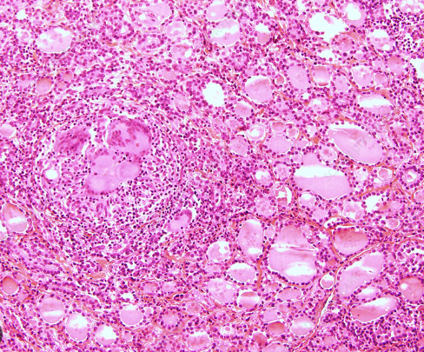

Slide 27
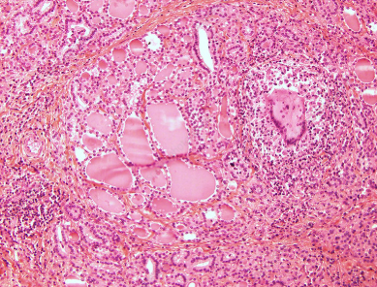

Slide 28
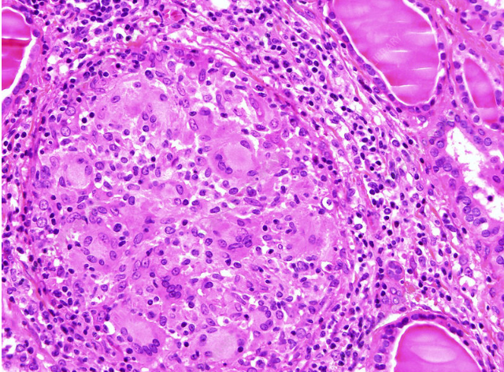

Slide 29
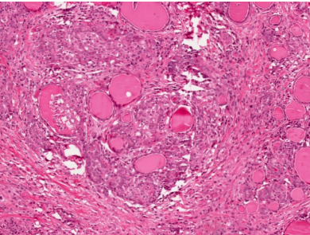

Slide 30
GRANULOMATOUS THYROIDITIS
Clinical Features
Pain and thyroid enlargement
Inflammation of the thyroid and hyperthyroidism are transient, usually diminishing in 2 to 6 weeks, even if the patient is not treated
Nearly all patients have high serum T4 and T3 levels and low serum TSH levels during this phase
However, unlike in hyperthyroid states such as Graves disease, radioactive iodine uptake is diminished
After recovery, generally in 6 to 8 weeks, normal thyroid function returns

Slide 31
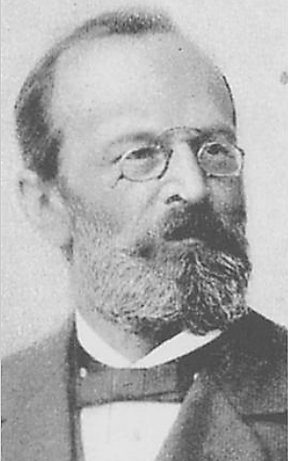
RIEDEL THYROIDITIS
rare disorder characterized by extensive fibrosis involving the thyroid and contiguous neck structures
First described by German surgeon, Bernhard Riedel in 1886 and described it as “Eisenharte Struma” (iron hard goitre)
Bernhard Moritz Carl Ludwig Riedel
(1846-1916)

Slide 32
RIEDEL THYROIDITIS
rare disorder characterized by extensive fibrosis involving the thyroid and contiguous neck structures
Presence of a hard (woody) and fixed thyroid mass clinically simulates a thyroid carcinoma
It may be associated with fibrosis in other sites in the body, such as the retroperitoneum and appears to be another manifestation of IgG4-related disease, which is associated with fibrosis and tissue infiltration by plasma cells producing IgG4

Slide 33
HYPOTHYROIDISM Clinical features
Decreased T3 and T4
Painful goitre
De quervain thyroiditis
Increased TSH
Goitre
Hashimotos thyroiditis
Post partum autoimmune thyroiditis
Reidels thyroiditis
Painless goitre

Slide 34
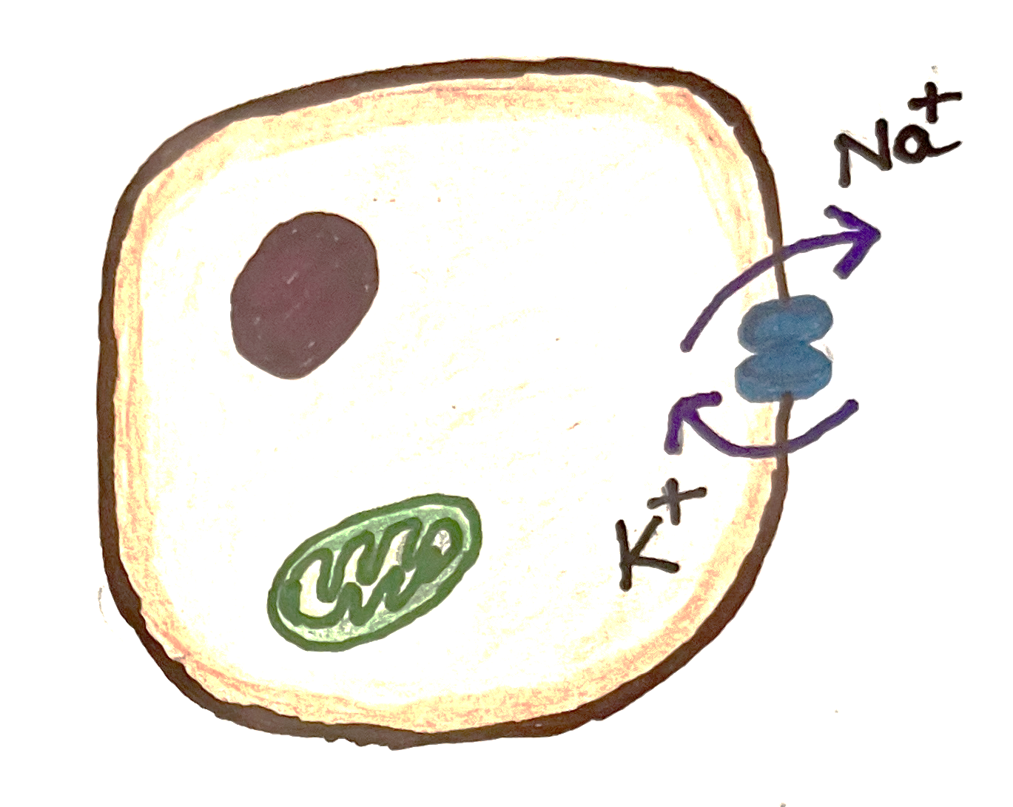
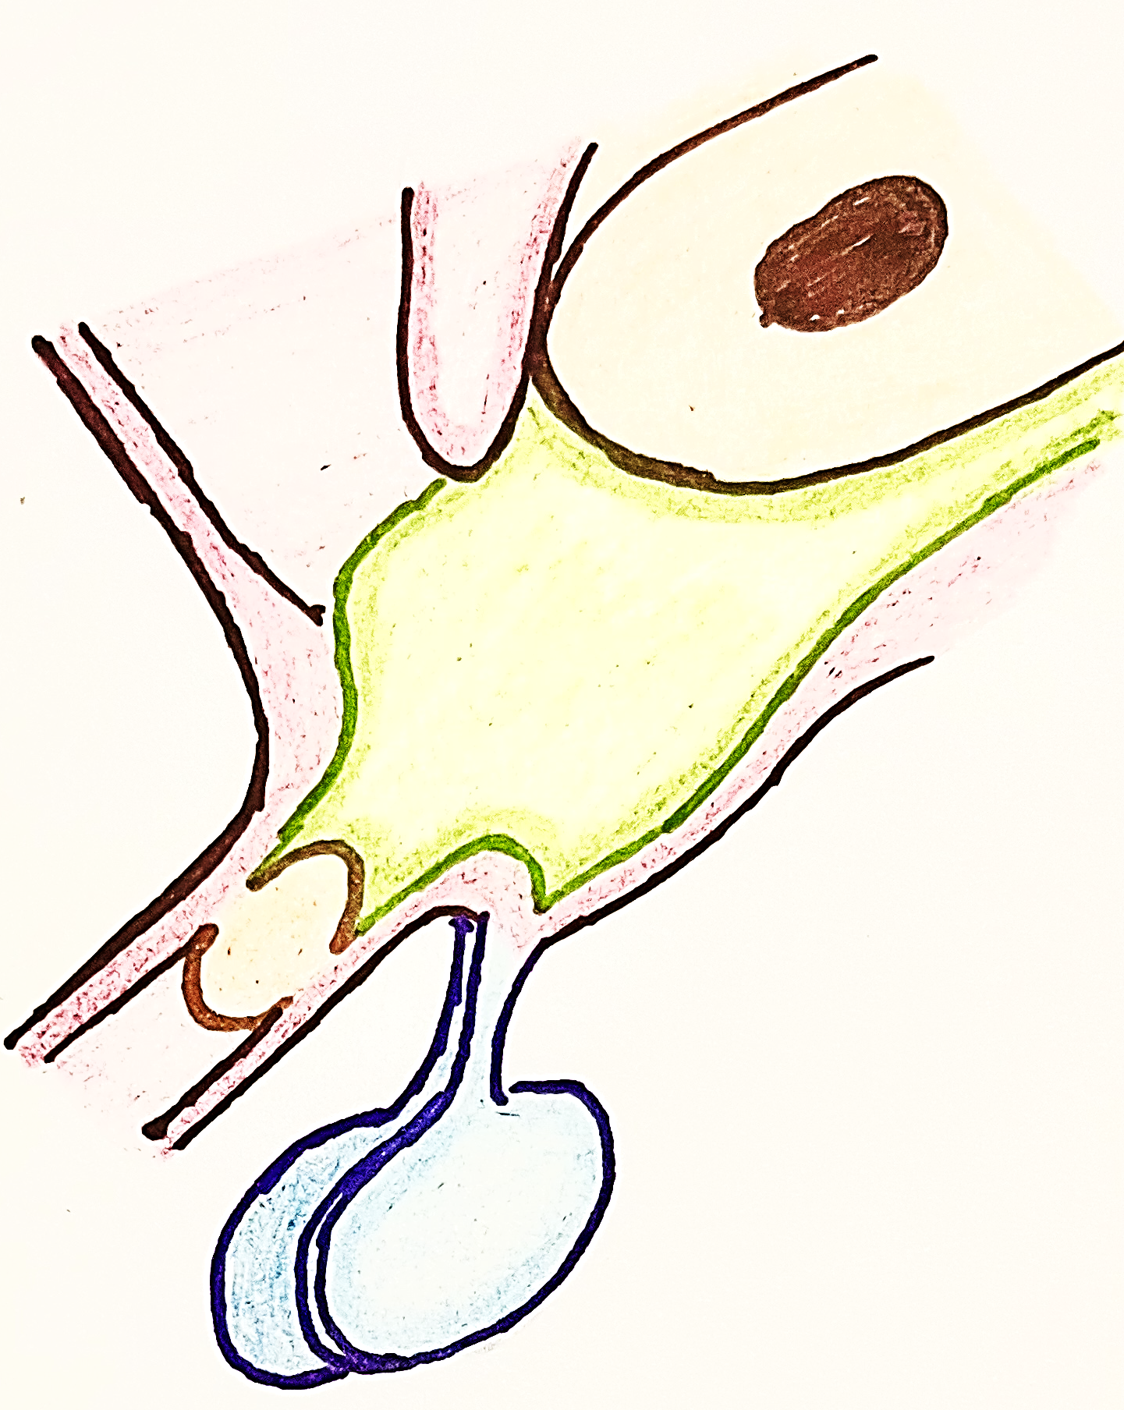
HYPOTHYROIDISM Clinical features
METABOLIC DYSFUNCTION
-
Decreased T3 and T4
ATP
Decreased catabolism
Stimulates hypothalamus
Heat
Weight gain
Cold intolerance
Increased ADH secretion by pituitary
Increased water retention
kidney

Slide 35
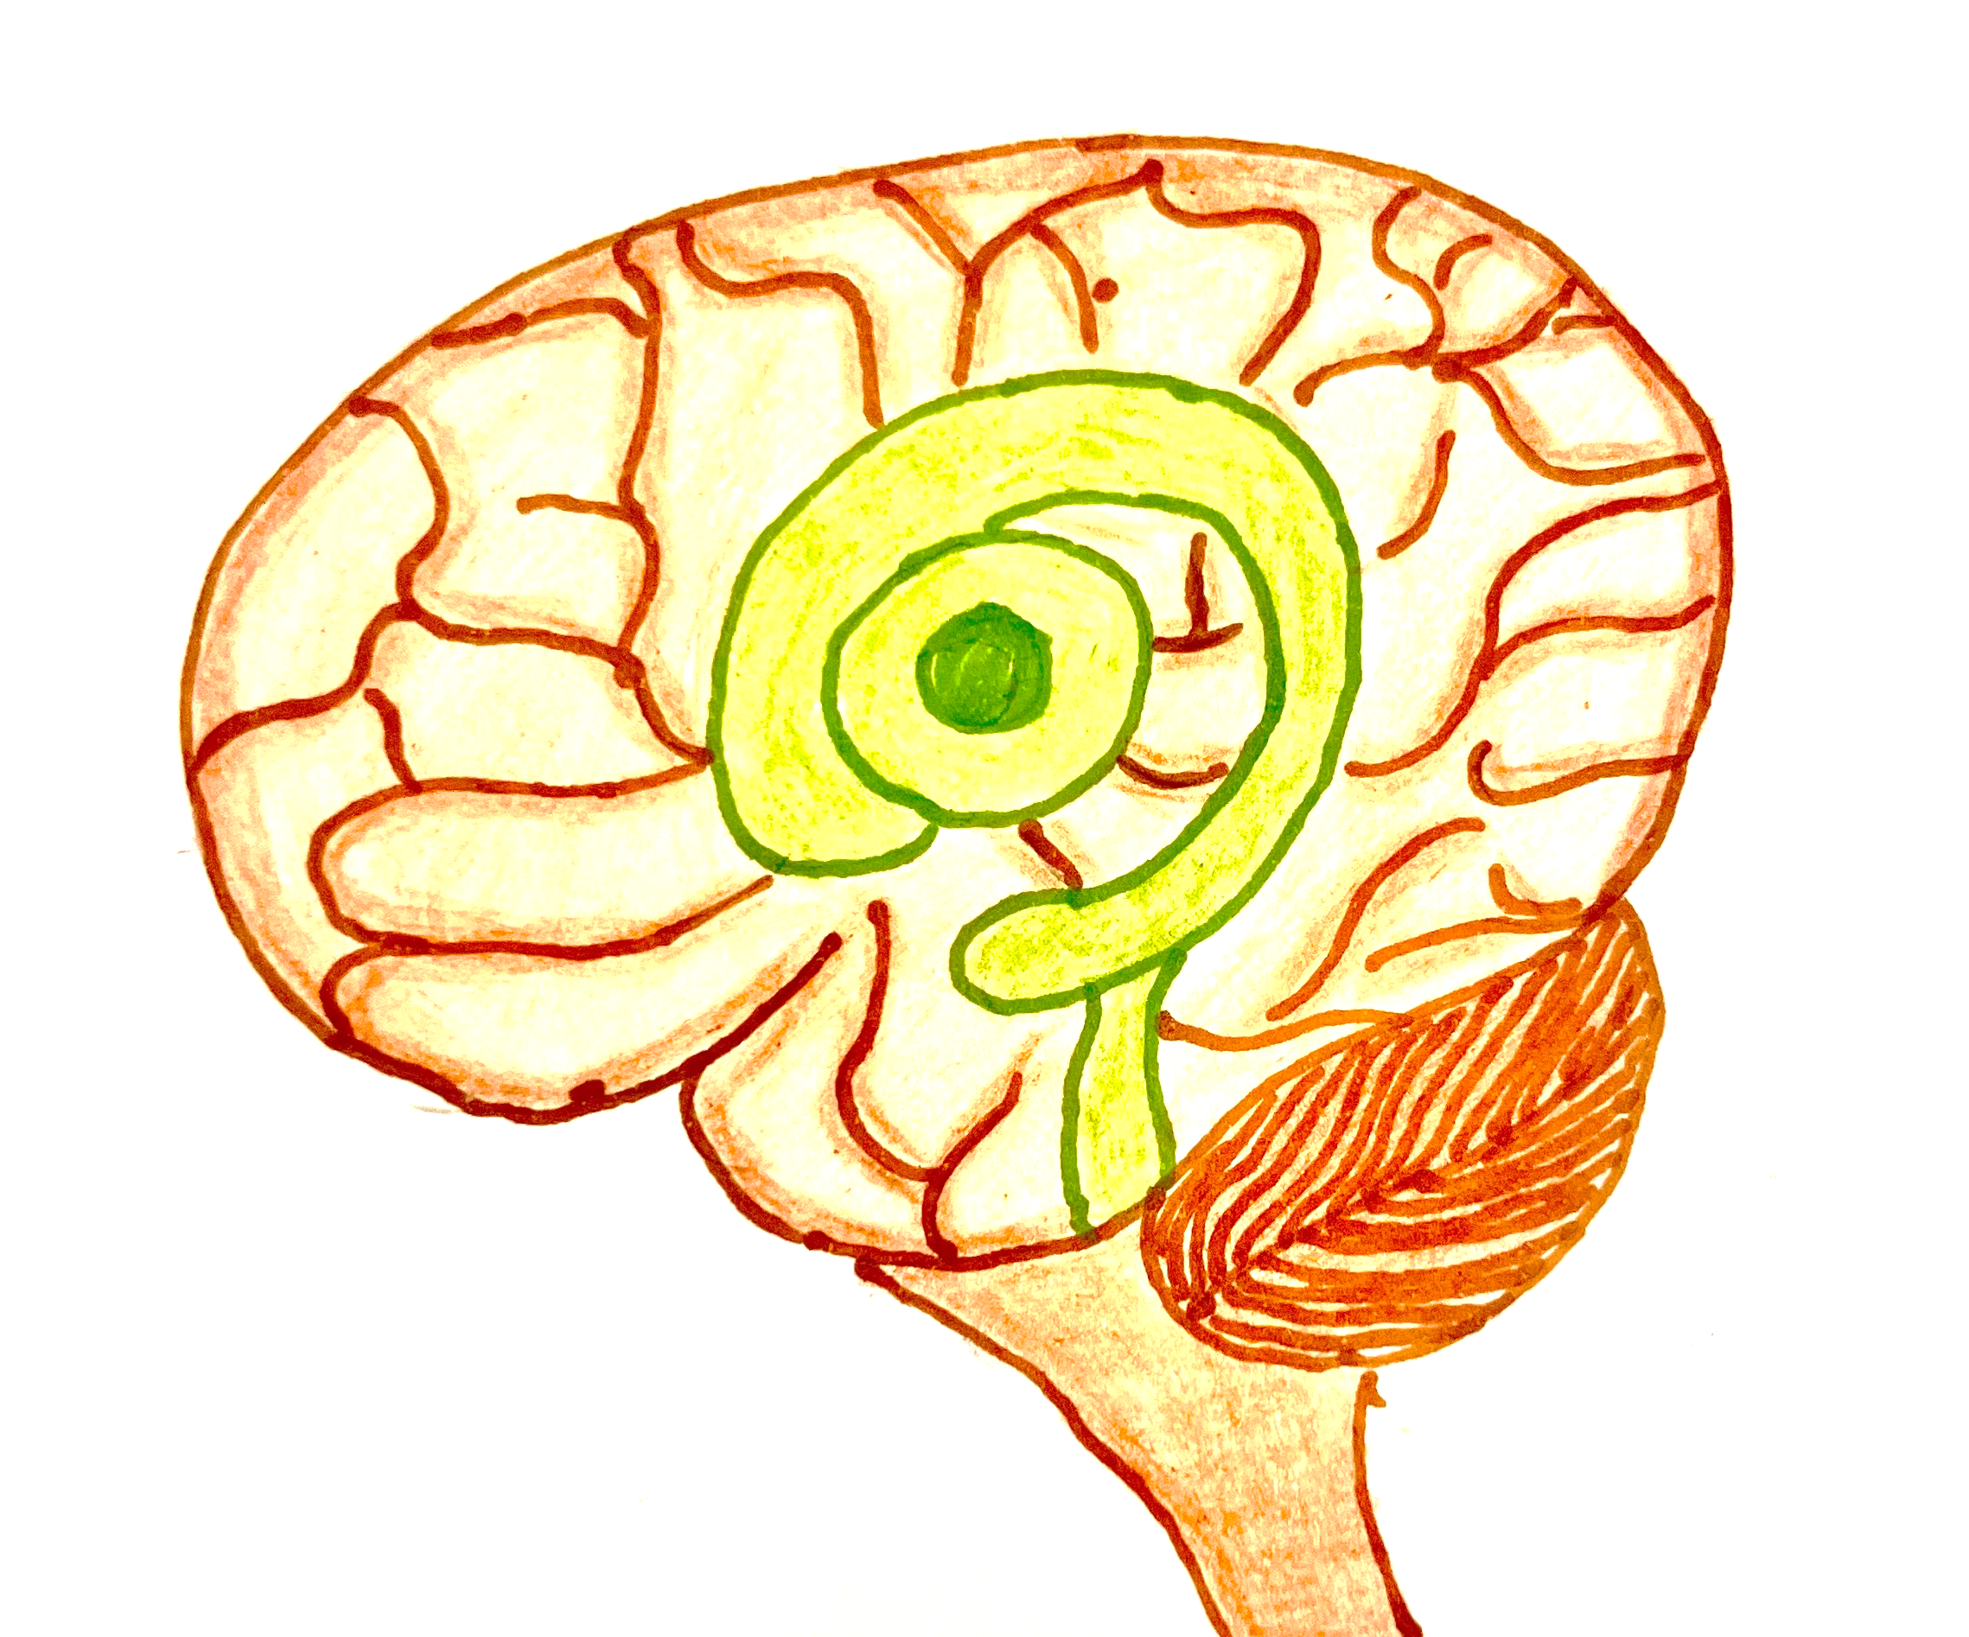
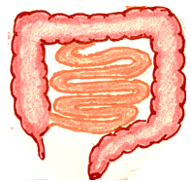
HYPOTHYROIDISM Clinical features
Decreased neuronal activity
Lethargy
Decreased DTR
Brain
Decreased motility
Constipation
Decreased T3 and T4
GIT
Hypothalamus and anterior pituitary
Increased prolactin
Decreased libido
Menstrual dysfunction
Infertility
Reproductive system

Slide 36
HYPOTHYROIDISM Clinical features
Heart
Decreased Beta 1 receptor sensitivity
Decreased heart rate
Decreased T3 and T4
Increased vasoconstriction
Liver
Blood vessels
Decreased LDL receptors expression
Increased systemic vascular resistance
Increased LDL in blood
Increased diastolic BP
Hyperlipidemia

Slide 37
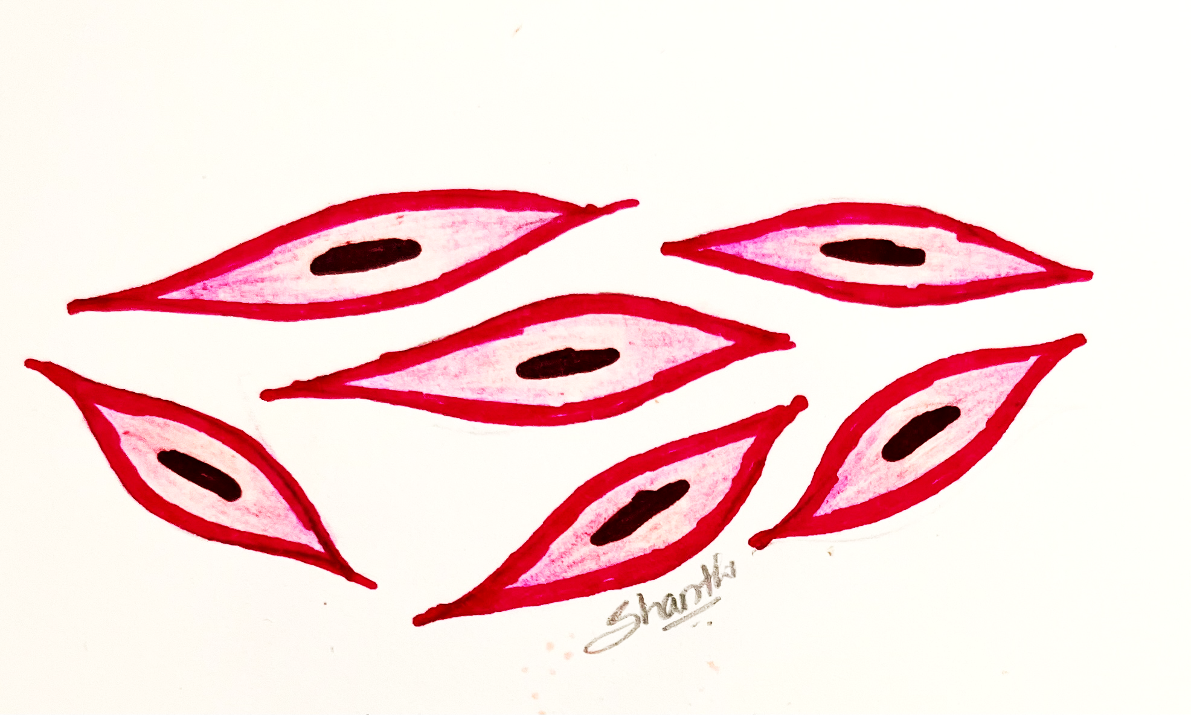
HYPOTHYROIDISM Clinical features
INTEGUMENTARY SYSTEM
Stimulates hypothalamus and anterior pituitary
Decreased T3 and T4
Increased TSH
Fibroblast
Pretibial edema
Retention of water
Nonpitting edema
Broadening and coarsening of facial features
Enlargement of the tongue
Deepening of the voice
Production of Glycosaminoglycans (GAGS)
Activation and Fibroblast proliferation

Slide 38
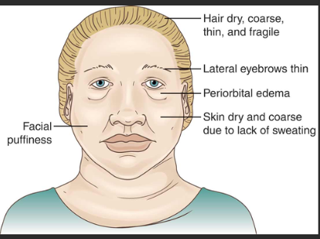
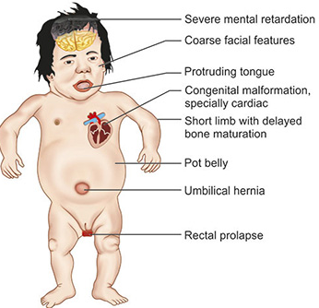
HYPOTHYROIDISM
Myxedema
Cretinism
Slowing of physical and mental activity

Slide 39
HYPOTHYROIDISM Laboratory diagnosis
Decreased TSH
Decreased T4
Thyroid function test
Increased TSH
Decreased T4
Primary hypothyroidism
Secondary hypothyroidism
Anti TPO/ thyroglobulin antibodies
Present
Absent
Hashimotos thyroiditis
Other causes like iatrogenic
Notes:
Euthyroid sick syndrome
Is an adaptive mechanism to concise energy during time of stress .decreased peripheral conversion of T4 (thyroxine to Tri iodod thyronine (T3) by 5’deiodinase resulting in low T3 levels and a relative build up of T4 that decreases as T4 is converted into reverse T3, an inactive form of thyroid hormone

Slide 40
THANK YOU

