Slide 1
DISORDERS OF PARATHYROID GLAND
Dr.V.Shanthi,
Professor, Department of pathology
Sri Venkateswara Institute Of Medical Sciences,
Tirupathi

Slide 2
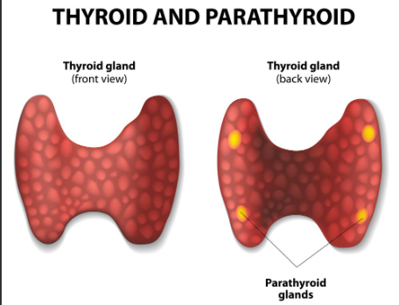

Slide 3
HYPERPARATHYROIDISM
Hyperparathyroidism is an increased parathyroid hormone levels in the blood due to the overactivity of one or four parathyroid glands

Slide 4
HYPERPARATHYROIDISM
An autonomous overproduction of PTH, usually resulting from an adenoma or hyperplasia of parathyroid tissue
Primary hyperparathyroidism
Types of Hyperparathyroidism
Secondary hyperparathyroidism
Compensatory hypersecretion of PTH in response to prolonged hypocalcemia, most commonly from chronic renal failure
persistent hypersecretion of PTH, even after the cause of prolonged hypocalcemia is corrected (e.g., after renal transplant
Tertiary hyperparathyroidism

Slide 5
PRIMARY HYPERPARATHYROIDISM
Adenoma: 85% to 95%
Causes for primary hyperparathyroidism
Primary hyperplasia 5% to 10%
Parathyroid carcinoma: ~1%

Slide 6
PARATHYROID ADENOMA
Age – commonly occurs in adults
Sex – common in men than in women (4:1)
Sporadic
Associated with molecular defects
Most common cause of primary hyperparathyroidism
Parathyroid adenomas
Familial
Associated with genetic syndromes

Slide 7
PARATHYROID ADENOMA
SPORADIC ADENOMA
Cyclin D1 (CCDN1) gene inversions
Overexpression of cyclin D1 protein, a major regulator of the cell cycle
Two molecular defects in the development of sporadic adenomas
MEN1 mutations
MEN1 gene, a tumor suppressor gene on chromosome 11q13, with loss of heterozygosity (LOH) of the second allele
CDC73 - which encodes a protein known as parafibromin, is mutated in ~70% of sporadic parathyroid carcinomas

Slide 8
PARATHYROID ADENOMA
The genetic syndromes associated with familial parathyroid adenomas include
MEN-1 (3P’s – Parathyroid hyperplasia or adenomas, pancreatic islet cell tumors, Pituitary tumors)
MEN-2A (M2P- Medullary thyroid carcinoma, parathyroid hyperplasia/adenomas and pheochromocytoma)
MEN-4 (2P – Pituitary adenoma, parathyroid adenoma)
Familial hypocalciuric hypercalcemia, a rare autosomal dominant disorder caused by loss-of-function mutations in the parathyroid calcium-sensing receptor (CASR) gene, which results in decreased sensitivity to extracellular calcium

Slide 9
PARATHYROID ADENOMA
MORPHOLOGY
Parathyroid adenomas are almost always solitary and, like normal parathyroid glands, may be in close proximity to the thyroid or in an ectopic site (e.g., the mediastinum)
Typical adenoma averages 0.5 to 5 g and consists of a well-circumscribed, soft, tan to reddish-brown nodule invested by a delicate capsule
In contrast to primary hyperplasia, the glands outside the adenoma are usually normal in size or shrunken because of feedback inhibition by elevated levels of serum calcium

Slide 10
PARATHYROID ADENOMA
Microscopically
Parathyroid adenomas are mostly composed of uniform, polygonal chief cells with small, centrally placed nuclei
At least a few nests of larger oxyphil cells are present as well
Uncommonly, adenomas are composed entirely of this cell type (oxyphil adenomas)
A rim of compressed, non-neoplastic parathyroid tissue, generally separated by a fibrous capsule, is often visible at the edge of the adenoma
Mitotic figures are rare, but it is not uncommon to find bizarre and pleomorphic nuclei even within adenomas (so-called endocrine atypia)

Slide 11
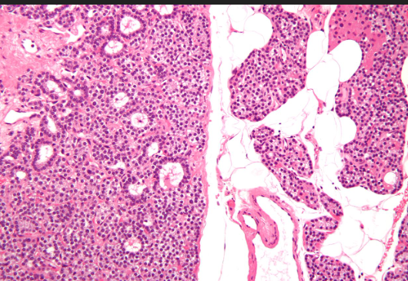
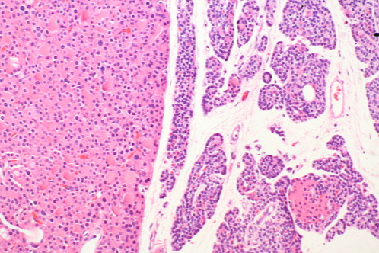
PARATHYROID ADENOMA
Mostly composed of uniform, polygonal chief cells with small, centrally placed nuclei
Adenomas are composed entirely of oxyphil adenomas

Slide 12
PARATHYROID CARCINOMA
May be circumscribed lesions that are difficult to distinguish from adenomas, or they may be clearly invasive neoplasms
Tumors enlarge one parathyroid gland and consist of gray-white, irregular masses that sometimes exceed 10 g in weight

Slide 13
PARATHYROID CARCINOMA
Cells are usually uniform and resemble normal parathyroid cells, and are arranged in nodular or trabecular pattern
Mass is usually enclosed by a dense, fibrous capsule
Diagnosis of carcinoma based on cytologic detail is unreliable, and invasion of surrounding tissues and metastasis are the only reliable criteria
Local recurrence occurs in one-third of cases, and more distant dissemination occurs in another

Slide 14
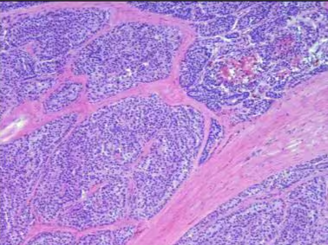
PARATHYROID CARCINOMA

Slide 15
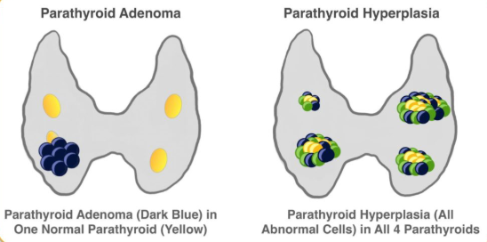
PARATHYROID HYPERPLASIA
Primary hyperplasia may occur sporadically or as a component of MEN syndrome
Although classically all four glands are involved, there is frequently asymmetry with apparent sparing of one or two glands

Slide 16
PARATHYROID HYPERPLASIA
Microscopically
the most common pattern seen is that of
Chief cell hyperplasia in a diffuse or multinodular pattern - contain abundant glycogen, giving them a clear appearance in histologic sections (“water-clear cell hyperplasia”)
Islands of oxyphil cells
Poorly developed, delicate fibrous strands may envelop the nodules
As in the case of adenomas, stromal fat is inconspicuous within hyperplastic glands

Slide 17
SECONDARY HYPERPARATHYROIDISM
Secondary hyperparathyroidism is caused by any condition that gives rise to chronic hypocalcemia, which, in turn, leads to compensatory overactivity of the parathyroid glands
Renal failure
Decreased production of active Vitamin D
Most common cause
Reduces intestinal absorption of calcium
Decreased phosphate excretion
Decreased calcium reabsorption
Inadequate dietary intake of calcium
Steatorrhea
Vitamin D deficiency
Elevated serum phosphate levels
Decrease the serum calcium levels
Stimulate parathyroid glands to increase the secretion of PTH
Notes:
Kidney plays a important role in activating vitamin D by converting its inactive form (25-hydroxyvitamin D) to its active form (1,25-Dihydroxyvitamin D or calcitriol)

Slide 18
SECONDARY HYPERPARATHYROIDISM
MORPHOLOGY
Parathyroid glands in secondary hyperparathyroidism are hyperplastic and glandular enlargement may be asymmetric
Microscopically, the hyperplastic glands contain an increased number of chief cells, or water-clear cells in a diffuse or multinodular distribution
Fat cells are decreased in number
Metastatic calcification may be seen in many tissues, including the lungs, heart, stomach, and blood vessels

Slide 19
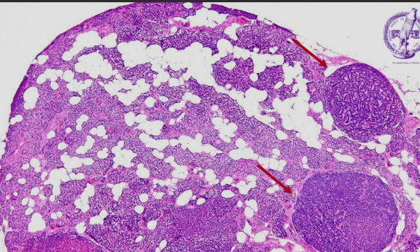
SECONDARY HYPERPARATHYRODIDSM

Slide 20
TERTIARY HYPERPARATHYROIDISM
Tertiary hyperparathyroidism is a state of excessive secretion of parathyroid hormone after long standing secondary hyperparathyroidism despite correction of underlying cause and resulting in hypercalcemia
Etiology is unknown but may be due to monoclonal expansion of parathyroid cells
Secondary hyperparathyroidism is no longer responsive to medications
Also occurs after renal transplant, where hypertrophied glands continue to over secrete PTH (set point alterations – change in set point of calcium sensing mechanism to hypercalcemic levels)

Slide 21
PRIMARY HYPERPARATHYROIDISM
Symptomatic, untreated primary hyperparathyroidism manifests with three interrelated skeletal abnormalities:
Osteoporosis
Brown tumors
Osteitis fibrosa cystica

Slide 22
HYPERPARATHYROIDISM
Increased PTH
Increased osteoclastic activity in both cortical and medullary bone
Increased calcium levels
Urinary tract stones (nephrolithiaisis)
Calcification of renal interstitium and tubules (nephrocalcinosis)
Metastatic ossification of the skin, stomach, lung, myocardium and blood vessels
Microfractures and secondary hemorrhages
Dissecting osteitis in medullary bone
Influx of macrophages and growth of reparative fibrous tissue
+
Cystic degeneration
Mass of reactive tissue
(BROWN TUMOR)
Increased osteolytic activity + peritrabecular fibrosis + cystic degeneration
Brown color is the result of the vascularity, hemorrhage, and hemosiderin deposition
Osteitis fibrosa cystica (von Recklinghausen disease of bone)
Notes:
Cortical bone is more severely affected than medullary bone

Slide 23
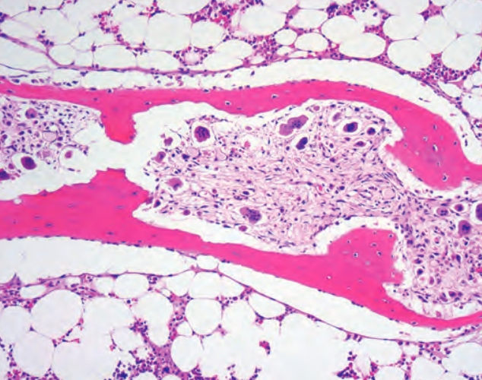
Dissecting osteitis- osteoclasts boring into the centre of trabeculum in medullary bone producing a rail -road track appearance

Slide 24
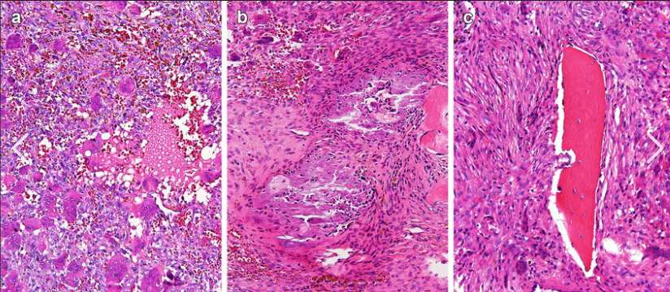
BROWN TUMOR

Slide 25
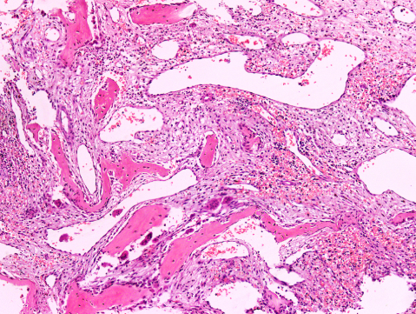
OSTEITIS FIBROSA CYSTICA

Slide 26
HYPERPARATHYROIDISM – CLINICAL FEATURES
Nephrolithiaisis
Pain and obstructive uropathy
Bone resorption
Osteoporosis /osteopenia
Bone pain and fractures
1⁰
Ca ⁺²
PO₄³⁻
PTH
Increased calcium absorption from kidney
Ca ⁺²
PO₄³⁻
Pancreatitis
Activation of pancreatic enzymes leading to pancreatitis
3⁰
Increased calcium absorption from GIT
Heart
Decreased QT interval and Arrhythmia prone
Notes:
Hypercalcemia can interfere with kidneys ability to concentrate urine leading to increased urine output. Increased calcium levels will impair the kidney response to the ADH which normally helps to reabsorb water

Slide 27
HYPERPARATHYROIDISM – CLINICAL FEATURES
Kidney
Decreased Kidneys ability to concentrate urine leading to increased urine output
Increased calcium levels will impair the kidney response to the ADH
Polydipsia and polyuria
GIT
Constipation, nausea, peptic ulcers, and gall stones
CNS
Depression, lethargy and eventually seizures

Slide 28
SECONDARY HYPERPARATHYROIDISM
Clinical Features
Usually dominated by the inciting chronic renal failure
Secondary hyperparathyroidism is usually not as severe or as prolonged as primary hyperparathyroidism, hence the skeletal abnormalities (referred to as renal osteodystrophy) tend to be milder
Control of the hyperparathyroidism allows the bony changes to regress significantly or disappear completely

Slide 29
SECONDARY HYPERPARATHYROIDISM
The vascular calcification associated with secondary hyperparathyroidism may occasionally result in significant ischemic damage to skin and other organs, a process referred to as calciphylaxis
Patients with secondary hyperparathyroidism often respond to dietary vitamin D supplementation as well as phosphate binders, which decrease the prevailing hyperphosphatemia
In a minority of patients, parathyroid activity may become autonomous and excessive, with resultant hypercalcemia, a process termed tertiary hyperparathyroidism
Parathyroidectomy may be necessary to control the hyperparathyroidism in such patient

Slide 30
LAB DIAGNOSIS OF HYPERPARATHYROIDISM
Calcium and phosphate
Increased calcium
Decreased phosphate
Decreased calcium
Increased phosphate
Possibly primary or tertiary hyperparathyroidism
Possibly secondary hyperparathyroidism
PTH and vitamin D and BMP
Decreased vitamin D
Increased PTH and decreased GFR
Increased PTH and normal GFR
Decreased GFR
Tertiary hyperparathyroidism
Primary hyperparathyroidism Vs FHH
CKD
Vitamin D deficiency
DEXA scan
urine calcium
urine calcium
Primary hyperparathyroidism
FHH
Notes:
BMP – Basal metabolic panel like blood sugar, chloride, calcium, sodium, potassium, carbon dioxide and chloride

Slide 31
HYPOPARATHYROIDISM Decreased secretion of PTH
IATROGENIC
AUTOIMMUNE
Causes
AUTOSOMAL DOMINANT HYPOPARATHYROIDISM
FAMILIAL ISOLATED HYPOPARATHYROIDISM
DI-GEORGE SYNDROME

Slide 32
HYPOPARATHYROIDISM
IATROGENIC
Inadvertent removal of all parathyroid glands during thyroidectomy
Excision of parathyroid glands in the mistaken belief that they are lymph nodes during radical neck dissection for some form of malignant disease
Removal of too large a proportion of parathyroid tissue in the treatment of primary hyperparathyroidism

Slide 33
HYPOPARATHYROIDISM AUTOIMMUNE HYPOPARATHYROIDISM
Mutations in the “autoimmune regulator (AIRE) gene” which encodes for transcription factor primarily expressed by medullary thymic epithelial cells for generating central tolerance
Associated with syndrome “Autoimmune polyendocrine syndrome type 1 (APS-1)”
Three characteristic features typically presents since childhood
Mucocutaneous candidiasis
Hypoparathyroidism
Adrenal insufficiency
Other associated abnormalities are hepatitis, type 1 Diabetes, hypogonadotropic hypogonadism
Notes:
Chromsome 21q22.3 – AIRE gene promotes tissue specific antigen (TSA) expression and promote expression of various TSA genes . AIRE in mETC express TSA during T cell development and then presents to maturing T cells, subsequently recognized by autoreactive T cells undergoing negative selction through apoptosis or inducing a specific subset of regulatory T cells to prevent the the development of sevre autoimmunity. Auto antibodies are produced specifically against type1 interferon

Slide 34
HYPOPARATHYROIDISM
Autosomal-dominant hypoparathyroidism
Caused by gain-of-function mutations in the calcium-sensing receptor (CASR) gene
Inappropriate CASR activity due to heightened calcium sensing suppresses PTH, resulting in hypocalcemia and hypercalciuria

Slide 35
HYPOPARATHYROIDISM Familial isolated hypoparathyrodism (FIH)
Rare condition with either autosomal dominant or autosomal recessive patterns of inheritance
Autosomal dominant FIH is caused by a mutation in the gene encoding PTH that impairs PTH processing to the mature active hormone
Autosomal recessive FIH is caused by loss-of-function mutations in the transcription factor gene GCM2, which is essential for development of the parathyroid

Slide 36
HYPOPARATHYROIDISM
Chromosome 22q11 deletion
3rd and 4th pharyngeal pouch is not formed
DI GEORGE SYNDROME
Congenital absence of parathyroid glands
Other abnormalities include
C- Cardiac defect
A- Anomalous face
T – Thymic hypoplasia
C – Cleft palate
H – Hypoparathyroid

Slide 37
HYPOPARATHYROIDISM Clinical features
Bone resorption
PTH
Kidney absorption of calcium
Decreased calcium and increased phosphate
Decreased production of Vit D 3
Intestinal absorption of calcium

Slide 38
HYPOPARATHYROIDISM Clinical features
PTH
Heart
Decreased Ca²⁺ and increased PO₄³⁻
Neurons
Increased activity of Na channels
Arrhythmias
Prolonged QT interval
Increased Na influx
Tetany
Generation of new action potential
Perioral paresthesia
Chvosteks sign
Increased release of neurotransmitters
Trousseau sign

Slide 39
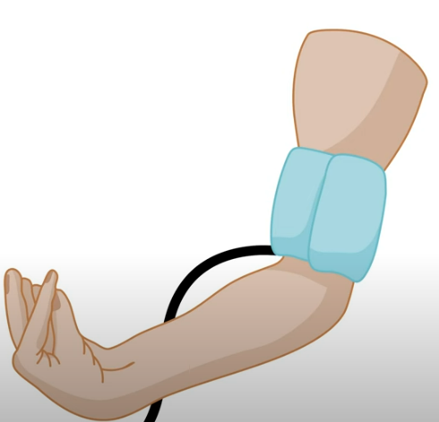
HYPOPARATHYROIDISM Clinical features
Trousseau sign
Induction of carpal spasms produced by occlusion of the circulation to the distal arm with a blood pressure cuff for several minutes
Carpopedal spasm characterized by
Adduction of the thumb
Flexion of the metacarpopalangeal joints
Extension of the interphalangeal joints
Flexion of the wrist

Slide 40
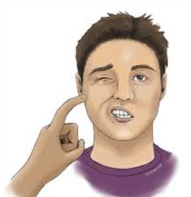
HYPOPARATHYROIDISM Clinical features
CHVOSTEKS SIGN
Elicited by tapping the fascial nerve just anterior to the ear will elicit contraction of the ipsilateral fascial muscles, eye, mouth and nose

Slide 41
HYPOPARATHYROIDISM
Clinical Features
Mental status changes include emotional instability, anxiety and depression, confusional states, hallucinations, and frank psychosis
Intracranial manifestations include calcifications of the basal ganglia, parkinsonian-like movement disorders, and increased intracranial pressure with resultant papilledema
Ocular disease takes the form of calcification of the lens and cataract formation
Cardiovascular manifestations include a conduction defect that produces a characteristic prolongation of the QT interval in the electrocardiogram
Dental abnormalities occur when hypocalcemia is present during early development

Slide 42
PSEUDOHYPOPARATHYROIDISM
Hypoparathyroidism occurs because of end-organ resistance to the actions of PTH
Serum PTH levels are normal or elevated
In one form of pseudohypoparathyroidism, there is end-organ resistance to TSH and FSH/LH as well as PTH
All of these hormones signal via G-protein–coupled receptors, and the disorder results from genetic defects leading to deficiency of alpha subunit of stimulatory G protein, a key regulator of cAMP pathway
TSH resistance is the most obvious clinical manifestation
It presents as hypocalcemia, hyperphosphatemia, and elevated circulating PTH

Slide 43
HYPOPARATHYROIDISM - LABORATORY DIAGNOSIS
Decreased calcium
Increased Phosphate
Reduced
PTH
Increased
Pseudohypoparathyroidism
Hypoparathyroidism
Present
H/O of recent neck surgery
AIRE gene mutation
APS-I
Iatrogenic
Absent
Genetic testing
Chromsome 22 deletion and CATCH features
Di-George syndrome

Slide 44
THANK YOU

