Slide 1
RHEUMATIC FEVER
Dr.V.Shanthi
Associate Professor, Pathology
Sri Venkateswara Institute of Medical Sciences, Tirupathi

Slide 2
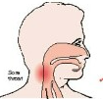
RHEUMATIC FEVER
Rheumatic fever (RF) is an acute, immunologically mediated, multisystem inflammatory disease classically occurring a few weeks after group A streptococcal pharyngitis
Most commonly affects children of 5 to 15 years of age.
Mortality by RF and RHD is reduced due to improved sanitation, and rapid diagnosis and treatment of streptococcal pharyngitis

Slide 3
RHEUMATIC FEVER Clinical features
Acute RF typically appears 10 days to 6 weeks after a group A streptococcal infection in about 3% of patients
Occurs most often in children between 5 and 15 years of age, but first attacks can occur in middle to later life
Pharyngeal cultures for streptococci are negative by the time the illness begins, antibodies to one or more streptococcal enzymes, such as streptolysin O and DNAase B, can be detected in the sera of most patients with RF

Slide 4
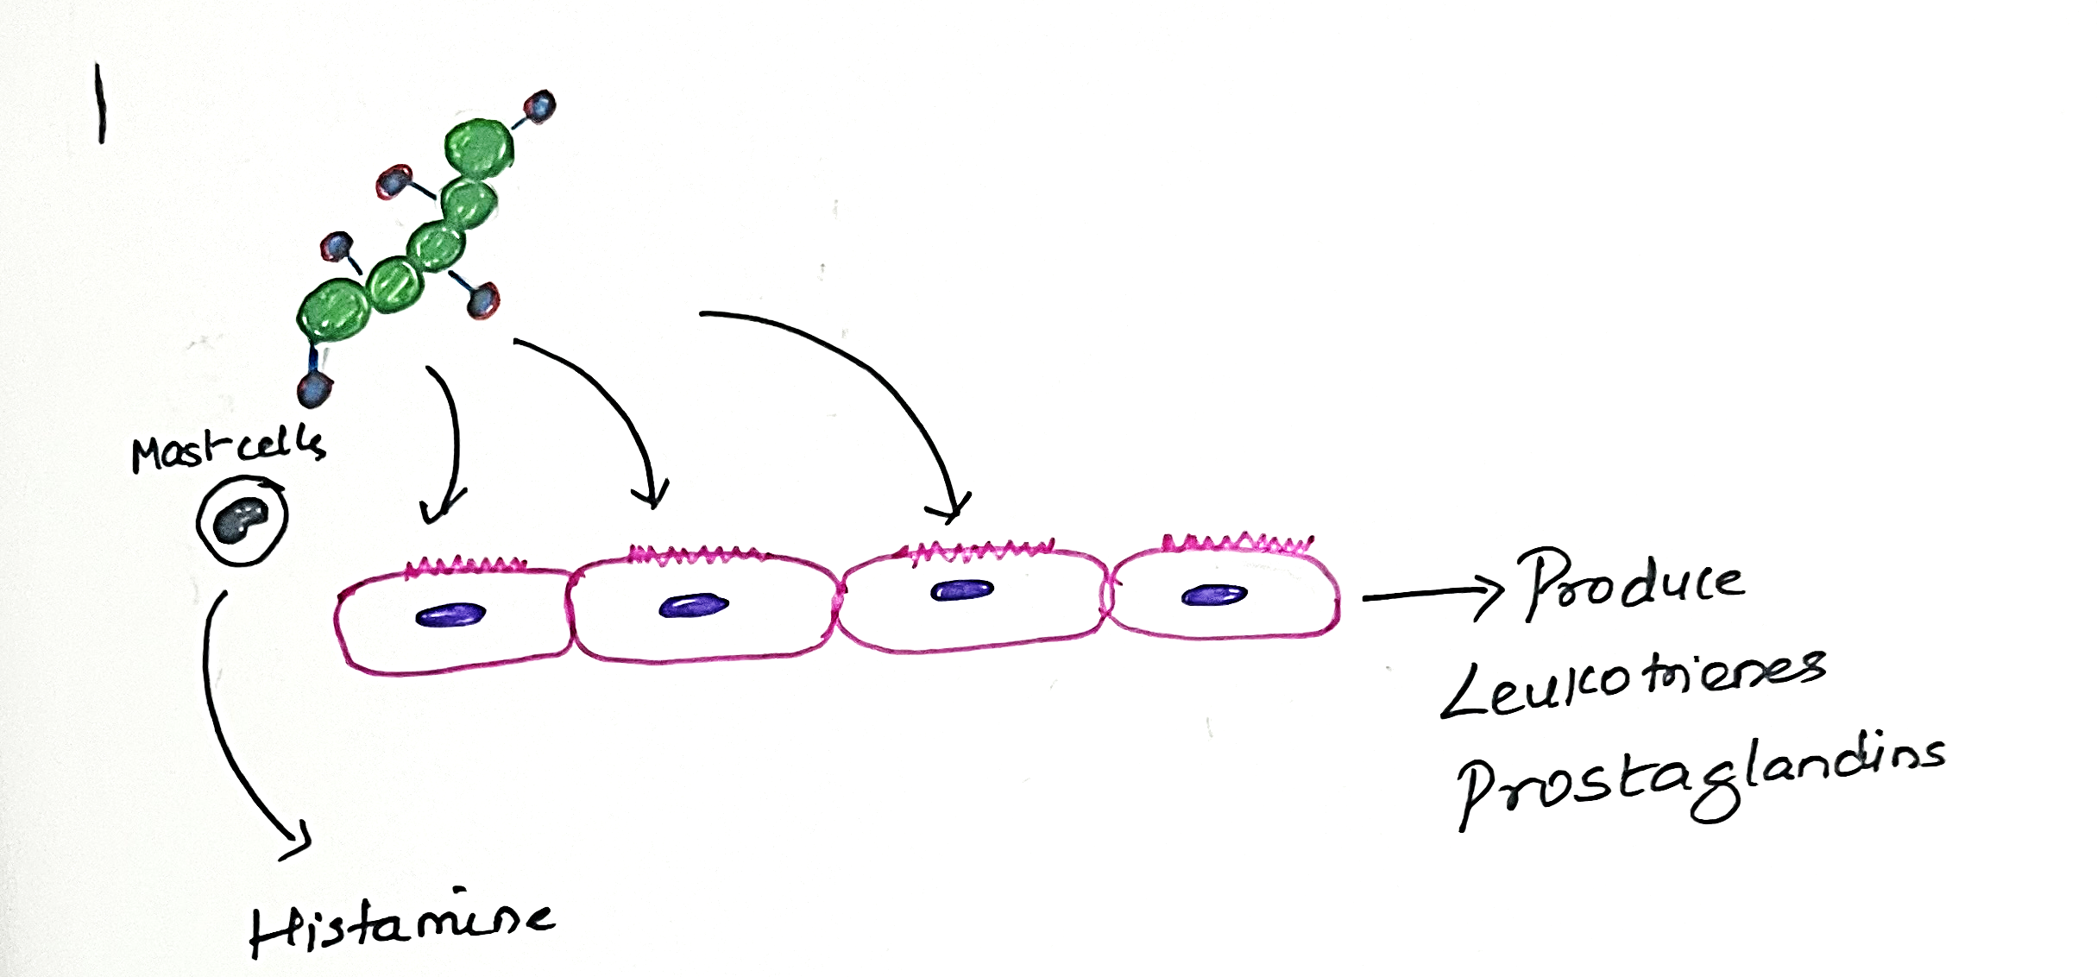
RHEUMATIC FEVER Pathogenesis
M-protein

Slide 6
Notes:
Acute rheumatic fever results from host immune responses to group A streptococcal antigens that cross-react with host proteins
Characteristic 2- to 3-week delay in symptom onset after infection is due to time needed to generate an immune response
Antibodies and CD4+ T cells directed against streptococcal M proteins can recognize cardiac self antigens
Antibody binding can activate complement, as well as recruit Fc- receptor–bearing cells (neutrophils and macrophages)
Cytokine production by the stimulated T cells leads to macrophage activation (e.g., within Aschoff bodies)
Damage to heart tissue may thus be caused by a combination of antibody- and T cell–mediated reactions
Streptococci are completely absent from the lesions

Slide 7
RHEUMATIC FEVER Pathogenesis
M- proteins of streptococci
Molecular mimicry
Skin
keratin
Heart
Laminin
Tropomyosin
Troponin
Actin
Myosin
Brain
Gangliosides in lentate nucleus, caudate nucleus and subthalamus
Joints
Vimentin
Small minority of infected patients develop rheumatic fever (estimated at 3%) due to genetic susceptibility which influence the development of the cross-reactive immune responses

Slide 8
RHEUMATIC FEVER Morphology
Pericardium
Pericarditis
Pericardial friction rub
HEART
Fibrinoid necrosis
Aschoff bodies
Myocardium
Myocarditis
Decreased contractility
Endocardium
CHF
Decreased cardiac output

Slide 9
ASCHOFF BODIES
composed of foci of T lymphocytes, occasional plasma cells, and plump activated macrophages called Anitschkow cells
These macrophages have abundant cytoplasm and central round to ovoid nuclei (occasionally binucleate) in which the chromatin condenses into a central, slender, wavy ribbon (hence the designation “caterpillar cells”)
Notes:
Anitschkow cells were named after the Russian pathologist Nikolay Anichkov.

Slide 10
RHEUMATIC FEVER Morphology
Endocardium
Mainly valvular tissues
HEART
Myocardium
Pericardium

Slide 11
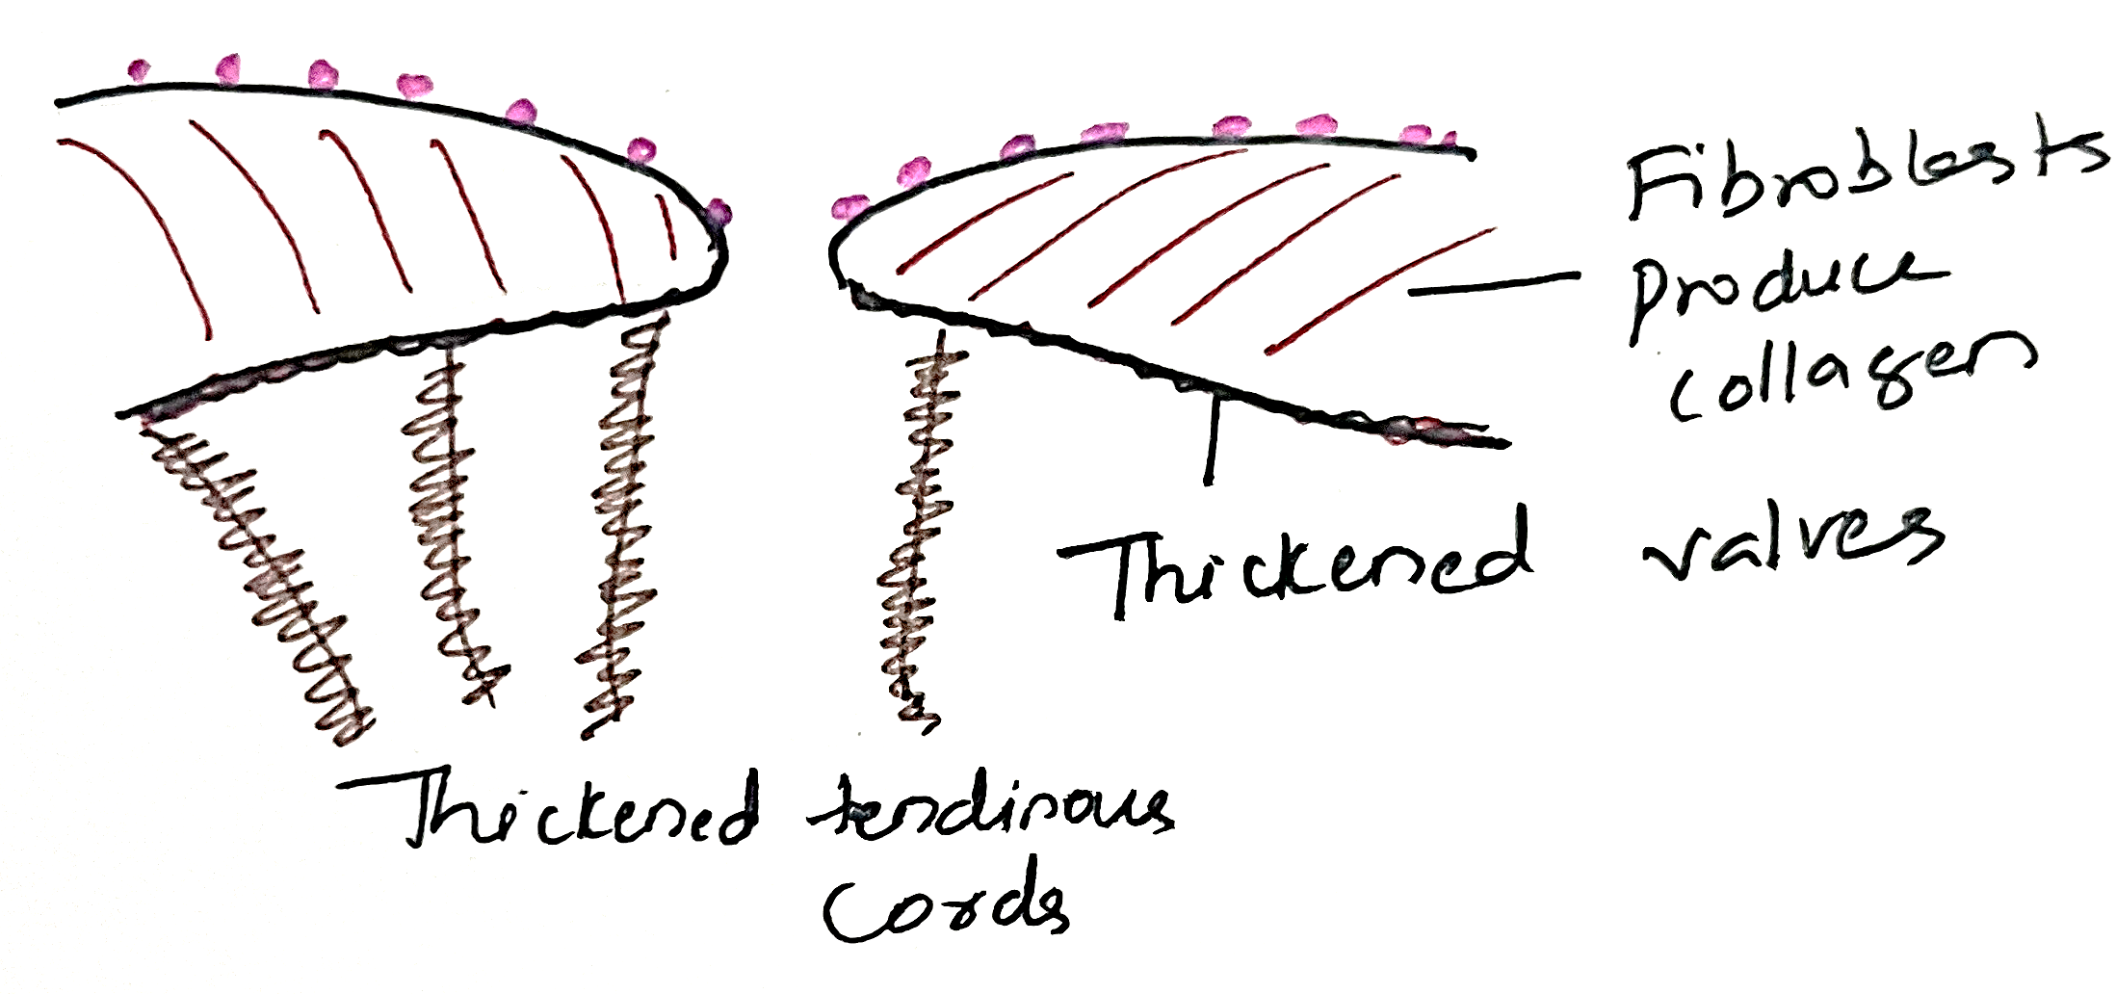
RHEUMATIC FEVER Morphology

Slide 12
RHEUMATIC FEVER Morphology
Overlying these necrotic foci and along the lines of closure are small (1 to 2 mm) vegetations, called verrucae which are grey white translucent

Slide 13
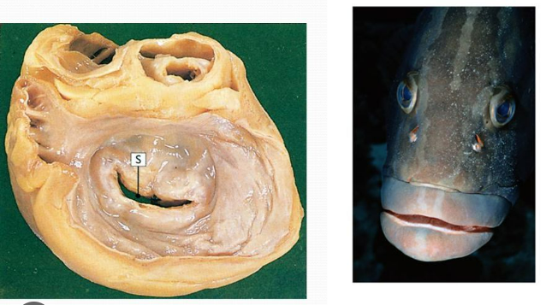
RHEUMATIC FEVER Morphology
Rheumatic mitral stenosis
Calcification and fibrous bridging across the valvular commissures create “fish mouth” stenoses
Left atrium progressively dilates and may harbor mural thrombi that can embolize

Slide 14
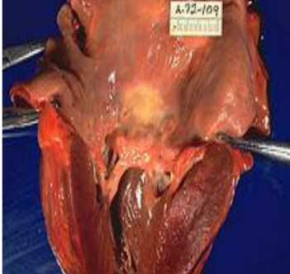
RHEUMATIC FEVER Morphology
Subendocardial lesions, perhaps exacerbated by regurgitant jets, can induce irregular thickenings of endocardium called MacCallum plaques, usually in the left atrium

Slide 15
RHEUMATIC FEVER Morphology
Mitral valve changes in chronic RHD
leaflet thickening
Commissural fusion
Shortening, thickening and fusion of the tendinous cords
Mitral valve is affected in isolation in roughly two-thirds of cases, and along with the aortic valve in another 25%

Slide 16
RHEUMATIC FEVER Morphology
Endocardium
HEART
Myocardium
Pancarditis
Pericardium

Slide 17
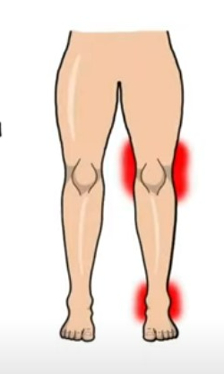
RHEUMATIC FEVER
Joints
Antibodies act on vimentin in synovial tissue producing
Polyarthritis
Large joints are involved
Migratory

Slide 18
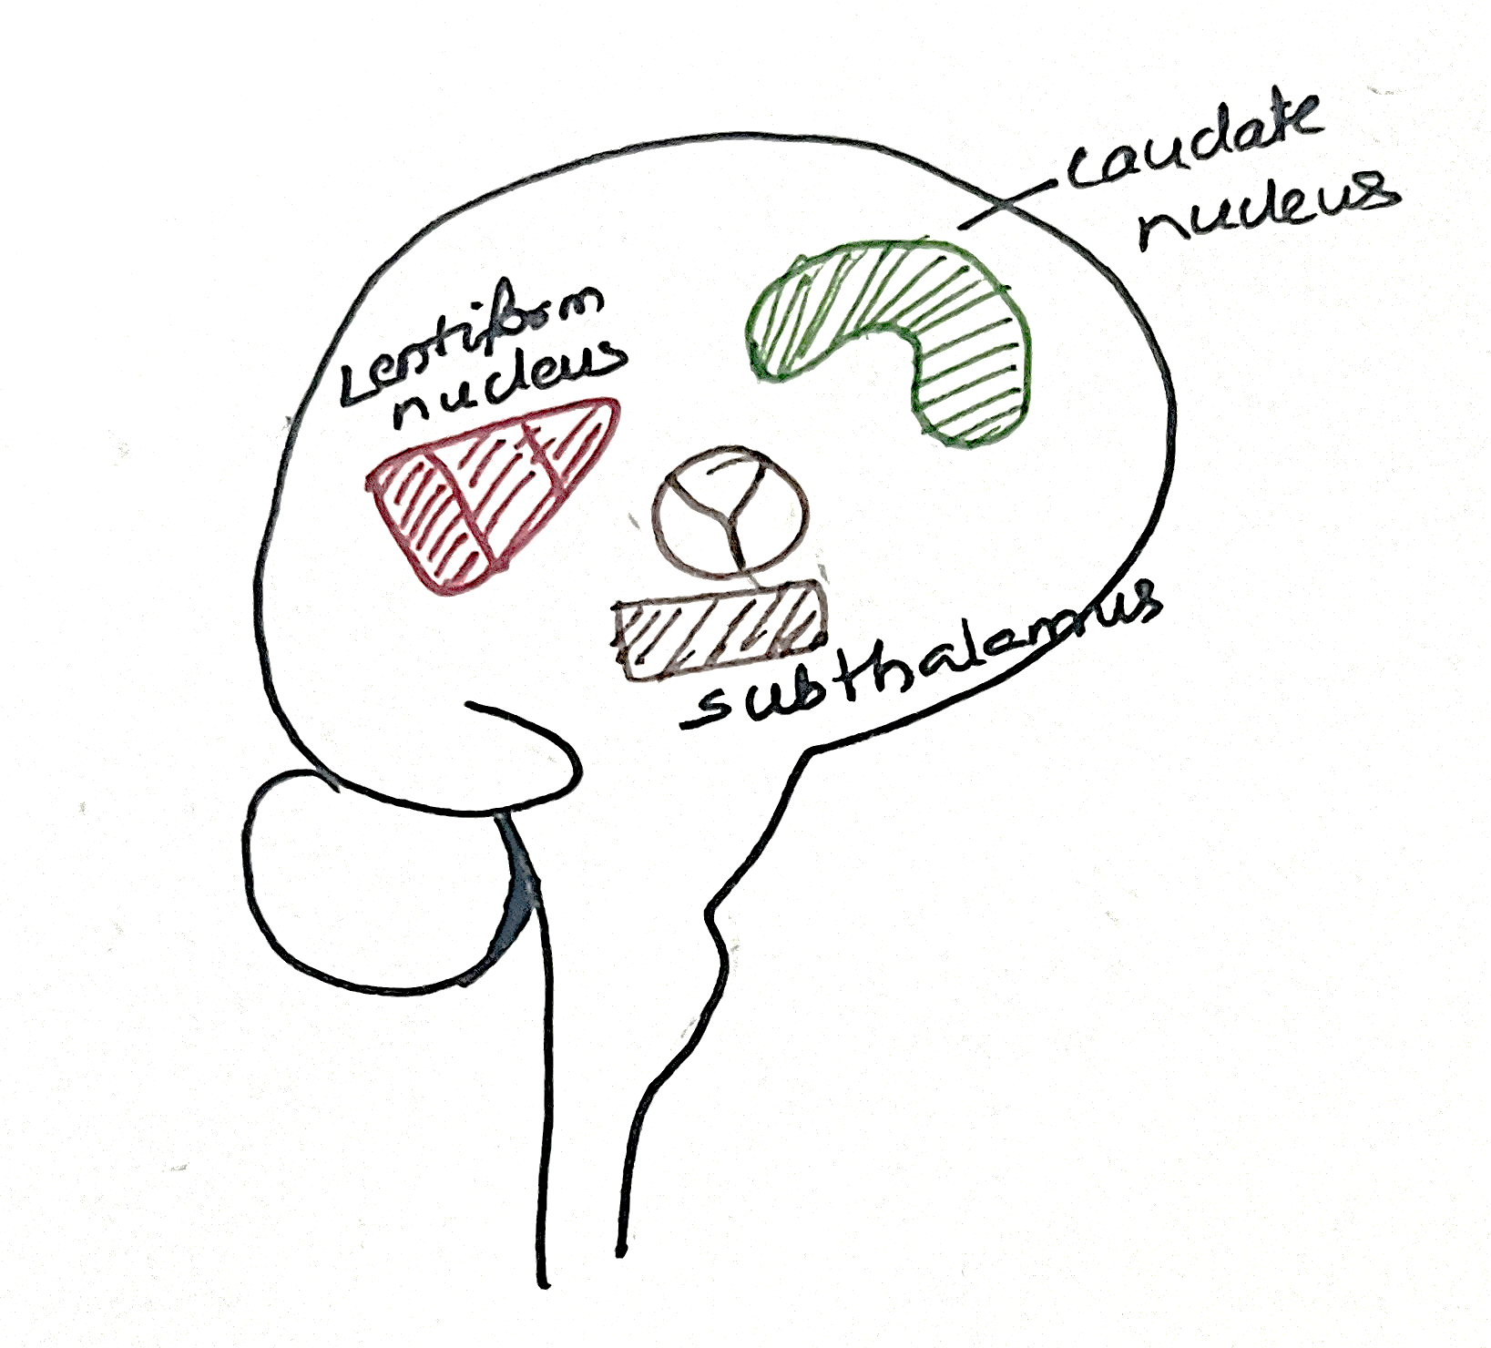
RHEUMATIC FEVER
CNS involvement
Antibodies act against gangliosides in
Produces Syndenhans chorea – characterized by uncontrolled and rapid movements of
Extremities
Face
tongue

Slide 19
RHEUMATIC FEVER
Skin involvement
Erythema marginatum
Subcutanous nodules – due to deposition of collagen.
Mostly seen on the back of the wrist, elbows and knee

Slide 20
RHEUMATIC FEVER
The diagnosis is established in accordance with the Jones criteria which has major and minor criteria
Evidence of a preceding group A streptococcal Infection (Rapid antigen test, culture sensitivity and Anti streptolysin O titres ) and the presence of
Two major manifestations
One major and two minor manifestations

Slide 21
RHEUMATIC FEVER Clinical features
RF is characterized by a constellation of major manifestations:
Migratory polyarthritis of the large joints
Pancarditis (myocarditis, pericarditis, or endocarditis)
Subcutaneous nodules (typically on extensor surfaces of extremities)
Erythema marginatum, an irregular circinate skin rash
Sydenham chorea, a neurologic disorder with involuntary rapid movements
J
O
N
E S

Slide 22
RHEUMATIC FEVER Clinical features
Minor manifestations (nonspecific signs) include
Fever
Arthralgia
Elevated blood levels of acute-phase reactants (C reactive protein)
Raised ESR
Prolonged PR interval
Valvular abnormalities

Slide 23
RHEUMATIC FEVER Clinical features
Clinical manifestations are carditis and arthritis, the latter more common in adults than in children
Arthritis typically begins with migratory polyarthritis (accompanied by fever) in which one large joint after another becomes painful and swollen for a period of days and then subsides spontaneously, leaving no residual disability
Clinical features related to acute carditis include pericardial friction rubs, tachycardia, and arrhythmias
Myocarditis can cause cardiac dilation that may culminate in functional mitral valve insufficiency or even heart failure
Approximately 1% of affected individuals die of fulminant RF involvement of the heart

Slide 24
RHEUMATIC FEVER Clinical features
Damage to the valves – cardiac murmers
In addition, they develop cardiac hypertrophy and dilation, and heart failure
Individuals with chronic RHD may suffer from arrhythmias (particularly atrial fibrillation in the setting of mitral stenosis), thromboembolic complications, and infective endocarditis
The long-term prognosis is highly variable.
Surgical repair or replacement of diseased valves has greatly improved the outlook for persons with RHD

Slide 25
THANK YOU

