Slide 1
TUMOR SUPPRESSOR GENES
Dr.V.Shanthi
Associate professor
Department of Pathology
www.Histopathology.guru

Slide 2
Protein products stimulate cell growth. They are
Growth factors
Growth factor receptors
Signal transduction proteins
Transcription factors
Apoptosis regulators
Oncogenes
Mutated proto-oncogenes
Gain of function mutations
Genes responsible for cell cycle progression
Neoplasm
Loss of function mutations
Protein products are negative regulators of cell cycle. They
Stop cell cycle progression
Promote apoptosis
Eg Rb and P53
Tumor suppressor genes

Slide 3
TUMOR SUPPRESSOR GENES
Products of tumor suppressor genes apply brakes to cell proliferation
Abnormalities in these genes lead to failure of growth inhibition
First described tumor supressor gene is Retinoblastoma (RB) gene present on chromosome 13q14
To explain familial pattern of inheritance and sporadic cases of retinoblastoma, Knudson proposed “two hit hypothesis”

Slide 4
TUMOR SUPPRESSOR GENES knudsons two hit hypothesis
Two mutations (hits) involving both the alleles of tumor suppressor genes is the basic requirement for the development of tumor
Hereditary retinoblastoma
Sporadic retinoblastoma
First Hit
Inherited mutation
Second Hit
Acquired mutation
First Hit
Acquired mutation
Second Hit
Acquired mutation
TUMOR
Notes:
In molecular term, Knudson hypothesis was stated as
Two mutation hits, involving both alleles of RB are required to produce retinoblastoma
In familial cases, children inherit one defective copy of RB (first hit) and one normal copy of RB in the germ line (children will be normal)
Retinoblastoma develops when the normal RB allele is mutated in retinoblastoma as a result of spontaneous mutation (second hit)
In sporadic cases both normal RB alleles must undergo somatic mutations (two hits)

Slide 5
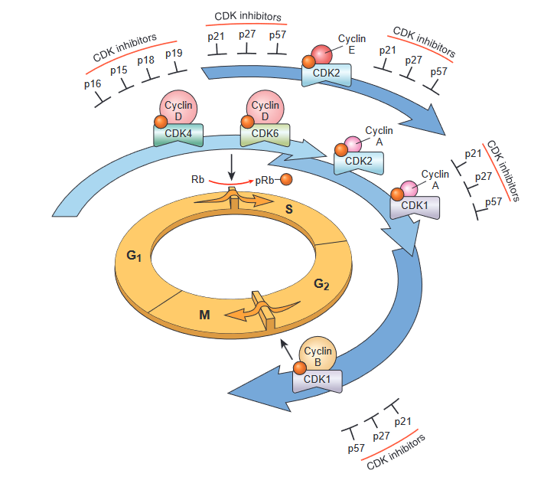
TUMOR SUPPRESSOR GENES
RB– Governor of proliferation
Key negative regulator of G1/S cell cycle transition and is directly or indirectly inactivated in most human cancers
RB exists in an active hypophosphorylated state in quiescent cell and hyperphosphorylated state in cells passing through G1/S cell cycle transition

Slide 6
TUMOR SUPPRESSOR GENES
RB– Governor of proliferation
Its function is compromised in two different ways –
Loss of function mutations involving both RB allelles
Shift from the active hypophosphorylated state to the inactive hyperphosphorylated state caused by gain of function mutations that upregulate CDK/cyclin D activity or by loss of function mutations that abrogate the activity of CDK inhibitor

Slide 7
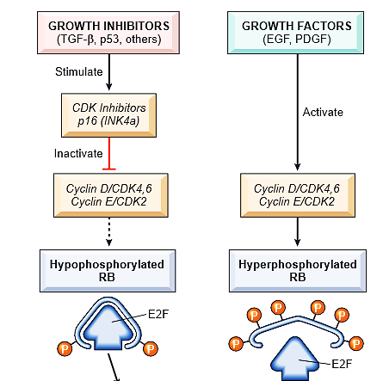
TUMOR SUPPRESSOR GENES
High levels of CDK4/cyclin D, CDK6/cyclin D, CDK2/cyclin E complexes lead to hyperphosphorylation and inhibition of RB releasing E2F transcription factors that drive the expression of genes that are needed for progression to S phase

Slide 8
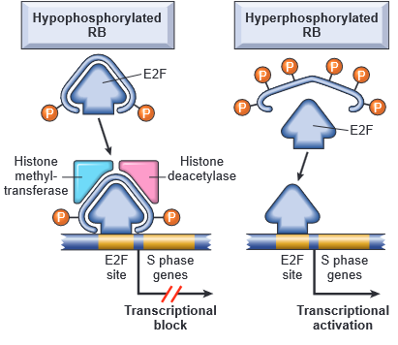
TUMOR SUPPRESSOR GENES
Hypophosphorylated RB in complex with E2F transcription factors bind to DNA, recruits chromatin modifying factors like histone deacetylase, histone methyl transferases and inhibit transcription of genes whose products are required for the S phase of the cell cycle
When the RB is phosphorylated by cyclin D-CDK4, cyclin D-CDK6 and cyclin E-CDK2 complexes, it release E2F
E2F activates the transcription of S-phase genes

Slide 9
TUMOR SUPPRESSOR GENES
Phosphorylation of RB is inhibited by cyclin-dependent kinase inhibitors which inactivates cyclin CDK – complexes
Mutations in genes that regulate phosphorylation of the RB causes defective G1-S check point.
Mutations in atleast one of the 4 genes can cause malignant transformation
RB
CDK4
Genes encoding cyclin D proteins
CDKN 2A (P16)

Slide 10
TUMOR SUPPRESSOR GENES
Transforming proteins of several oncogenic human DNA viruses neutralize the growth inhibitory activity of RB
E.g. polyoma virus – large T antigen and E 7 proteins of HPV bind to hypophosphorylated RB through the same pocket that RB uses to bind and sequester E2F transcription factor
This releases E2F factor and causes cell cycle progression

Slide 11
TUMOR SUPPRESSOR GENES TP53 – guardian of genome
TP53 encode P53 protein which is a transcription factor that binds DNA in a sequence specific fashion and activates hundreds of target genes with P53- binding regulatory elements
Target genes that execute the functioning of P53 are not completely defined but fall into 3 major categories
Genes that cause cell cycle arrest
Genes that cause apoptosis
Genes that enhance catabolic metabolism or inhibit anabolic metabolism

Slide 12
TUMOR SUPPRESSOR GENES TP53 – guardian of genome
It regulates cell cycle progression, DNA repair, cellular senescence and apoptosis
TP53 is located on chromosome 17p13.1
TP53 mutations are seen in most cancers commonly in cancer of colon, breast and lung
Mutations should be present in both alleles and are acquired in somatic cell (not inherited germline)
Inheritance of mutated copy of TP53 predisposes individuals to malignant tumor and an additional hit is required in normal allele
E.g. Individuals with these inherited mutations as in Li-Fraumeni syndrome are 25 folds increased risk of malignancy. Tumors in these pts are sarcomas, breast cancers, leukemias, brain tumors and carcinomas of adrenal cortex.
Tumors develop in early life and develop multiple cancers

Slide 13
TUMOR SUPPRESSOR GENES TP53 – guardian of genome
In healthy cells, P53 is held at bay through its association with MDM2, an enzyme that ubiquitinates P53, leading to its degradation by the proteasome
As a result P53 is virtually undetectable in normal cells
In stressed cells however P53 is released from the inhibitory effects of MDM2 via 2 major mechanisms which vary depending upon the nature of stress
DNA damage and hypoxia
Oncogenic stress

Slide 14
TUMOR SUPPRESSOR GENES TP53 – guardian of genome

Slide 15
TUMOR SUPPRESSOR GENES TP53 – guardian of genome
Regulation of P53 protein in normal cells
Ubiquitin mediated degradation
P53 – MDM2 complex
Degraded p53
MDM 2 protein

Slide 16
TUMOR SUPPRESSOR GENES TP53 – guardian of genome
DNA damage and hypoxia –
Initiators of P53 activation following DNA damage or hypoxic stress are two related kinases
Ataxia – Telangiectasia Mutated (ATM)
Ataxia – Telangiectasia and Red 3 related (ATR)
Once triggered both ATM and ATR stimulate the phosphorylation of P53 and MDM2
This post translational modifications disrupts the binding and degradation of P53 by MDM2 allowing P53 to accumulate

Slide 17
TUMOR SUPPRESSOR GENES
Oncogenic stress –
Activation of oncoproteins such as RAS leads to sustained signaling through pro-growth pathways such as MAPK and PI3K/AKT cascades which leads to increased expression of P14/ARF which is encoded by the CDKN2A tumor suppressor gene
P14/ARF binds to MDM2 and displaces P53, again allowing P53 levels to rise in cell
Once activated P53, thwarts neoplastic transformation by inducing
Transient cell cycle arrest
Senescence (permanent cell cycle arrest)
Programmed cell death

Slide 18
Transient P53 induced cell cycle arrest
occurs late in G1 phase and is caused in part by P53 dependent transcription of CDKN1A gene, which encodes the CDK inhibitor P21
P21 inhibits CDK4/cyclin D complexes, there by maintaining RB in an active hypophosphorylated form and blocking the progression of cells from G1 to S phase
P53 also helps the process by inducing proteins such as GADD45 (Growth Arrest and DNA Damage)
This pause in cell cycle helps in repairing DNA damage

Slide 19
TUMOR SUPPRESSOR GENES TP53 – guardian of genome
P53 induced senescence
Senescence is a state of permanent cell cycle arrest
Senescence is a product of epigenetic changes that result in the formation of heterochromatin at key loci including the genes that are required for progression of cells from G1 to S phase

Slide 20
TUMOR SUPPRESSOR GENES TP53 – guardian of genome
P53 induced apoptosis
P53 directs the transcription of several proapoptotic genes such as BAX and PUMA which causes apoptosis via the intrinsic pathway
Affinity of P53 for its binding sites in the promoters and enhancers of DNA repair genes is higher than its affinity for binding sites in proapoptotic genes
Hence P53 first activates DNA repair pathway and then further accumulation leads to epigenetic silencing of genes that are needed for cell cycle progression, leading to senescence.
Alternatively if enough P53 accumulates it stimulates the transcription of pro-apoptotic genes

Slide 21
TUMOR SUPPRESSOR GENES TP53 – guardian of genome
With loss of P53 function
DNA damage goes unrepaired
Driver mutations accumulate in oncogenes and other cancer genes
Another effect of P53 is that cells with defective P53 acquire a mutator phenotype, a tendency to acquire mutations at higher rate
P53 also has therapeutic implications
Irradiation and chemotherapy induces DNA damage and subsequent apoptosis of tumor cells – tumor cells with mutated P53 are not killed

Slide 23
TUMOR SUPPRESSOR GENES APC-Gatekeeper of colonic neoplasia
Adenomatous Polyposis Coli (APC) is a member of class of tumor suppressors that function by down regulating growth promoting signaling pathway
APC locus is on chromosome 5q21
Both copy APC gene should be inactivated either by methylation or mutations to develop familial adenomatous polyposis an autosomal dominant disorder in which individuals inheriting one mutant allele develop 1000’s of polyps in colon in teens or 20’s and one or more polyps can undergo malignant transformation
Further additional mutations must occur for adenomas to develop into carcinomas

Slide 24
TUMOR SUPPRESSOR GENES APC-Gatekeeper of colonic neoplasia
APC is a component of the WNT signaling pathway, which has major role in controlling cellular growth and differentiation during embryonic development
WNT molecules signal by binding to cell surface receptors of the frizzled family
In the absence of WNT signaling, APC participates in the formation of “destruction complex” that leads to proteasomal degradation of B-catenin
WNT signaling blocks the formation of destruction complex, stabilizing B-catenin and allowing it to translocate from the cytoplasm to the nucleus
In the nucleus it forms a transcription activation complex with a DNA binding factor called TCF that promotes the growth of colonic epithelial cells by increasing the expression of MYC, Cyclin D1, and other genes
Thus the cells with loss of APC behaves as if they are continuously stimulated by WNT and show elevated expression of genes that are regulated by B-catenin

Slide 26
TUMOR SUPPRESSOR GENES B-catenin
In many colon tumors, APC genes are normal and B-catenin mutations prevent APC dependent destruction leading to its accumulation and increased expression of B-catenin dependent target genes
Thus B-catenin itself is a oncoprotein.
APC/B-catenin mutations are seen in colon cancer and B-catenin mutations are seen in 20% of Hepatocellular carcinoma

Slide 27
TUMOR SUPPRESSOR GENES E-cadherin
B-catenin also binds to cytoplasmic tail of E-cadherin, a cell surface protein that maintains intercellular adhesiveness
Loss of cell to cell contact as in epithelial injury, disrupts the interaction between E-cadherin and B-catenin which allows B-catenin to translocate to the nucleus that promotes proliferation
After repair of wound, re-establishment of E-cadherin in its position leads to sequestration of B-catenin at the membrane and reduces the proliferation activation
Reduced cell surface expression of E-cadherin are associated with cancer of esophagus, colon, breast, ovary and prostate
Germline loss of function mutation of E-cadherin gene, Known as CDH1 are associated with familial gastric carcinoma

Slide 28
TUMOR SUPPRESSOR GENES CDKN2A
CDKN2A gene encodes two protein products
P16/INK4a cyclin dependent kinase inhibitor, which blocks CDK4/Cyclin D mediated phosphorylation of RB, there by reinforcing the G1/S checkpoint
P14/ARF which activates P53 pathway by inhibiting MDM2 and prevents destruction of P53
P16 also induces cell senescence
Germ line mutations in CDKN2A are associated with familial forms of melanoma, bladder cancer, head and neck tumors, ALL, cholangiocarcinoma
In cervical carcinoma P16 is silenced by hypermethylation of gene (epigenetic change)

Slide 29
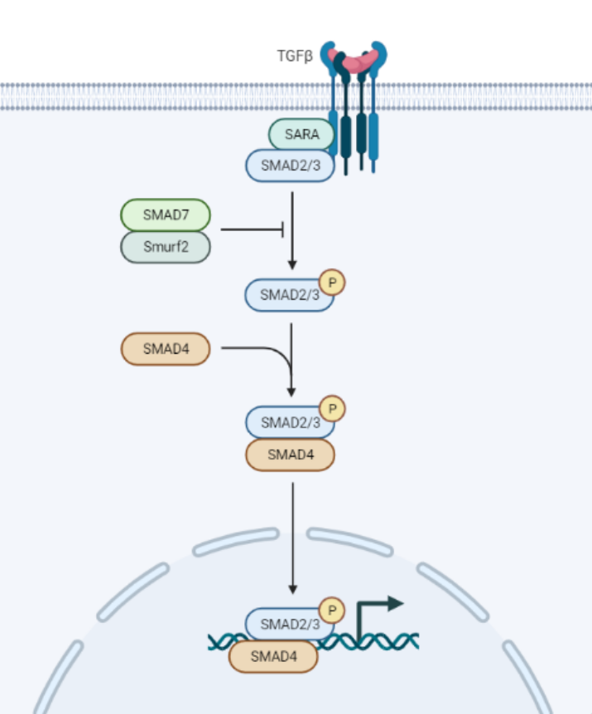
TUMOR SUPPRESSOR GENES TGF-β PATHWAY
In the most normal epithelial, endothelial and hematopoietic cells, TGF-β is potent inhibitor of proliferation
Normal TGF-β combines with TGF-β receptors, thereby stimulating intracellular signals that involve transcriptional regulators of SMAD protein family which turn on antiproliferative genes and turn off genes that drive cell growth (eg MYC, Cyclins, and Cyclin dependent kinase)
These changes result in decreased phosphorylation of RB and cell cycle arrest
Mutations of TGF-β are common in cancers of colon, stomach and endometrium while mutational inactivation of SMAD 4 is common in pancreatic cancers

Slide 30
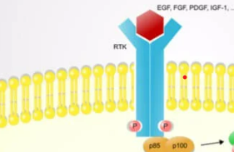
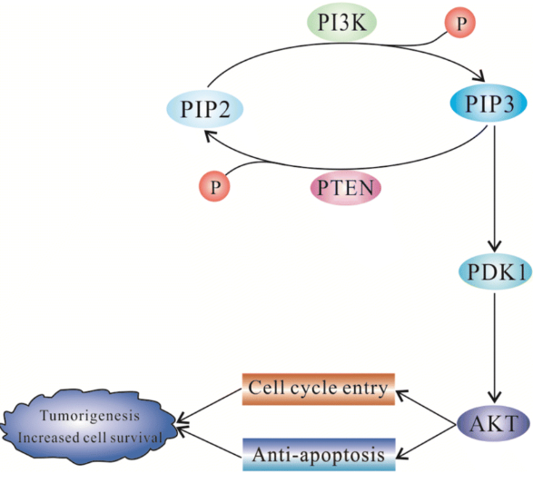
TUMOR SUPPRESSOR GENES PTEN
Phosphatase and tensin homologue (PTEN) is membrane associated phosphatase encoded by a gene on chromosome 10q23
PTEN acts as a tumor suppressor by serving as brake on PI3K/AKT signal cascade
Deletions, deleterious point mutations or epigenetic silencing of PTEN gene can cause tumors of breast, endometrium and thyroid
Notes:
Phosphatidylinositol (4,5)-bisphosphate (PIP2) and phosphatidylinositol (3,4,5)-trisphosphate (PIP3)
PDK (phosphoinositide-dependent protein kinase) homologues,
AKT – protein kinase B

Slide 31
TUMOR SUPPRESSOR GENES VHL
Von Hippel Lindau (VHL) gene on chromosome 3p produces VHL which forms a component of a protein complex that covalently links ubiquitin chains to specific protein substrates there by promoting their degradation by the proteasome
One of the substrate for VHL-ubiquitin ligase is the transcriptional factor Hypoxia-inducible transcription factor 1α (HIF-1α)
In the presence of O2, HIF-1α is hydroxylated and binds to VHL leading to its ubiquitination and degradation

Slide 32
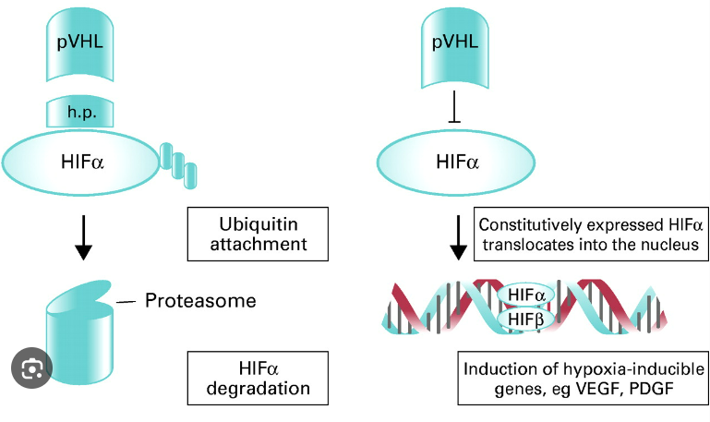
In the presence of oxygen
In the absence of oxygen
Hydroxylated HIF α
Induction of hypoxia inducible genes eg VEGF, PDGF, erythropoeitin
RCC

Slide 33
TUMOR SUPPRESSOR GENES VHL
In hypoxic environment hydroxylation does not occur and it escapes recognition by VHL. Later HIF-1α accumulates in the nuclei of hypoxic cells and turns on target genes like –
VEGF – angiogenic factor
PDGF – potent mitogen
GLUT 1- glucose transporter
Glycolytic enzymes that contribute to Warburg metabolism
Loss of function mutation of VHL prevent ubiquitination and degradation of HIF-1α, even under normotoxic conditions and is associated with hereditary renal cell carcinoma and also a subset of hereditary RCC

Slide 34
TUMOR SUPPRESSOR GENES STK 11
Also known as LKB1 encodes a serine/threonine kinase – important regulator of cellular metabolism
STK 11 has pleiotropic effects on multiple facets of cellular metabolism including
Glucose uptake
Gluconeogenesis
Protein synthesis
Mitochondrial biogenesis
Lipid metabolism
Germ line loss of function STK11 mutations are found in Peutz-Jeghers syndrome with benign polyps of GIT
Sporadic STK11 loss-of-function mutations are found in diverse carcinoma

Slide 35
TUMOR SUPPRESSOR GENES
Tumor suppressor genes – produces proteins which are negative regulators of cell cycle. They stop cell cycle progression, promote apoptosis eg Rb and P53
RB
Acts through E2F
Stops cell cycle through P21
TP53
Cellular senescence
Apoptosis through BAX and PUMA
APC
Through WNT pathway
Β-catenin
Through B –Catenin stabilization
TUMOR SUPPRESSOR GENES
E-Cadherin
P16/INK4a cyclin dependent kinase inhibitor
CDKN-2A
P14/ARF which activates P53 pathway
TGF- β
Acts through SMAD proteins
PTEN
Inhibits PI3K pathway
STK 11
Important for cellular metabolism
VHL
Inactivates HIF α

Slide 36
THANK YOU

