Slide 1
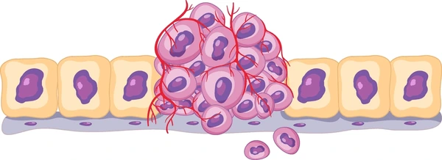
NEOPLASIA

Slide 2
NEOPLASIA
OVER VIEW
DEFINITION
DIFFERENCES BETWEEN BENIGN AND MALIGNANT NEOPLASM
EPIDEMIOLOGY AND FACTORS CAUSING NEOPLASM
MOLECULAR BASIS OF NEOPLASM (IN BREIF)

Slide 3
NEOPLASIA
Definition
Neoplasia means - New growth (“Neo” – New; “Plasia” – growth)
Abnormal mass of tissue formed as a result of excessive, uncoordinated, autonomous and purposeless proliferation of cells, even after removal of external stimuli – old definition
Modern era definition – genetic disorder of cell growth that is triggered by acquired or less commonly inherited mutations affecting a single cell and its clonal progeny – new definition

Slide 4
NEOPLASIA
Tumors arise from single cell which has acquired or inherited genetic abnormality – clonal in nature
Survival and growth advantage to the tumor cell
Genetic abnormality
Neoplasm
Tumor cell
Clonal in nature
Proliferation does not require growth stimuli
Oncology – study of tumors or neoplasms

Slide 5
NEOPLASIA
Parenchymal component
Responsible for classification of tumors and their biological behavior
Proliferating tumor cells
Tumors
Stromal component
Responsible for growth and spread of tumor
Fibrous connective tissue, blood vessels and inflammatory cells

Slide 6
NEOPLASIA
Tumors
Benign
Malignant

Slide 7
NEOPLASIA
Benign tumors
Nomenclature – suffix “oma
Mesenchymal tumors
Epithelial tumors
Nomenclature – attached to cell type
Eg-
Tumors of fibrous tissue –fibroma
Tumors of cartilage –chondroma
Tumors of smooth muscle - leiomyoma
Nomenclature – based on cell of origin, microscopic and macroscopic appearance
Eg-papilloma, adenoma, cystadenoma

Slide 8
NEOPLASIA
Malignant tumors
Epithelial tumors
Mesenchymal tumors
Carcinoma
Sarcoma
Nomenclature – based on cell of orgin, microscopic and macroscopic appearance
Eg-papillary carcinoma, adenocarcinoma, cystadenocarcinoma
Nomenclature – attached to cell type
Eg- fibrosarcoma, chondrosarcoma
When tumors are of unknown origin – undifferentiated tumors

Slide 9
NEOPLASIA
Some benign sounding neoplasms which are malignant are
Lymphoma
Melanoma
Mesothelioma
Seminoma

Slide 10
NEOPLASIA
Special categories of tumors are
Mixed tumors- two types of components in tumor
e.g. Pleomorphic adenoma, Adenosquamous carcinoma, carcinosarcoma
Teratoma – tumors made up of mixture of various tissue types derived from totipotent stem cells giving rise to three germ cell layers (ectoderm, mesoderm or endoderm)
Hamartomas- benign neoplasms consisting disorganized masses composed of cells indigenous to the involved tissue eg in lung mature differentiated tissue elements like cartilage, smooth muscle and epithelium
Choristoma- Heterotopic rests of normal tissue
e.g. Pancreatic tissue in the submucosa of the stomach

Slide 11
NEOPLASIA
Characteristic of tumors
Differentiation and anaplasia
Normal mucosa
Well differentiated
Moderately differentiated
Poorly differentiated

Slide 12
NEOPLASIA
Characteristic of tumors
Normal gland
Atypical gland lined by pleomorphic cells
Loss of polarity
Nucleoli
Atypical mitosis
Abnormal nuclear morphology
Pleomorphism
Local invasion
Other changes
Necrosis
hemorrhage
variation in nuclear size and shape
Increased nuclear cytoplasmic ratio (normal N:C ratio is 1:4 to 1:6, but in tumor cells it can be 1:1)
Hyperchromatic nuclei – coarse and clumped chromatin with prominent nucleoli

Slide 13
DIFFERENCES BETWEEN BENIGN AND MALIGNANT TUMOR
BENIGN TUMORS
MALIGNANT TUMORS
Boundaries
Encapsulated or well circumscribed
Poorly circumscribed or infiltrative
Surrounding tissue
Often compressed
Often invaded
Size
Small
Usually large
Secondary changes like necrosis
Occurs rarely
Occurs more often

Slide 14
DIFFERENCES BETWEEN BENIGN AND MALIGNANT TUMOR
Clinical and gross features | BENIGN | MALIGNANT
Boundaries | Encapsulated or well circumscribed | Poorly circumscribed or infiltrative
Surrounding tissue | Often compressed | Often invaded
Size | Small | Usually large
Secondary changes like necrosis | Occurs less often | Occurs more often

Slide 15
DIFFERENCES BETWEEN BENIGN AND MALIGNANT TUMOR
Microscopic features | BENIGN | MALIGNANT
Differentiation | Well differentiated – resembling tissue of origin | Poorly differentiated
Basal polarity | Retained | Often lost
Pleomorphism | Usually not present | Often present
Nucleo cytoplasmic ratio | Normal | Increased
Anisonucleosis | Absent | Present
Hyperchromatism | Absent | Often present
Mitosis | Atypical mitosis is absent | Atypical mitosis present
Chromosomal abnormalities | Infrequent | Invariably present

Slide 16
NEOPLASIA
FEATURES | BENIGN TUMORS | MALIGNANT TUMORS
Growth rate | Slow | Rapid
Local invasion | Often compresses the surrounding tissue without invading or infiltrating them | Usually infiltrates and invades the adjacent tissue
Metastasis | Absent | Frequently present
Prognosis | Good with only local complications | Bad with death due to local and metastatic complications

Slide 17
NEOPLASIA
Epidemiology of cancer
In 2018 – 9.5 million deaths caused by cancer
By 2030 – death rate due to cancer will increase to 21.4 millions
This increase is due to increase in age, population size and estimated cancer size
Most common cancers among
Men – prostate, lung, and colon and rectum
Women – breast, lung and colon and rectum

Slide 18
NEOPLASIA
Environmental factors affecting incidence of cancer are
Infectious agents –
HPV - causing carcinoma cervix and head and neck cancers
Hepatitis B virus – Hepatocellular carcinoma
EBV – lymphoma
Smoking – 90% of lung carcinoma, cancer of mouth, pharynx, larynx, esophagus, pancreas and bladder
Alcohol – carcinoma of oropharynx, larynx, esophagus and HCC
Diet – colorectal carcinoma, prostatic carcinoma, breast carcinoma
Obesity

Slide 19
NEOPLASIA
Environmental factors affecting incidence of cancer are
Reproductive history -
Exposure to estrogen without or unopposed by progesterone increases the risk of cancers of breast and endometrium
Environmental carcinogens – UV rays, Asbestos, drinking water with arsenic (particularly in Bangladesh)
Age –
As the age increases the incidence of carcinoma also increases
Due to accumulation of somatic mutations that accompanies the ageing of cells
Some cancers occurring in children are due to inherited mutations

Slide 20
HPV - causing carcinoma cervix and head and neck cancers
Hepatitis B virus – Hepatocellular carcinoma
EBV – lymphoma
Infectious agents
Smoking
90% of lung carcinoma, oropharyngeal cancer, cancer of larynx, esophagus, pancreas and bladder cancer
Environmental factors affecting incidence of cancer
Alcohol
carcinoma of oropharynx, larynx, esophagus and HCC
Diet
colorectal carcinoma, prostatic carcinoma, breast carcinoma
Obesity
Reproductive history
Exposure to estrogen without or unopposed by progesterone increases the risk of cancers of breast and endometrium
Environmental carcinogens
UV rays, Asbestos, drinking water with arsenic (particularly in Bangladesh)
As the age increases the incidence of carcinoma also increases
Due to accumulation of somatic mutations that accompanies the ageing of cells
Some cancers occurring in children are due to inherited mutations
Age

Slide 21
NEOPLASIA
Chronic inflammatory disorders
Acquired predisposing conditions
Precursor lesions
Acquired conditions that predispose to cancer
Immunodeficiency states

Slide 22
NEOPLASIA Acquired predisposing conditions
Chronic inflammation
Increased pool of tissue stem cells which are susceptible for transformation
Activated immune cells
ROS
Inflammatory mediators
Tissue injury
Damage DNA
Promote cell survival even in the face of genomic damage
Compensatory proliferation of cells that serves to repair the damage
NEOPLASM
H.Pylori gastritis causing gastric carcinoma

Slide 23
NEOPLASIA Acquired predisposing conditions Precursor lesions
Defined as localized morphologic changes in the epithelium that is at increased risk for malignant transformation
These changes are
Hyperplasia eg – endometrial hyperplasia
Metaplasia eg – Barrets esophagus
Benign tumors – villous adenoma can progress to cancer in 50% of cases

Slide 24
NEOPLASIA Acquired predisposing conditions
Immunodeficiency conditions
Conditions particularly with deficits of T cell immunity are at increased risk for cancer especially with oncogenic virus
Eg – virus associated with lymphoma, certain carcinomas and sarcomas

Slide 25
NEOPLASIA
Genetic alterations
Genetic damage caused by environmental exposures (by viruses or environmental chemicals or by endogenous products of cellular metabolism such as ROS
Tumor is formed by the clonal expansion of single precursor cell that has increased genetic damage
Alterations in these DNA are heritable
Molecular basis of cancer
Epigenetic alterations

Slide 26
NEOPLASIA Genetic alterations
Primary targets of cancer causing mutations are four classes of genes
Protooncogenes (Growth promoting)– gain of function mutations
Tumor suppressor genes (Growth inhibiting) – loss of function mutations and both alleles must be damaged
Apoptosis regulating genes (regulate programmed cell death) – gain of function mutations in genes which suppress apoptosis and loss of function mutations which promote cell death
DNA repair genes- loss of function mutations impairs impairs the ability of cell to recognize and repair non-lethal genetic damage

Slide 27
NEOPLASIA
Cancer hall mark – phenotypic characteristic of malignant neoplasm such as excessive growth, local invasiveness and the ability to form distant metastasis
Driver mutations – mutations that contribute to the acquisition of cancer hallmarks
First driver initiating mutation that starts a cell on the path to malignancy – initiating mutations, which is typically maintained in the cells of subsequent cancer
Loss of function mutations in genes that maintain genomic integrity will be the common early step in the development of malignancy

Slide 28
NEOPLASIA
However single mutation does not transfer cell into malignant cells and requires additional driver mutations
Genomic instability increases the likelihood of acquiring driver mutations
It also increases the frequency of mutations that have no phenotypic consequence – “passenger mutations” which are more common than driver mutations
By the time cell transforms into malignant cell – it acquires hundreds or even thousands of passenger mutations and all driver mutations

Slide 29
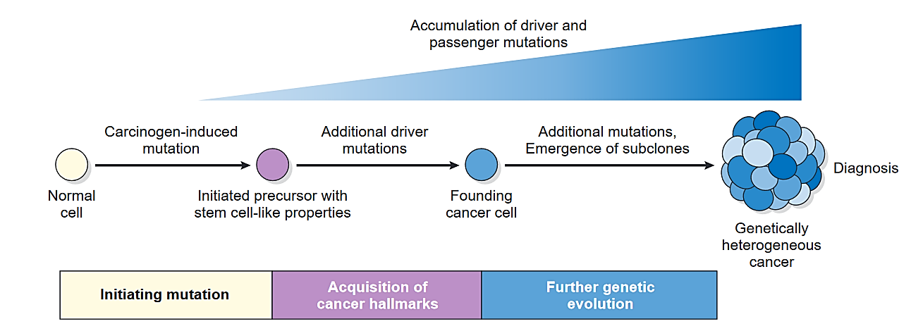
NEOPLASIA PROTO-ONCOGENES
Carcinogenesis results from the accumulation of complimentary mutations in a step wise manner

Slide 30
NEOPLASIA
Other gene mutations that contribute to tumorigenesis by interfering with host immune response or altering interactions with the stroma or by other mechanism – not classified into driver and passenger mutations
All the cells in tumor have same genetic alterations – as the progeny is from single transformed cell
Tumor presents clinically when it attains mass of 1g or 10 ⁹ cells and would have gone through a minimum of 30 cell doubling

Slide 31
NEOPLASIA
During expansion, individual tumor cells acquire additional mutations at random
As a result – tumor has cells with extremely heterogenous genetic alterations
These diverse clones compete for nutrients and microenvironmental niches and those that are more fit (Darwinian struggle) dominate the tumor mass
This tendency of tumor to become more aggressive is referred to as tumor progression

Slide 32
NEOPLASIA
In tumor two types of mutations were identified –
Mutations that are present in all tumor cells – present in founding cells at the moment of transformation
Mutations that are unique to a subset of tumor sites which are acquired after transformation during growth
In addition to DNA mutations, epigenetic aberrations also contribute to malignant properties of cancer cells

Slide 33
NEOPLASIA
Epigenetic alterations
Epigenetic modifications include
DNA methylation – which tends to silence the gene expression
Modification of histones, that packs the DNA into chromatin
Epigenetic state of cell determines which gene to be expressed, which in turn determines the lineage commitment and differentiation state of both normal and neoplastic cells

Slide 34
NEOPLASIA
Cellular and molecular hallmark of cancer
All the cancers display 8 fundamental changes in cell physiology, which are considered the hall mark of cancer. These changes are
Self sufficiency in growth signals - tumors cells proliferate without external stimulus, usually as a consequence of oncogene activation
Insensitivity to growth-inhibiting signals – tumors does not respond to molecules that inhibit the proliferation of normal cells, because of inactivation of tumor suppressor genes that encode components of growth inhibitory pathway
Evasion of apoptosis – tumor cells are resistant to apoptosis

Slide 35
NEOPLASIA
Cellular and molecular hallmark of cancer
Altered cellular metabolism – tumors undergo a metabolic switch aerobic glycolysis, called the “Warburg effect” which enables the synthesis of macromolecules and organelles needed for rapid cell growth
Limitless replicative potential (immortality)- tumor cells have stem cell like property that permits tumors cells to avoid- cellular senescence and mitotic catastrophe
Sustained angiogenesis – tumor induces angiogenesis as tumor cells require nutrients and O2
Ability to invade and metastasize
Ability to evade the host immune response

Slide 36
THANK YOU

