Slide 1
MALE GENITAL SYSTEM
Dr.V.Shanthi
Associate Professor, Pathology
Sri Venkateswara Institute of Medical Sciences
Tirupathi

Slide 2
MALE GENITAL TRACT- PENIS
Congenital anomalies
Hypospadias
Epispadias
Phimosis
Inflammation
Tumors
Notes:
Malformation of urethral groove and canal may create an abnormal opening on the ventral or dorsal surface of penis
Orifice of prepuce is small for normal retraction of penis – produces recurrent infections and scarring

Slide 3
MALE GENITAL TRACT
Tumors of the penis
They include
Benign tumor
Carcinoma in situ
Malignant tumors

Slide 4
BENIGN TUMOR
Condyloma Acuminatum
Benign epithelial proliferation caused by Human Papilloma virus especially 6 & 11
Modes of transmission – sexual contact
Site – moist mucocutaneous genital surface or perineal areas

Slide 5
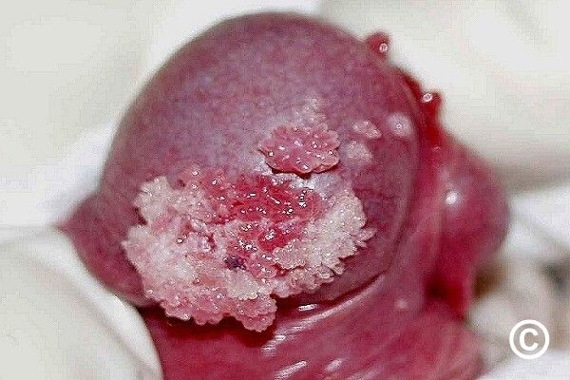
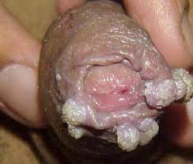
CONDYLOMA ACCUMINATUM
Gross –
Single or multiple and sessile or pedunculated red papillary excrescences, often involving the coronal sulcus or inner surface of the prepuce
Size – several millimetres in diametre

Slide 6
CONDYLOMA ACCUMINATUM
Microscopic examination –
Branching stromal papillae covered by hyperplastic stratified squamous epithelium, often associated with prominent hyperkeratosis
Peinuclear cytoplasmic vacuolation of superficial epithelial cells (koilocytosis) is common
Maturation of epithelial cells is orderly, in contrast to carcinoma insitu

Slide 7
Condyloma Acuminatum papillary architecture

Slide 8
Condyloma Acuminatum koilocytosis

Slide 9
Carcinoma-in-situ
Indicates cytologic evidence of malignancy confined to epithelium
Variants include –
Bowen disease
Erythroplasia of queyrat
Bowenoid papulosis

Slide 10
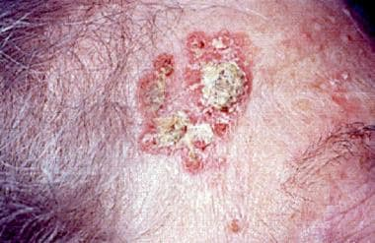
Carcinoma-in-situ BOWEN DISEASE
Age - more than 35 years
Site – shaft of penis or scrotum of older men
Presents as thickened, gray white plaque

Slide 11
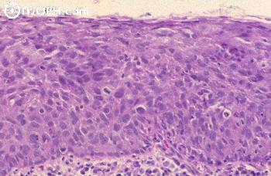
Carcinoma-in-situ BOWEN DISEASE
Microscopic features –
Marked epithelial atypia with complete loss of normal surface maturation but no invasion of underlying stroma
Transition to SCC – 10 % of cases
Possible association with visceral malignancy

Slide 12
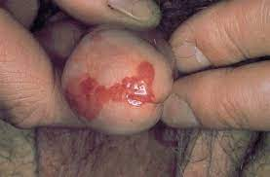
CARCINOMA-IN-SITU
ERYTHROPLASIA OF QUERAT
Present as – single or multiple, shiny red, some times velvety plaque on the glans and prepuce
Histologically similar to Bowens disease
No association with visceral malignancy

Slide 13
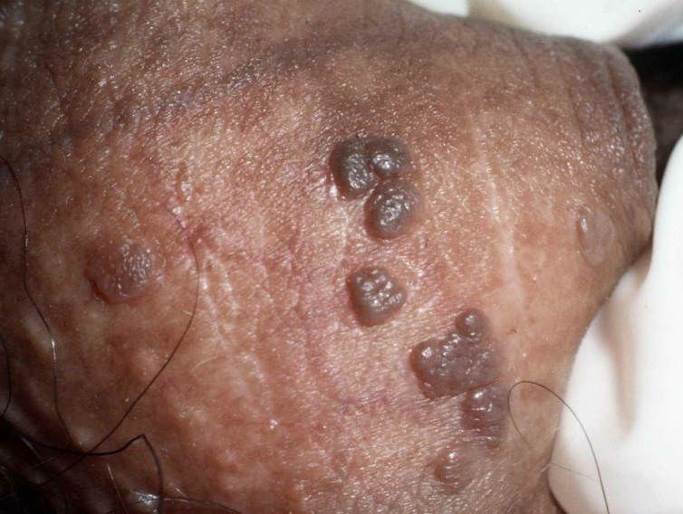
CARCINOMA-IN-SITU BOWENOID PAPULOSIS
Presents as multiple, pigmented papular lesions on external genitalia
Mimics condyloma accuminata grossly
Age – younger than those with Bowens disease
Histologically similar to Bowens disease but evolution into invasive carcinoma is rare

Slide 14
MALIGNANT TUMORS
SQUAMOUS CELL CARCINOMA
Accounts for 1% of cancers in men in US and 10% to 20% of men in Asia, Africa and South America
Prevalence is higher in regions where circumcision is not routinely practiced
Most cases are seen between the ages of 40 & 70 years
Causes – carcinogens with in smegma accumulating under the foreskin and HPV types 16 & 18

Slide 15
SQUAMOUS CELL CARCINOMA
Grossly presents as epithelial thickening on the glans or inner surface of the prepuce, progressing to ulcero infiltrative or exophytic growth eroding penile tip, shaft or both
Presents as
fungating cauliflower like
Flat – indurated lesions
Large verruciform/ papillary lesions

Slide 16
SQUAMOUS CELL CARCINOMA
Histologically similar to cutaneous SCC
Clinical course is characterized by slow growth, with metastasis to regional lymph nodes
WHO classified SCC as HPV related and non-HPV related
Verrucous carcinoma, a non-HPV related variant also called Giant condyloma or Buschke lowenstein tumor, is an uncommon well differentiated form of SCC with low malignant potential
Basaloid carcinoma – HPV related variant with small cells having aggressive course

Slide 17
MALIGNANT TUMORS
SQUAMOUS CELL CARCINOMA
Non –HPV related SCC
HPV related SCC
Squamous cell carcinoma –usual type
Pseudohyperplastic carcinoma
Pseudoglandular carcinoma
Verrucous carcinoma
Carcinoma cuniculatum
Papillary carcinoma NOS
Adenosquamous carcinoma
Sarcomatoid squamous cell carcinoma
Mixed SCC
Basaloid squamous cell carcinoma
Papillary basaloid carcinoma
Warty carcinoma
Warty basaloid carcinoma
Clear cell carcinoma
Lymphoepithelioma like carcinoma

Slide 18
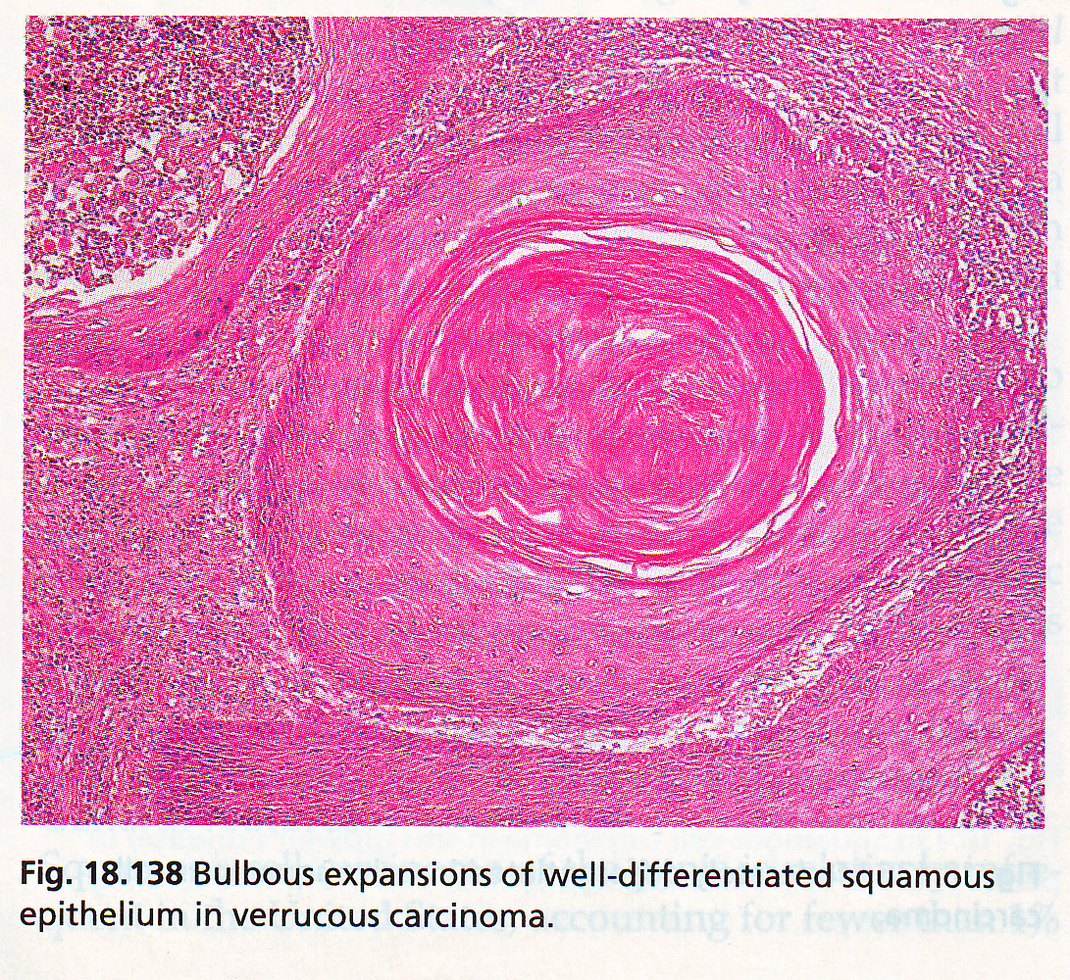
SQUAMOUS CELL CARCINOMA

Slide 19
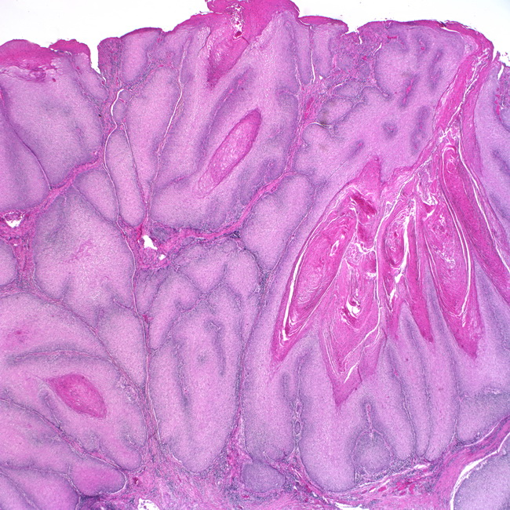
Verrucous carcinoma

Slide 20
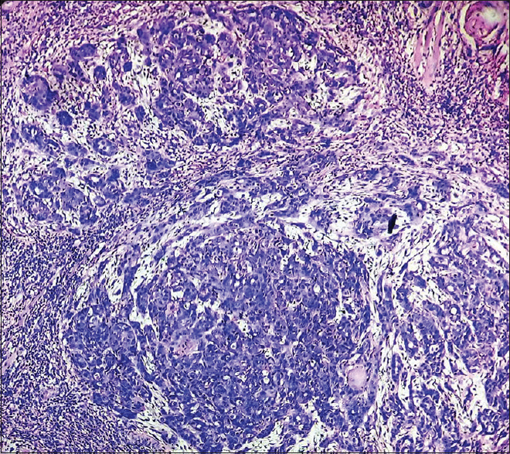
BASALOID CARCINOMA

Slide 21
Thank you

