Slide 1
Adenocarcinoma prostate
Dr.V.Shanthi
Associate Professor, Pathology
Sri Venkateswara Institute of Medical Sciences
Tirupathi

Slide 2
PROSTATE
Prostate is a retroperitoneal organ with anatomically 4 distinct zones i.e. the peripheral, central, transitional, and periurethral zones
Histologically the glands are characteristically lined by two cell layers i.e. a basal layer of low cuboidal epithelium, covered by a layer of columnar secretory cells

Slide 3
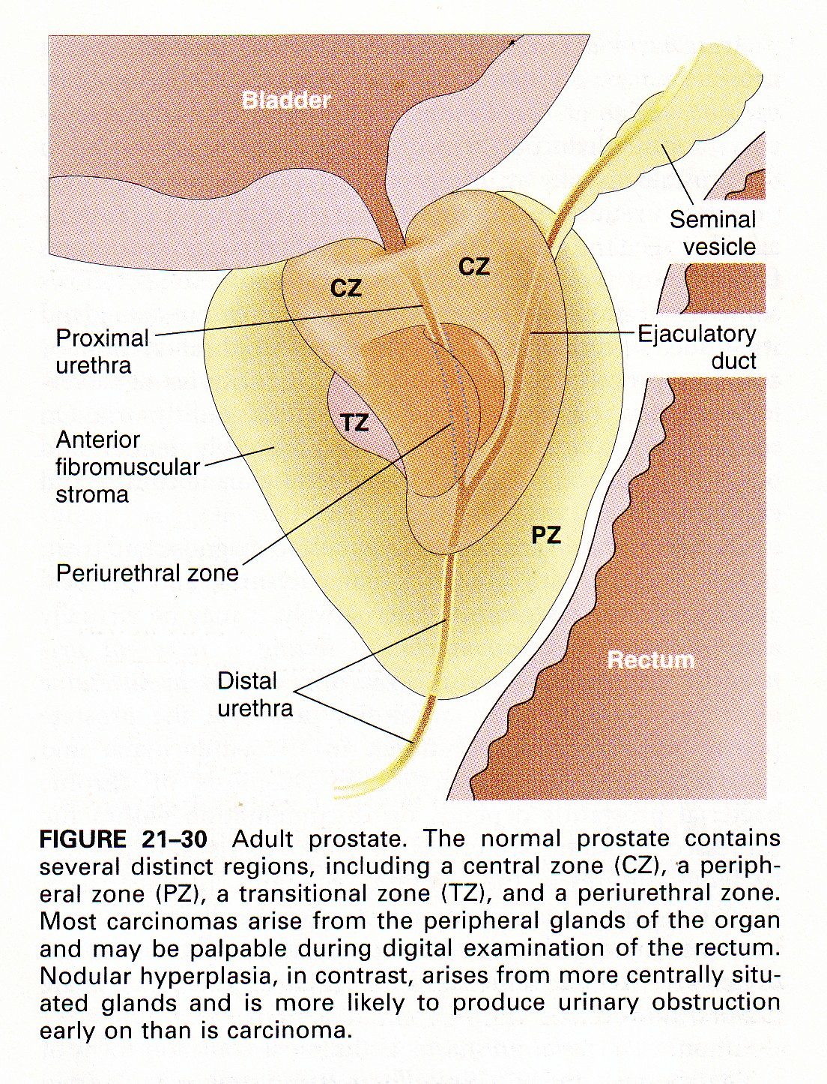
PROSTATE

Slide 4
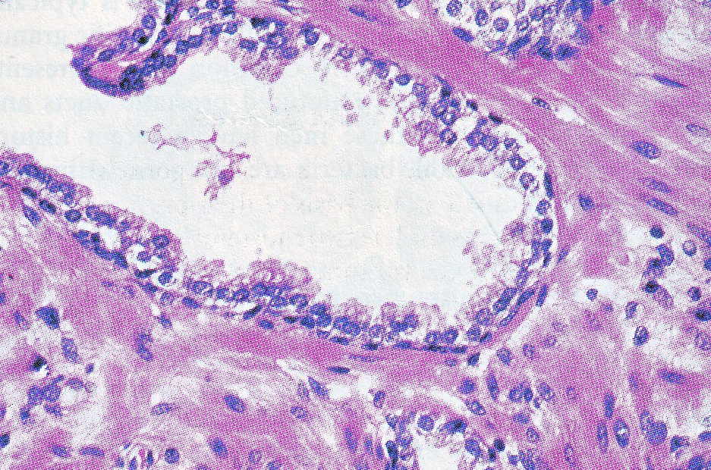
PROSTATE

Slide 5
PROSTATE
Three pathologic processes which involve prostate are –
Inflammation
Benign prostatic hyperplasia
Tumors

Slide 6
PROSTATE BENIGN ENLARGEMENT
This is referred to as Nodular hyperplasia
Commonest age – men over 50 years
It is characterized by hyperplasia of prostatic stromal and epithelial cells, resulting in the formation of large, fairly discrete nodules in the periurethral region of the prostate
Nodules compress and narrow the urethral canal & cause obstruction of the urethra

Slide 7
PROSTATE BENIGN ENLARGEMENT
Pathogenesis
Dihydrotestosterone (DHT), a metabolite of testosterone is the mediator of the prostatic growth & is 10 times more potent
Circulating testosterone
5 Alpha reductase
Dihydroxytestosterone
Enzyme is localized in the stromal cells and not in epithelial cells

Slide 8
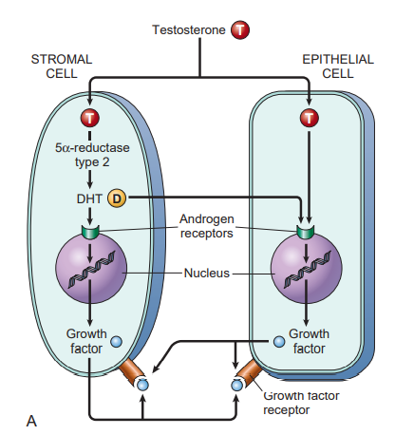
PATHOGENESIS OF BPH
Notes:
Binding of DHT stimulates Ars to translocate from the cytoplasm to the nucleus and activates the transcription of androgen dependent genes which encodes several growth factors and their receptors

Slide 9
PATHOGENESIS OF BPH
Important upregulated factors are members of Fibroblast growth factor (FGF) family and transforming growth factor β (TGF β)
FGFs are paracrine regulators and stimulate epithelial proliferation
TGF β mitogen for fibroblast and other mesenchymal cells

Slide 10
PROSTATE BENIGN ENLARGEMENT
Morphology
Prostatic enlargement occurs
Hyperplasia starts in the transition zone
First nodules are composed entirely of stromal cells
Later predominantly epithelial nodules arise
Grossly on cut section the tissue is yellow pink with a soft consistency & a milky white prostatic fluid oozes out of these areas

Slide 11
BENIGN PROSTATIC HYPERPLASIA

Slide 12
PROSTATE BENIGN ENLARGEMENT
Microscopically
Nodularity in prostatic hyperplasia is due to glandular proliferation or dilatation and due to fibrous or muscular proliferation of the stroma
Glandular proliferation takes the form of aggregations of small to large to cystically dilated glands, lined by two layers , an inner columnar & an outer cuboidal or flattened epithelium based on an intact basement membrane

Slide 13
BENIGN PROSTATIC HYPERPLASIA

Slide 14
PROSTATE BENIGN ENLARGEMENT
Microscopically
Two other histologic changes associated with Benign Prostatic Hyperplasia are –
a. foci of squamous metaplasia
b. small areas of infarction

Slide 15
PROSTATE BENIGN ENLARGEMENT
Clinical course
Symptoms of nodular hyperplasia are –
Compression of the urethra
Retention of urine in the bladder
Subsequent distention and hypertrophy of bladder
Infection of the urine and development of cystitis and renal infection
Hydronephrosis & azotemia & uremia

Slide 16
ADENOCARCINOMA PROSTATE
Adenocarcinoma of the prostate is the most common form of cancer in the men and the second leading cause of cancer death
This is typically a disease of men over the age of 50 years
Screening is recommended from the age of 40 years
Notes:
First being lung cancer

Slide 17
ADENOCARCINOMA PROSTATE
Etiology
Several risk factors such as
Age – risk increases to 20% in men in the age of 50’s and 70% in men between the ages of 70 & 80 years
Race uncommon in the Asians & common among the whites in the united states
Hormone levels – androgens play a role
Environmental influences
Genetic factors

Slide 18
ADENOCARCINOMA PROSTATE
Environmental factors
Exposure to carcinogens, estrogens and oxidants
Damage prostatic epithelium
Acquisition of genetic and epigenetic changes by epithelial cells
Development of carcinoma
Notes:
Epigenetic changes are modifications to DNA that regulate whether genes are turned on or off. These modifications are attached to DNA and od not change the sequence of DNA building blocks

Slide 19
ADENOCARCINOMA PROSTATE
Environmental factors
Dietary components like charred red meat and animal fats
Formation of carcinogenic heterocyclic aromatic amines and polycyclic aromatic hydrocarbons
Detoxifies
Glutathione-S-transferase
Polymorphism in GSTP1 is seen in prostatic carcinoma
Creates oxidant stress in prostatic epithelium
Cell injury and inflammation

Slide 20
ADENOCARCINOMA PROSTATE
Men with first degree relatives affected by disease have 2 folds increased risk
Important genes involved
Amplification MYC oncogene
Chromosomal rearrangement juxta positioning of ETS family transcription factor gene next to androgen regulated TMPRSS2 promoter producing TMPRSS-ETS fusion gene leading to its overexpression
Silencing of gene encoding p27, an inhibitor of cyclin dependent kinase
Deletion of PTEN
Loss of TP53
Deletions of RB
Amplifications of AR gene

Slide 21
ADENOCARCINOMA PROSTATE
Effects of androgens
Androgens – required for growth and survival of prostate cancer cells
Therapeutic castration or treatment with antiandrogens can induce disease regression

Slide 22
ADENOCARCINOMA PROSTATE
Effects of androgens
Tumors escape this by variety of mechanisms like
AR gene amplification – hypersensitivity to low levels of androgens
Ligand independent AR activation
Mutations in AR that allows it activation by non-androgen ligands
Mutations that activate alternate signaling pathway and bypass the need for AR

Slide 23
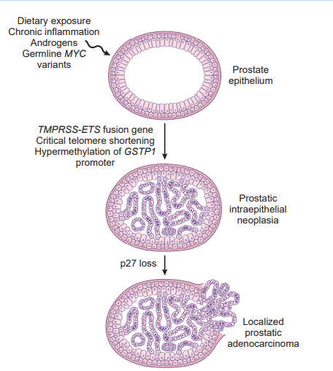
ADENOCARCINOMA PROSTATE

Slide 24
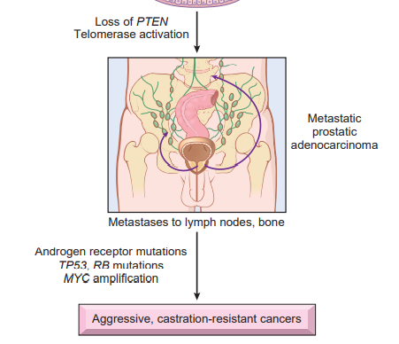
ADENOCARCINOMA PROSTATE

Slide 25
ADENOCARCINOMA PROSTATE
Prostatic intraepithelial neoplasia
Low grade high grade
Low grade – ducts and acini are composed of crowded irregularly spaced epithelial cells with variably sized nuclei
Cells may have small round to oval nuclei
High grade – may have papillary, cribriform, or flat architecture
Cells have enlarged nuclei with prominent nucleoli
PIN – basal cells & intact basement membrane

Slide 26
ADENOCARCINOMA PROSTATE
Morphology
70% of prostate cancer arises in the peripheral zone of the gland, classically in a posterior location
C/S – tumor is firm to gritty but when embedded within the prostatic substance, it may be extremely difficult to visualize & be more apparent on palpation

Slide 27
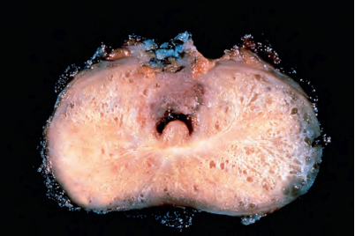
ADENOCARCINOMA PROSTATE

Slide 28
ADENOCARCINOMA PROSTATE
Histologically
Neoplastic glands are typically smaller than benign glands and are lined by a single uniform layer of cuboidal or low columnar epithelium
Cancer glands are typically crowded characteristically lacking branching and papillary infolding
The outer basal layer of cells are absent
The cells have large nuclei with prominent nucleoli and with pale to clear cytoplasm

Slide 29
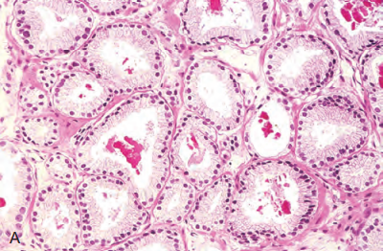
ADENOCARCINOMA PROSTATE

Slide 30
ADENOCARCINOMA PROSTATE

Slide 31
ADENOCARCINOMA PROSTATE

Slide 32
ADENOCARCINOMA PROSTATE
Gleasons Grading System
Grade 1 - circumscribed nodule of uniform, closely packed neoploastic glands ( considered now as adenosis)
Grade 2 – focally infiltrative glandular proliferation composed of more loosely arranged neoplastic glands
Grade 3 – infiltrative glandular proliferation composed of variably sized neoplastic glands that may form a cribriform pattern
Grade 4 – proliferation of fused and irregular glands with infiltrative growth pattern. Hypernephroid cells.
Grade 5 – infiltrating tumor composed of individual or solid masses of neoplastic cells often shows comedonecrosis

Slide 33
ADENOCARCINOMA PROSTATE

Slide 34
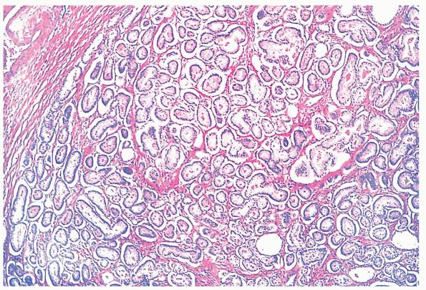
GLEASON GRADE 1

Slide 35
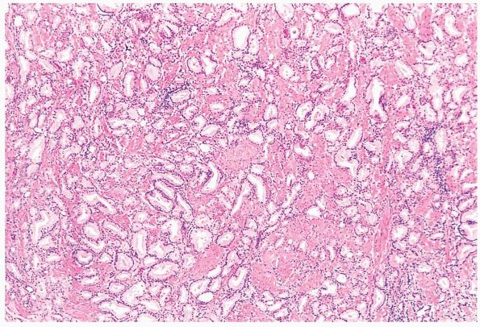
GLEASON GRADE 2

Slide 36
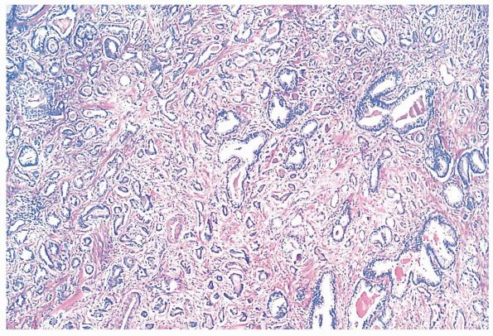
GLEASON GRADE 3

Slide 37
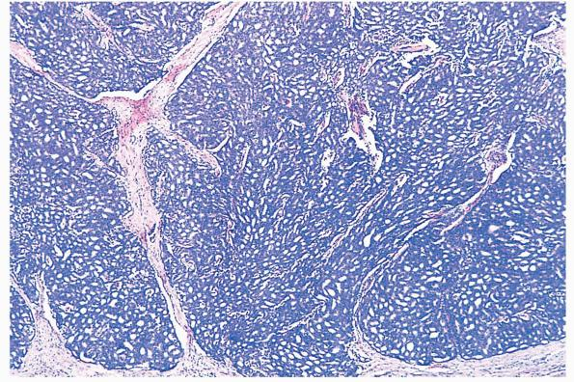
GLEASON GRADE 4

Slide 38
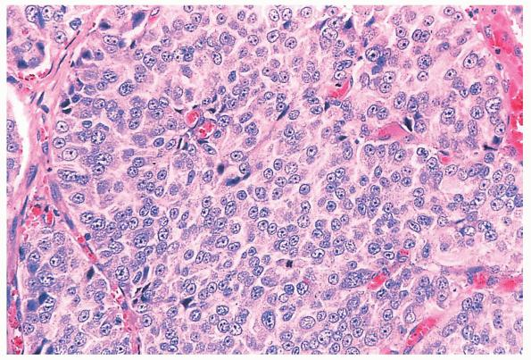
GLEASON GRADE 5

Slide 39
ADENOCARCINOMA PROSTATE
Gleasons score is the sum of the two most prevalent patterns i.e. Gleasons pattern 3 and 4 would have Gleason score of 7
If only one pattern is present it is multiplied by 2
Gleason score 2-4 – well differentiated ca.
Gleason grade 5-6 – intermediate grade cancer
Gleason grade 7 – moderate to poorly differentiated cancer
Gleason grade 8 – 10 – high grade cancer

Slide 40
ADENOCARCINOMA PROSTATE
Grading system includes 5 distinct grade groups based on the modified Gleason score group
Grade group 1 = Gleason score ≤ 6
Grade group 2 = Gleason score 3 + 4
Grade group 3 = Gleason score 4 + 3
Grade group 4 = Gleason score 4 + 4
Grade group 5 = Gleason score 9 and 10

Slide 41
ADENOCARCINOMA PROSTATE
Spread occurs through direct local extension & through blood stream and lymph
Local extension – seminal vesicles & base of the bladder , urethral obstruction
Hematogenous spread – axial skeleton but some times widely spread to viscera
Bone metastasis are typically osteoblastic
Bones involved are lumbar spine, proximal femur, pelvis, thoracic spine and ribs
Lymphatic spread – obturator lymphnodes, perivescical, hypogastric, iliac, presacral & para aortic lymphnodes

Slide 42
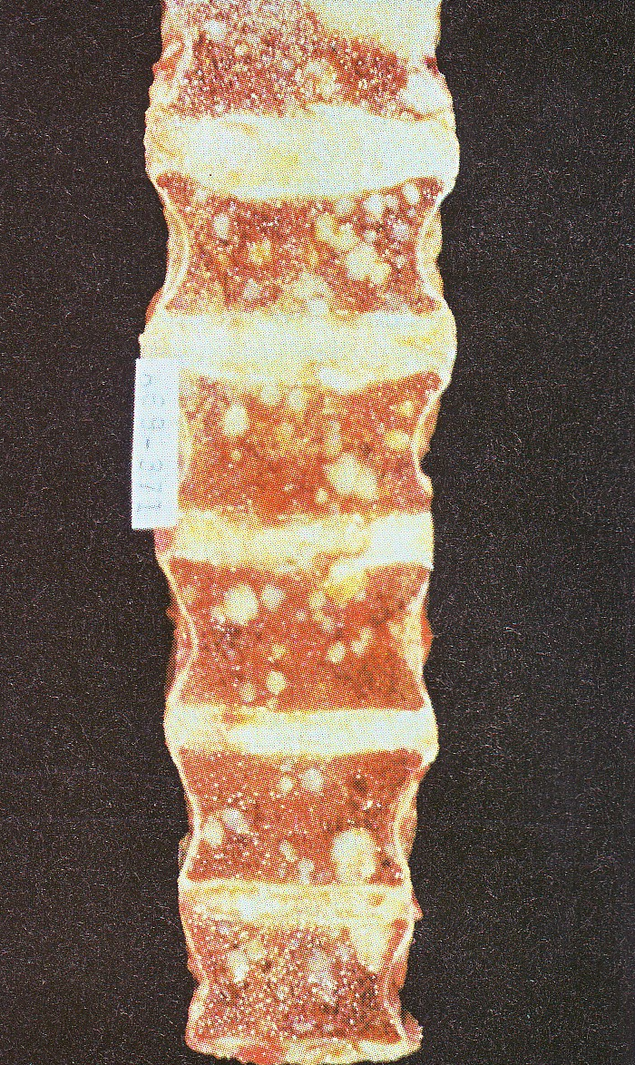
ADENOCARCINOMA PROSTATE

Slide 43
ADENOCARCINOMA PROSTATE
Primary tumor staging
pT 1 – cancer found incidentally in trans urethral resection for BPH
pT 2 – organ confined cancer
pT 3 – extra prostatic extension with or without seminal vesicle involvement
pT 4 – direct invasion of contagious organs

Slide 44
ADENOCARCINOMA PROSTATE
Clinical course
Nodule on rectal examination & elevated PSA level
PSA is a product of prostatic epithelium and is normally secreted in the semen
Serum level of more than 4 ng/ml is abnormal
PSA is organ specific but not cancer specific
Serial measurement of PSA is useful in assessing response to therapy

Slide 45
ADENOCARCINOMA PROSTATE
Treatment
Radical prostatectomy
Advanced metastatic carcinoma – endocrine therapy i.e depriving tumor cells of testosterone by orchidectomy & by administering synthetic agonists of lutenizing hormone

Slide 46
THANK YOU

