Slide 1

Xenobiotics
Dr .Thenmozhi Ravikumar
Junior Resident
SVIMS, Tirupathi.

Slide 2
Contents :
Introduction
Metabolism of Xenobiotics
Phase I reaction
Phase II reaction
Cytochrome P450
Toxic effects to xenobiotics
Summary

Slide 3
Xenobiotics
In Greek, Xenos = “Stranger / foreign”
Definition : A xenobiotics is a compound that is foreign to the body, that are not normally produced by humans.
Xenobiotics can produce a variety of biological effects including
Pharmacological responses
Toxicity
Immunologicol responses
Carcinogenic effects

Slide 4
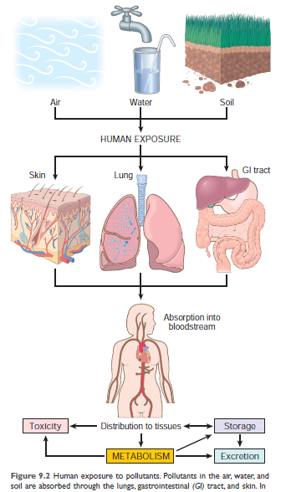

Slide 5
Knowledge of the metabolism of xenobiotics is essential for an understanding of pharmacology, therapeutics, and toxicology.
Types of xenobiotics :
Exogenous | Endogenous
Drugs | Bilirubin
Food additives | Bile acids
Pollutants | Steroids
Insecticides
Carcinogens

Slide 6
Understanding the mechanisms involved in xenobiotic metabolism will permit the development of transgenic microorganisms and plants.
Can be used to render potentially hazardous pollutants harmless.

Slide 7
CHARACTERISTICS :
Penetrate membrane by diffusion
Transported by lipoproteins in blood
Require chemical conversion to facilitate excretion
Lipophilic

Slide 8
Biotransformation Reactions: A process by which a substance is changed to another chemical by a chemical reaction within the body.
Consequences :
  Changes in solubility characteristics
  Detoxification
  Metabolic activation

Slide 9
These reactions maybe :
Desirable:
  as in the activation of a prodrug to the active compound.
Undesirable:
  as in the formation of a carcinogen or mutagen from an inert precursor.

Slide 10
Potentially toxic xenobiotics
          Detoxification
  Inactive metabolite
Prodrug
      Metabolic activation
  Reactive metabolite

Slide 11
Detoxification reaction:
Biochemical reaction involved in the conversion of foreign toxic and water insoluble molecules to nontoxic, water soluble and excretable form.
Purpose :
Converts lipophilic to hydrophilic compounds
facilates excretion

Slide 12
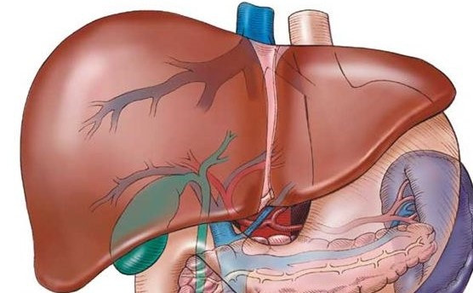
Role of liver :
Major organ involved
Heptaocytes contain wide variety of enzymes to process xenobiotics
Enzymes are present in endoplasmic reticulum and to lesser extent in other organelles
Each enzyme represents a large family of gene product
Each gene product maybe induced by different xenobiotics .

Slide 13
Metabolism of Xenobiotics
Two phases of metabolism:
Phase I | Phase II
Alteration of xenobiotics molecule so as to add a functional group which can be conjugated in phase2 | Compounds produced in phase1 are converted by specific enxymes to various polar metabolites by conjugation. They become more water soluble and excretable form
Oxidation, reduction , hydrolysis, deamination, dehalogenation, desulfuration, epoxidation,peroxygenation | Glucuronic acid, sulfate, acetate, glutathione, certain amino acids, by methylation.

Slide 14
Phase I reaction:
Oxidation
Reduction
Hydrolysis
They are also called hydroxylation reactions , since they introduce or expose a functional group (eg: -OH) that serves as active centres for sequential conjugation in a phase II reaction.

Slide 15
Phase II:
Conjugation
Phase 2 reaction prepare xenobiotics for excretion
It involves covalent attachment of small polar endogenous molecule such as glucuronic acid , sulfate or glycine to form water soluble compounds.
Conjugation reactions can occur independently or can follow phase I ( hydroxylation) reactions.

Slide 16
Conjugation takes primarily in liver but can occur in kidney also.
By the end of conjugation , the products are rendered non-toxic
Glucuronidation is the most frequent conjugation reaction.
With the exception of glutathione conjugation, most conjugation reactions involving xenobiotics are secondary, involving, as substrates, the products of phase I reactions.

Slide 17
At least 8 different conjugating agents have been identified in the body.
  Glucuronic acid,
  Glycine,
  Cysteine,
  Glutamine,
  Methyl group,
  Sulfate,
  Acetic acid and
  Thiosulfate.

Slide 18
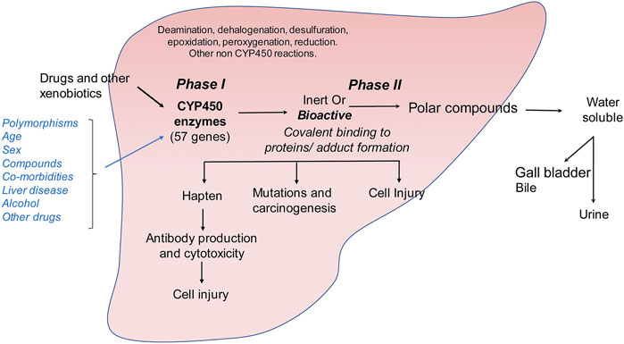
This Photo by Unknown Author is licensed under CC BY

Slide 19
Phase I phase II
  Oxidation Conjugation
  Reduction conjugated drugs are
  And/ or hydrolysis usually inactive

Slide 20
Following phase1 , the drug/carcinogen maybe activated or unchanged or most often inactivated.
Some drugs directly enter phase 2 metabolism.

Slide 21
1.Oxidation :
Oxidation of alcohols : primary aliphatic and aromatic alcohols are oxidized to corresponding acids
Eg:
Methanol formaldehyde Formic acid
Ethanol acetaldehyde Acetic acid
2.Reduction:
Para nitro phenol para aminophenol
3.Hydrolysis :
Aspirin + H₂O Salicylic acid + acetic Acid

Slide 22
Phase I reaction enzymes:
Mainly catalyzed by a class of enzymes referred to as monooxygenases, mixed function oxidases or cytochrome P450s.
Other enzymes of significance are
  Aldehyde and alcohol dehydrogenase
  Deaminases
  Estrases
  Epoxide hydrolases

Slide 23
Properties of human cytochrome P450s:
Involved in phase I of the metabolism of innumerable xenobiotics
Involved in the metabolism of many endogenous compounds
They catalyze reactions involving introduction of one atom of oxygen into the substrate and one into water

Slide 24
There are atleast 57 genes for Cyt P450 genes in human genome
CYP system also known as mixed function oxidase system since as it involves both oxidation and reduction.
CYP functions as the terminal oxidase in the electron transport chain.

Slide 25
Why the number 450??

Slide 26
Numbered so because.....
Originally discovered when it was noted that preparations of microsomes that had been chemically reduced and then exposed to carbon monoxide had an absorption peak at 450 nm.

Slide 27
All are haemoproteins
Exhibit broad substrate specificity, thus act on many compounds
Extremely versatile catalyst, about 60 types of reactions

Slide 28
Liver contains highest amounts , but found in most if of all tissues including small intestine , brain and lung.
Located in smooth endoplasmic retinaculum

Slide 29
Molecular weight 55kDa
Many are inducible ,resulting drug interactions
Many are inhibited by various drugs or their metabolic providing another cause of drug interactions.

Slide 30
Some exhibit genetic polymorphism which can result in atypical drug metabolism
At least half of the common drugs that we ingest are metabolized by isoforms of cytochrome P450.

Slide 31
Nomenclature for the cytochromes P450
It is a systematic nomenclature
Based on their amino acid sequence homology.
Terminologies :
  Root,
  Family,
  Subfamily,
  Individual

Slide 32
Eg: CYP1A1, CYP2A6
The Root - CYP denotes a cytochrome P450.
1- designating the family;
cytochromes P450 are included in the same family if they exhibit >40% amino acid sequence identity.
Capital letter A indicating the subfamily; P450s are in the same subfamily if they exhibit > 55% sequence identity.
1- individual of the subfamily

Slide 33
The major cytochromes P450 involved in drug metabolism are CYP1 (with 3 subfamilies),
CYP2 (13 subfamilies), and CYP3 (1 subfamily).
The various cytochromes P450 have overlapping substrate specificities, so that a very broad range of xenobiotics can be metabolized by one or other of the enzymes.

Slide 34
Induction of cytochrome P450 underlies drug interactions, when the effects of one drug are altered by administration of another.
For example: warfarin is metabolized by CYP2C9, which is induced by phenobarbital
Induction of CYP2C9 will increase the metabolism of warfarin, so reducing its efficacy, so that the dose must be increased.

Slide 35
The P-450 system catalyzes reactions that either detoxify xenobiotics or, less commonly, convert xenobiotics into active compounds that cause cellular injury.

Slide 36
CYP2E1 catabolizes the metabolism of some widely used solvents and compounds found in tobacco smoke, many of which are pro-carcinogens; it is induced by ethanol, so increasing the risk of carcinogenicity.
It is also called as MEOS- microsomal ethanol oxidizing system

Slide 38
Naturally occurring compounds in foods may also affect cytochrome P450.
Grapefruit contains a variety of furanocoumarins, which inhibit cytochrome P450
It affect the metabolism of many drugs

Slide 39
Aflotoxin B1 to 8,9- epoxide is an example of making an active metabolite by CYP450.

Slide 40
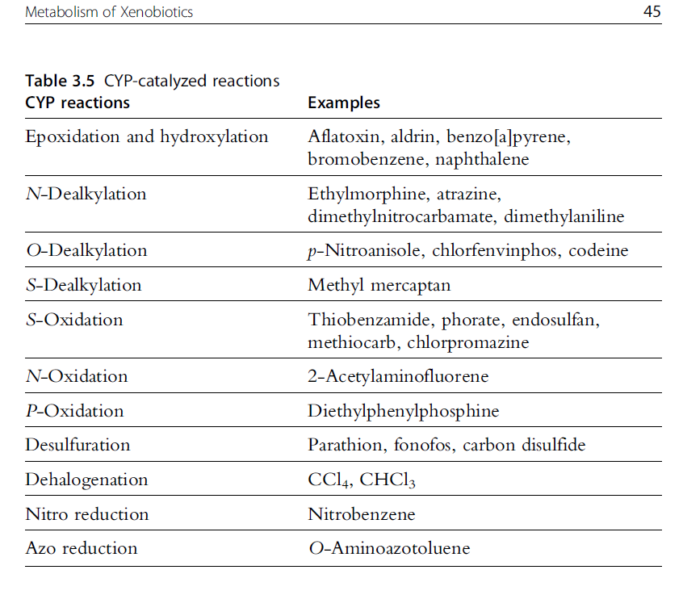

Slide 41
Polymorphism of cytochromes P450 may explain much of the variation in xenobiotic responses by different patients

Slide 42
FLAVIN CONTAINIMG MONOOXYGENASES
FMOs are microsomal enzymes, monooxygenases requiring NADPH and oxygen, and existing as multiple isoforms in various tissues.
FMO is found in highest levels in the liver but is also found in significant levels in the lung and kidney

Slide 43
Unlike CYPs, catalyze only oxygenation reactions, have more specific substrate requirements, and are not known to be subject to induction or inhibition by xenobiotics, apart from competitive inhibition by alternate substrates.
The mechanism of catalysis is also distinct in that electrons are transferred directly from NADPH, and not via an NADPH reductase.

Slide 44
There are five types of FMO’s were reported.
In humans, there is a switch around birth from the predominately fetal FMO1 to the predominately adult FMO3.
FM03 is important in the metabolism of several pharmaceuticals and xenobiotics including the chemotherapeutic drugs.

Slide 45
ELIMINATION
Just as wastes from normal metabolic processes are excreted in the urine, feces, and exhaled air, xenobiotics and their metabolites are also excreted from the kidneys, liver, and lungs.
Chemicals that are rapidly eliminated may have limited phase I metabolism

Slide 46

This Photo by Unknown Author is licensed under CC BY

Slide 47
Why do we bother about Xenobiotics ??

Slide 48
Toxic effects of xenobiotics
Undesirable effects covers a wide spectrum, but can be considered under three general headings:
Cytotoxicity
Altering antigenicity
Chemical carcinogenisis

Slide 49
Cytotoxicity:
  Covalent binding of xenobiotic metabolites to macromolecules including DNA, RNA, and protein can lead to cell injury
  Occurs by severely impaired ATP formation, and cell death

Slide 50
2. Altering antigenicity:
  The reactive metabolite of a xenobiotic may bind to a protein, acting as an hapten, and altering its antigenicity
  Resultant antibodies react not only with the modified protein but also with the unmodified protein, potentially initiating autoimmune disease.

Slide 51
3.Chemical carcinogenesis
  Reactions of some activated xenobiotics with DNA are important in chemical carcinogenesis.
  Some chemicals (eg, benzo[α]pyrene) require activation by cytochrome P450 in the endoplasmic reticulum to become carcinogenic .

Slide 52
    Carcinogen metabolism is carried out by large groups of xenobiotic-metabolizing enzymes that include the phase I cytochromes P450 (P450) and microsomal epoxide hydrolase, and various phase II transferase enzymes
    The activities of the xenobiotic-metabolizing enzymes of endoplasmic reticulum, determine whether such compounds become carcinogenic or are “detoxified.”

Slide 53
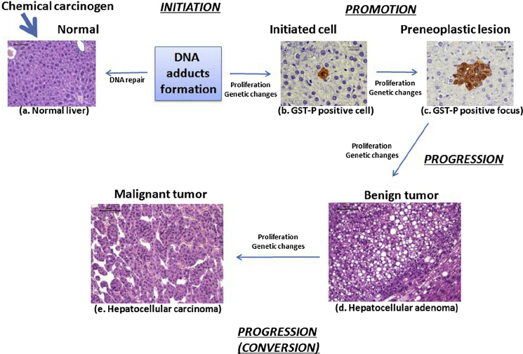

Slide 54
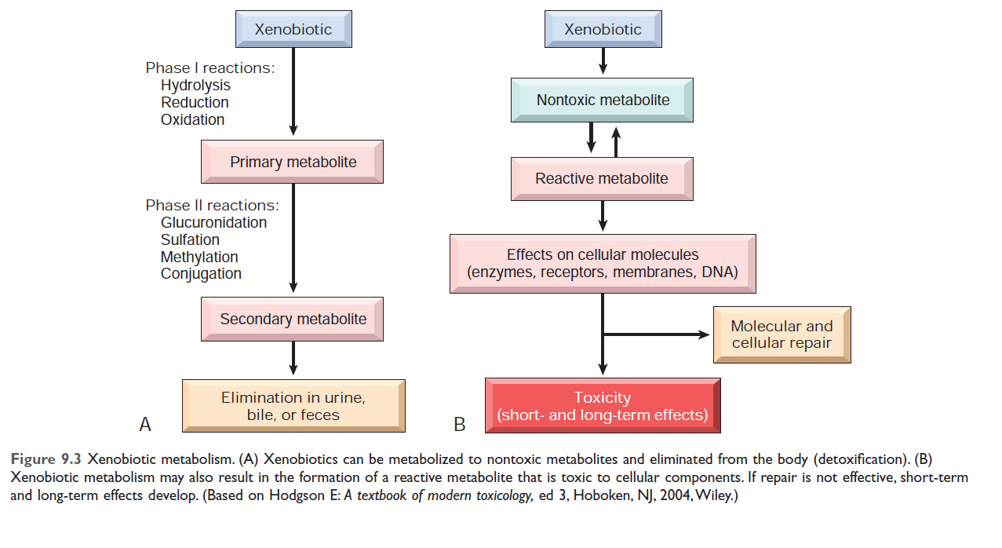

Slide 55
SUMMARY:
Xenobiotics are chemical compounds foreign to the body.
Xenobiotics are metabolized in phase I and II.
Xenobiotics can produce a variety of biological effects, including toxicity, immunological reactions, and cancer.

Slide 56
Reference :
Harper’s Illustrated Biochemistry – 31st edition; chapter -47: 1358-67.
Biochemistry, U.Satyanarayana, 4th edition;chapter -31:638-43.
Robbins & Cotran pathologic basis of disease- 10th edition ; chapter 9:407-8.

Slide 57
Thank you !!!

