Slide 1
SHOCK
Dr.V.Shanthi
Associate Professor, Department of Pathology
Sri Venkateswara Institute of Medical College
Tirupathi

Slide 2
SHOCK
Shock is characterized by systemic hypotension due to either reduced cardiac output or reduced effective circulating blood volume
This leads to impaired tissue perfusion and cellular hypoxia

Slide 3
SHOCK
Types of shock depending on etiology
Cardiogenic shock
Hypovolemic shock
Septic shock
Neurogenic shock
Anaphylactic shock

Slide 4
CARDIOGENIC SHOCK
Mechanism - Results from low cardiac output due to myocardial pump failure
Causes - Myocardial damage (M.I)
- Ventricular rupture
- Arrhythmias
- Cardiac tamponade (External compression)
- Pulmonary embolism (outflow obstruction)

Slide 5
HYPOVOLEMIC SHOCK
Mechanism – loss of blood or plasma volume leads to decreased cardiac output and reduced tissue perfusion
Causes – massive hemorrhage or fluid loss from severe burns

Slide 6
Pathophysiology of hypovolemic shock
HYPOVOLEMIA
MULTIORGAN FAILURE
Decreased venous return
Organ dysfunction
Perfusion failure and tissue hypoxia
Decreased preload
DECREASED CARDIAC OUT PUT
Hypotension

Slide 7
NEUROGENIC SHOCK
Mechanism – result due to anesthetic accident or spinal cord injury which leads to loss of vascular tone and peripheral pooling of blood

Slide 8
ANAPHYLACTIC SHOCK
Mechanism – in this there is systemic vasodilatation and increased vascular permeability caused by an Ig E- mediated hypersensitivity reaction
Acute widespread vasodilatation results in tissue hypoperfusion and hypoxia

Slide 9
SEPTIC SHOCK
Definition - Septic shock is defined as hypotension associated with severe sepsis and cannot be corrected by infusing fluids

Slide 10
SEPTIC SHOCK
Causes for Septic shock
- Overwhelming microbial infections (bacteria and fungi)
- Gram positive septicemia
- Gram negative bacteria
- Fungal sepsis
- Rarely protozoa or Rickettsiae

Slide 11
Septic SHOCK
PATHOGENESIS
Major factors contributing to the pathophysiology include
Inflammatory mediators
Endothelial activation and injury
Induction of procoagulant state
Metabolic abnormalities
Organ dysfunction
Immune suppression

Slide 12
SEPTIC SHOCK
PATHOGENESIS
Inflammatory mediators
Microbial cell wall constituents (LPS) engage receptors on neutrophils, mononuclear inflammatory cells and endothelial cells leading to cellular activation
Activated cells produce inflammatory mediators like TNF, IL-1, IFN-γ, IL-12, IL-18, HMGB 1 (High mobility group box 1 protein), prostaglandins and PAF. These mediators activate endothelial cells which express adhesion molecules
They activate complement and coagulation cascade .

Slide 13
Septic SHOCK
PATHOGENESIS
Inflammatory mediators
Complement cascade is activated by microbial components
Results in production of anaphylotoxins (C3a, C5a), chemotactic fragments (C5a) and opsonins (C3b)
All these contribute to proinflammatory state

Slide 14
Septic SHOCK
PATHOGENESIS
Inflammatory mediators
Microbial components activate coagulation directly through factor XII and indirectly through altered endothelial function
Accompanying widespread activation of thrombin may further augment inflammation by triggering protease-activated receptors on inflammatory cells

Slide 15
SEPTIC SHOCK
PATHOGENESIS
Endothelial activation and injury
Endothelial cell activation and inflammatory mediators produce 3 major sequelae
a. Thrombosis
b. Increased vascular permeability
c. Vasodilation

Slide 16
Endothelial activation and injury
Proinflammatory cytokine
Loosen endothelial cell tight junctions
Leaky vessels with increased permeability
Accumulation of protein rich edema through out the body
Impedes tissue perfusion

Slide 17
Endothelial activation and injury
Activated endothelial cells
Upregulate NO production and other vasoactive inflammatory mediators (C5a, C3a and PAF)
Vasomotor smooth muscle relaxation and systemic hypotension

Slide 18
SEPTIC SHOCK
PATHOGENESIS
Induction of procoagulant state
Pro inflammatory cytokine affects on endothelial cells
Increase in tissue factor production
Increased plasminogen activating inhibitors which prevent fibrinolysis
Diminshed endothelial anticoagulant factors such as thrombomodulin and protein C

Slide 19
SEPTIC SHOCK
Vascular leak and tissue edema
Decreased blood flow in small vessels
Stasis of circulation and diminished washout of activated coagulation factors
Deposition of fibrin rich thrombi in small vessel
Hypoperfusion of tissue
In DIC coagulation factors and platelets are consumed leading to concomitant bleeding and hemorrhage

Slide 20
SEPTIC SHOCK
PATHOGENESIS
Metabolic abnormalities
Septic patients exhibit insulin resistance and hyperglycemia
Pro inflammatory cytokines suppress insulin release while simultaneously promoting insulin resistance in the liver and other tissues by impairing surface expression of GLUT-4 a glucose transporter
Cytokines such as TNF and IL-1, stress induced hormones (glucagon, growth hormone and glycocorticoids) and catecholamines drive gluconeogenesis

Slide 21
SEPTIC SHOCK PATHOGENESIS Metabolic abnormalities
Decreased tissue perfusion leads to hypoxia
Prevents aerobic metabolism and decreases energy production
Anerobic glycolysis
Pyruvic acid and lactic acid accumulation
Metabolic acidosis
Electrolyte imbalance due to failure of sodium pump

Slide 22
SEPTIC SHOCK
PATHOGENESIS
Immune suppression
Hyperinflammatory state initiated by sepsis can activate counter regulatory immunosuppressive mechanisms
Shift from proinflammatory to antiinflammatory cytokine production (IL-10, IL-1 receptor antagonists etc
Lymphocyte apoptosis and induction of cellular ageing

Slide 23
SEPTIC SHOCK
PATHOGENESIS
Organ dysfunction
Systemic hypotension, interstitial edema and small vessel thrombosis leads to decreased delivery of oxygen and nutrients to the tissues which produces alterations in cellular metabolism
High levels of cytokines and secondary mediators diminish myocardial contractility, cardiac output, endothelial injury and increased vascular permeability
These factors lead to multiple organ failure

Slide 24
SEPTIC SHOCK
Severity and outcome of septic shock depends upon
Extent and virulence of the infection
The immune status of the host
The presence of other co-morbid conditions
Levels of mediator production

Slide 25
SEPTIC SHOCK
TOXIC SHOCK SYNDROME
Group of secreted bacterial proteins called “super antigens” cause syndrome similar to shock
Superantigens are polyclonal T-lymphocyte activators that induce the release of high levels of cytokines that produce various clinical manifestations like rash to vasodilatation, hypo perfusion and death

Slide 26
SEPTIC SHOCK
STAGES OF SHOCK
Shock is progressive disorder that if uncorrected leads to death
Shock evolves through 3 phases
a. Initial non-progressive phase
b. Progressive phase
c. Irreversible stage

Slide 27
SEPTIC SHOCK
STAGES OF SHOCK
Initial non-progressive phase
Compensatory mechanism to maintain the homeostasis so that blood supply to vital organs is maintained
By neuro humoral mechanism which maintains blood pressure and cardiac output
Widespread vasoconstriction of vessels except coronary and cerebral vessels
Fluid conservation by kidney
tachycardia

Slide 28
SEPTIC SHOCK – INITIAL PHASE
ACUTE HYPOVOLEMIA
REDUCED CENTRAL VENOUS PRESSURE
REDUCED CARDIAC FILLING
REDUCED CARDIAC OUTPUT
REDUCED ARTERIAL PRESSURE
PERIPHERAL RECEPTORS
CENTRAL RECEPTORS

Slide 29
SEPTIC SHOCK – INITIAL PHASE
PERIPHERAL RECEPTORS
CENTRAL RECEPTORS
SYMPATHETIC NERVE STIMULATION
ADRENAL MEDULLA STIMULATION
CATECHOLAMINE SECRETION
ANTIDIURETIC HORMONE
VASOCONSTRICTION
GIT, LIVER AND SPLEEN
KIDNEY
SKIN
MAINTENANCE OF BLOOD PRESSURE AND CONSERVATION OF FLUID

Slide 30
SEPTIC SHOCK
Progressive phase
As the stage advances there is failure of compensatory mechanism, dilatation of arterioles, veinules and capillary bed
Because of this fluid leaks out of capillaries into interstitium and there is sludging of blood
This reduces the tissue perfusion leading to hypoxia

Slide 31
Septic shock
Initially body tissue except brain and heart suffers from hypoxia
HYPOXIA
DAMAGE TO CELLS AND TISSUES
CAPILLARY ENDOTHELIAL DAMAGE
ANAEROBIC GLYCOLYSIS
PRODUCTION OF VASODILATOR SUBSTANCES
EG. KININS, PROSTAGLANDIN
INCREASED PERMEABILITY
LACTIC ACIDOSIS
LOSS OF FLUID TO TISSUE SPACES
AND LOSS OF CIRCULATING FLUID
DECREASED CARDIAC OUTPUT AND FALL IN BP
DIC
TISSUE HYPOXIA AND VITAL ORGAN DAMAGE

Slide 32
SEPTIC SHOCK
IRREVERSIBLE PHASE
Cellular injury and tissue injury is so severe that condition does not revert back to normal even after correcting hemodynamic defects
Hypoxic and ischemic cell injury – causes leakage of lysosomal enzymes which further aggravates condition
Myocardial infarction and synthesis of NO further worsens condition
Intestinal ischemia causes microbes from intestinal flora to enter the circulation which produces superimposed bacteremic shock
Acute tubular necrosis occurs in kidney

Slide 33
SEPTIC SHOCK
Compensated phase
15 to 25% of fluid loss from vessels and there are subtle signs of shock
Intermediate phase
25 to 35% of fluid loss from vessels and classical signs of shock appears
Irreversible phase
>35% of fluid loss from vessels, body cells die to hypoxia and vital signs come to bottom

Slide 34
SEPTIC SHOCK
Morphology
Changes manifest mainly in brain, heart, lungs, kidney, adrenals and GIT
Adrenals – there is cortical cell lipid depletion reflecting relatively inactive vacuolated cells to metabolically active cells that utilize stored lipids for the synthesis of steroids
Heart – due to hypoxia and fall in cardiac output – myocardial infarction
Brain – cerebral ischemia develops leading to altered state of consciousness
Liver – congestion and centrilobular necrosis
GIT –erosions of gastric mucosa and Diffuse ischemic necrosis of intestine

Slide 35
SEPTIC SHOCK
Lungs
congestion and edema develops leading later to formation of hyaline membrane and alveolar collapse.
If patient survives organization and fibrosis occurs leading to emphysema and bronchiectasis
Kidney
fall in the BP leads to reduction in glomerular filtrate which further produces uremia due to retention of waste products
Due to tubular ischemia, tubular necrosis develops which leads to anuria further leading to severe progressive uremia

Slide 36
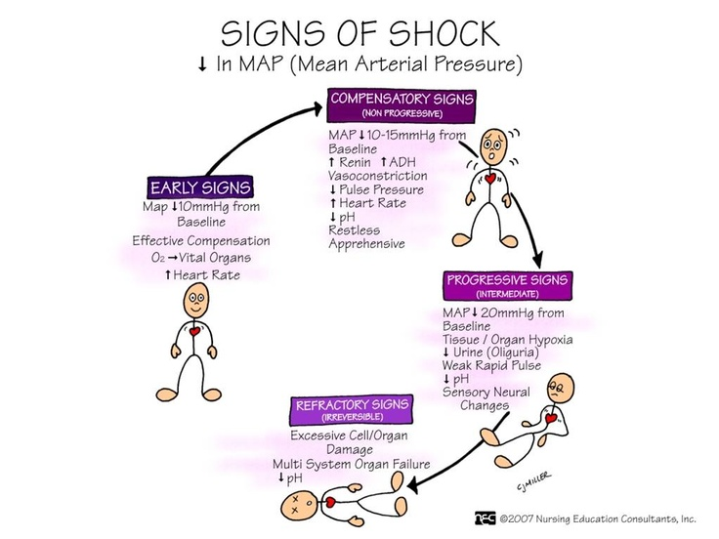

Slide 37
ESSAY QUESTIONS
A 55 years old lady was brought to the emergency room unconscious. her blood pressure was very low. pulse was weak and rapid. Her skin was warm and flushed. Her blood culture revealed growth of gram positive bacteria.
a. What is possible diagnosis
b. Describe the pathogenesis of this condition
c. Describe the stages of this disorder
(Answer: Septic Shock) (Dr.NTRUHS Jan 2015)

Slide 38
SEPTIC SHOCK
ESSAY QUESTIONS
Define shock. Write about the classification, etiology, pathogenesis and morphological changes in various organs in shock (RGUHS- Jan 2008)
Define shock. What are the different types of shock? Describe the pathogenesis of septic shock. (RGUHS- Jun 2012, Dec 2012)
Discus pathogenesis of septic shock. Enumerate various stages in evolution of Shock. Describe the various morphological changes in various organs in shock. (RGUHS- Jun 2010)

Slide 39
SHOCK
SHORT QUESTIONS (4 MARKS)
Pathogenesis of Endotoxic shock (NTRUHS July / Aug 2014)
Define shock. Pathogenesis of septic shock.(RGUHS-Jun 2008,Jan 2009,Dec 2009, Dec 2011, Jul 2012)
Septic shock (NTRUHS May 2006)
VERY SHORT QUESTIONS (2 MARKS)
Hypovolaemic Shock (NTRUHS July, 2011)
Stages of shock (NTRUHS Sept/Oct, 2007)
Decompensated shock (NTRUHS April 2003)

Slide 41
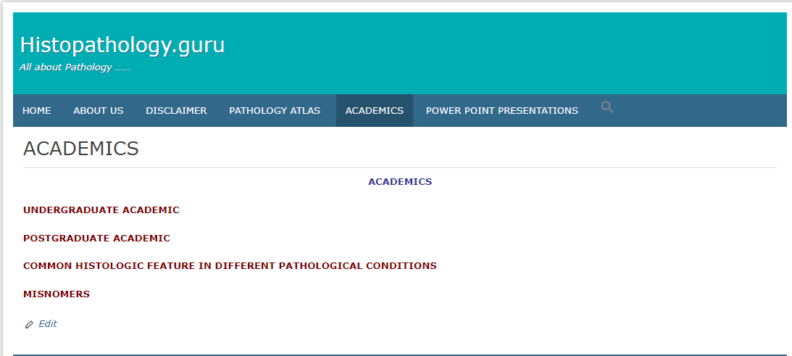

Slide 42
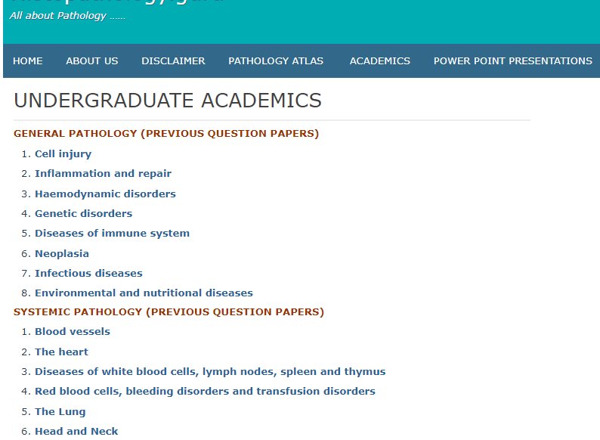

Slide 45
THANK YOU

