Slide 1
HASHIMOTOS THYROIDITIS

Slide 2
HASHIMOTO THYROIDITIS
Other name of Hashimoto thyroiditis
Sex predilection for Hashimoto thyroiditis
Basic pathogenic mechanism of the disease
Gene associated with Pathogenesis of Hashimoto thyroiditis
Antibodies responsible for destruction of thyroid cells

Slide 3
HASHIMOTO THYROIDITIS
6. Immunologic mechanism for destruction of thyroid
7. Gross features of Hashimoto thyroiditis
8. Microscopic features of Hashimoto thyroiditis
9. Presenting clinical features in disease
10. Malignancies which can arise in the background of Hashimoto thyoiditis

Slide 4
HASHIMOTO THYROIDITIS
1. Other name of Hashimoto thyroiditis

Slide 5
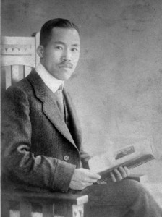
HASHIMOTO THYROIDITIS
Other name of Hashimoto thyroiditis
Struma lymphomatosa
First described by Hakaru Hashimoto , Japanese ophthalmologist in 1912

Slide 6
HASHIMOTO THYROIDITIS
2. Sex predilection for Hashimoto thyroiditis

Slide 7
HASHIMOTO THYROIDITIS
2. Sex predilection for Hashimoto thyroiditis
Most common in females with female to male ratio of 10:1 to 20:1
Common age group is 45 yrs to 65yrs

Slide 8
HASHIMOTO THYROIDITIS
3. Basic pathogenic mechanism of the disease

Slide 9
HASHIMOTO THYROIDITIS
3. Basic pathogenic mechanism of the disease
- Autoimmune destruction of thyroid

Slide 10
HASHIMOTO THYROIDITIS
4. Gene associated with Pathogenesis of Hashimoto thyroiditis

Slide 11
HASHIMOTO THYROIDITIS
4. Gene associated with Pathogenesis of Hashimoto thyroiditis
Cytotoxic T-Lymphocyte associated – 4 (CTLA -4) gene
The protein produced by this gene down regulates the T cell functioning.
Polymorphism of CTLA -4 leads to increased activity of T-lymphocyte

Slide 12
HASHIMOTO THYROIDITIS
5. Antibodies responsible for destruction of thyroid cells

Slide 13
HASHIMOTO THYROIDITIS
5. Antibodies responsible for destruction of thyroid cells
Thyroglobulin antibodies
Thyroid microsomal antibodies
Thyroid peroxidase antibodies
TSH receptor antibodies

Slide 14
HASHIMOTO THYROIDITIS
6. Immunologic mechanism for destruction of thyroid

Slide 15
PATHOGENESIS OF HASHIMOTO THYROIDITIS

Slide 16
7. Gross features of Hashimoto thyroiditis

Slide 17
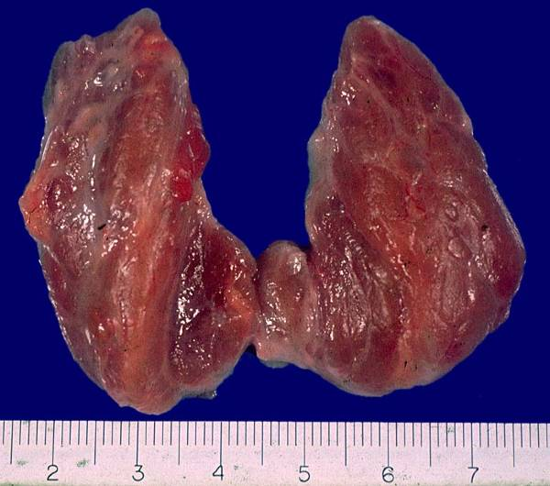
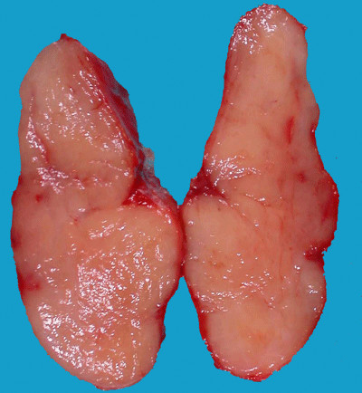
GROSS FEATURES

Slide 18
8. Microscopic features of Hashimoto thyroiditis

Slide 19
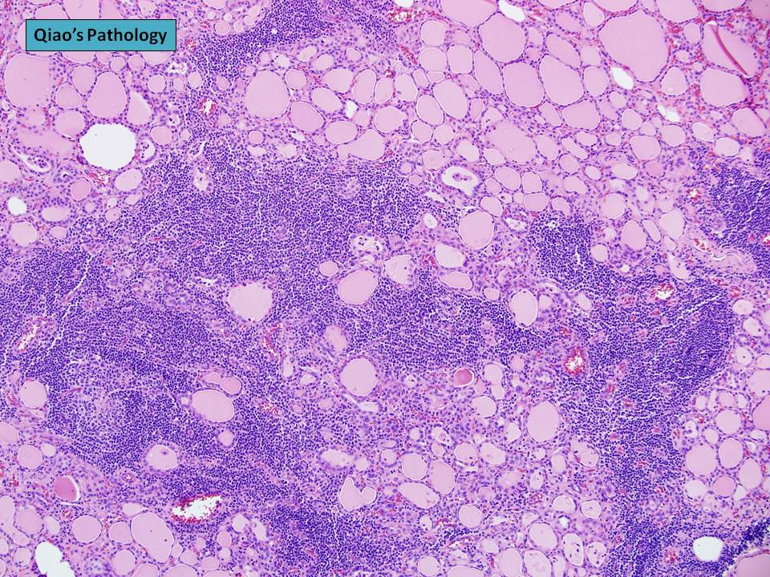

Slide 20
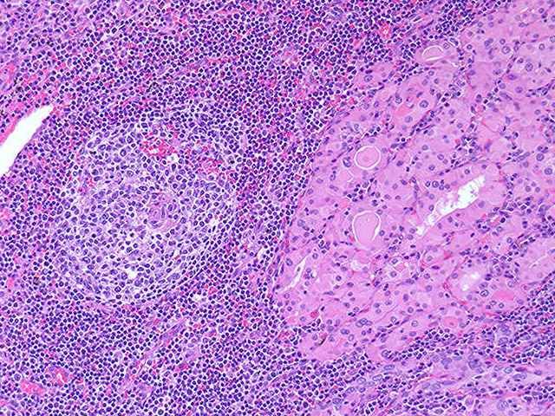

Slide 21
HASHIMOTO THYROIDITIS
9. Presenting clinical features in disease

Slide 22
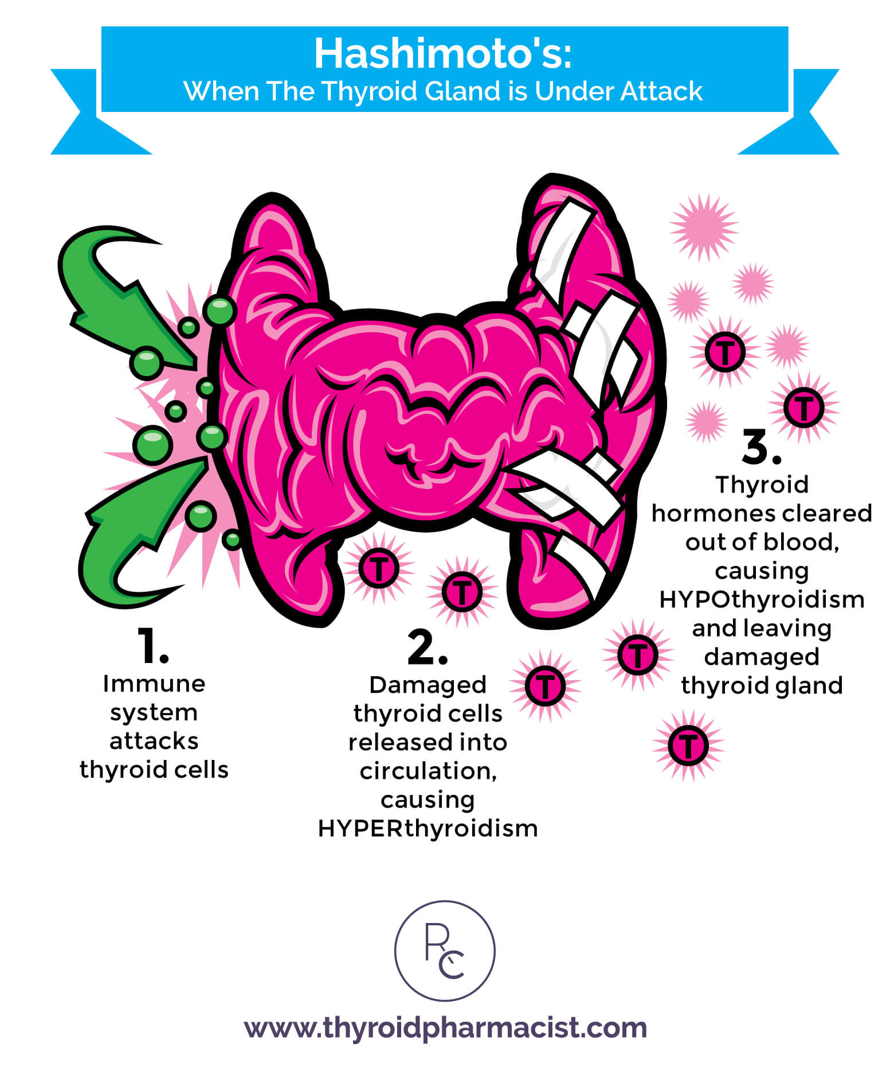
CLINICAL FEATURES

Slide 23
HASHIMOTO THYROIDITIS
10. Malignancies which can arise in the background of Hashimoto thyoiditis

Slide 24
HASHIMOTO THYROIDITIS
10. Malignancies which can arise in the background of Hashimoto thyroiditis
B cell non-hodgkins lymphoma
Papillary carcinoma

